Slide 1
System Precheck Review
Generated from MATLAB assets on 2026-08-31 11:48

Slide 2
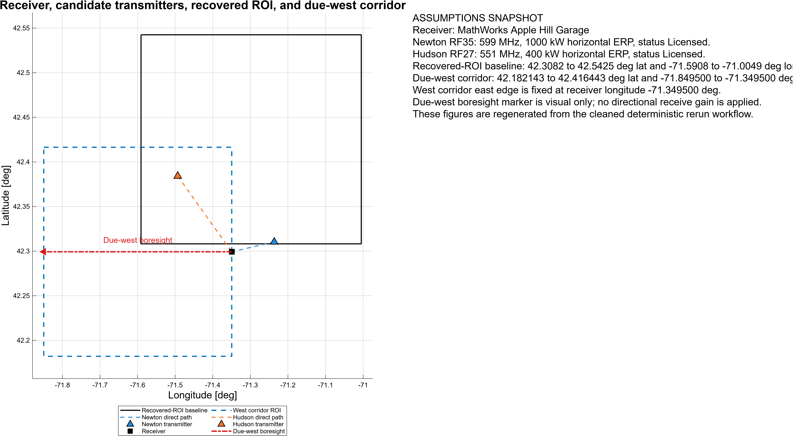
Assumptions and Geometry Context

Slide 3
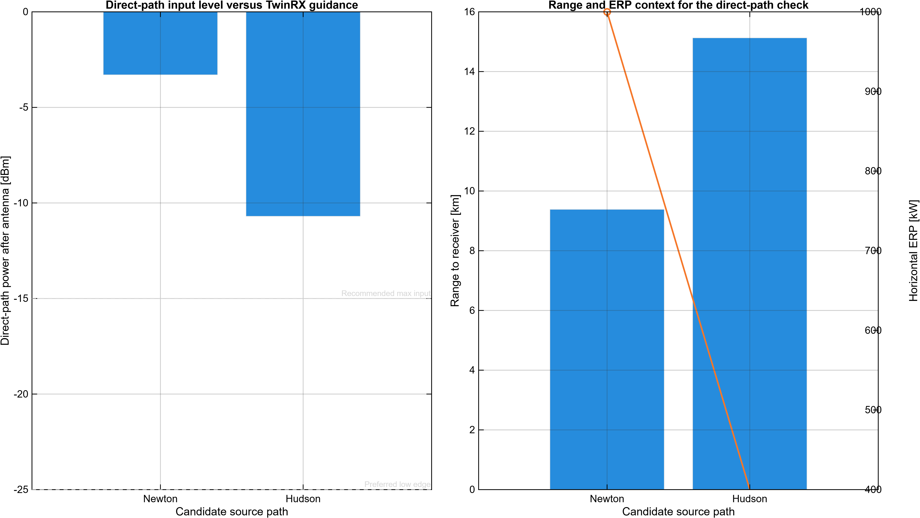
Direct-Path Source Viability

Slide 4
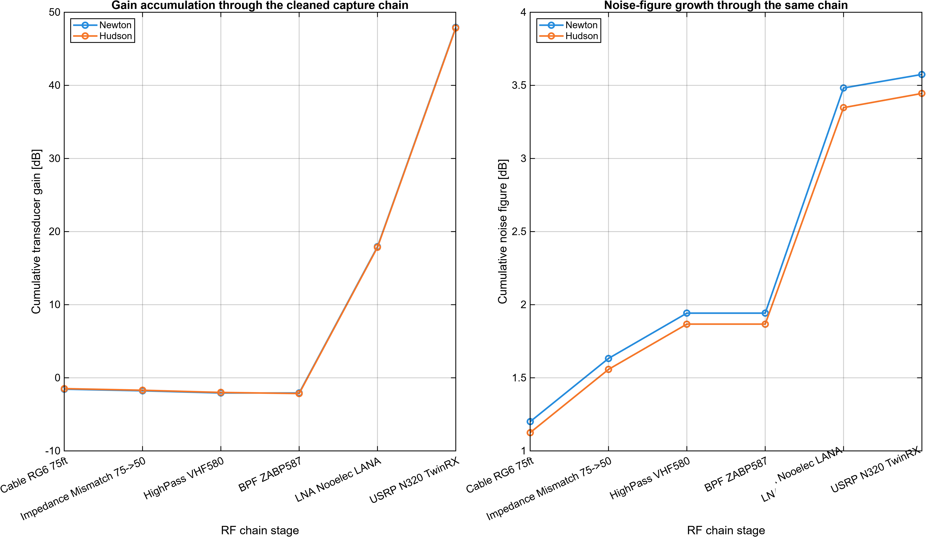
RF Chain Gain and Noise Figure

Slide 5
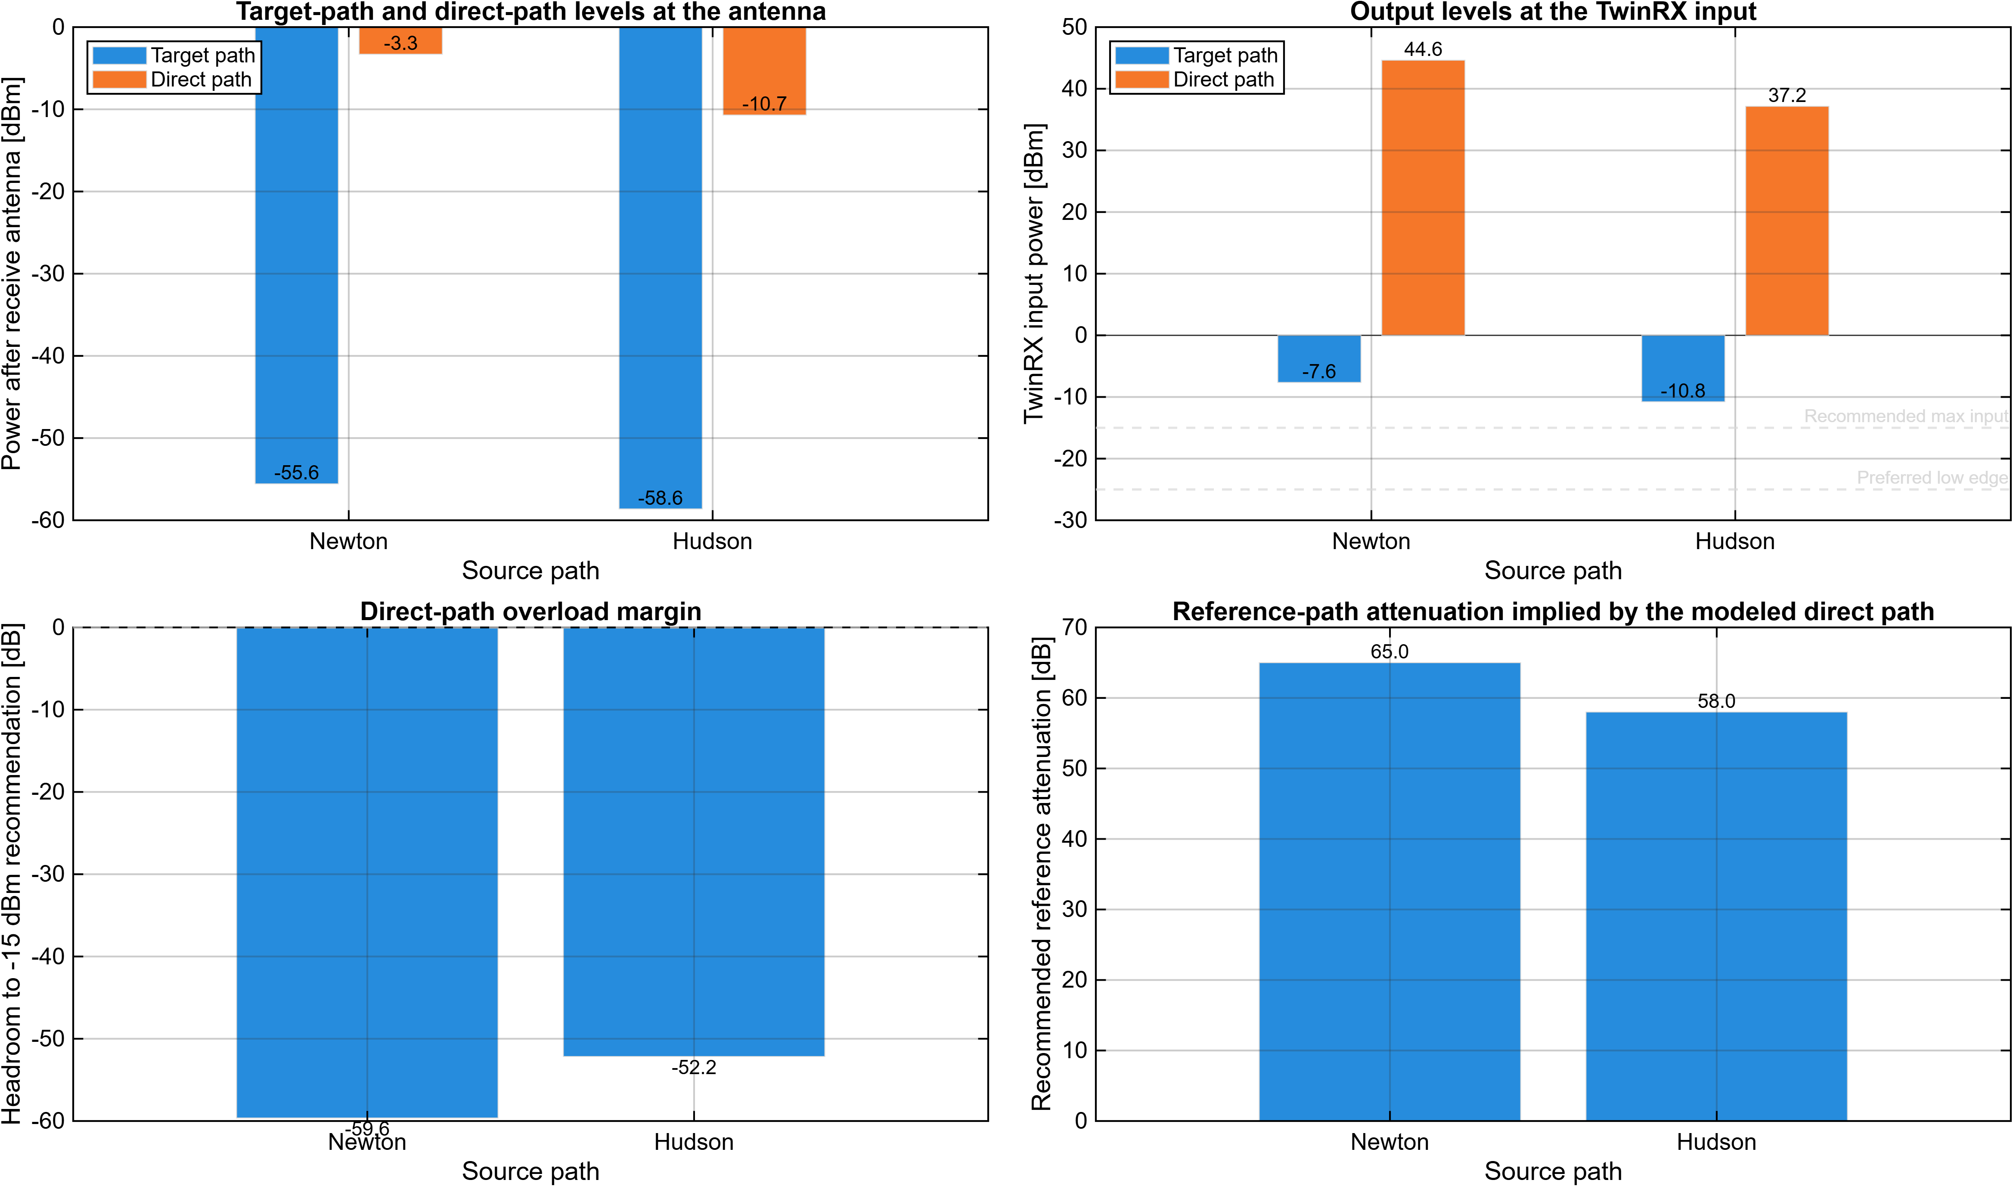
RF Levels, Headroom, and Reference Attenuation

Slide 6
RF Budget Analyzer Component View
Manual RF Budget Analyzer screenshot pending. Expected artifact path: C:\Users\pwilliam\agenticProjects\flightTest\SystemPrechecks\Artifacts\Figures\SystemPrecheck_RFBudgetAnalyzer_Newton.png Run helperOpenSystemPrecheckRfAnalyzer("Newton") in desktop MATLAB. Capture the native show(budget) component view and save it to the fixed path. Regenerate the deck after the screenshot is in place.

Slide 7
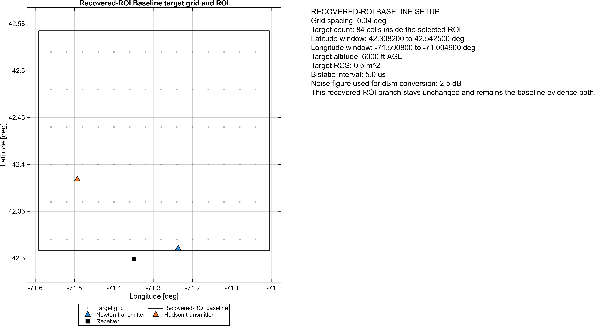
Recovered-ROI Baseline Target-Grid Setup

Slide 8
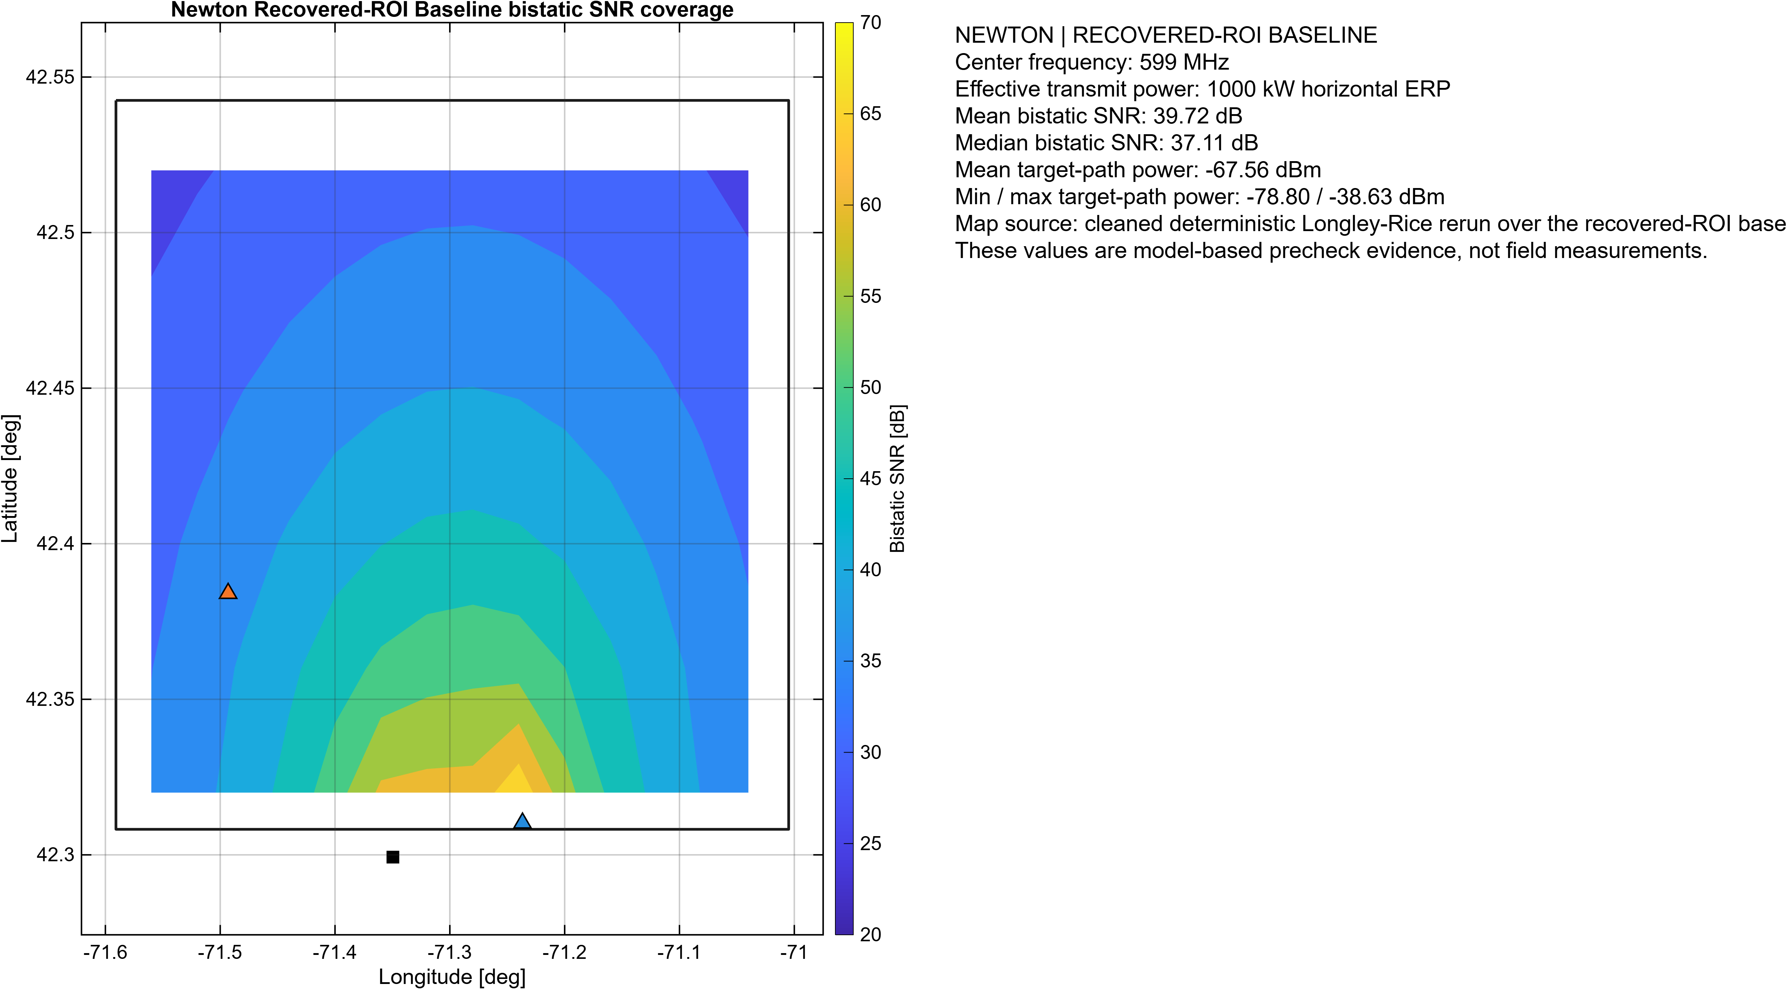
Recovered-ROI Baseline Newton Bistatic SNR Coverage

Slide 9
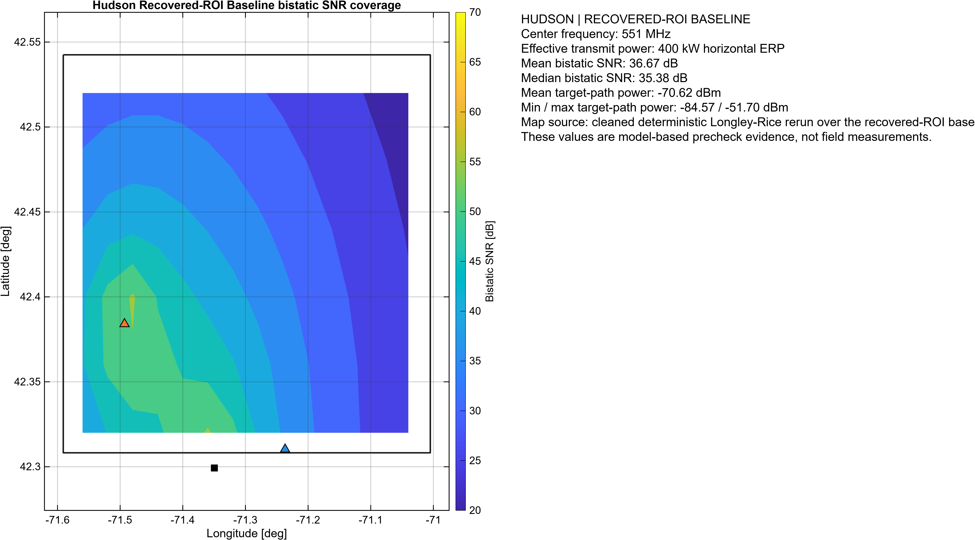
Recovered-ROI Baseline Hudson Bistatic SNR Coverage

Slide 10
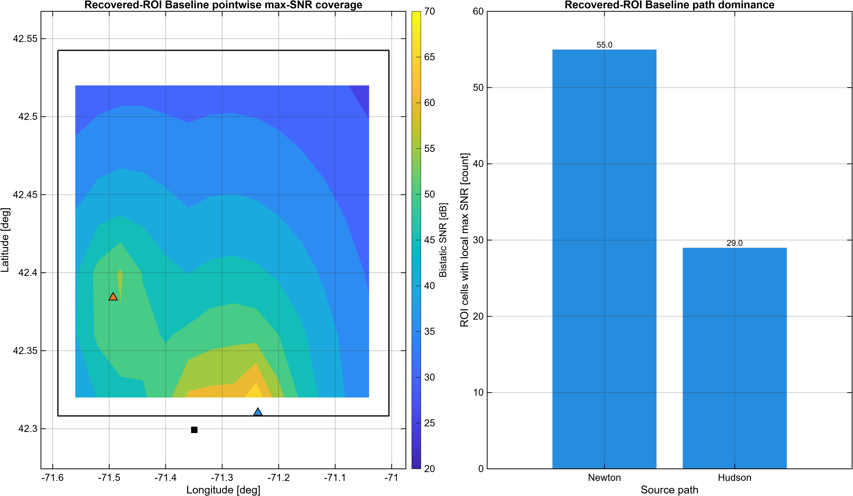
Recovered-ROI Baseline Combined Max-SNR Coverage

Slide 11
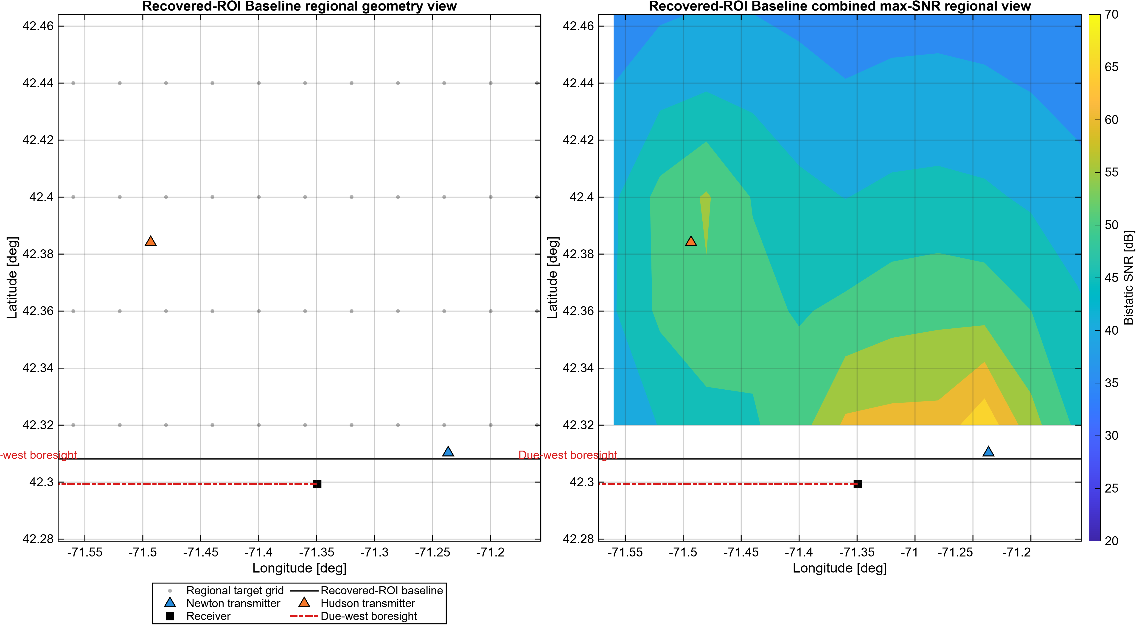
Recovered-ROI Baseline Regional SNR View

Slide 12
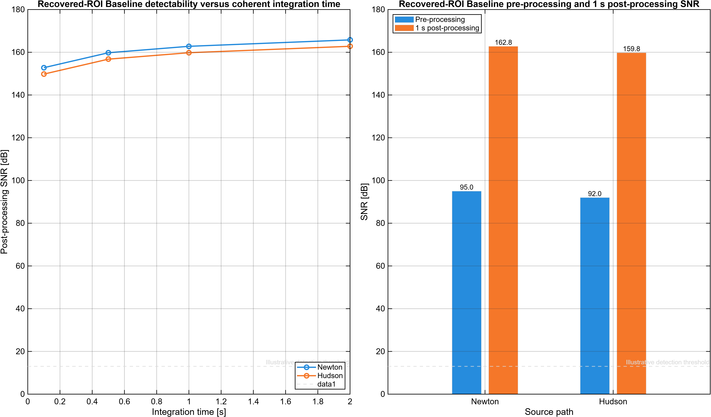
Recovered-ROI Baseline Detectability Summary

Slide 13
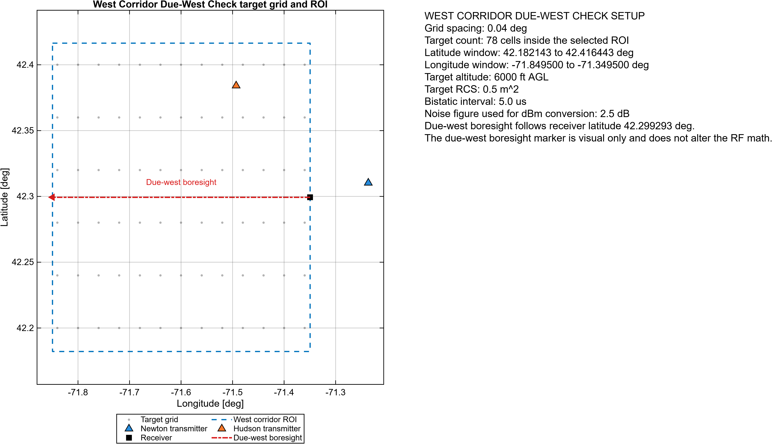
West Corridor Due-West Setup

Slide 14
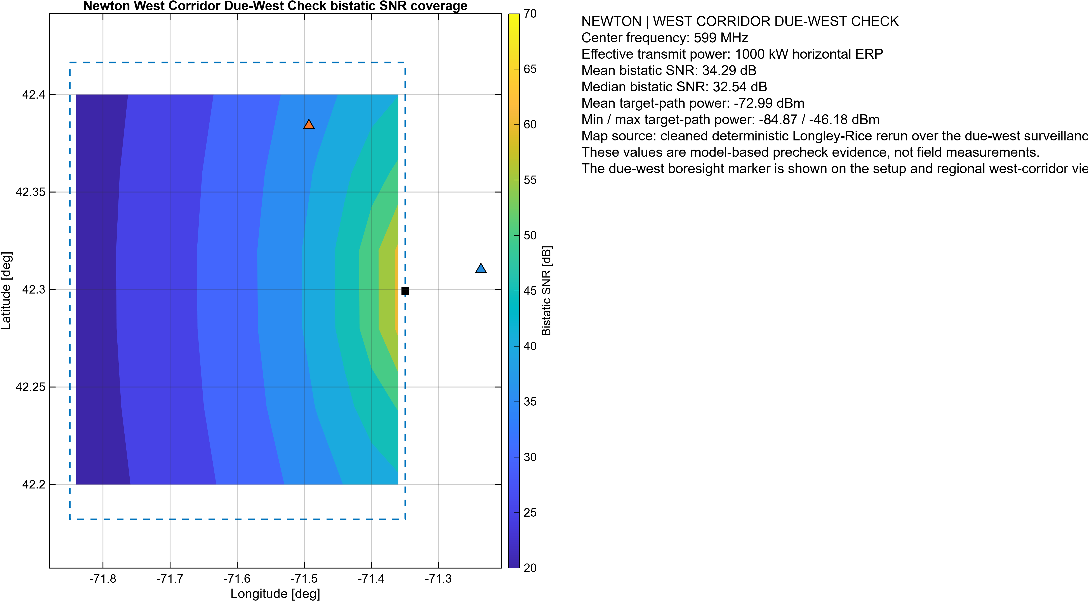
West Corridor Newton Bistatic SNR Coverage

Slide 15
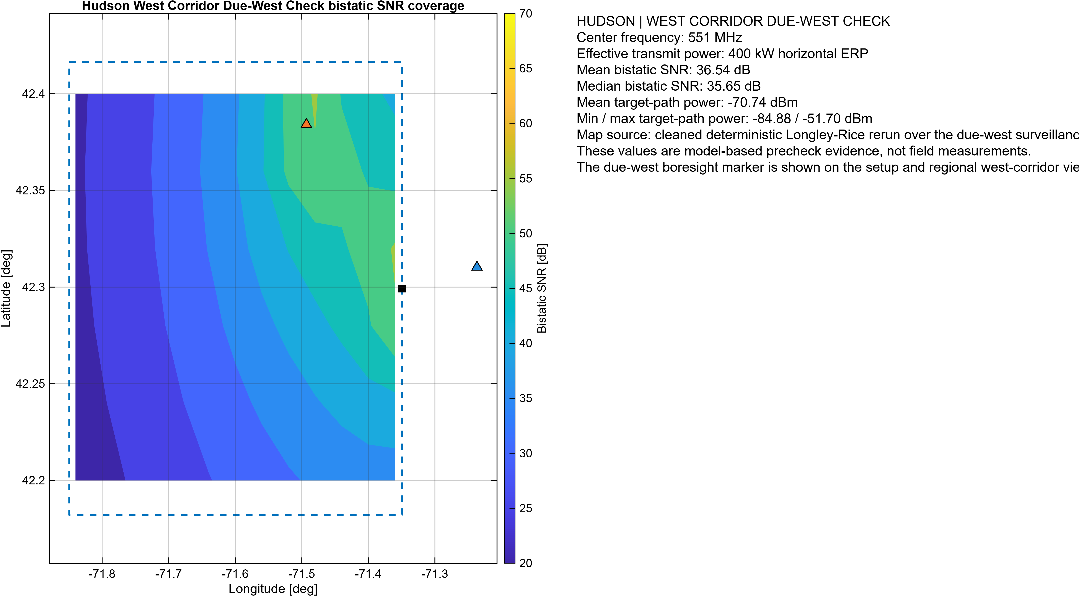
West Corridor Hudson Bistatic SNR Coverage

Slide 16
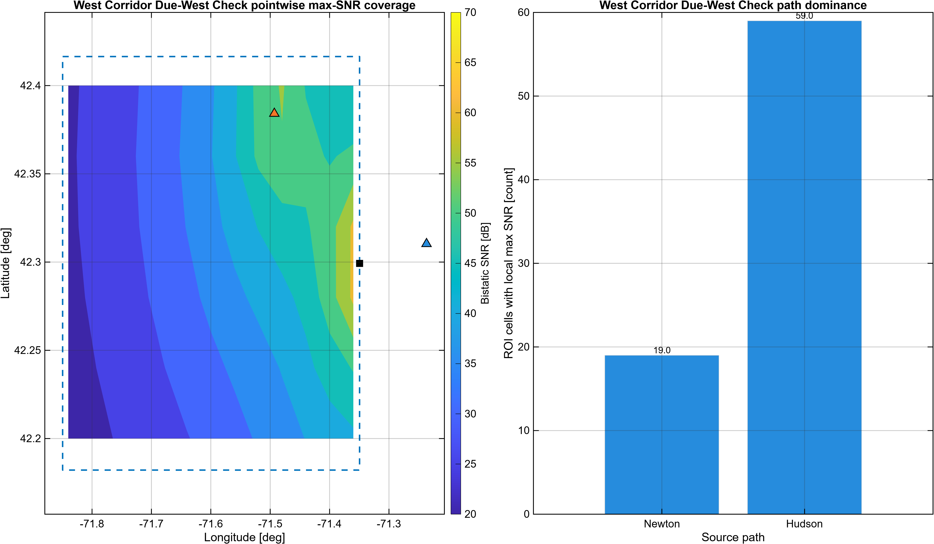
West Corridor Combined Max-SNR Coverage

Slide 17
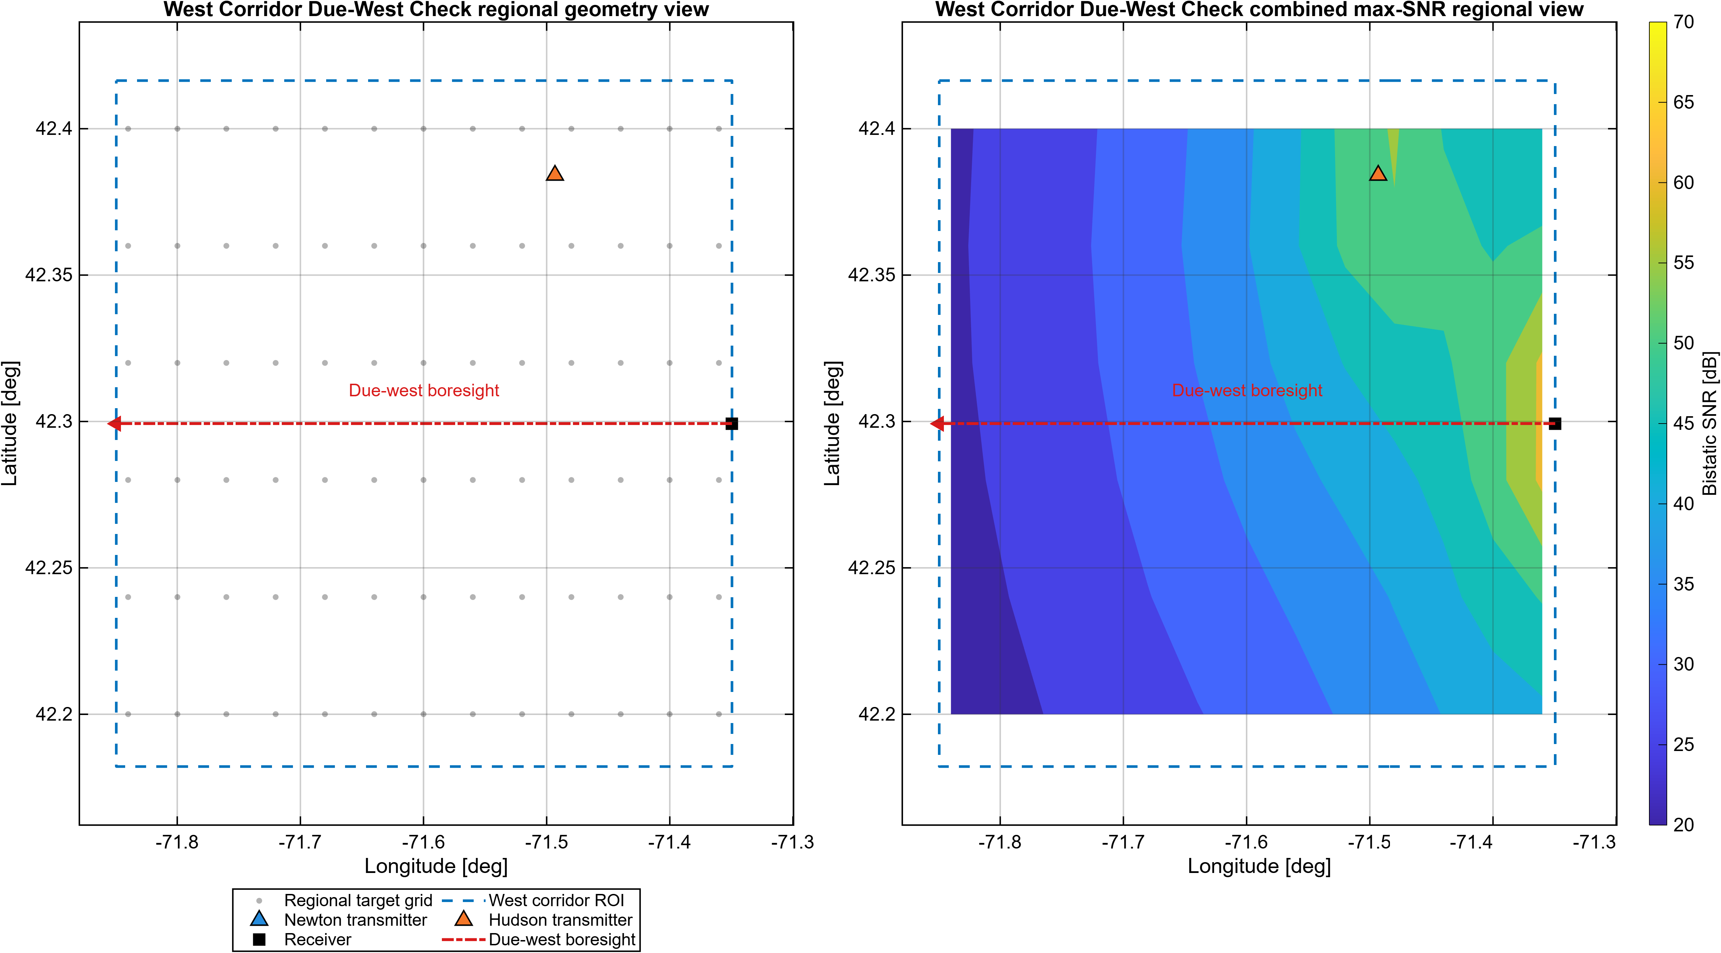
West Corridor Regional SNR View

Slide 18
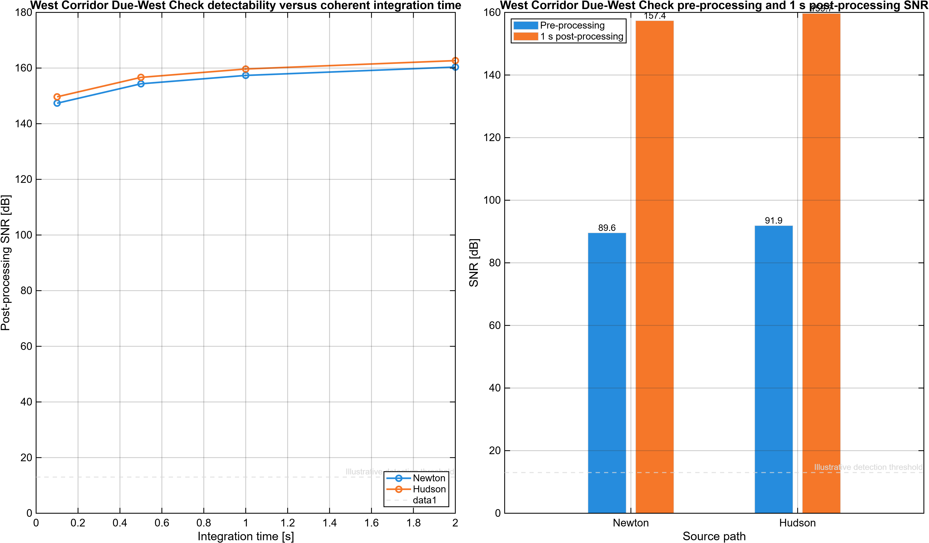
West Corridor Detectability Summary

Slide 19
Risks and Scope Boundaries
Direct-path power remains the dominant RF risk and still implies a heavily attenuated reference branch. Target-path strength is deterministic model output, not field-validated aircraft data. Adjacent-channel environment, assembled-chain headroom, and interference tolerance still need bench or field checks. This deck supports pre-hardware plausibility only; it does not claim calibration, DSI cancellation, clutter rejection, or measured detection performance.

