Slide 1
System Precheck Review
Generated from MATLAB assets on 2026-07-30 09:37

Slide 2
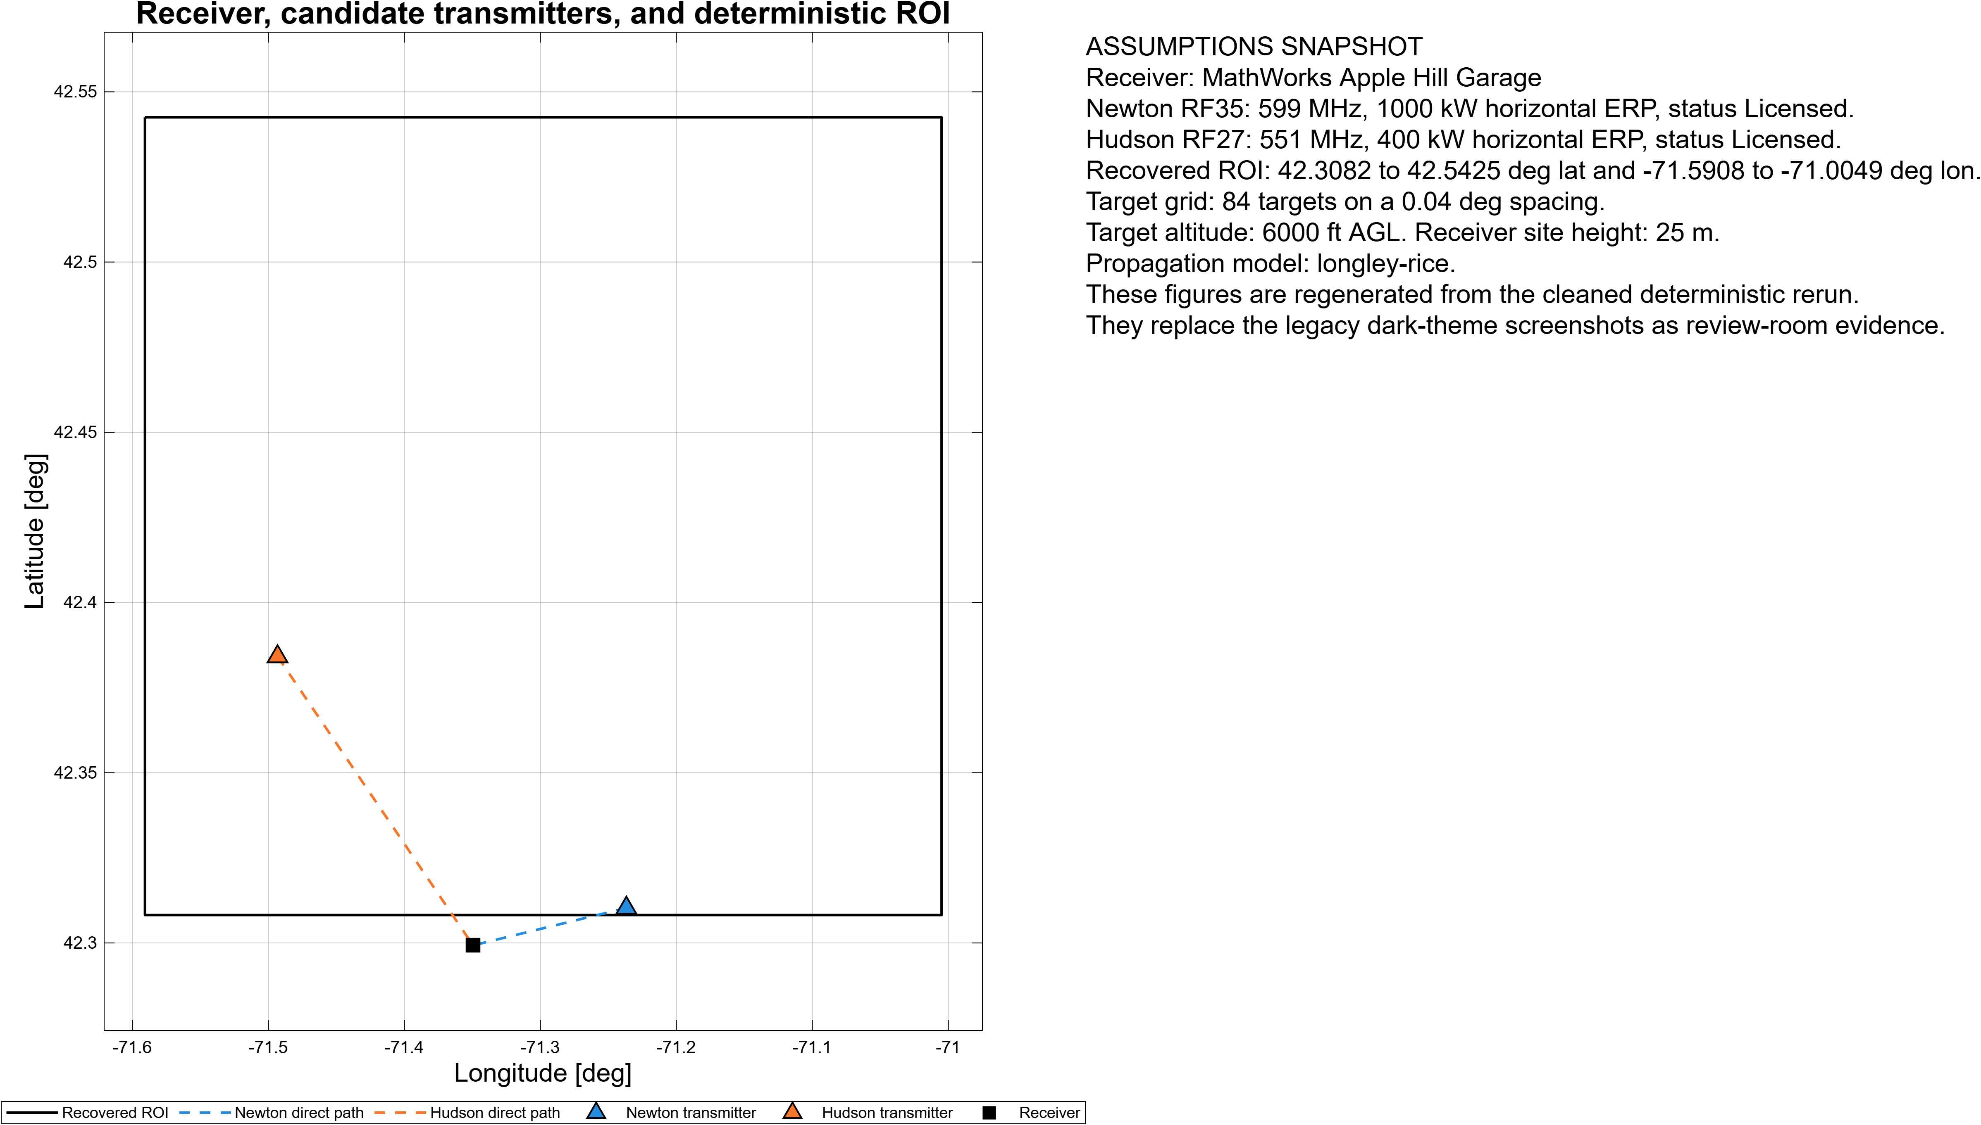
Assumptions and Geometry Context

Slide 3
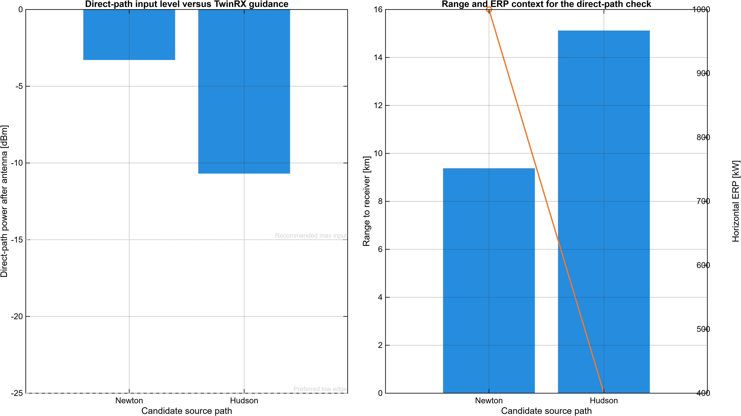
Direct-Path Source Viability

Slide 4
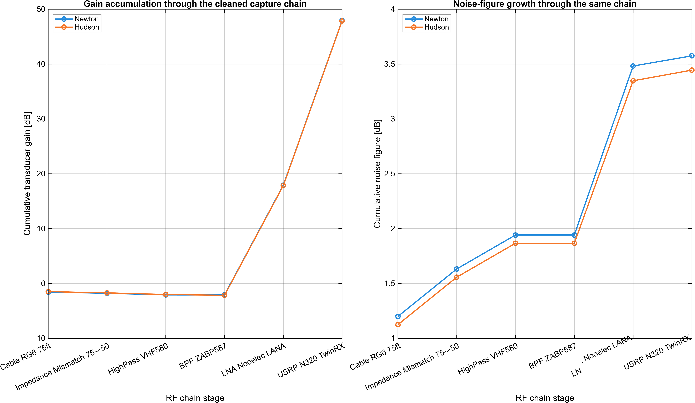
RF Chain Gain and Noise Figure

Slide 5
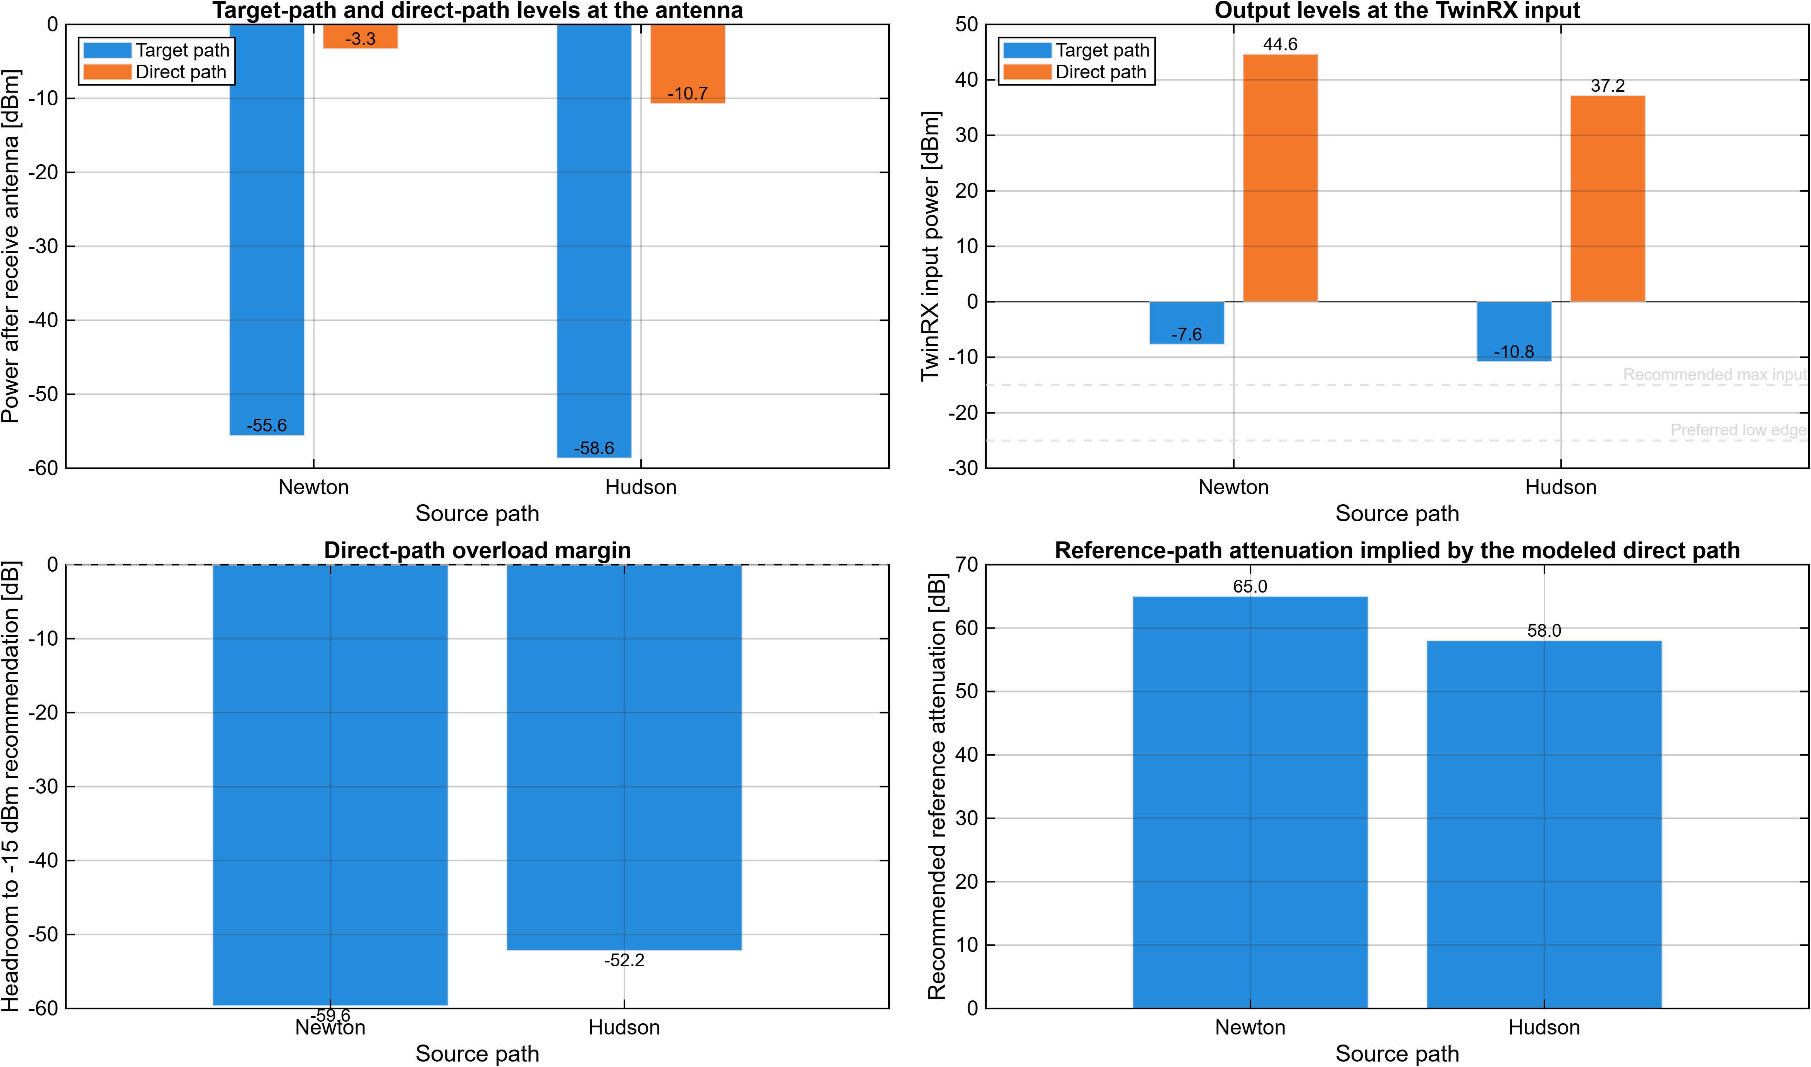
RF Levels, Headroom, and Reference Attenuation

Slide 6
RF Budget Analyzer Component View
Manual RF Budget Analyzer screenshot pending. Expected artifact path: C:\Users\pwilliam\agenticProjects\flightTest-systemprechecks\SystemPrechecks\Artifacts\Figures\SystemPrecheck_RFBudgetAnalyzer_Newton.png Run helperOpenSystemPrecheckRfAnalyzer("Newton") in desktop MATLAB. Capture the native show(budget) component view and save it to the fixed path. Regenerate the deck after the screenshot is in place.

Slide 7
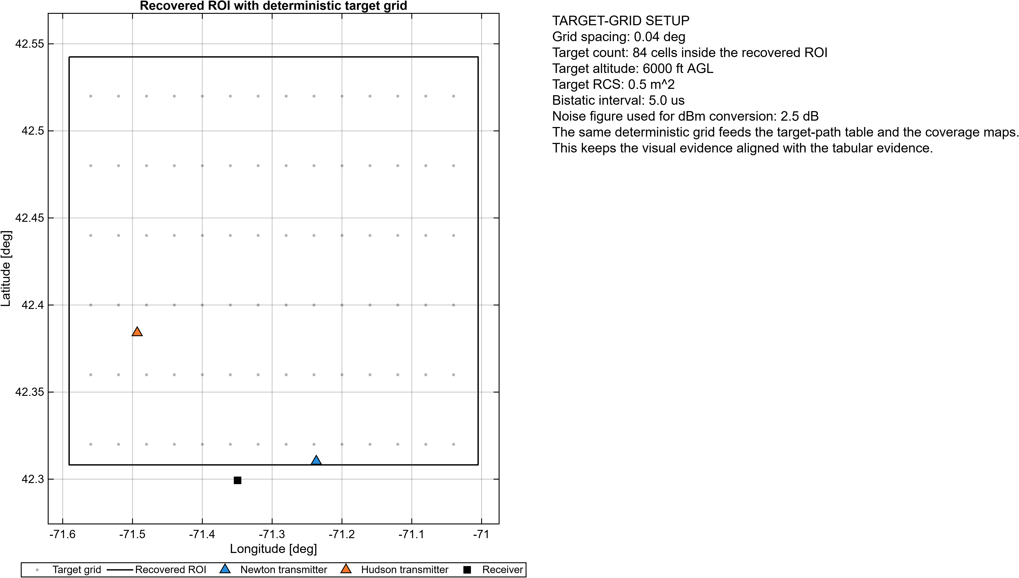
Deterministic ROI and Target-Grid Setup

Slide 8
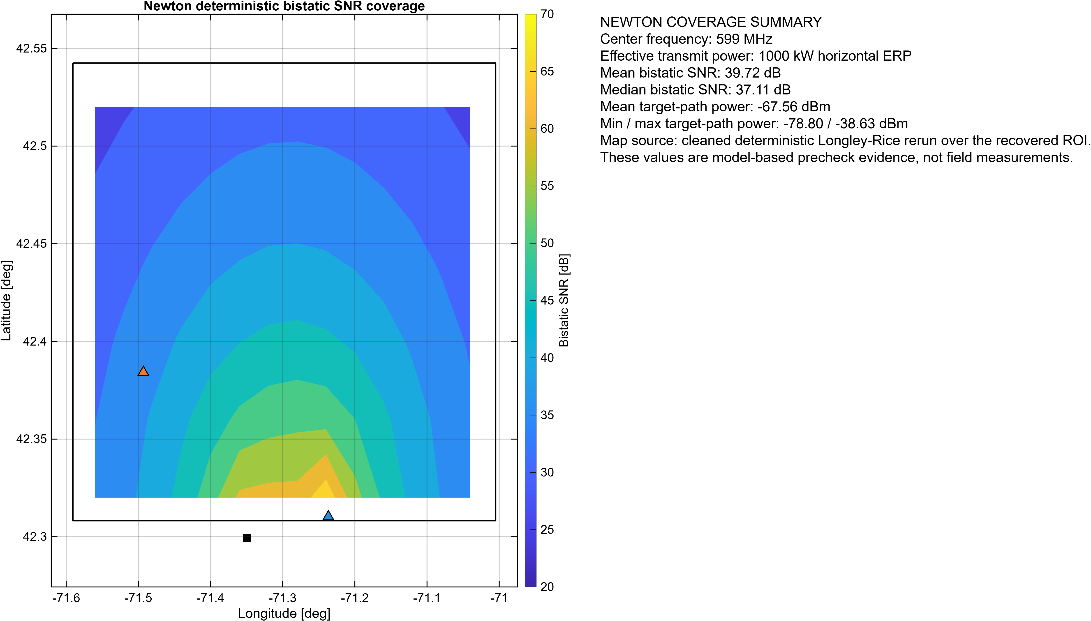
Newton Deterministic Bistatic SNR Coverage

Slide 9
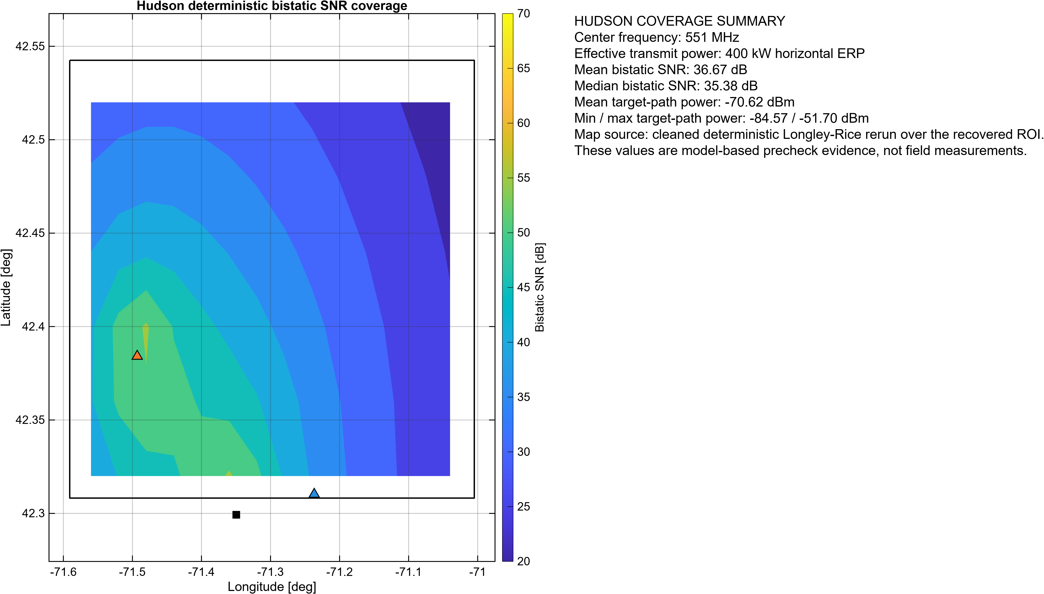
Hudson Deterministic Bistatic SNR Coverage

Slide 10
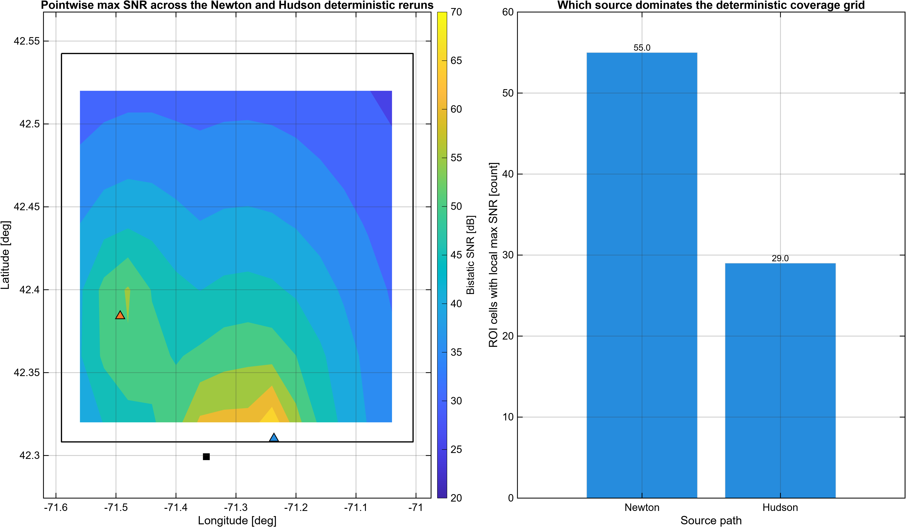
Combined Deterministic Max-SNR Coverage

Slide 11
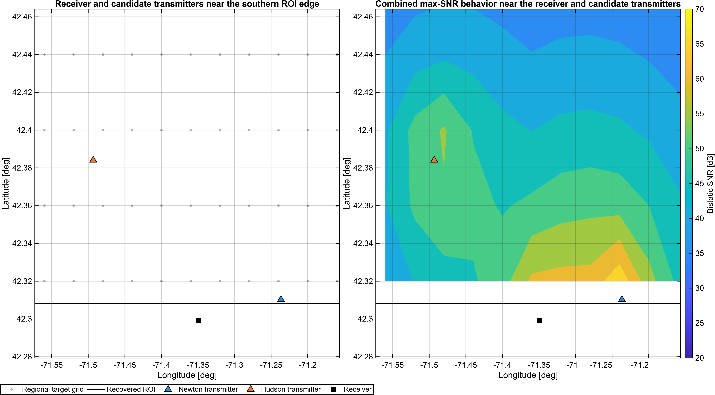
SNR Near the Receiver and Candidate Transmitters

Slide 12
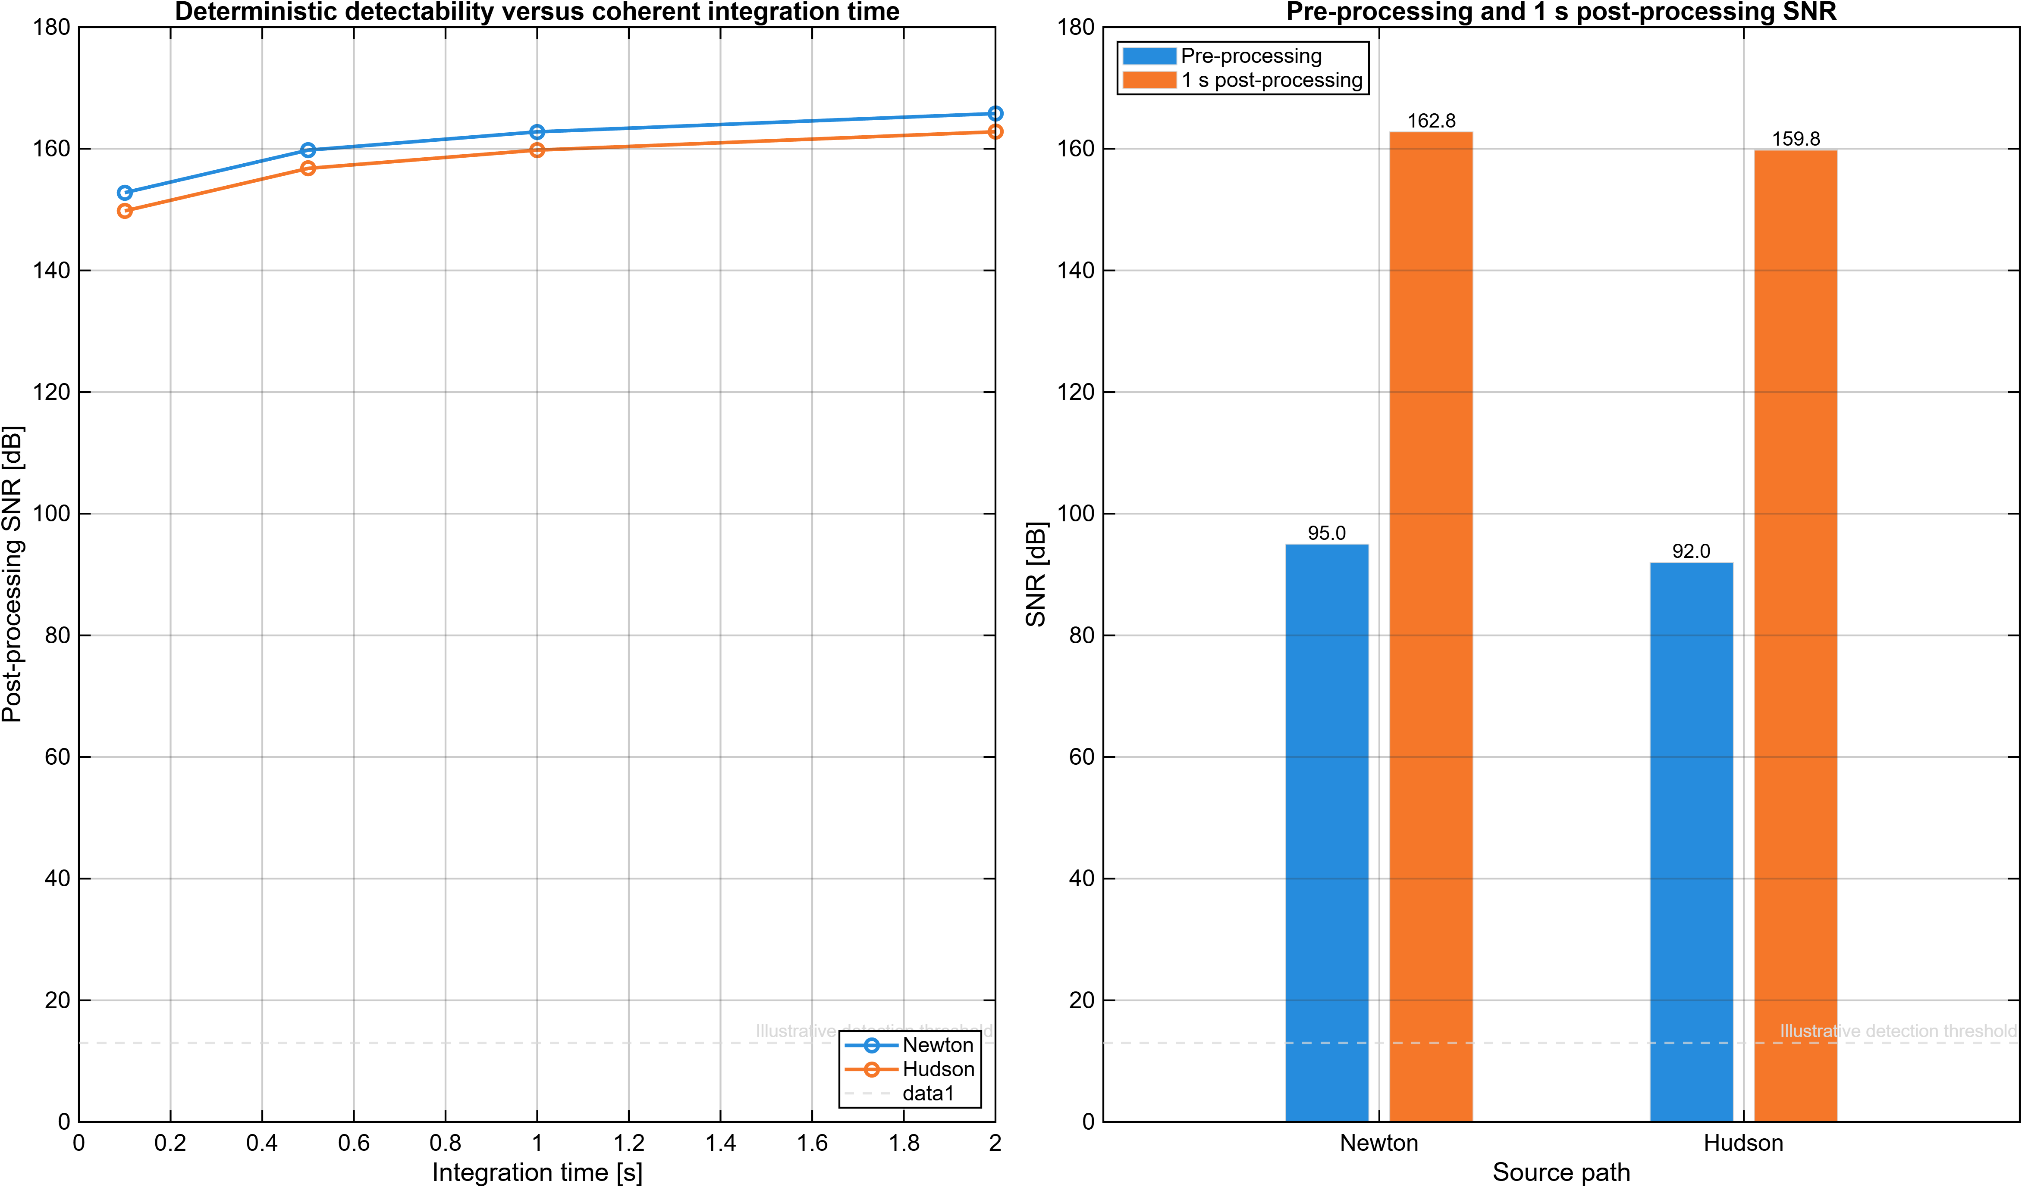
Detectability Summary Under the Deterministic Rerun

Slide 13
Risks and Scope Boundaries
Direct-path power remains the dominant RF risk and still implies a heavily attenuated reference branch. Target-path strength is deterministic model output, not field-validated aircraft data. Adjacent-channel environment, assembled-chain headroom, and interference tolerance still need bench or field checks. This deck supports pre-hardware plausibility only; it does not claim calibration, DSI cancellation, clutter rejection, or measured detection performance.

