Slide 1
Flight Test: RF Budget Analysis
Pat Williamson, PhD
Parts List Excel

Slide 2
RF Budget Analysis Based on Link Budget and Previously estimated requirements
For further info (messier ppt) – here are the precursor steps to this analysis.

Slide 3
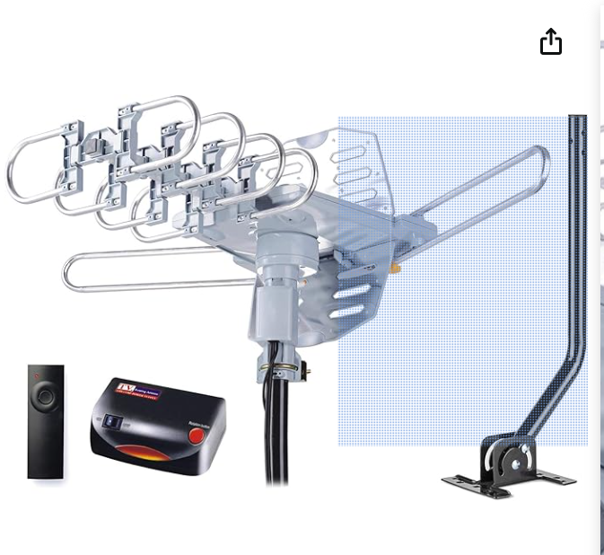
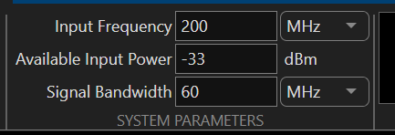
RF Budget Analysis – Spec out additional filter and amplifier
Hardware Specs:
Specifications:
Working Frequency: VHF 170230MHz | UHF 470890MHz
Noise Figure: ≤2.5dB
Typical Antenna Gain: VHF 28~32dB | UHF 32~36dB
Impedance: 75 Ohm
Max Output Level: 105dB uV
Main Voltage: AC120V±10%/60Hz
Operating Temperature: -10°C ~ 50°C
Coaxial Cable Length: 40FT RG6
Updated Values Next Slides

Slide 4
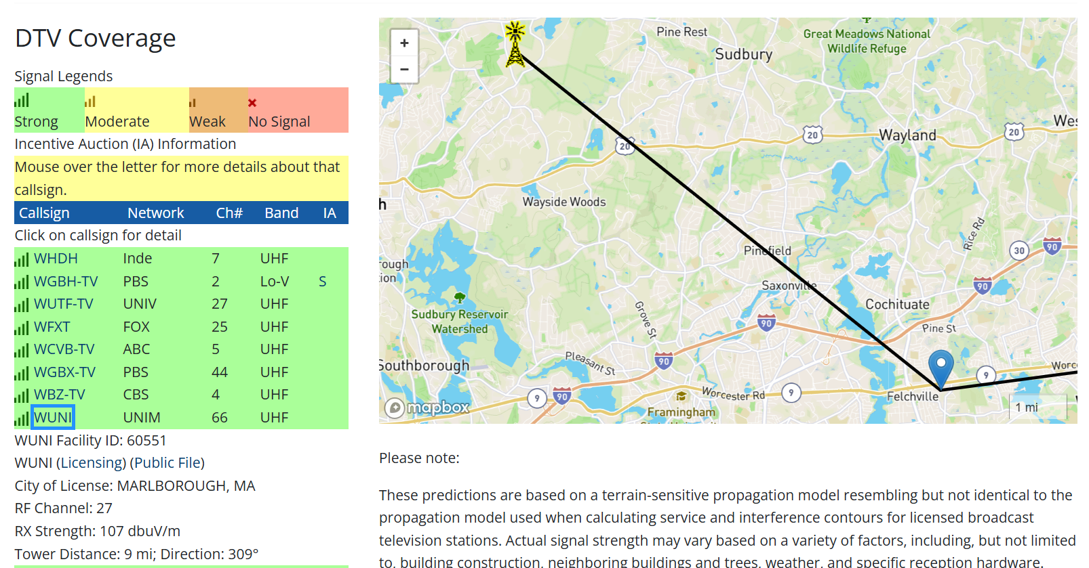
Univision Tower → 548 - 554 MHz Google Maps Link
# | Dir | ST | Area | Community of License (if other) | Call Sign | Netw. (Primary) | Vir. CH | RF CH | Repack RF CH | Repack Band | Repack Move | F_low (MHz) | F_high (MHz) | Host/ Guest | Phase | ERP (kW) | Polarity | ERP (v) | Pattern | HAAT (m) | AMSL (m) | AGL (m) | Facility ID # | Location/Notes
7 | SE | MA | BOSTON | NORWELL | WWDP | ind. | 46.1 | 10 | 10 | Hi-V | 0 | 192 | 198 | - | - | 5 | H | - | ND | 142 |  | 149 | 23671 | Cochesett, MA
7 | - | MA | BOSTON | LAWRENCE | WMFP | ind. | 62.1 | 18 | 10 | Hi-V | -8 | 192 | 198 | G | - | 1000 | H | - | D | 289 |  | 302 | 41436
7 | - | MA | BOSTON |  | WGBH | PBS | 2.1 | 19 | 5 | Lo-V | -14 | 76 | 82 | H | 4 | 700 | H | - | ND | 374 |  | 370 | 72099
7 |  | MA | BOSTON |  | WFXZ-CD |  | 24.1 | 19 | 5 | Lo-V | -14 | 76 | 82 | G | -
7 | - | MA | BOSTON |  | WCVB | ABC | 5.1 | 20 | 33 | UHF | 13 | 584 | 590 | - | 4 | 625 | H | - | ND | 390 |  | 387 | 65684
7 | W | MA | BOSTON | MARLBOROUGH | WUNI | uni | 66.1 | 27 | 27 | UHF | 0 | 548 | 554 | H | - | 400 | E | 100 | D | 356 |  | 374 | 60551 | Hudson, MA
7 | NW | NH | BOSTON | DERRY | WWJE | uni | 50.1 | 27 | 27 | UHF | 0 | 548 | 554 | G | - | 7.3 | H | - | ND | 205 |  | 125 | 14682
7 | W | MA | BOSTON | WORCESTER | WUTF | unimas | 27.1 | 29 | 19 | UHF | -10 | 500 | 506 | - | 4 | 270 | H | - | ND | 468 |  | 400 | 30577
7 | - | MA | BOSTON |  | WBZ | CBS | 4.1 | 30 | 20 | UHF | -10 | 506 | 512 | - | 4 | 825 | H | - | ND | 390 |  | 387 | 25456 | CBS Tower, MA
7 | - | MA | BOSTON |  | WFXT | FOX | 25.1 | 31 | 34 | UHF | 3 | 590 | 596 | - | 4 | 780 | E | 176 | D | 363 |  | 357 | 6463 | UHF Candelabra, MA
7 | - | MA | BOSTON |  | WBPX | ion | 68.1 | 32 | 22 | UHF | -10 | 518 | 524 | H | 4 | 300 | H | - | D | 292 |  | 305 | 7692 | FM128 Tower, MA
7 | - | MA | BOSTON |  | WSBK | ind. | 38.1 | 39 | 21 | UHF | -18 | 512 | 518 | - | 8 | 135 | H | - | ND | 390 |  | 387 | 73982
7 | - | MA | BOSTON | CAMBRIDGE | WLVI | CW | 56.1 | 41 | 35 | UHF | -6 | 596 | 602 | G | - | 690 | H | - | D | 346 |  | 344 | 73238
7 | - | MA | BOSTON |  | WHDH | NBC | 7.1 | 42 | 35 | UHF | -7 | 596 | 602 | H | 8 | 1000 | H | - | ND | 288 |  | 298 | 72145
7 | - | MA | BOSTON |  | WGBX | PBS | 44.1 | 43 | 32 | UHF | -11 | 578 | 584 | H | 8 | 500 | H | - | ND | 391 |  | 387 | 72098
7 |  | MA | BOSTON |  | WYCN-CD |  | 15.1 | 43 | 32 | UHF | -11 | 578 | 584 | G | -
7 | - | MA | BOSTON | WORCESTER | WYDN | day | 48.1 | 47 | 23 | UHF | -24 | 524 | 530 | G | - | 84.8 | H | - | D | 319 |  | 316 | 18783 | CBS Tower, MA
1
Hudson
(1) Hudson Tower → 548 - 554 MHz
Google Maps Link

Slide 5
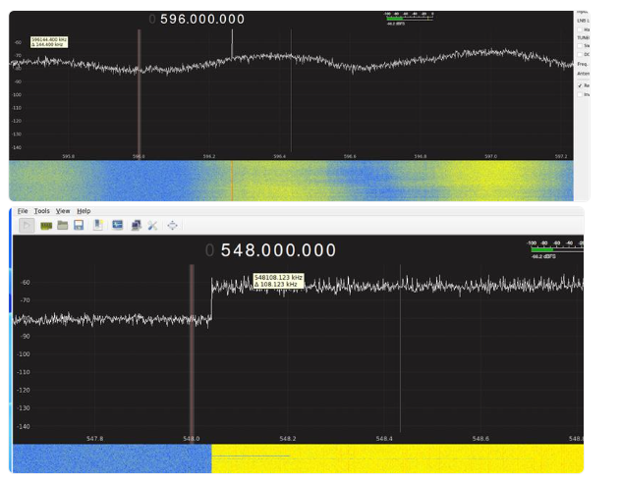
Sample of two DTV Signals (ATSC Modulation)
Location: CBS Tower (Newton)
ATSC Channel: 35
Freqs: 596 → 602 MHz
Modulation Scheme: ATSC 1.0
Pilot Tone: 596.3 MHz
Location: Univision Tower (Hudson)
ATSC Channel: 27
Freqs: 548 → 554 MHz
Modulation Scheme: ATSC 3.0
Pilot Tone: None in this scheme

Slide 6
CBS Tower Info
******************************************
**** Processing station: station_8_65684
******************************************
Station Details: 1274' 922 kW Non-Directional (E) | (Vertical ERP: 184 kW)
ERP Calc: (55.3 kW + 12.22 dB gain = 922 kW ERP)
Coverage: 64.9 mile contour / | 13232.5 sq. mi. area | / Est. Pop. 7,707,431
ALT: 1264' AGL; 1417' AMSL; (1003433)
Pointing: 0.75° Elec Beam Tilt; | Full Service Filter | Antenna: RF Systems PEP70E-O5-2-T
Location: (NAD83) N 42° 18' 37", W 71° 14' 12" | LatLon: 42.310278, -71.236667 | Location Name: CBS Tower (MA)

Slide 7
Files used for Analysis
RF Budget for Newton
RF Budget for Hudson
Comparative Analysis

Slide 8
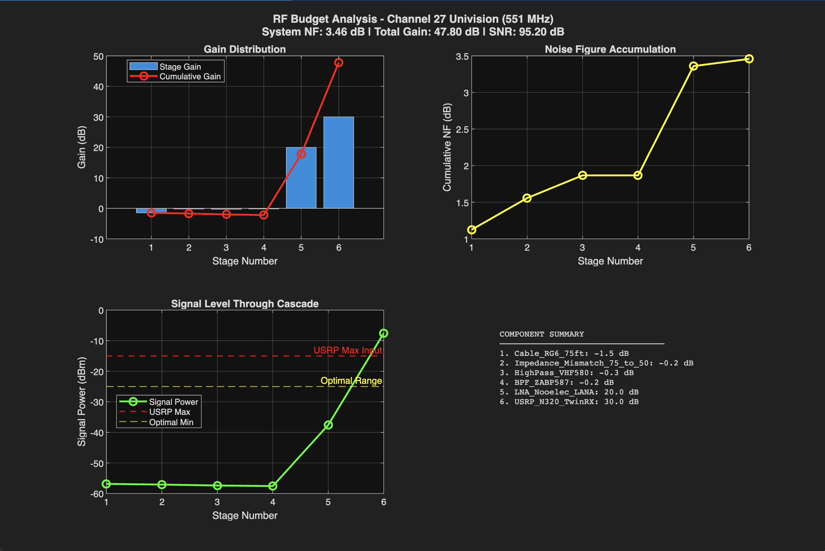
RF Budget Analysis for Hudson Tower

Slide 9
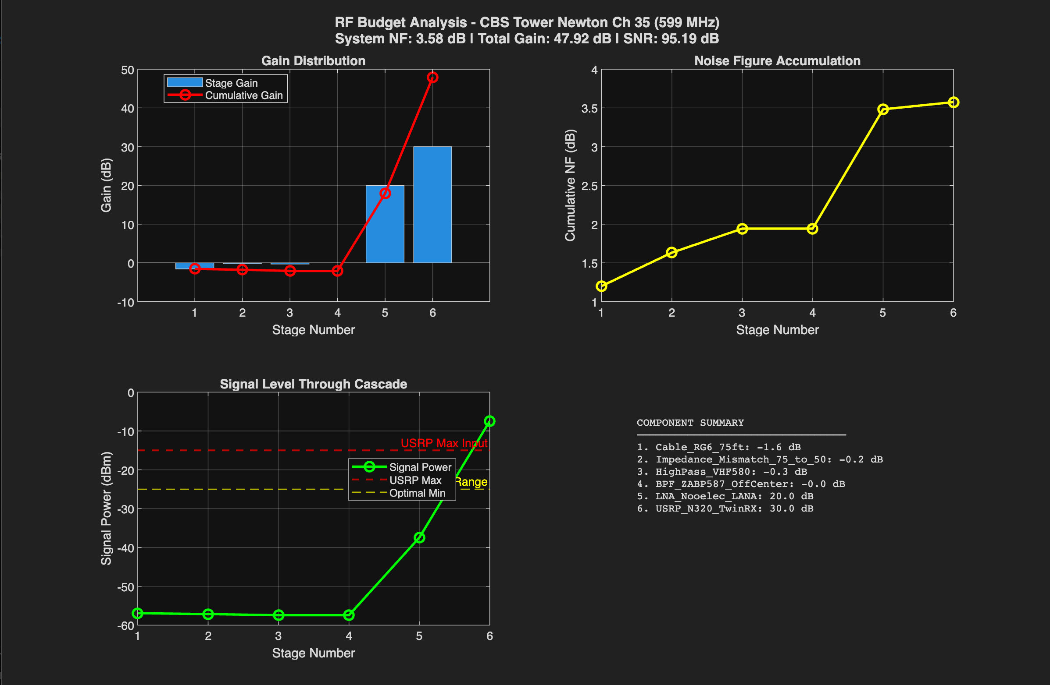
RF Budget Analysis for Newton Tower

Slide 10
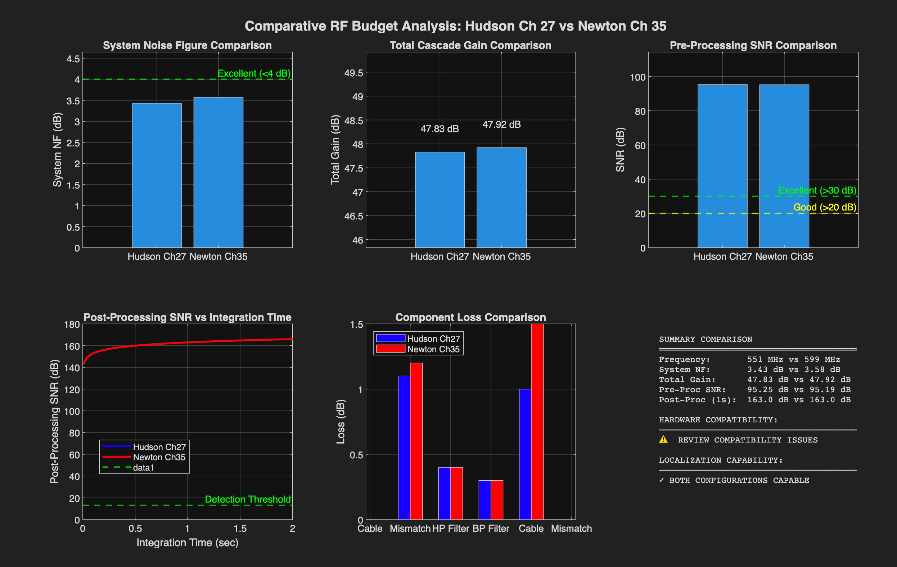
Comparative Analysis
Can we detect bistatic targets?
Are we using the right hardware to do so?

Slide 11
Tim Reeves – First pass review
The N320 radio has an input impedance of 50 ohms, so you are left with a couple of choices, you can design the entire system for 50 ohms, all the way from the antenna to the USRP output, or you can use an impedance transformer if you choose to use 75 ohm cables. I would suggest that you make use of 50 ohm characteristic components throughout your entire system.
I would encourage you to include the antenna in your analysis, it might make a small difference in the LNA’s gain value.
I would encourage you to make use of the transmission line elements to model the cables. Amplifier’s are not bi-directional, and this will have an ever so-slight impact on the RF Budget analysis.
Given that this appears to be a receiver system, you may want to consider making use of a smaller LC bandpass filter, rather than the higher performing coaxial cavity filter. I would also suggest that you download the S-parameters for the cavity filter and include them in your initial analysis. An abstracted model of the filter can then be constructed which does not violate a given vendor’s IP. Chebyshev filter’s are typically used in wireless communication transmitters and receivers.

Slide 12
Although it is not going to make any difference to the system performance, you may want to check your SFDR calculations. Third order intermodulation products aren’t going to be a problem for the test system, however, you will want to determine the minimal detectable signal level and the noise power at the output of the LNA. You can get this value from the Noise Power quantity from the RF Budget Analysis.
What is the approximate distance that you plan to be away from the CBS tower? That may be a good number to include in the analysis, so that a rough estimate of the power level at the receive antenna can be predicted (When I say rough estimate, this could be +/-10 dB or so, depending on antenna orientation and physical orientation with respect to the antenna).

