Slide 1
Most proteomics analyses are protein-centric
Proteins are what we start with
Proteins are digested with trypsin
Tryptic digest is analyzed with mass spec
Peptides sequences are determined
FASTA file, search engine, some filtering for “correct” assignments
Proteins are inferred from assigned peptide sequences
Proteins are often quantified for differential abundance
Protein (gene) annotations used to aid interpretation of results

Slide 2
Phospho peptide enrichment is peptide-centric
Mass spec sequences the peptide
Search engines assign peptide sequence and PTMs
Filtering for “correct” assignments is unchanged
Protein inference makes several assumptions that do not apply
Peptide-centric data should have peptide-centric result summaries
All phospho peptide studies are analyzed with protein-centric software

Slide 3
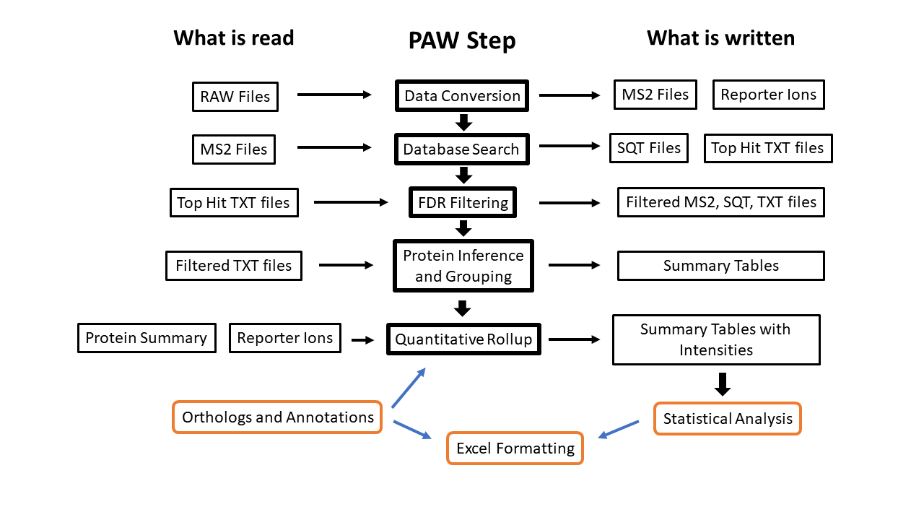
Typical proteomics data analyses
The peptide part:
The protein part:

Slide 4
What are issues with using protein-centric tools?
Protein ID requirement must allow proteins with single peptides
Note that single peptide per protein IDs are error-prone
Site numbering ambiguity
FASTA file affect residue numbering
Protein grouping creates residue numbering ambiguity
All software attempts some protein-level error control
This biases the peptide sequences that are retained (a little)
All peptide and PTM reports are conditioned on the list of proteins
Quantification conditioned on peptide relationships to proteins
Shared or unique definitions require a protein context

Slide 5
Where does that leave us?
Need peptide centric summaries of results
Need to worry about site numbering and FASTA file choice
Need to ignore shared or unique peptide concept
Need to worry about site localization
Need to group peptides in some sensible way
Improves quantitation
Improves statistical testing
Can have some loss of information

Slide 6
Multiple TMT plex experiments are hard
Matching proteins between plexes is MUCH more robust than matching peptides
Far fewer peptides will be seen across plexes than proteins
A few thousand proteins versus tens of thousands of peptides
Peptide matching will have site localization issues
Grouping peptides will improve matching
Grouping can lead to loss of information
There is no software to do this yet (coding this is not easy)

