Slide 1
Adding an R kernel to Jupyter notebooks
Phil Wilmarth
OHSU
August 27, 2021

Slide 2
There are many possible ways to do this
We want the most generic install (easier to do it again)
We want a hassle-free Python installation
Jupyter notebooks not part of the Python.org distribution
Ability to update Python packages desirable
We want to be able to maintain R (add and update packages)
Need to search and install R packages
Need to update packages
Additional R support (IDE, RMarkdown, etc.) could be nice

Slide 3
Anaconda Python 3 Individual Edition
Download at https://www.anaconda.com/products/individual
Current Python 3 version
Core scientific Python packages already installed
Support for Jupyter notebooks
Conda package manager for updates
Other tools included in the distribution

Slide 4

Python version and platform may differ from what is shown here

Slide 5
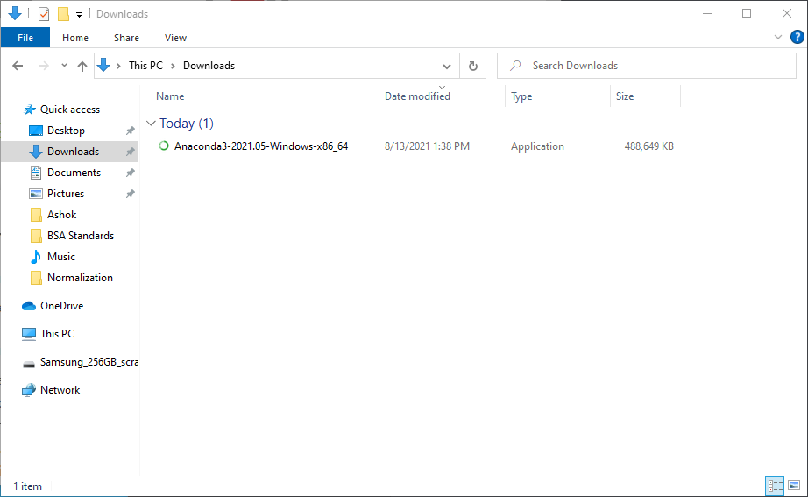
An installer file will be in your downloads folder. Run the installer.

Slide 6
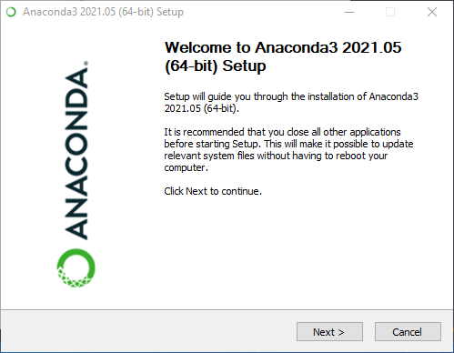
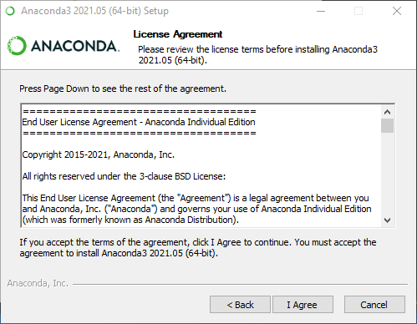
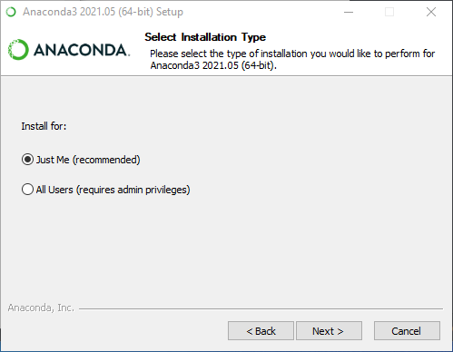
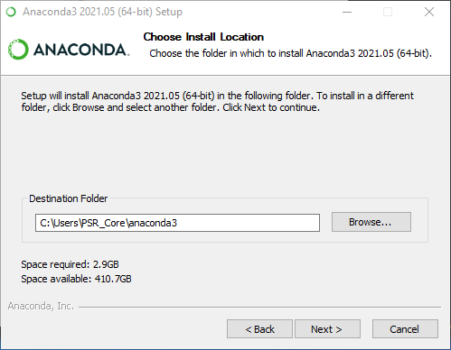
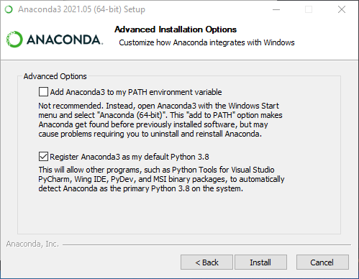
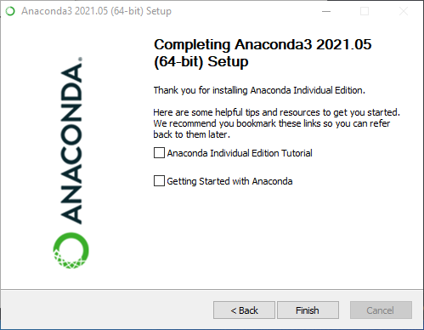
Anaconda Installation Steps:
1
2
3
4
5
6

Slide 7
Install the latest release of R
Download at https://cran.r-project.org/bin/windows/base/
Latest release of R and Bioconductor are usually compatible
If a major R release was done very recently, check Bioconductor’s website (www.bioconductor.org) for compatibility
Older R releases are available, too

Slide 8
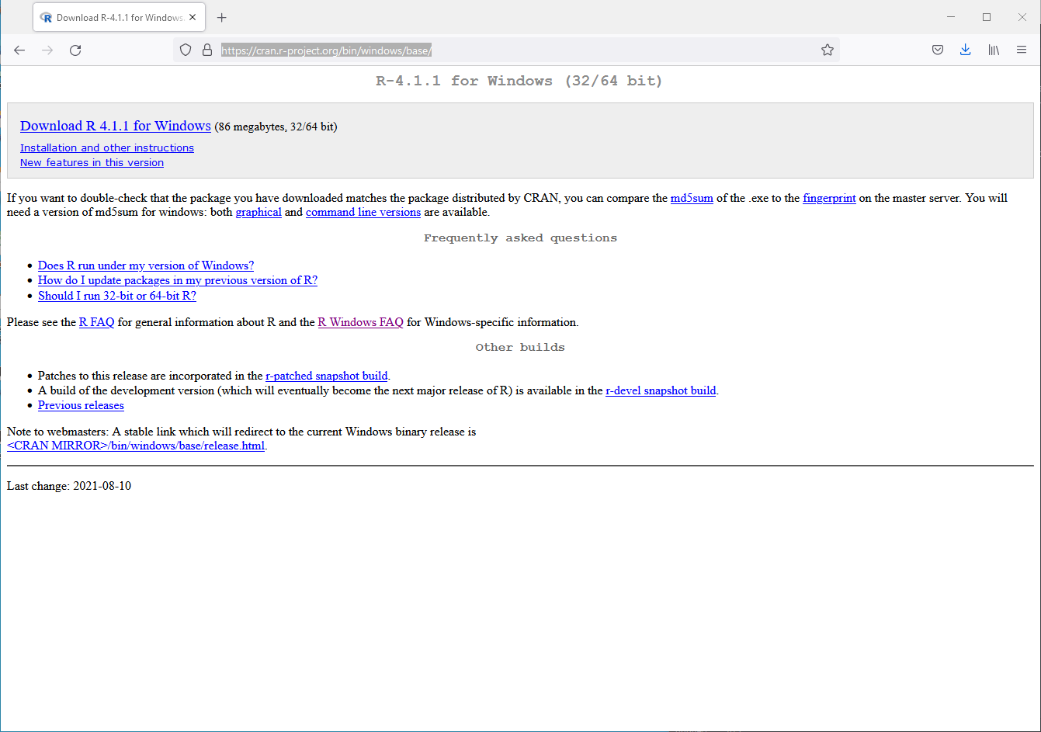
Download the R installer program

Slide 9
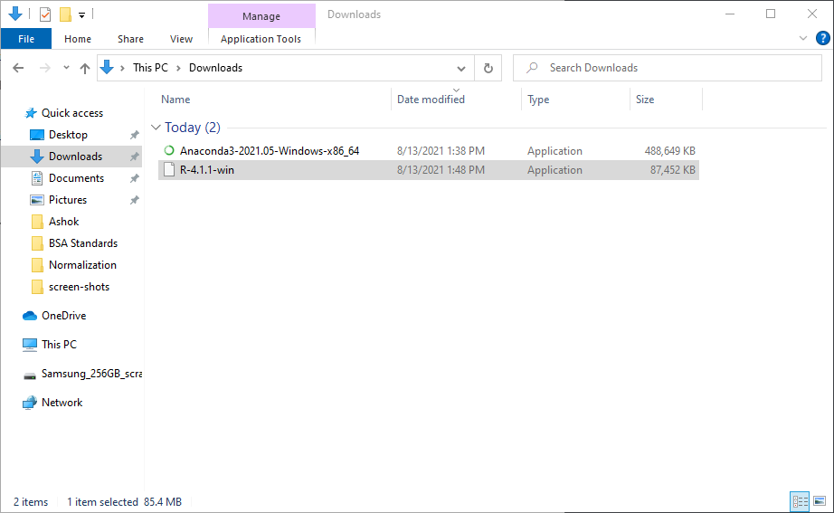
Run the R installer program in the downloads folder

Slide 10
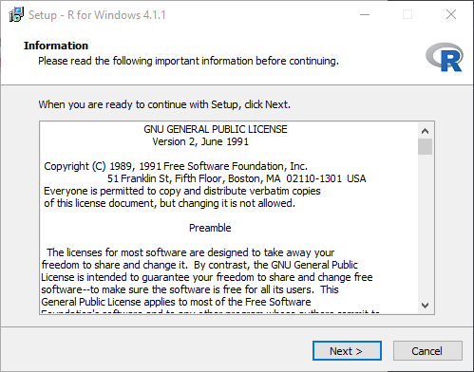
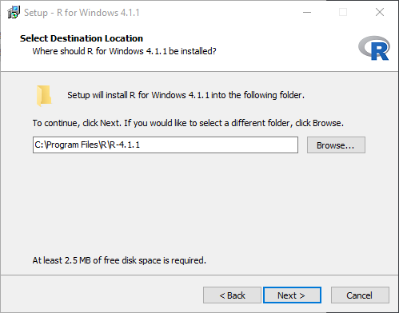
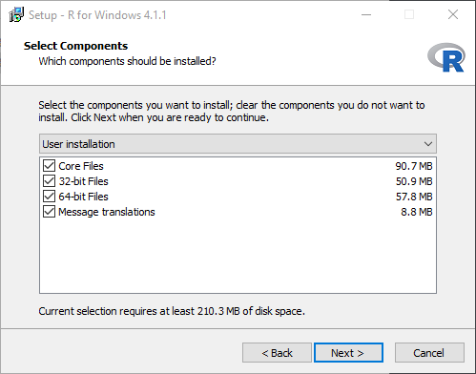
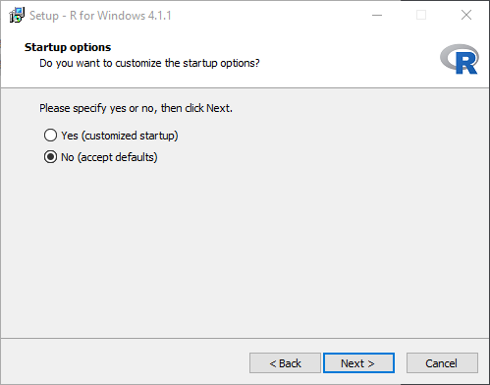
R installation steps:
Default settings are okay
1
2
3
4

Slide 11
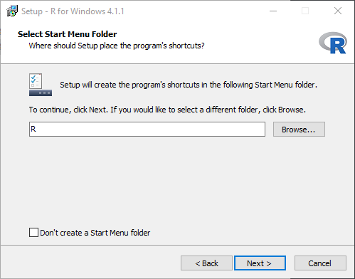
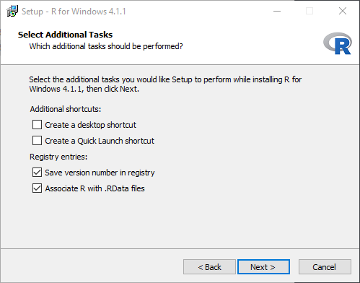
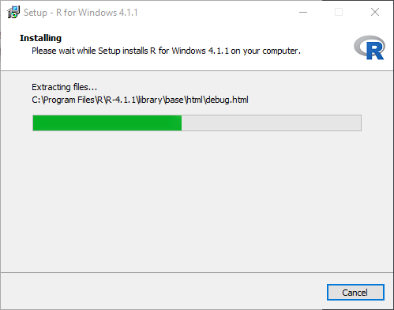
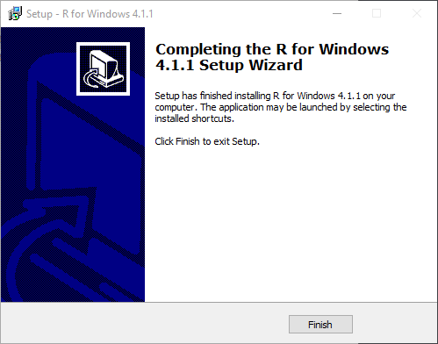
R installation steps (cont.):
5
6
7
8

Slide 12
Install RStudio to manage R packages
There are thousands of R packages
To manage R packages, you need to:
Find R packages
Install R packages for your R release
Update R packages
Use RStudio (https://www.rstudio.com/products/rstudio/)
Download RStudio
https://www.rstudio.com/products/rstudio/download/#download

Slide 13
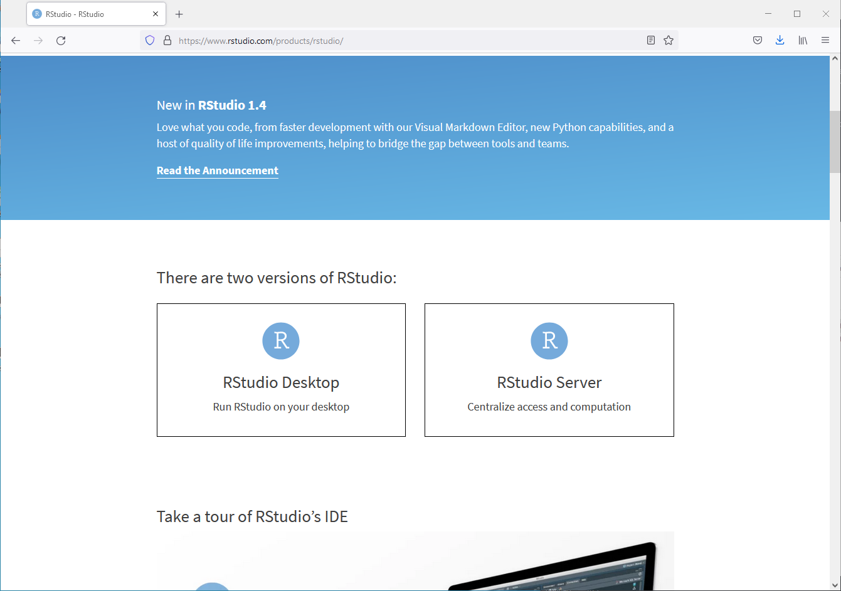
We want the desktop version

Slide 14
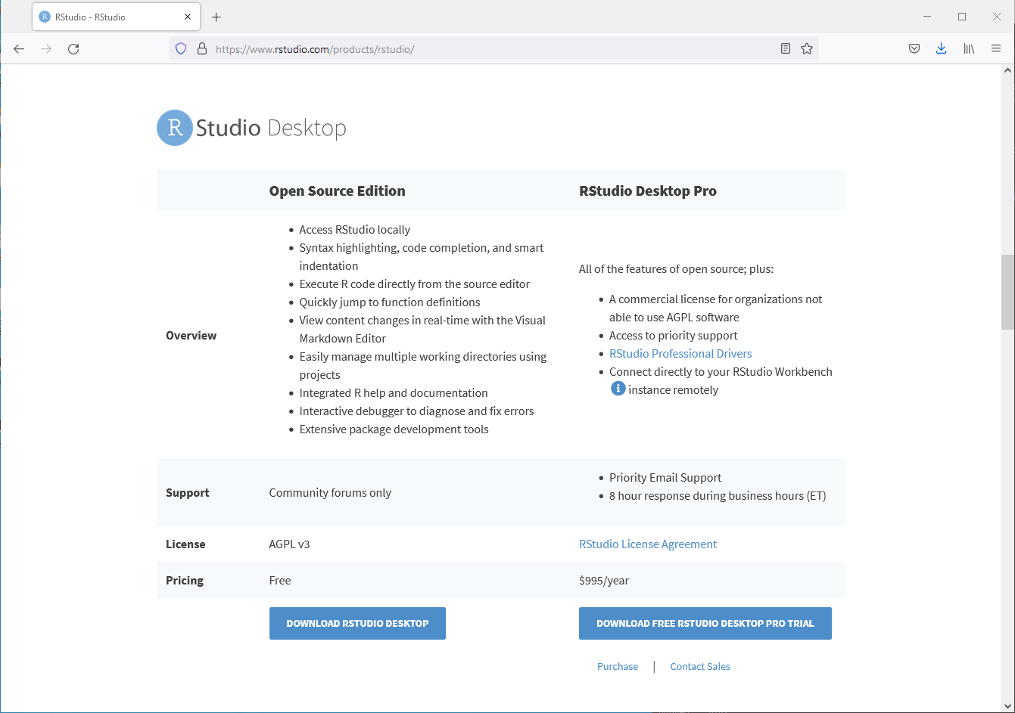

Slide 15
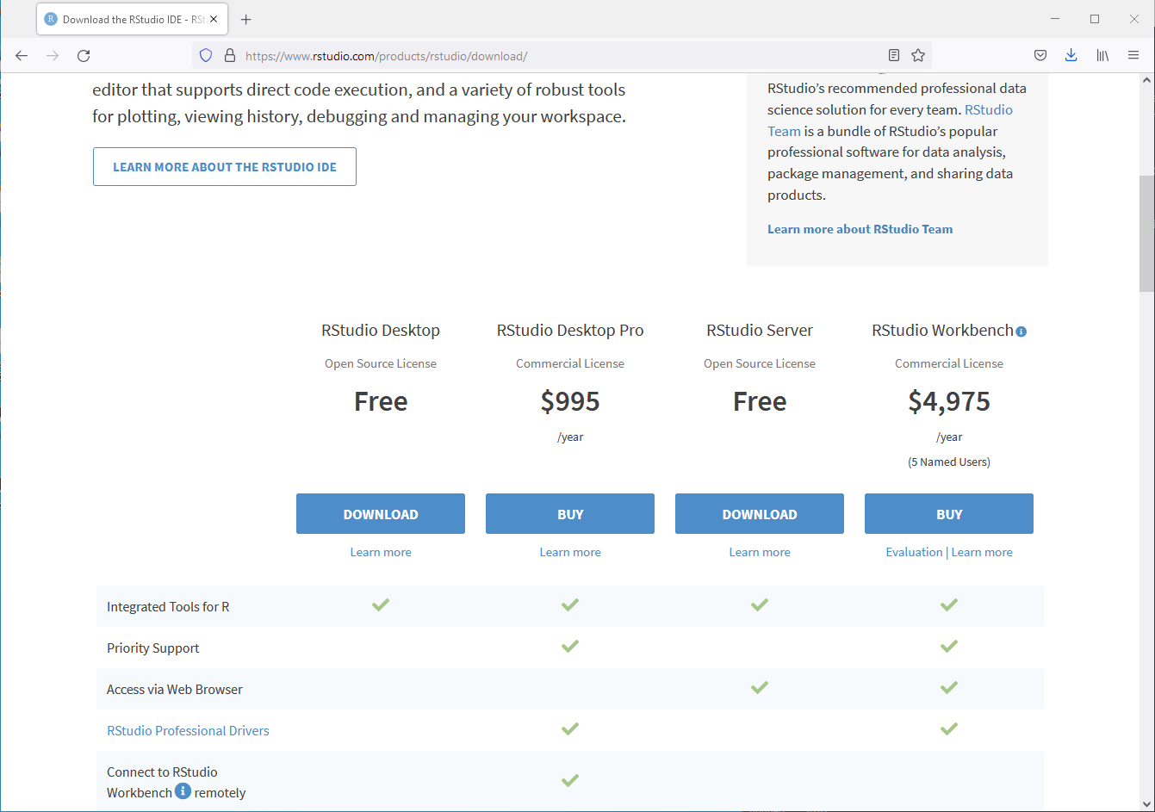

Slide 16
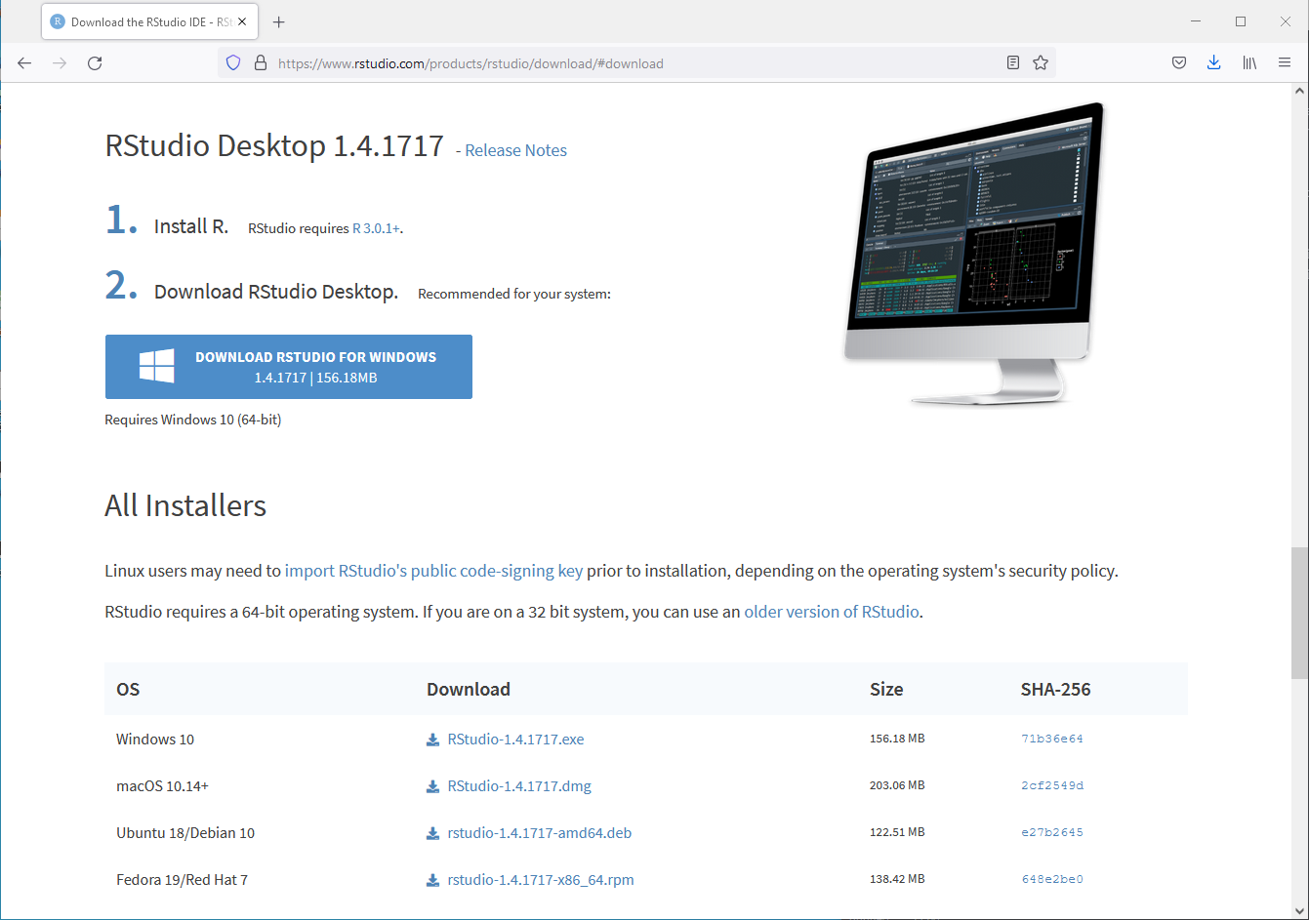
Download the installer

Slide 17
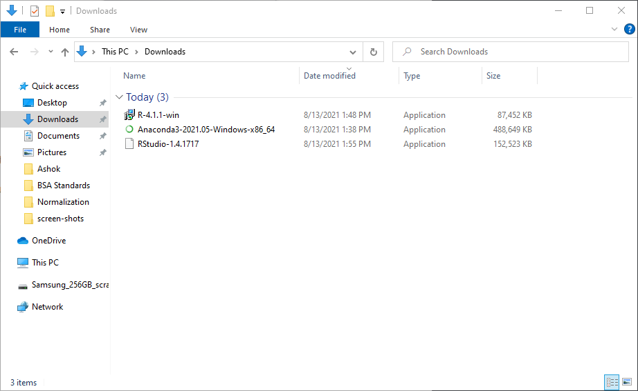
Run the RStudio installer program

Slide 18
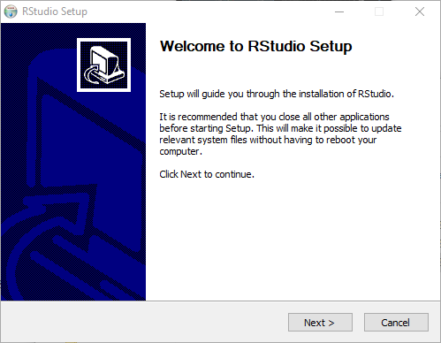
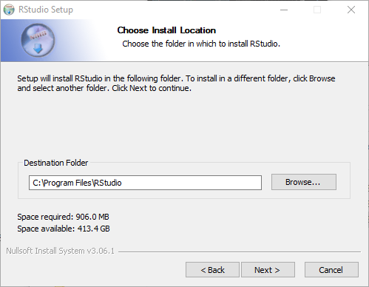
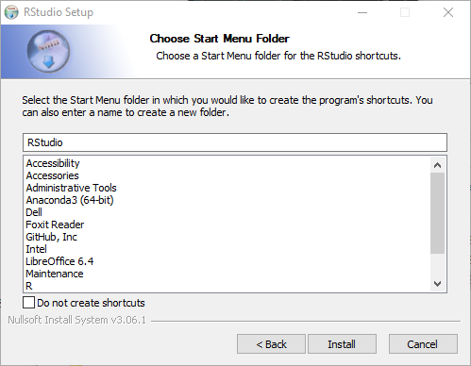
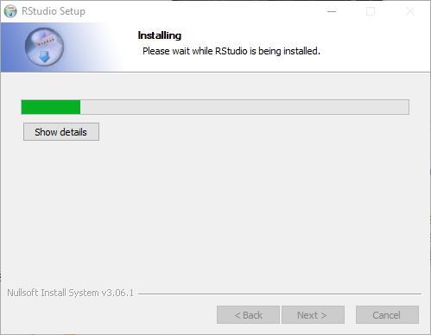
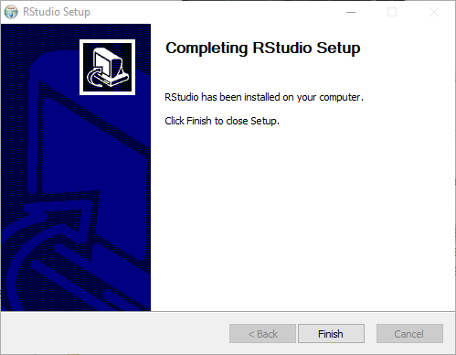
Install RStudio: (default settings okay)
1
2
3
4
5

Slide 19
Tell Jupyter that we have R installed
See instructions at https://irkernel.github.io/installation/
Jupyter needs to know what R to run for its R kernel
It is a two-step process
Need to install a package in our R release
Need to install an R kernel spec in a way that Jupyter can see it

Slide 20
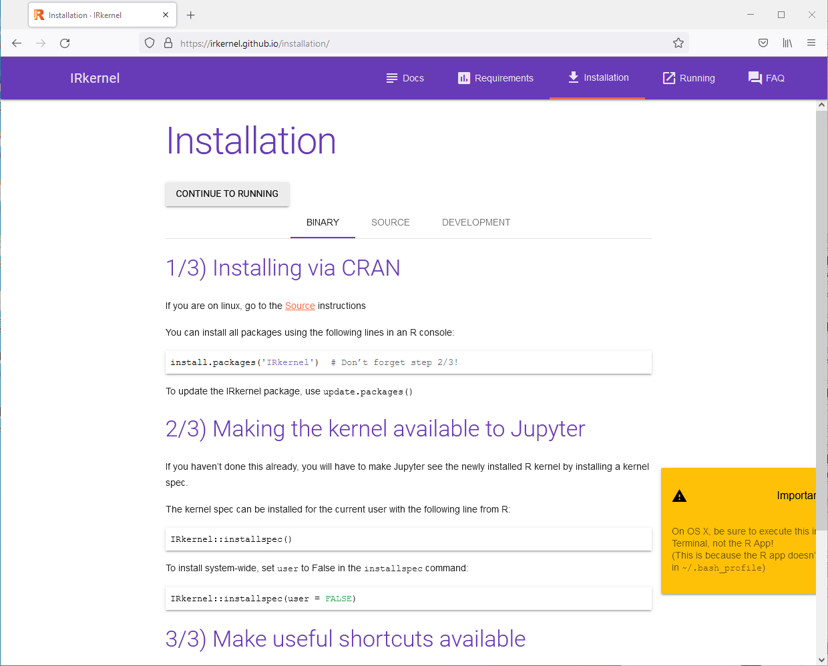

Slide 21
Install the R package with RStudio
We installed RStudio to manage packages
RStudio has a very nice interface
RStudio is a great IDE for developing R scripts, functions, packages
RMarkdown is an alternative way to create notebooks

Slide 22
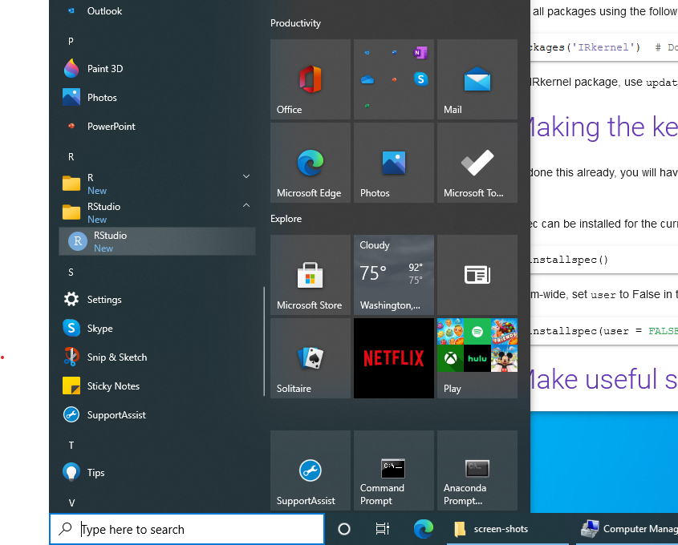
Launch RStudio from the Start Menu

Slide 23
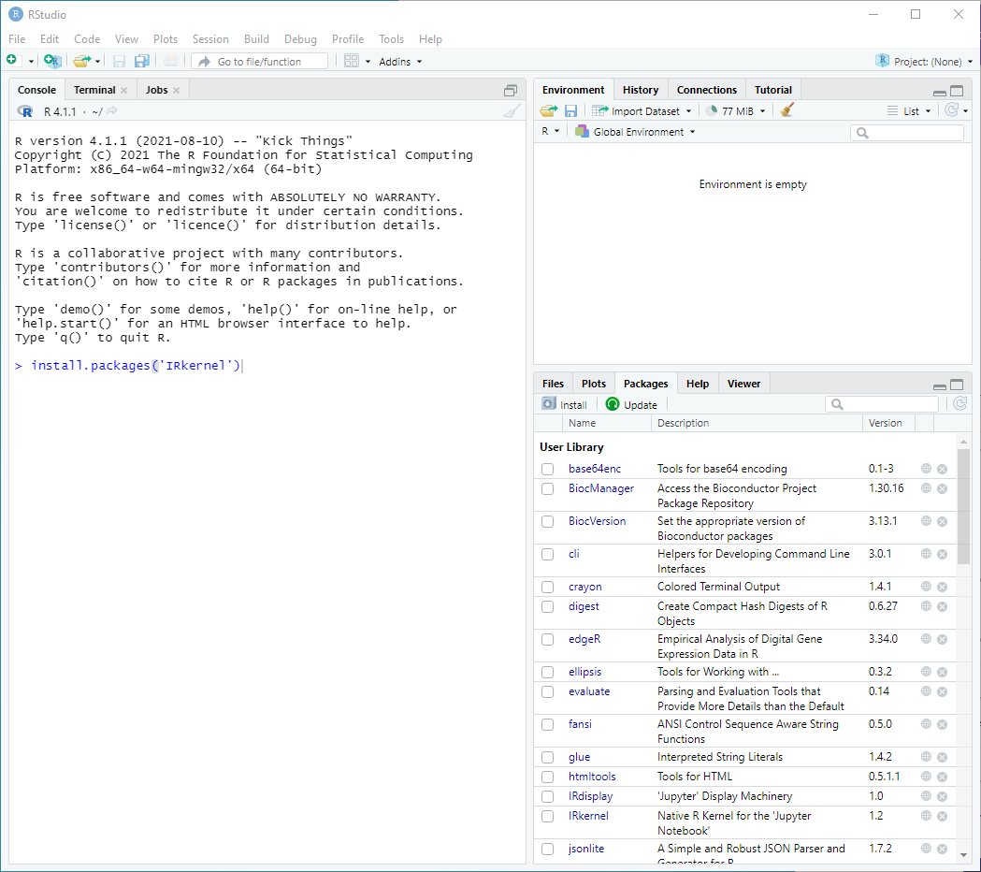
Install the ‘IRkernel’ package in the Console pane
Resources to learn about the RStudio environment
https://www.rstudio.com/products/rstudio/?wvideo=520zbd3tij
https://sites.tufts.edu/datalab/files/2018/04/R_RStudio_Basics.pdf
https://dss.princeton.edu/training/RStudio101.pdf

Slide 24
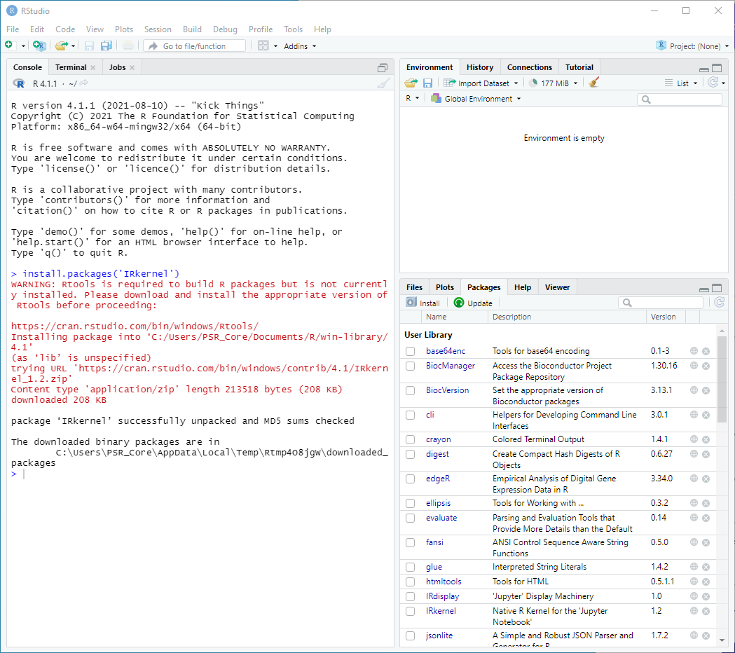

Slide 25
Run the other R command directly in R
We may not need to be this formal on Windows
We need to do similar steps for Mac OS
We need to use the command line (as little as possible)
Anacoda sets up a command line environment we will use
The environment set some paths for Anaconda packages
The Anaconda prompt is a Windows command shell

Slide 26
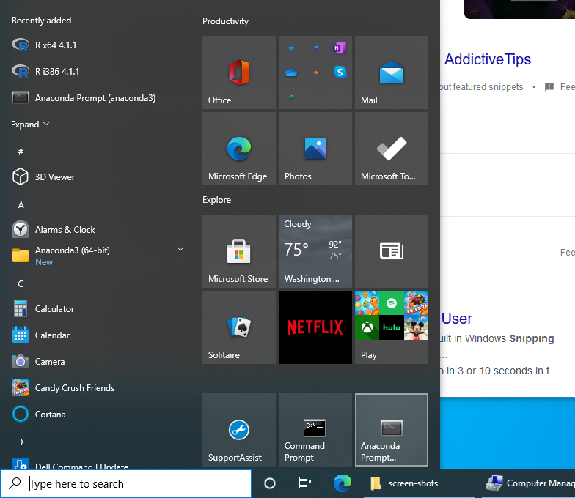
Find and click the Anaconda Prompt icon from the Start menu
Running as an administrator is often good (right click on the icon, follow More submenu, Run as administrator…

Slide 27
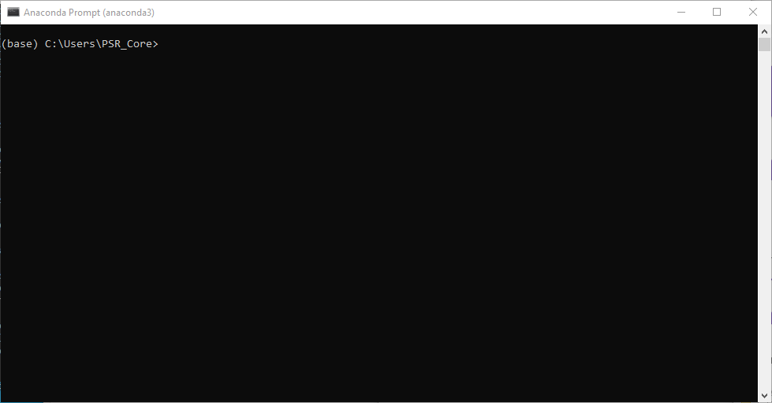
Command prompt

Slide 28
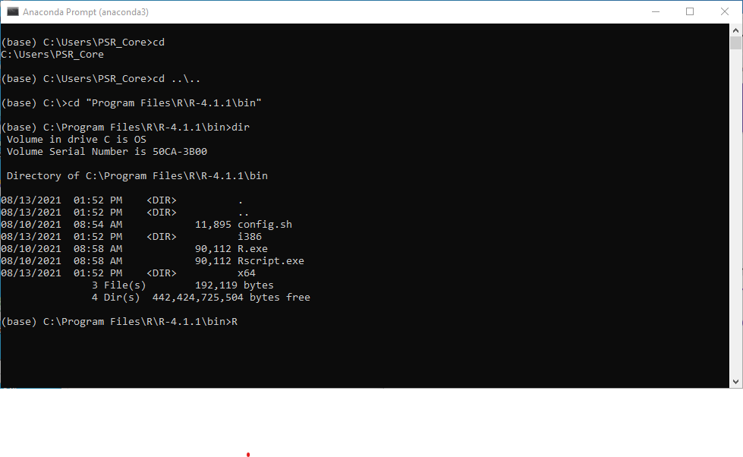
See where we are in the file system
Move up two levels to the C: root level
Change directory to our R installation
Run R

Slide 29
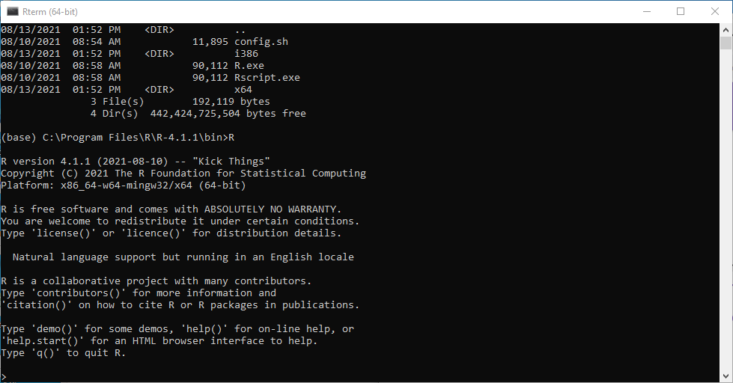
This is a typical R start up message
R command prompt is “>”

Slide 30
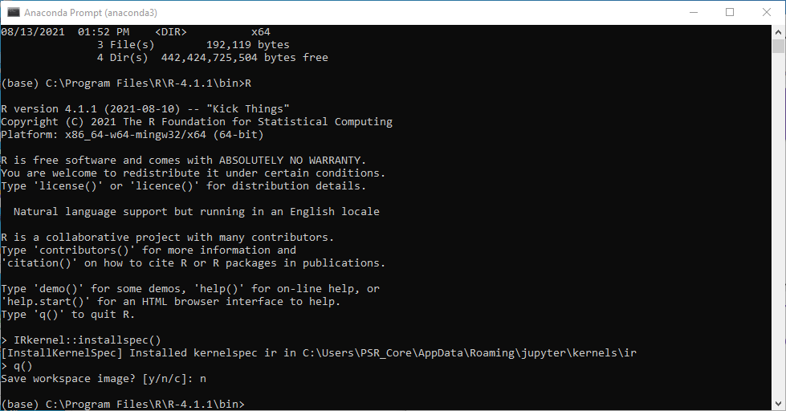
Install the R kernel spec
Quit R and do not save the workspace image

Slide 31
Navigate to folder and create a Jupyter notebook
Use the Anaconda Prompt command shell
Navigate to desired data analysis folder location
Launch Jupyter notebook

Slide 32
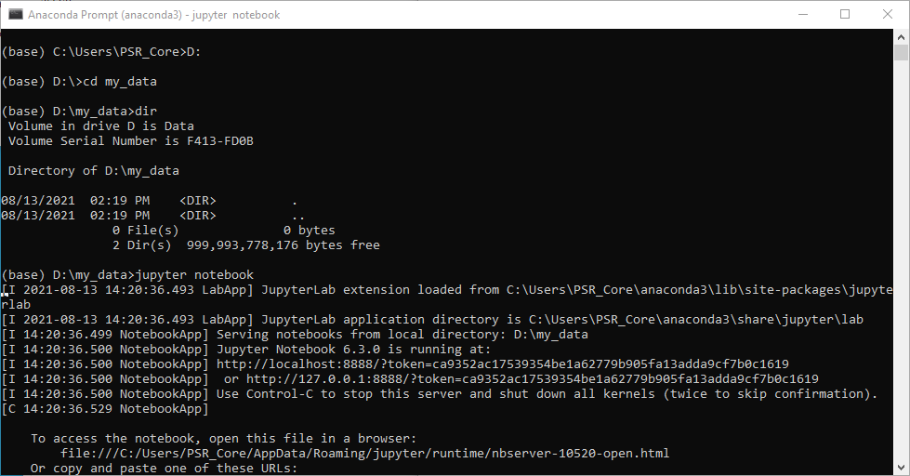
Data may be on a second volume
Change directory to analysis folder location (remember tab completion)
Check the files in your new location
Launch the Jupyter notebook environment

Slide 33
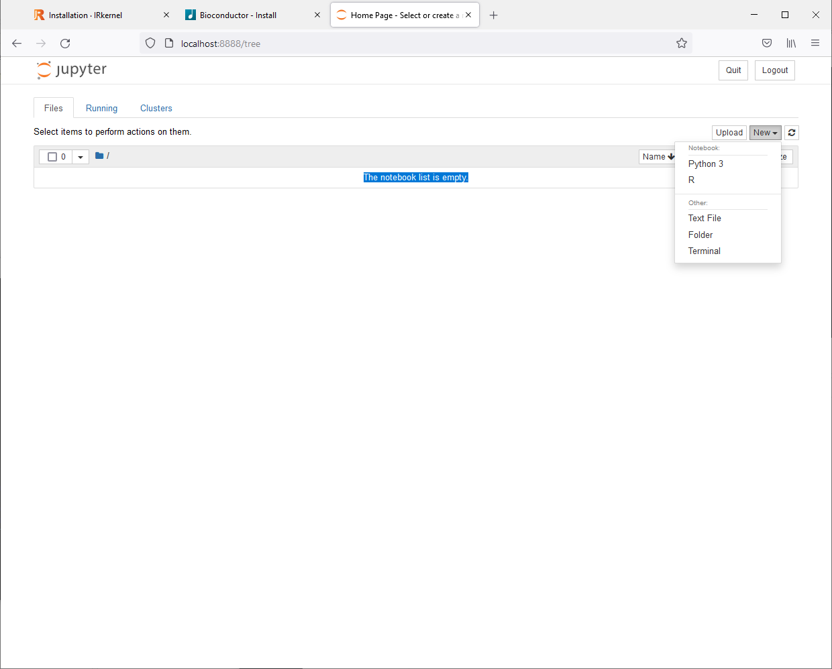
Create a new R notebook
To learn more about Jupyter notebooks:
Documentation at www.jupyter.org
Tutorials on the web
https://www.dataquest.io/blog/jupyter-notebook-tutorial/
Most tutorials cover Python notebooks

Slide 34
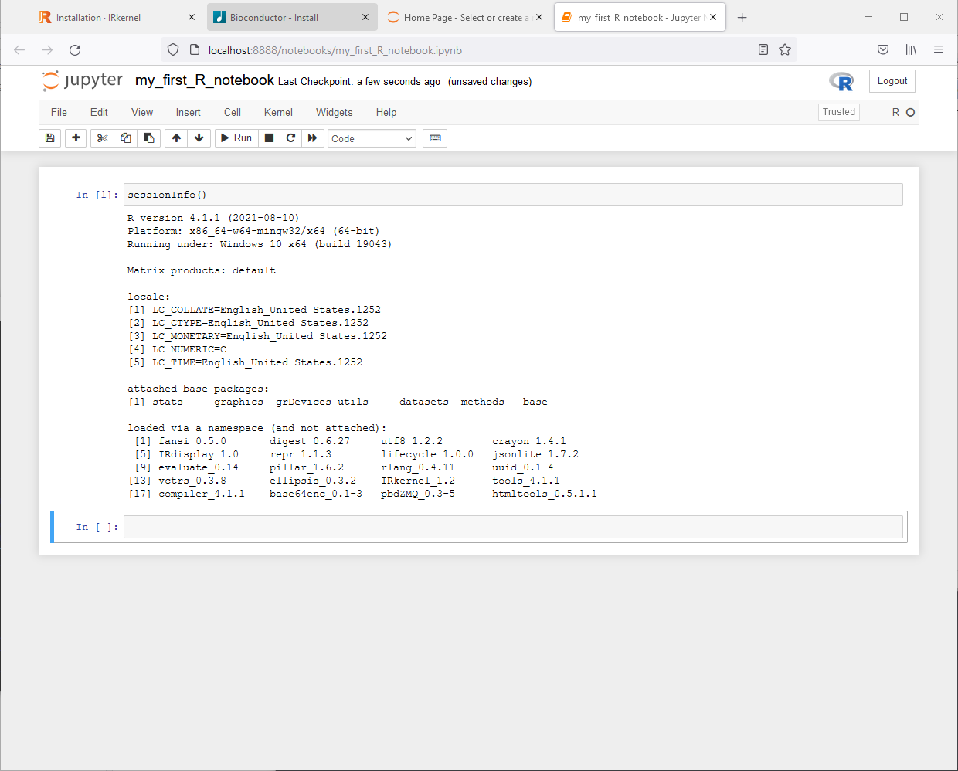
This is an R notebook in our web browser It was renamed to “my_first_R_notebook” It is running the R release we installed
Execute “sessionInfo()” R command and check what R version notebook is running

Slide 35
Add R packages using RStudio
Install Bioconductor and other R packages in RStudio
RStudio’s interface for packages is very good

Slide 36
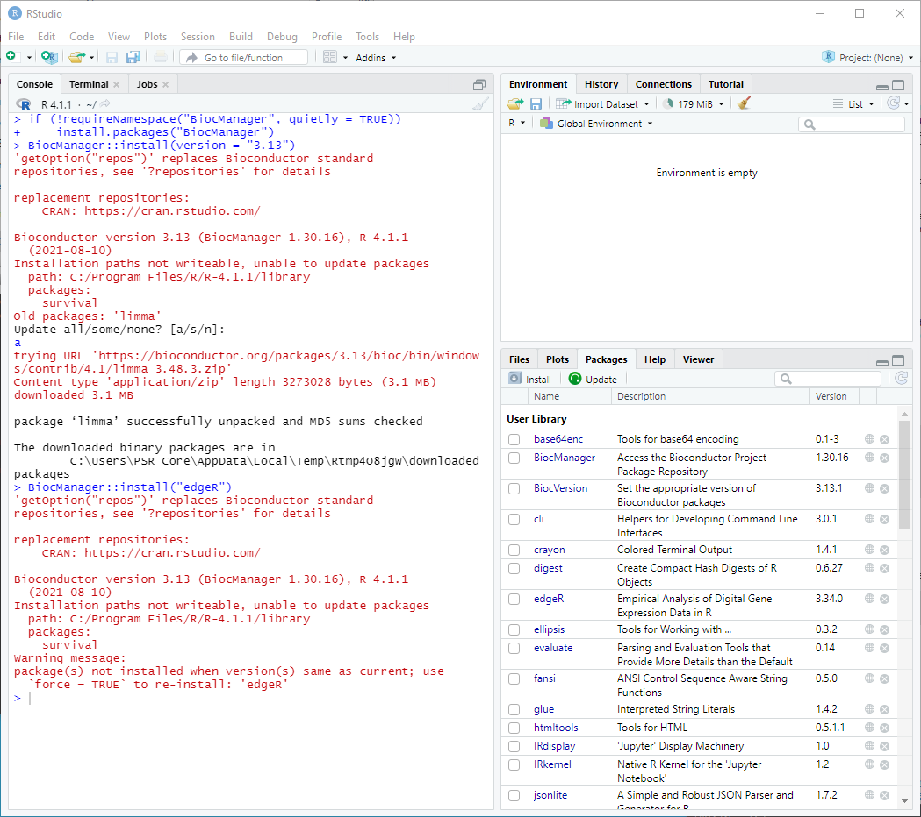
Bioconductor is not integrated into RStudio’s package manager by default
Follow instructions at: https://www.bioconductor.org/install/
Install any desired Bioconductor packages like ‘edgeR’ RStudio manages packages after they are installed

Slide 37
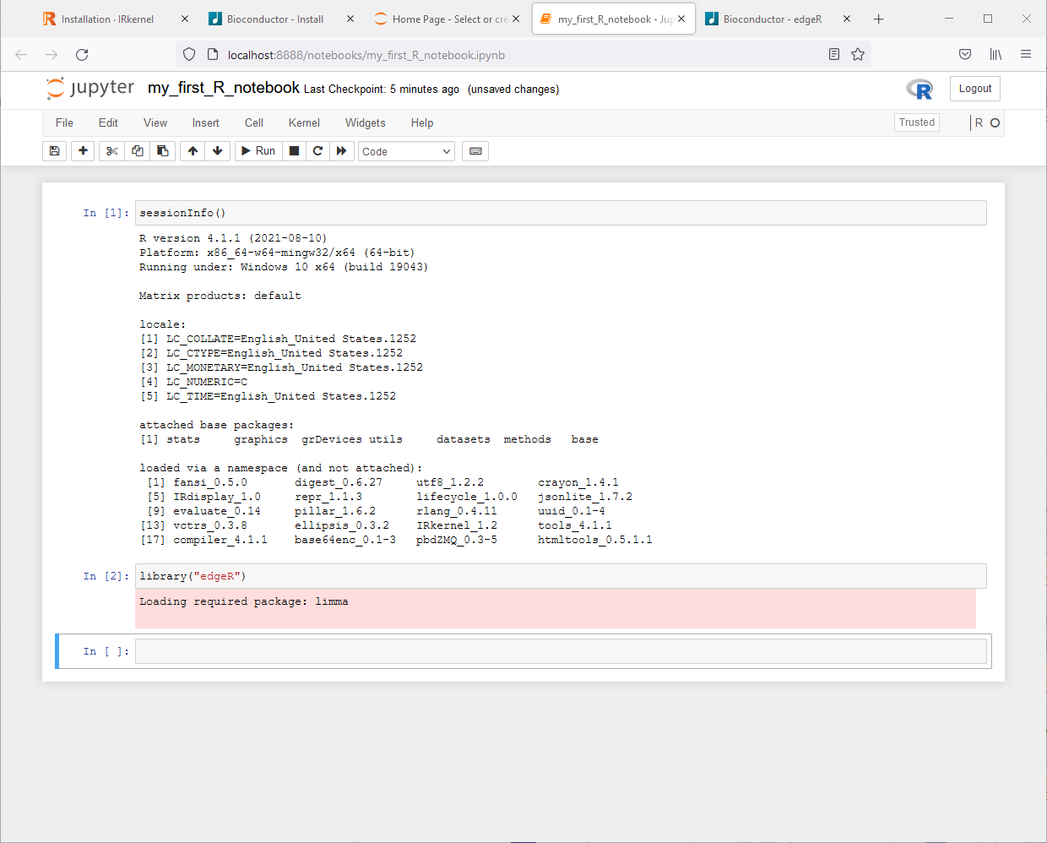
Bioconductor packages are now available in the notebook

Slide 38
Summary
Installed Anoconda, R, and RStudio using default installations
Anaconda gives us Python 3, Jupyter, and much more
RStudio is the best R work environment
Very nice IDE (integrated development environment)
Access to RMarkdown and many other tools
RStudio does not install R or manage R installations
Jupyter notebooks were configured for an R kernel

