Slide 1
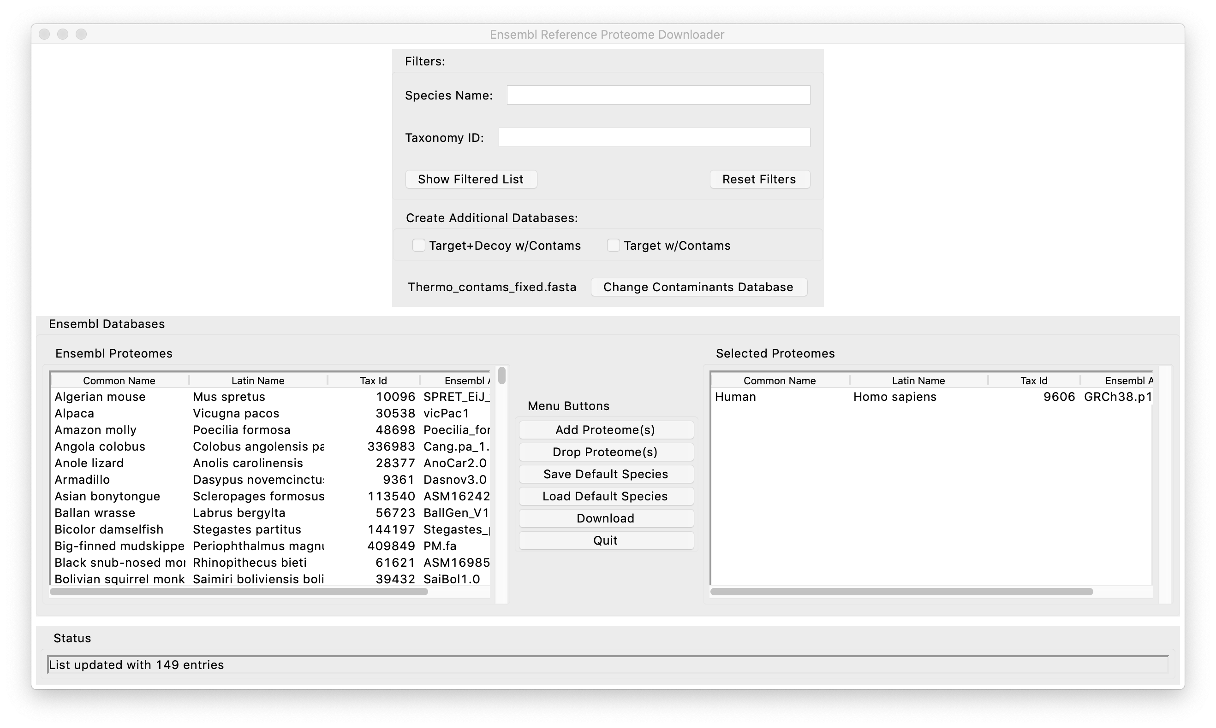
Filter fields and Options
Proteome choices
Proteomes to download
Actions

Slide 2
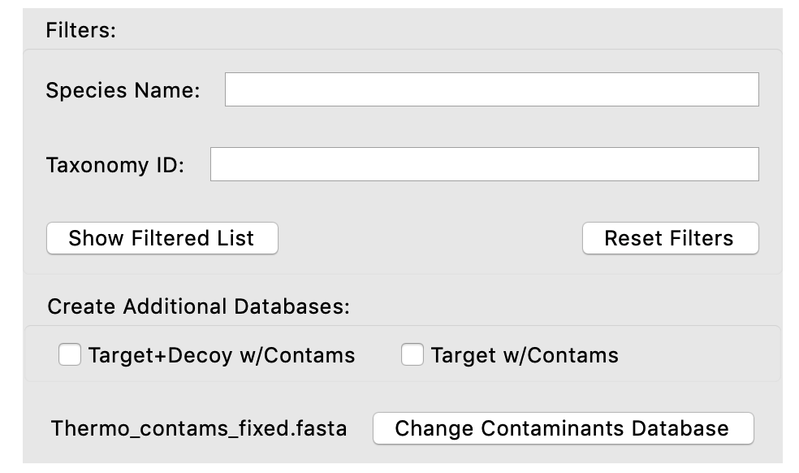
Can search by name string
Can search by taxonomy number
<- Filter or Reset ->
Pick desired processing (or none)
Can customize contaminants

Slide 3
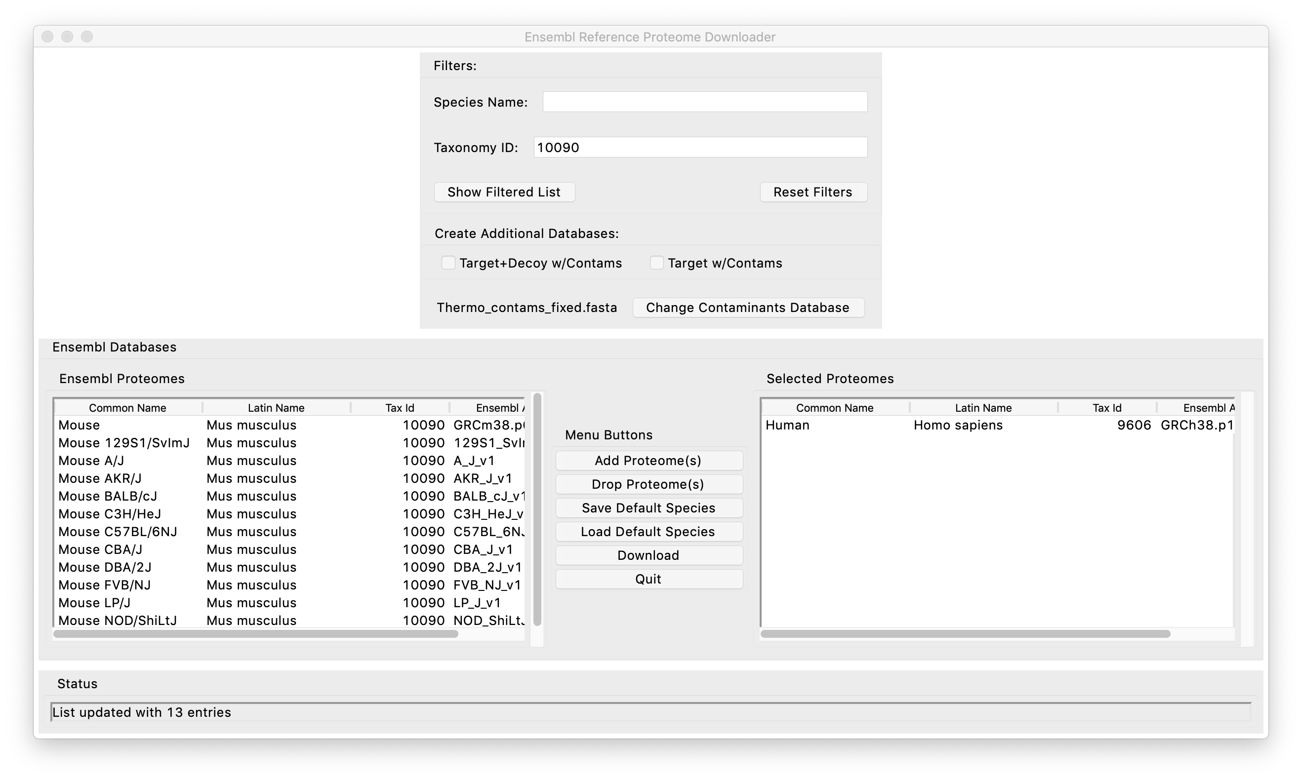
You can search by name text or by taxonomy number
Left is now only mouse

Slide 4
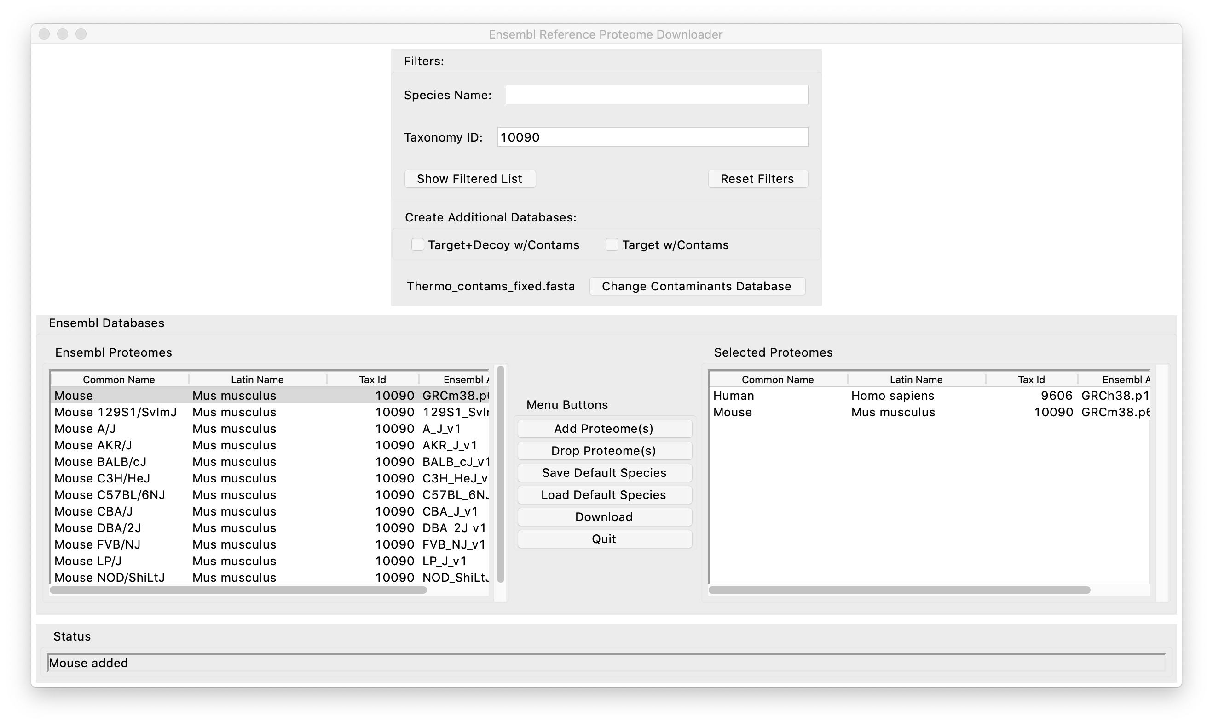
1. Select one or more from left
3. Right is download list
2. Click Add button

Slide 5
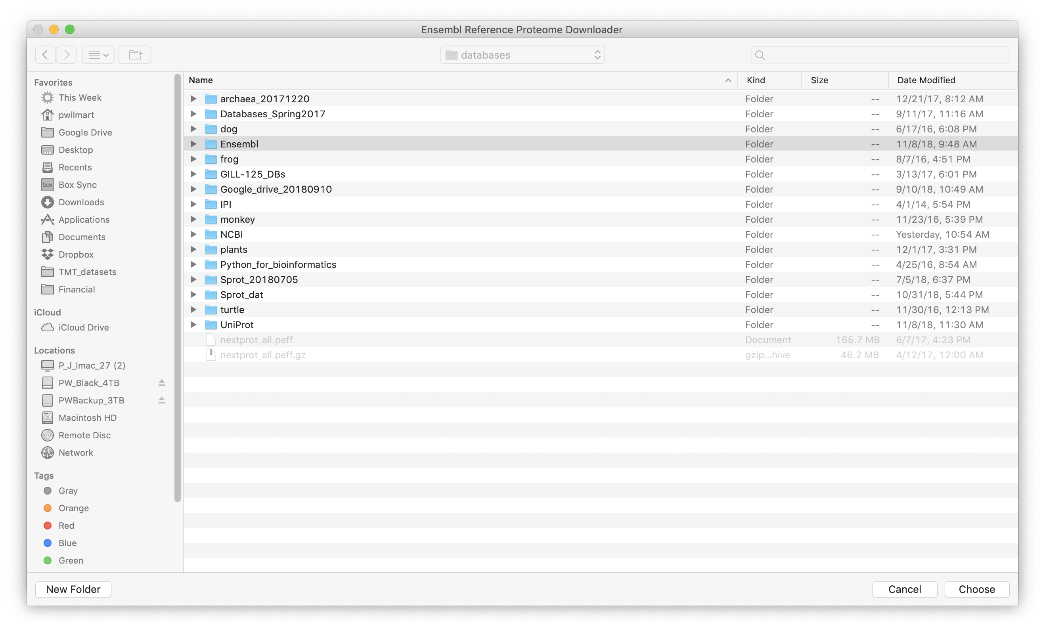

Slide 6
