Slide 1
TMT channel cross-talk
Phil Wilmarth
August 20, 2022

Slide 2
+1 Da relative abundance contributions
8
7
6
5
4
3
2
1
126C 100
127N 100
127C 100
128N 100
128C 100
129N 100
129C 100
130N 100
130C 100
131N 100
131C 100
132N 100
132C 100
133N 100
133C 100
134N 100
134C 100
135N 100
C series
8
7
6
5
4
3
2
1
126C 100
127N 100
127C 100
128N 100
128C 100
129N 100
129C 100
130N 100
130C 100
131N 100
131C 100
132N 100
132C 100
133N 100
133C 100
134N 100
134C 100
135N 100
N series

Slide 3
-1 Da relative abundance contributions
126C 100
127N 100
127C 100
128N 100
128C 100
129N 100
129C 100
130N 100
130C 100
131N 100
131C 100
132N 100
132C 100
133N 100
133C 100
134N 100
134C 100
135N 100
C series
1
2
3
4
5
6
7
8
126C 100
127N 100
127C 100
128N 100
128C 100
129N 100
129C 100
130N 100
130C 100
131N 100
131C 100
132N 100
132C 100
133N 100
133C 100
134N 100
134C 100
135N 100
N series
1 (1)
1, 1 (2)
2, 1 (3)
3, 1 (4)
4, 1 (5)
5, 1 (6)
6, 1 (7)
7, 1 (8)
8, 1 (9)

Slide 4
Minimal cross-talk series
126C 100
127N 100
128C 100
129N 100
130C 100
131N 100
132C 100
133N 100
134C 100
135N 100
Series 1
127C 100
128N 100
129C 100
130N 100
131C 100
132N 100
133C 100
134N 100
Series 2

Slide 5
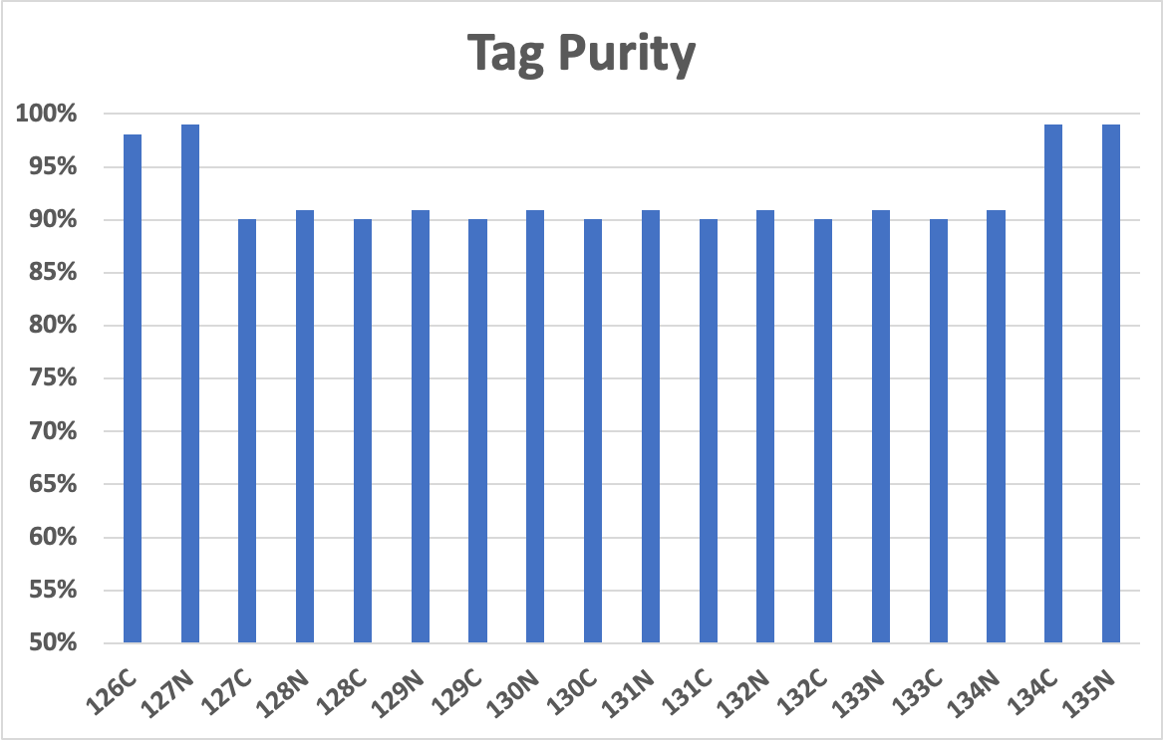

Slide 6
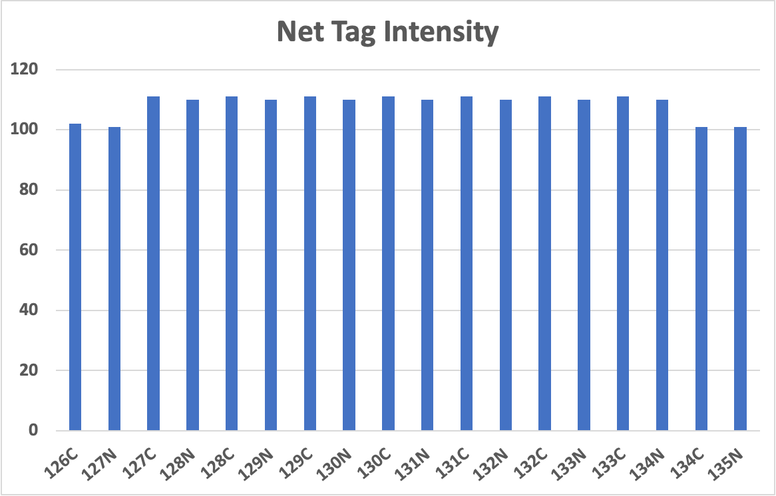

Slide 7
