Slide 1
What can you do with whole proteomes?
Contams are red
Others are blue
Someone said
Exclude a few
Notes:
Prepared October 27, 2025, by Phil Wilmarth, PSR Core, OHSU. Is it about time for proteomics to start thinking about proteomes? After nearly 30 years of single protein quantitative proteomes, it is time to think about whole proteomes.

Slide 2
Precise relative abundances of whole proteomes are information rich
Does your proteome look like the right proteome?
Assess proteome dynamic range
Check distribution of protein relative abundances
Do a few highly abundant proteins dominate proteome?
Are protein relative abundances more broadly distributed?
Are sample proteomes consistent and clean?
Blood proteins and keratins can variably contaminate many samples
Some samples have more complicated proteome contaminations
Notes:
What are proteomes? Are they just parts lists? Most parts lists also specify the number of each type of part. Don’t you sort the bag of fasteners from that IKEA purchase, count the items, and compare that to the parts list in the instructions before you start putting it together? We can do similar checks when we measure whole proteomes (a list of protein present in the samples and some relative abundance measure that can be used to rank proteins from high abundance to low abundance). There is usually a lot that is known about any sample type from years of prior study. A logical first sanity check is whether the proteome you measured bears some resemblance to what was known about the proteome. LC systems and mass spectrometers have limited dynamic ranges, and many proteomes can have larger dynamic ranges. You can’t identify proteins below the measuring system’s limit of detection no matter how much mass spec noise you impute. Most studies now focus on quantitation, and the limit of quantification is always less than the limits of detection. Whole proteomes can help you figure out ballpark limits of detection and limits of quantitation so don’t look like a fool when analyzing the data.
Body fluids and cell lysates have very different proteomes. Proteomes with a smaller number of highly abundant proteins have profound implications for data normalization and statistical testing. Cell lysates with broad distributions of protein relative abundances are much more forgiving when it come to data analysis choices.
There is too little consensus in the filed about contaminants. Common contaminants, such as, trypsin autolysis peptides, hair and skin keratins (unless you are studying hair and/or skin) should be excluded from downstream data analysis. What about blood proteins? Do you use bovine serum albumin to check your instrument performance? Do your samples have significant blood components? Plasma and serum certainly do. Should albumin be a protein in a common contaminants collection? Should albumin always be considered a contaminant protein? Immunoglobulin proteins in bio fluids are another issue. Immunoglobulins are overrepresented in FASTA files (how to represent immunoglobulins in protein sequence collections is far more complicated a topic that you would imagine). In bottom-up experiments, immunoglobulin complexes are disrupted and digested into peptides. Any knowledge of where immunoglobulin peptides might have come from (IgG, IgA, etc.) are lost and not recoverable. Immunoglobulins in bio fluids should be reported and quantified as one protein family.
There are many examples of more complicated proteome contamination situations. Some tissues are difficult to dissect cleanly and may have variable contamination from adjacent tissues (that likely have different proteomes). Many secreted bio fluids have dynamics to need to be considered. Stimulated tears (crying, from irritation in the eye, dry air, cold air, etc.) have a different composition from basil tearing. Saliva also has stimulated parotid gland secretion in response to mechanical chewing, levels of acid in foods, etc.) that changes the composition of saliva compared to the unstimulated state.

Slide 3
Do you have one proteome or two?
The most important part of any proteomics study is sample prep
A close second is data quality control checks
Do all sample within biological groups look okay and consistent?
Did the LC and MS systems perform okay?
Did you configure the search engine correctly?
Do you have a second contaminant proteome complicating the data analysis?
Notes:
It is really difficult to notice the presence of a second contaminating proteome in samples without considering whole proteomes. All proteome experiments have some homework that needs to be done before tackling the actual experiment. You need an experimental design that can answer an interesting biological question. That may take some pilot studies to work out. Sample collection and sample preparation needs to be practiced to reduce non-biological variability so that biological changes can actually be measured. Once you have raised an interesting question, figured out an experiment to answer the question, optimized the sample collection and preparation, figured out an LC-MS technique that can measure what you need to address the question, you can perform your experiment and collect data. Data analysis in bottom-up quantitative proteomics experiments is not trivial. FASTA file choice, search engine and/or pipeline choice, search engine settings, and data summarization choices all strongly affect what you get for the protein relative abundance data table. That data will need to be run through data normalization algorithms and used in statistical modeling steps. You have to get the protein relative abundance data table right before you can get any meaningful statistical testing results. Several data quality control metrics need to be computed, visualized, and understood to know if the protein relative abundance data table is okay for use in downstream steps or if you need to try different choices in the upstream steps. These data QC steps are where the presence possible contaminating proteomes can be seen. If the data suggests mixed proteomes, how to resolve that will need to be addressed. It might involve revisiting the sample collection methods to increase purity of the main proteome of interest. It might involve excluding samples if some samples have contamination and others do not (and that there are enough replicates of non-contaminated samples). Maybe trying to define the proteins present in the contaminating proteome and excluding those proteins from statistical analysis could be done.

Slide 4
Example 1: Mouse mammary glands
Mouse breast cancer model
Hard to dissect mammary gland without adjacent muscle tissue
Known proteome of human skeletal muscle from another project
Mapped top human muscle proteins to mouse orthologs
Tracked sum of 88 muscle protein levels across samples
Highlight muscle proteins in scatter plot
Notes:
A recent client project had evidence of a contaminating second proteome in TMT-labeled tissue samples. The tissues of interest were mouse mammary glands in a breast cancer model. It is difficult to dissect the glands without also collecting some adjacent muscle tissue. We had a proteome for human skeletal muscle from a previous project from another client. Assuming mouse muscle and mouse mammary gland have different proteomes (a set of proteins with some relative abundance measure) and that the adjacent mouse muscle proteome would have some similarity to human skeletal muscle, the top 100 or so proteins (by relative abundance) in human muscle were mapped to their mouse orthologs by gene symbols. The possible mouse muscle protein markers (88 proteins) had their intensities summed for each sample to track total muscle levels present. The 88 proteins could also be highlighted in scatter plots to verify contaminant pattern.

Slide 5
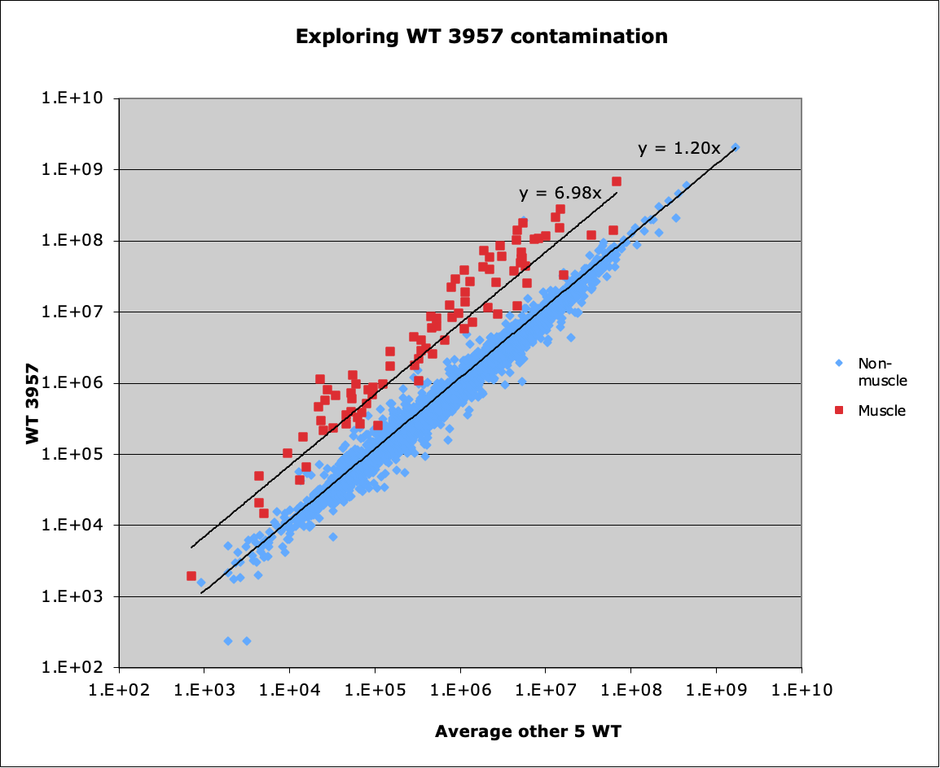
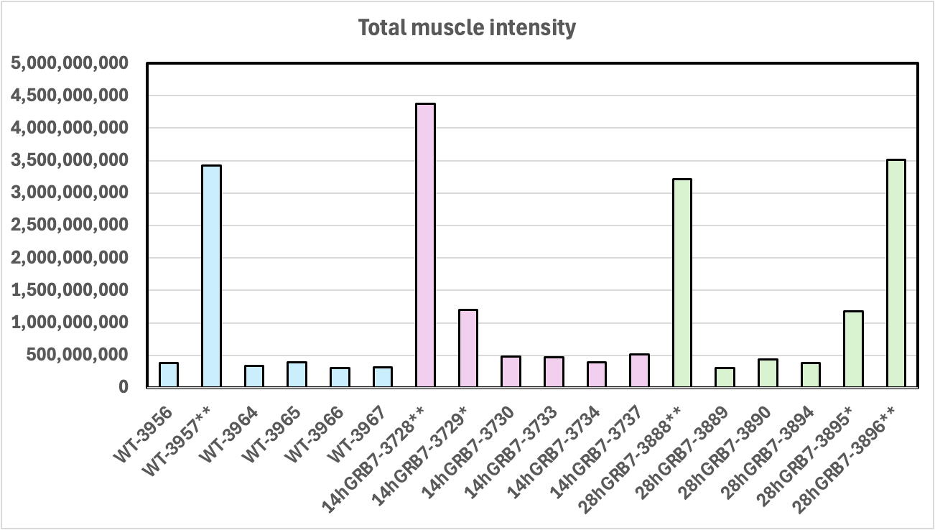
88 muscle proteins in several samples
Notes:
The total intensity of the 88 muscle proteins in combination with all the other QC evidence, clearly shows that the 4 proteins that cluster on the left side of the MDS plot have high levels of muscle contamination. The 2 proteins in the center of the cluster plot have lower muscle contamination levels but are still distinguishable from non-contaminated samples. The scatter plot on the right has the 88 muscle proteins highlighted in red. The WT-3957 intensities are the y-axis values. The x-axis values are the average of the other 5 WT samples. The muscle proteins are clearly the second proteome in the QC notebook sample-to-sample scatter plots. Note that these proteins are also present in the mammy gland cells because the points fall on a diagonal trend line rather than along the y-axes. These 88 proteins are probably a subset of the contaminating muscle proteome.

Slide 6
What to do about contamination?
There are two choices:
Exclude samples that have high contamination levels
Exclude proteins associated with contaminant proteome
Excluding samples seems better for this experiment
Relatively small number of contaminated samples per biological group
Groups after exclusion of contaminated samples have sufficient replicate number for statistical testing
Notes:
Doing an experiment over with cleaner sample collection that eliminates the second proteome contamination is, surprisingly, seldom the first choice to fix this problem. The first choice is to invoke some sort of software magic that fixes everything. That must be the “silk purse from a sow’s ear” package that I could not get to install. There are two choices if you do not want to redo the experiment: exclude samples or exclude proteins. Of the two strategies (excluding samples with high muscle content or trying to define a list of muscle proteins to exclude from quantitative analysis), dropping samples may be safer for this experiment. The replicate numbers per biological group after dropping samples would still be sufficient for statistical testing.

Slide 7
Example 2: Mouse aorta samples
Mice had three genotypes at a few ages
Difficult tissue to process
Samples had blood and were washed thoroughly three times before homogenization
Major blood proteins were still present
Other proteins also seemed inconsistent across samples
Notes:
Another recent project’s data analysis was started, and similar contaminating proteome evidence was observed in the QC notebooks for the TMT-labeled samples. The project involves mouse aorta tissue. There are 3 genotypes and some different ages of mice. There are several biological groups with variable (generally low) numbers of replicates. Aorta is a very difficult tissue to homogenize, and blood is always present in heart/aorta tissue. Tissue samples were washed to remove blood before homogenization and digestion. The tissue homogenization involves aggressive bead beating. Hemoglobins, albumin, other major blood proteins (Sigma top 20 list), and many immunoglobulin proteins were detected indicating that blood was present in the samples. However, there seemed to be many additional proteins and protein families that were variable between samples. This suggests that more than just blood might be involved in the contamination.

Slide 8
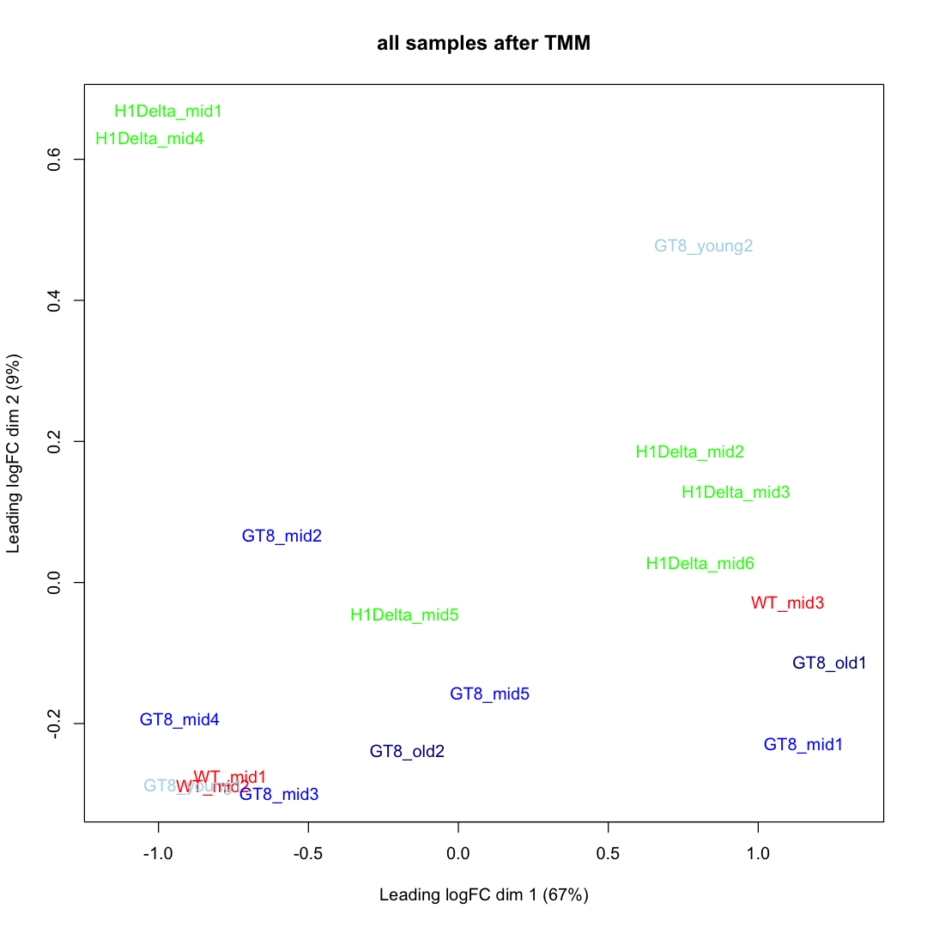
MDS clustering
Left Side Group
Right Side Group
Samples do not cluster by biological groups
8 samples are on left side
7 samples on right side
3 samples in the middle
X-axis distances seven times more important than Y-axis distances
Notes:
The biological groups are color coded, and the samples of the same color do not appear to cluster together. The x-axis dimension captures about 7 times more variance than the y-axis, so the left-side and right-side clustering is the dominant feature. To see what is different between the samples in the two cluster regions, the average intensities of the proteins for the left-side samples were computed and compared to the average intensities of the proteins from the right-side samples.

Slide 9
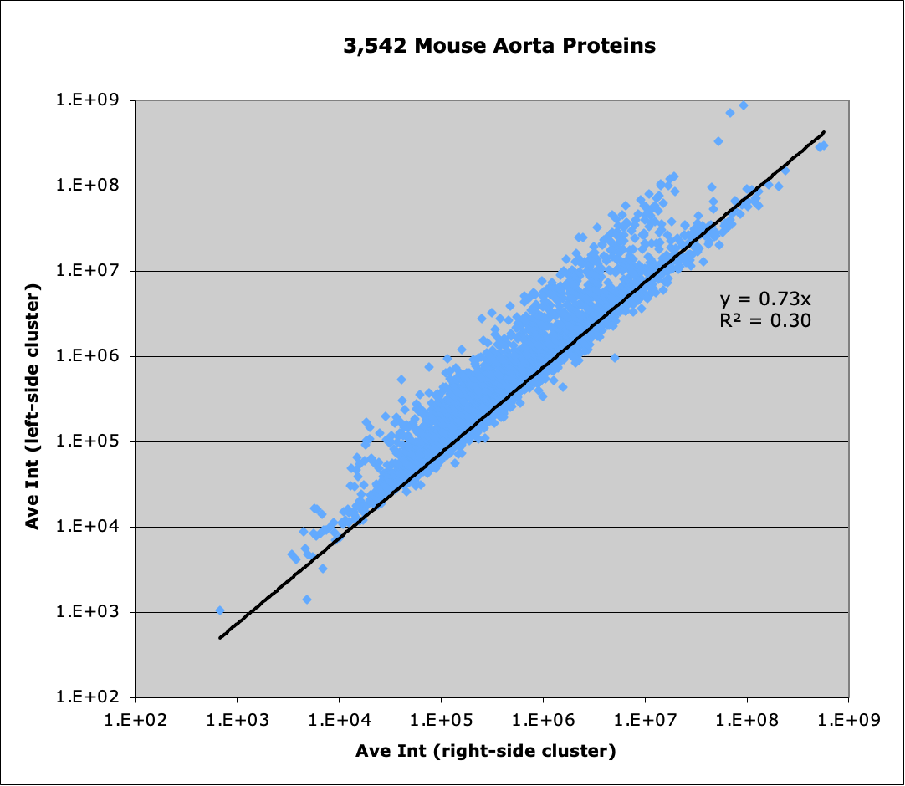
Average intensity by clustering side
Average of left-side samples –vs– right-side samples
Most proteins lie along black trend line
Other proteins lie along a second trend line
Other proteome is more abundant in left-side samples
Other Proteome
Main Proteome
Notes:
The scatter plots of TMT intensities in these types of TMT experiments should fall along a single trend line, and they typically have correlation coefficients close to 1. These scatter plot may also have a small number of proteins off the diagonal trend line (DE candidates) and proteins at lower intensity may have more dispersion. This scatter plot has a fork-like appearance for the most abundant proteins suggesting a superposition of more than one proteome. The very low correlation coefficient of 0.3 for the black trend line is very unusual. The density of points in these plots can be deceptive. There are over 3,500 proteins and most of them are associated with the black trend line.

Slide 10
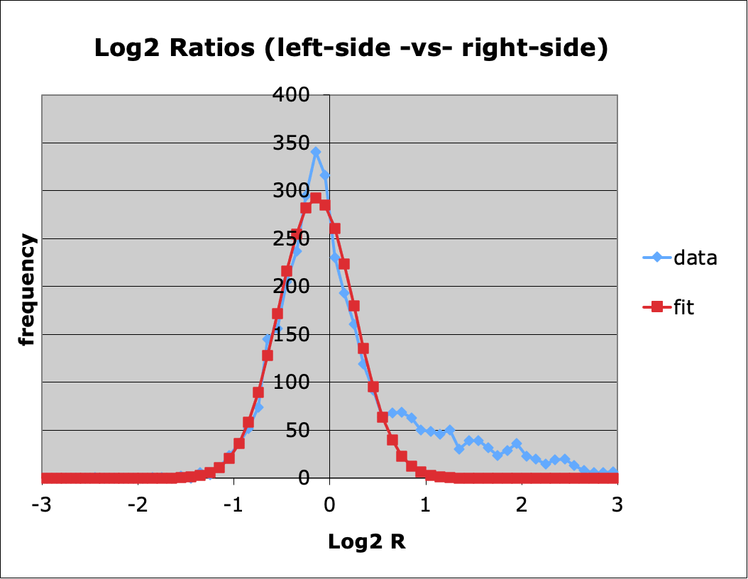
Identifying proteins in “other” proteome
Contaminants add intensity
Positive fold change cutoff of 2-fold excludes main proteome
Proteins more than 2-fold up come from the other proteome
Categorize major blood proteins and other families
Other Proteome Cutoff
Notes:
The distribution of protein abundance ratios also have typical patterns in these experiments. The frequency histogram of the log2 of the ratios is usually a single Gaussian-like distribution centered at zero (if the normalization worked well). These experiments typically have mostly unchanged proteins with smaller numbers of DE candidates falling outside the main distribution. When comparing the average of the clustering left-side samples to the right-side samples, there is a large excess of positive fold-change proteins. The main distribution is a little to the left of center, and there should not be many “unchanged” proteins with log fold changes greater than 1 (2-fold change). Proteins with fold changes greater than 2-fold was used as the criteria to identify the contaminating proteome(s).

Slide 11
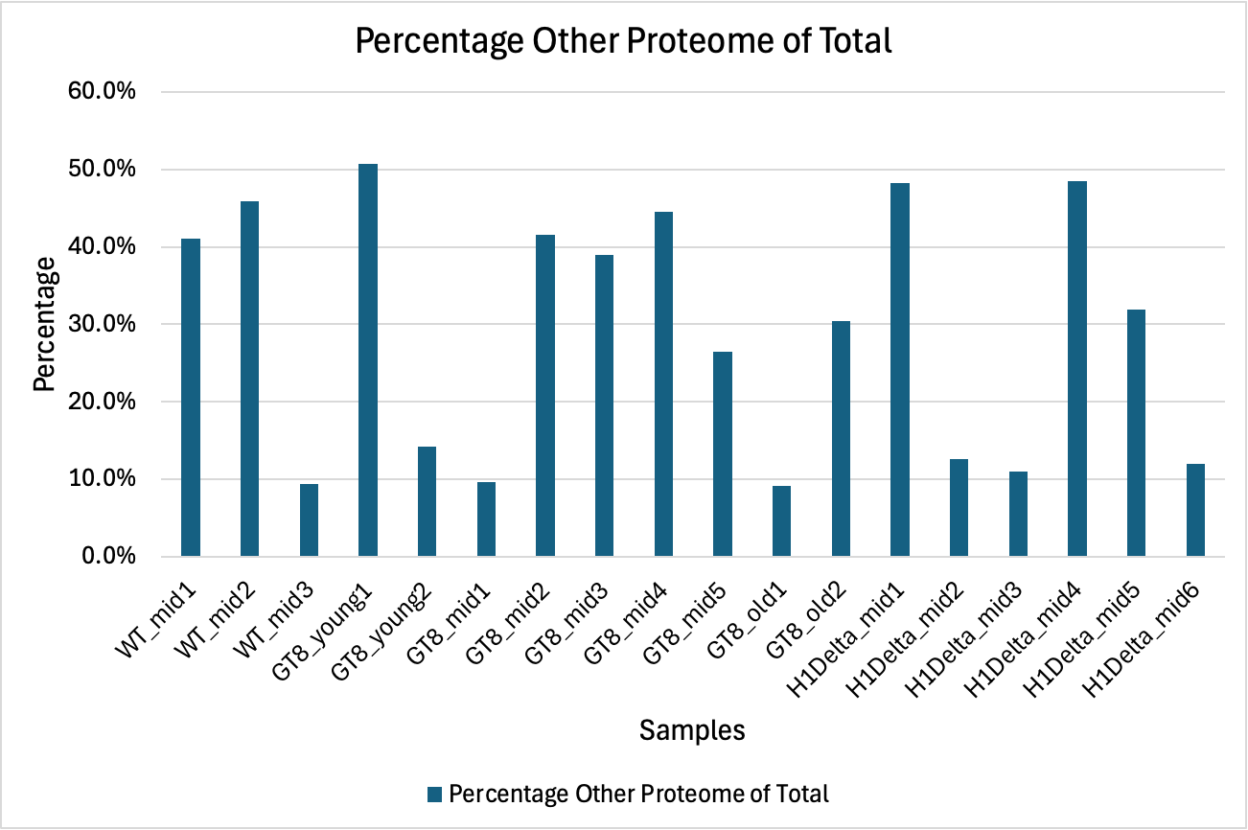
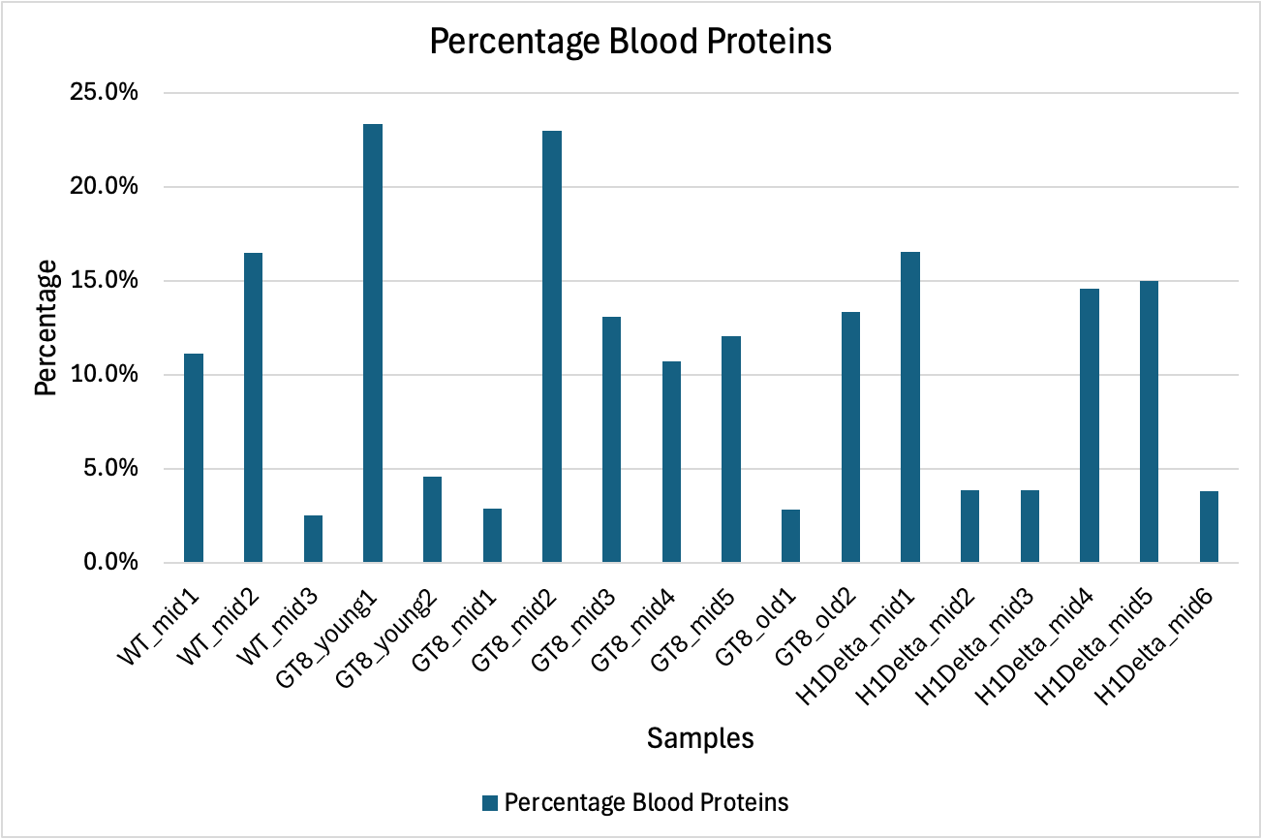
Eleven samples have higher levels of contamination, 7 have lower levels
Total intensity of 540 “other” proteins and intensities of major blood proteins are similar but not identical
Notes:
The fold change cutoff was used to identify 540 likely contaminant proteins. These proteins included the blood proteins (hemoglobins, albumin, and other top-20 serum proteins). The total intensity of the 540 proteins is quite large in 11 of 18 samples, and much lower in the other 7 samples. Blood proteins mostly tracked the high or low intensity pattern but also show some differences.

Slide 12
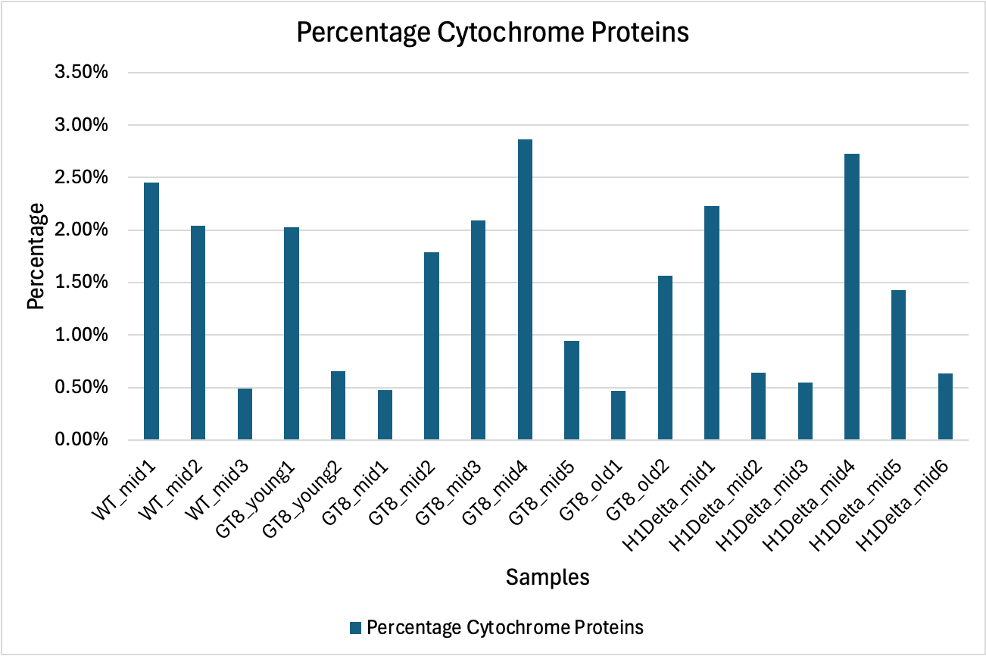
28 of 36 cytochrome proteins are elevated in “other” proteome
Notes:
There were many “cytochrome” proteins in the 3,542 identified proteins. They were highly enriched in the “other” proteome (28 of 36). The total intensities of the cytochrome proteins are much less than the total intensity of the 540 “other” proteins but have a very similar pattern across the samples. The “other” proteome and the main proteome can have some of the same proteins (but they could be at dramatically different relative abundances) or the proteins could be mostly distinct (nothing is ever 100% distinct in proteomics data). Individual proteins could be mostly one proteome, or mostly the other proteome, or any mixture in between. Separating mixed proteomes into distinct proteomes may be trivial or extremely challenging. Ever sample and every proteome seems to be different. There are no safe and/or general assumptions that will hold.

Slide 13
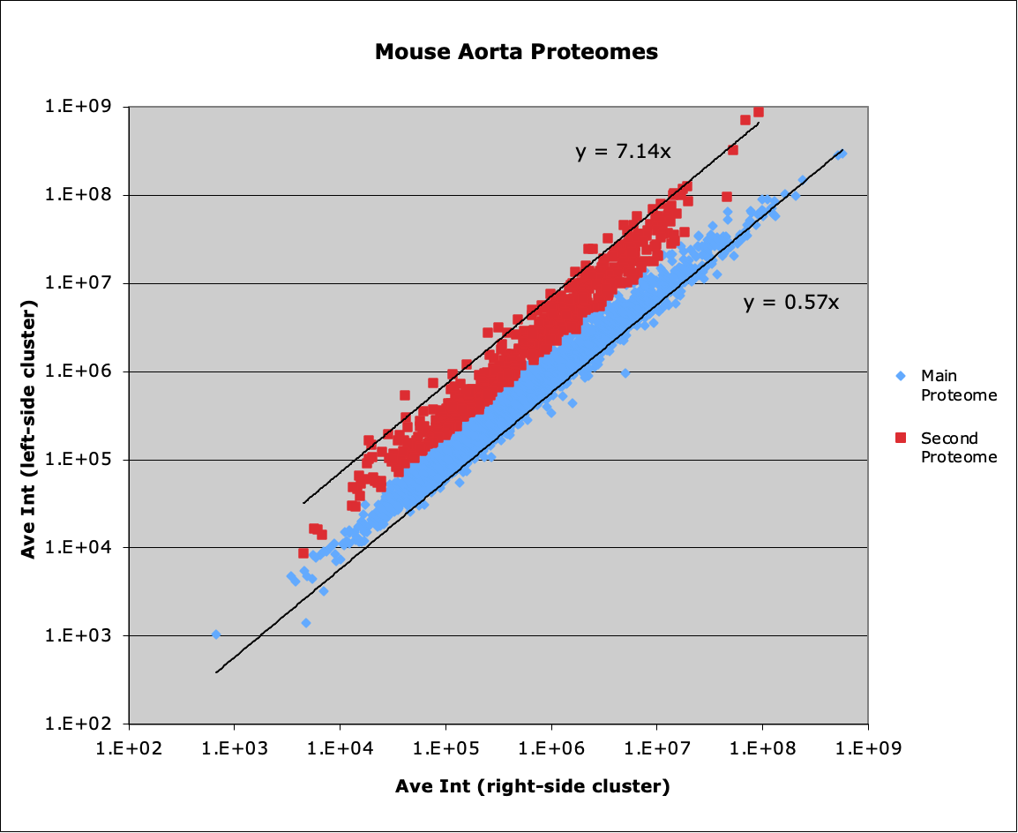
Two proteomes
“other” proteome in red
Main proteome in blue
Presence of ”other” proteome affects normalizations
Source of ”other” proteome(s) has not been determined yet
540 Proteins
3,002 Proteins
Notes:
This project’s analysis was just started. The main proteome and the other proteome are not distinct (non-overlapping) sets of proteins. Any “other” protein not present in the main proteome should lie along the y-axis, not fall along a diagonal. It is important to point out that the nature of TMT tags do not allow very good measurements of zero intensity. It is not clear if samples with “other” proteome can be used or need to be excluded. The presence of the “other” proteome severely affects normalizations and statistical testing results.
Note that the arbitrary grouping of samples by which side of the MDS cluster plot they come from is what is being shown here. This is to find the proteins (that are present in both proteomes) that have the highest levels of contamination. The true biological samples are different. The caution here is that more proteins than the 540 red proteins could have contaminant intensity and that may affect the statistical testing (false positives and negatives). The left-side versus right-side comparison find the subset of proteins with the highest contamination levels.

Slide 14
What to do about contamination?
Excluding proteins from “other” proteome seems better here
Too many contaminated samples per biological group
Groups after exclusion of contaminated samples would have insufficient replicate number for statistical testing
Other and main proteomes may have significant protein overlap
Proteins with high levels of contamination can be identified but lower levels of contamination could still distort results
Notes:
The strategy of excluding a moderate list of proteins (540-ish) most likely to be associated with the contaminant proteome looks better for this experiment. There are many biological groups and more than 50% of the samples have likely contamination. Most biological groups have contaminated samples. Excluding those samples would leave too few samples per group for statistical analyses. Proteins associated with the other proteome can be identified using the MDs clustering categorization. Excluding several hundred proteins will have consequences. Many of those proteins are probably present in both the main aorta proteome and in the contaminating proteome and could be of biological interest. There may also be other proteins that have smaller levels of contamination that is still high enough to create false positive or false negative statistical testing results.

Slide 15
Other experiments where this can be seen
Tear samples and stimulated tearing
Lacrimal gland output (400 or so abundant proteins) creates stimulated tearing
Stimulated tearing severely distorts the tear proteome (no easy fix)
Need to collect samples without stimulating tearing
Saliva samples
Parotid gland output dramatically increases with stimulation (chewing, citric acid on tongue, etc.)
Increased parotid gland output distorts the saliva proteome
Also need to collect samples without stimulation
Notes:
Bio fluids are another type of sample where the concept of contaminant proteomes can be seen. Tears and saliva are of interest as less invasive bio fluids to collect (compared to blood) for systemic health/disease monitoring. Tears are a mixture of lacrimal gland secretions and proteins from other eye orbit sources. The lacrimal gland proteome is several hundred proteins, and the lacrimal gland output can be very dynamic (watching a sad movie, chopping onions, getting something irritating in your eye, etc.). Dramatic increases in the lacrimal gland output will severely distort the tear proteome. Protocols to collect basal (unstimulated) tears are very important for tear studies to have any validity.
Saliva also has complications with unstimulated saliva and stimulated saliva. The parotid gland has watery secretions with tons of amylase, and its output is stimulated by the mechanical pressure of chewing or by acids in foods (citric acid on the tongue is the classic way to stimulate parotid secretion). Stimulated saliva and unstimulated saliva have very different compositions. It takes considerable time and effort to learn how to collect bio fluids in ways that facilitate proteomic studies. You do not just collect some tears or saliva and run it on the instrument.

Slide 16
Proteome information is essential
Define proteome as list of proteins and relative abundances within a sample
Scatter plots with proteins spread out over wide ranges of relative abundance and relative abundances of groups of proteins are essential for proper quality control
Identifying and understanding contaminant proteomes can be used to exclude samples and/or improve future sample prep
There are many biological uses of properly summarized whole proteome relative abundance data
Notes:
Identifying potential contaminating proteomes in samples is one of many biologically relevant ways that whole proteome information can be used. Summarizing protein abundance measurements (MS1 feature intensities, TMT reporter ion intensities, fragment ion intensity weighted spectral counts, DIA intensities, etc.) to create whole proteome information is extremely valuable. It enables a rich variety of quality control metrics to be computed. Abundances of common contaminants can be tracked across samples to assess the quality of sample processing. Potential contaminating tissue proteomes can be identified. Total abundances of groups of proteins (families like immunoglobulin or cytochrome proteins, for example) can be compared between samples. There are other important biological information in proteome summarizations. This is your opportunity to learn about the proteome you are studying. Is the proteome you are measuring a good representation of what previous studies have shown? Did you use a FASTA file that had the proteins you expected to be in your proteome? Did you mistakenly use a fully tryptic search for bio fluid samples (which have many semi-tryptic peptides)? Do you need to redo some upstream data processing steps? Is the proteome dominated by a small number of highly abundant proteins or large numbers of intermediate abundance proteins? The characteristics of the proteome under study can have profound implications for normalization and statistical testing strategies. Have you determined some robust criteria for peptide/protein identification and some way to determine a workable limit of quantitation? (Hint: if you are imputing data, you are probably doing something wrong.) The proteomics field has had the capability to generate proteome information for many years. Maybe it time to finally make use of it?

