Slide 1
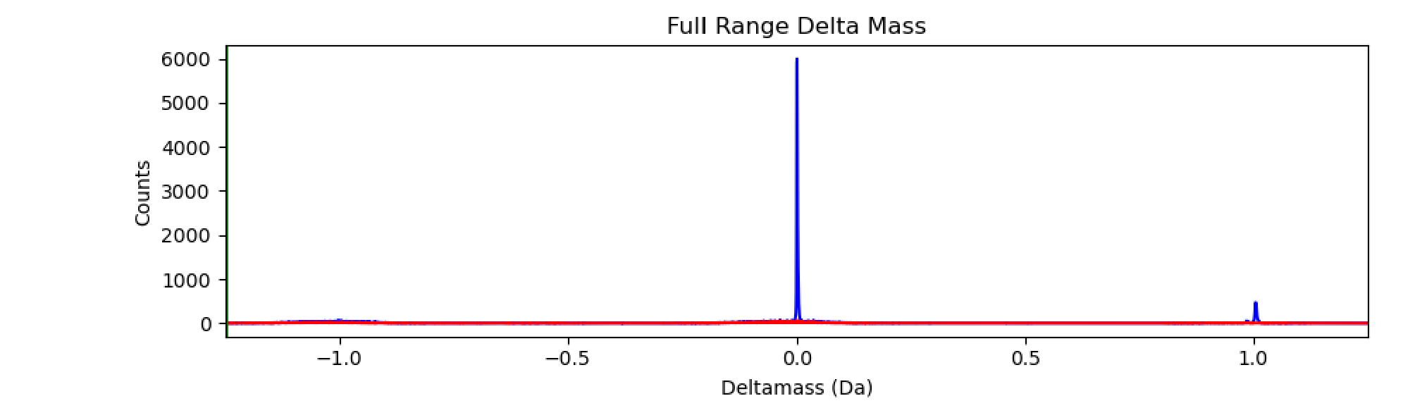
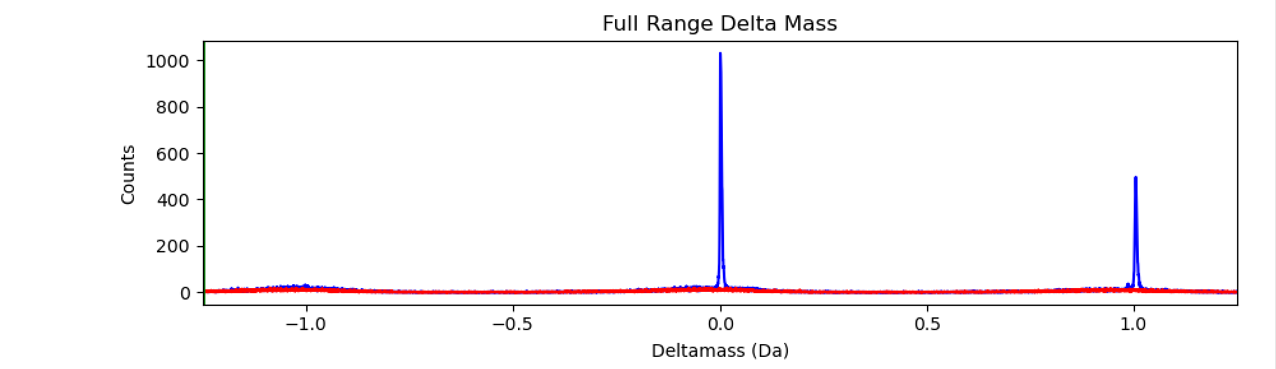
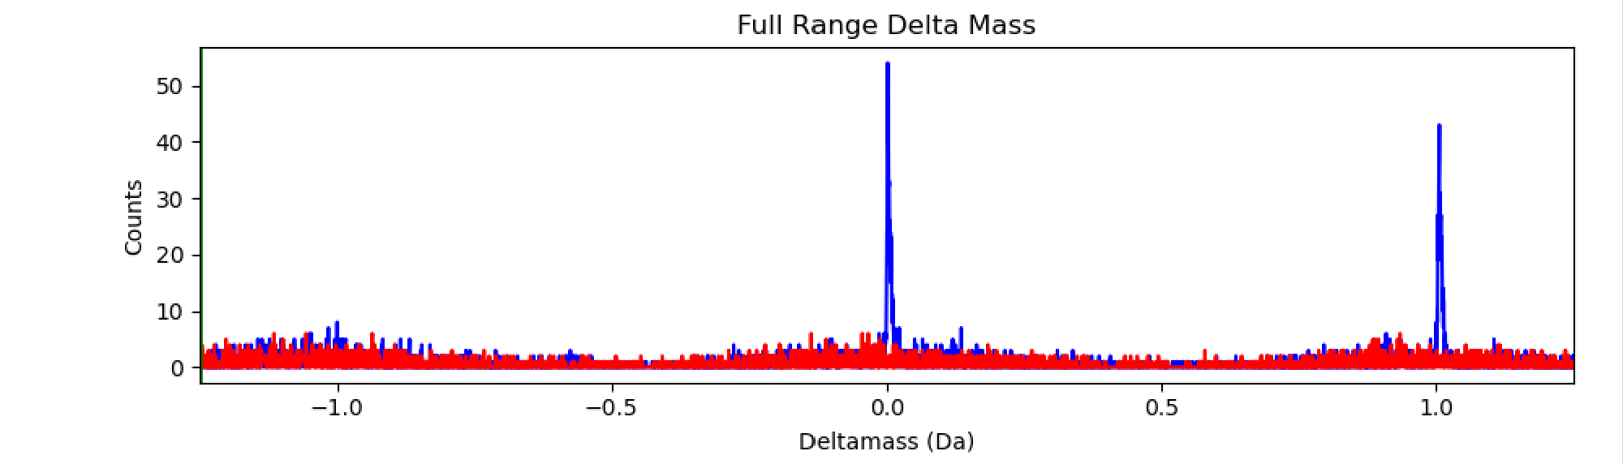
2+ (1.25 Da)
37245 PSMs
0-Da
M1
(15%)
3+ (1.25 Da)
18709 PSMs
0-Da
M1
(36%)
deamidation
0-Da
M1 (46%)
4+ (1.25 Da)
1232 PSMs

Slide 2
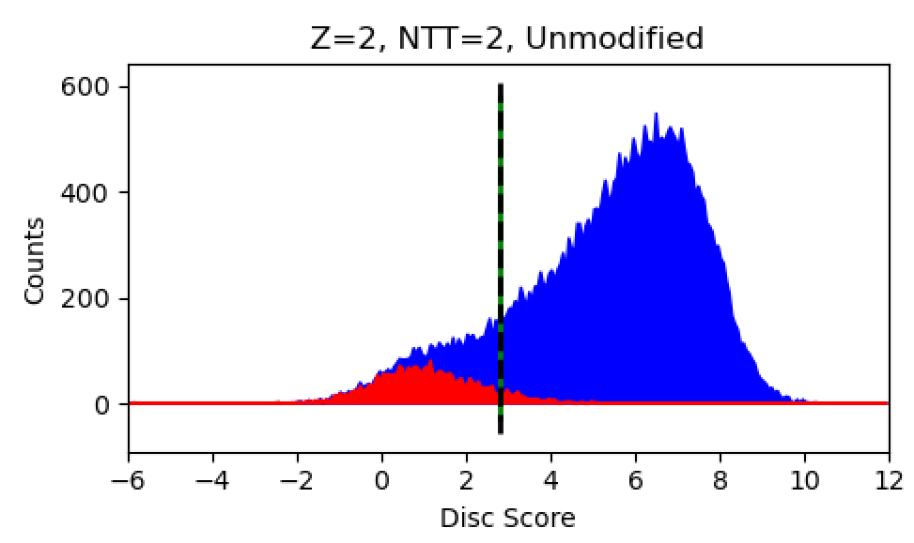
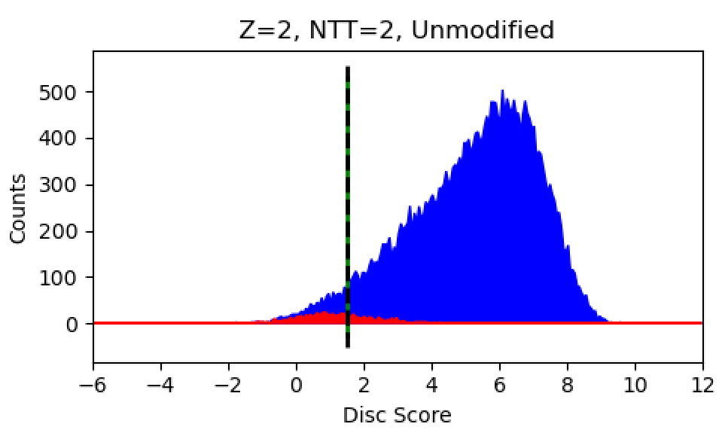
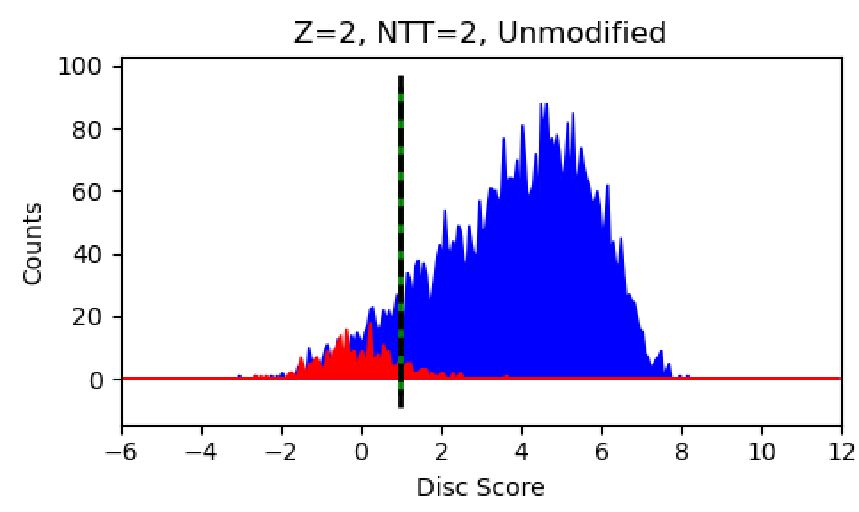
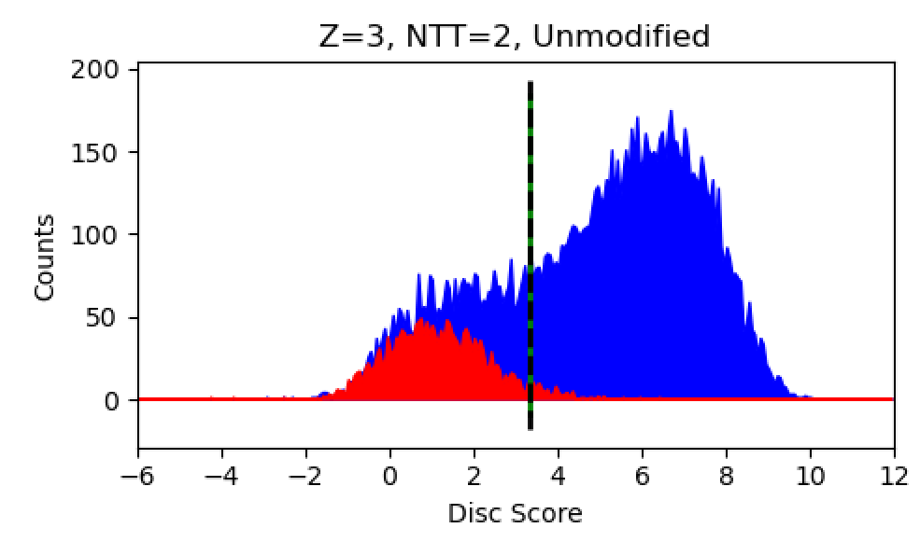
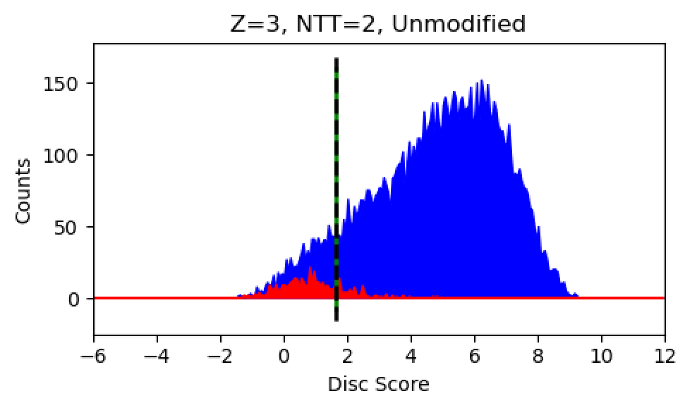
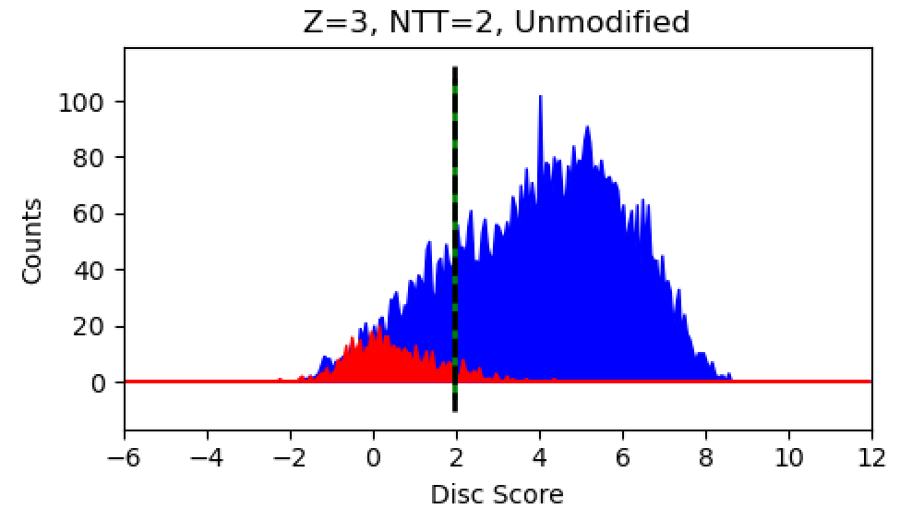
2+
30255
2+
29488
2+
4678
50 PPM
1.25 Da: 0-Da peak
1.25 Da: 1-Da peaks
3+
9486
3+
9636
3+
5034

Slide 3
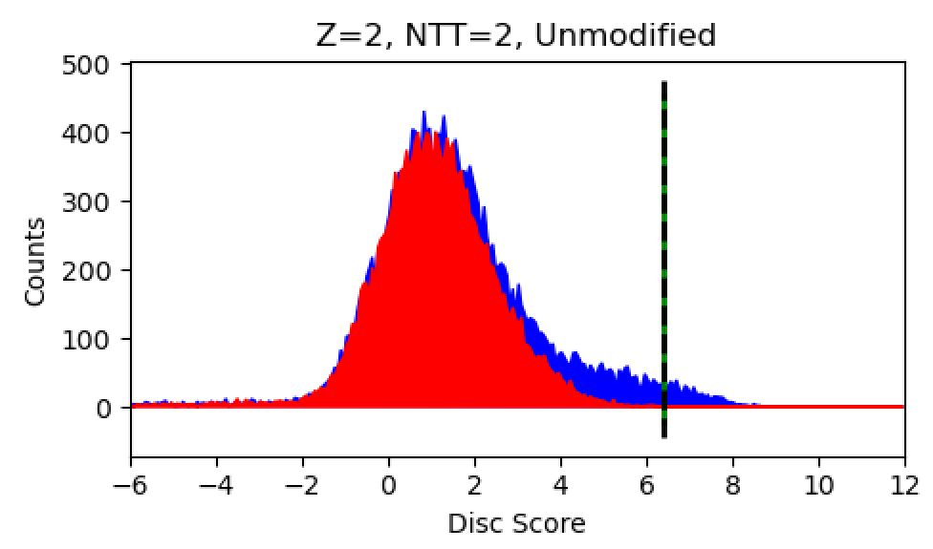
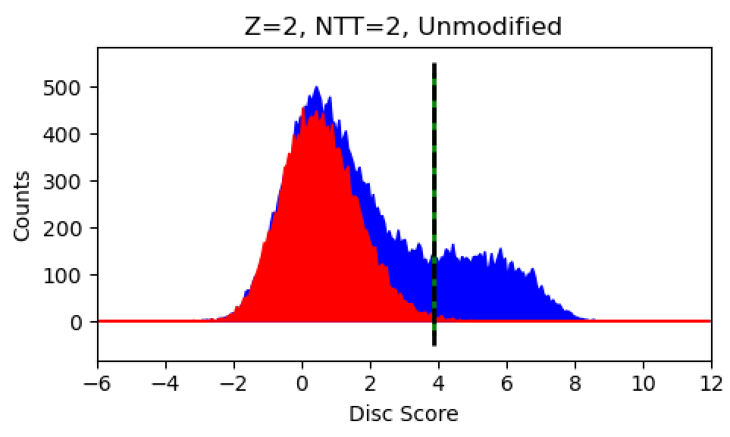
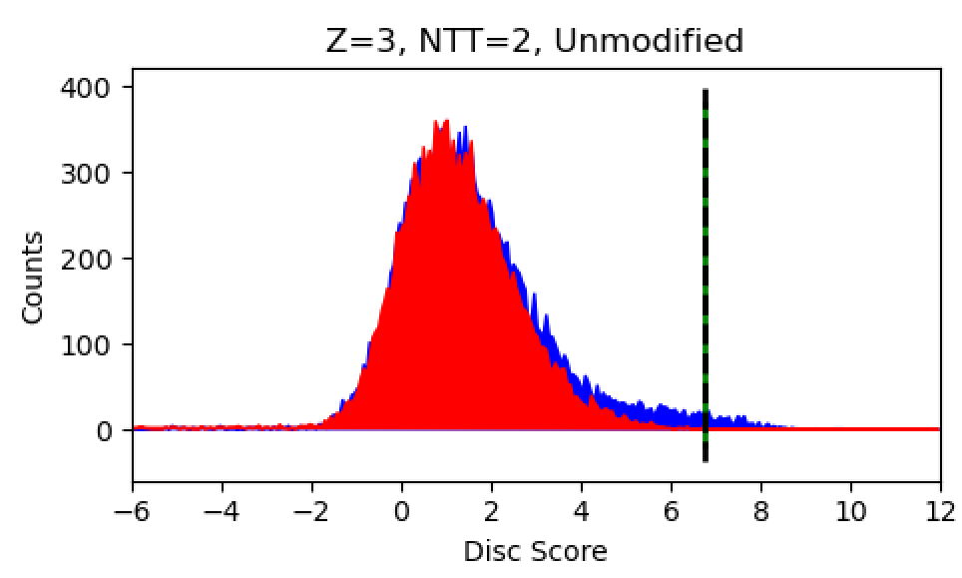
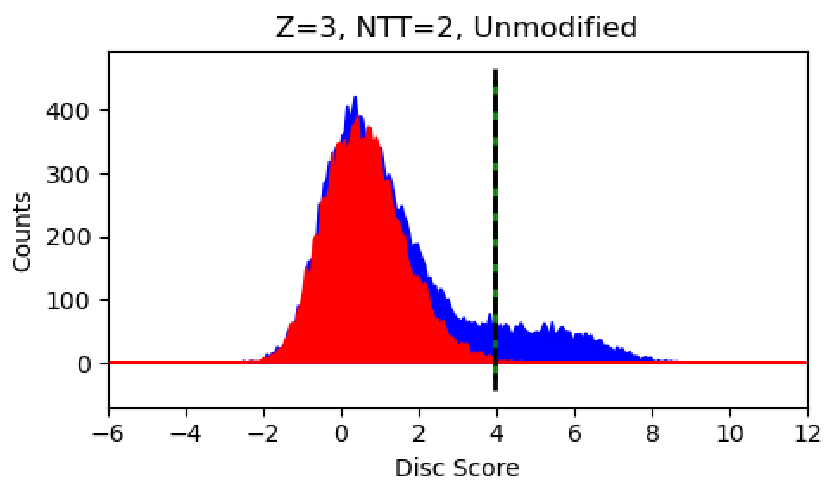
2+
2+
6402
599
50 PPM, outside windows
1.25 Da, outside windows
3+
3+
2332
253

