Slide 1









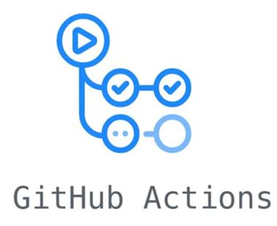
Retrigger fine-tuning
Model
sweep
Saved on
Save requests
dev
Connects Model + Data
Triggers
user
Trigger on success
Deploy container
Send Request

