Slide 1

Raw-image Compression

Slide 2

Problem Statement
Design a software module that takes a raw image file as input and converts it into a compressed image format such as JPEG or PNG. The module should be able to handle various image resolutions and color depths.

Slide 3
Objective
File Size Reduction
Image Quality Preservation
Format Compatibility
Processing Speed
Metadata Retention

Slide 4
Methodology
Project
Setup
Select
Libraries
Design
Application
Develop
Maintain
Deploy
Optimize
&
Test

Slide 5
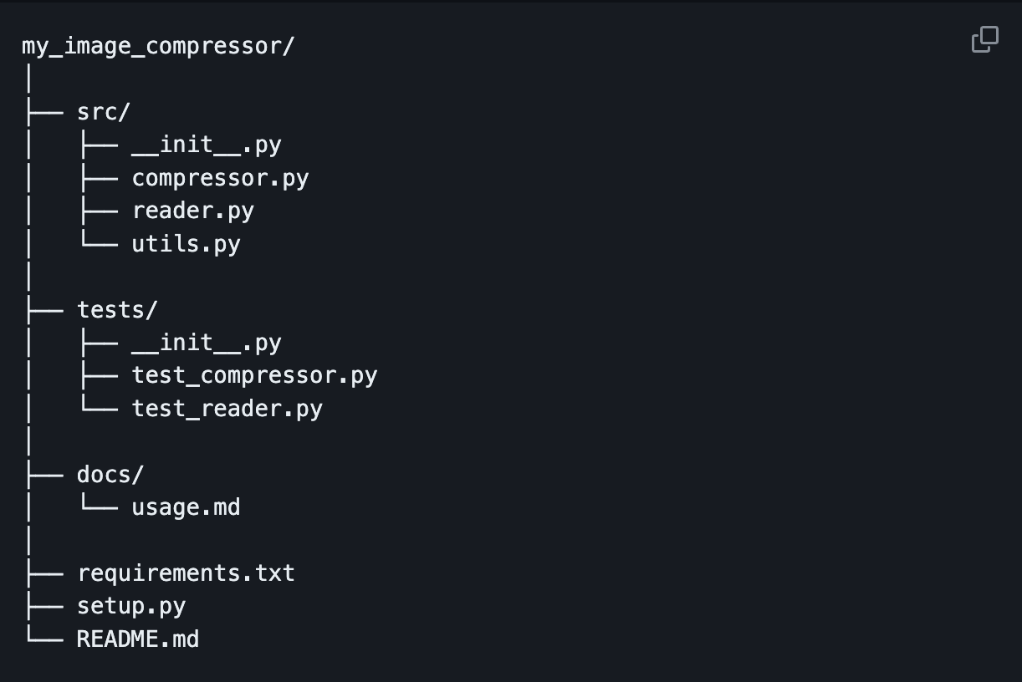
Implementation

Slide 6

Thank you
Paul Jensen, Aaron Feinberg and Israel Coleman

