Slide 1

Assignment on
Dynamic SVG Game

Slide 2

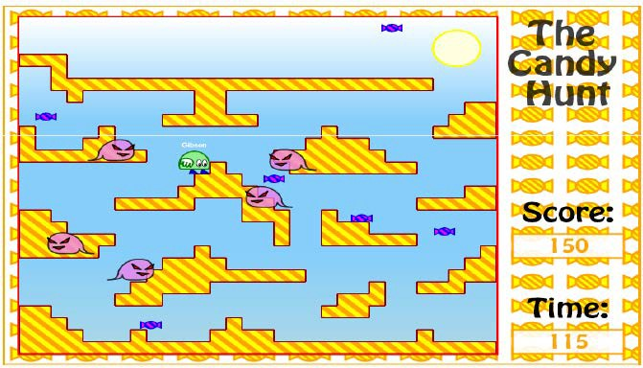

Slide 3
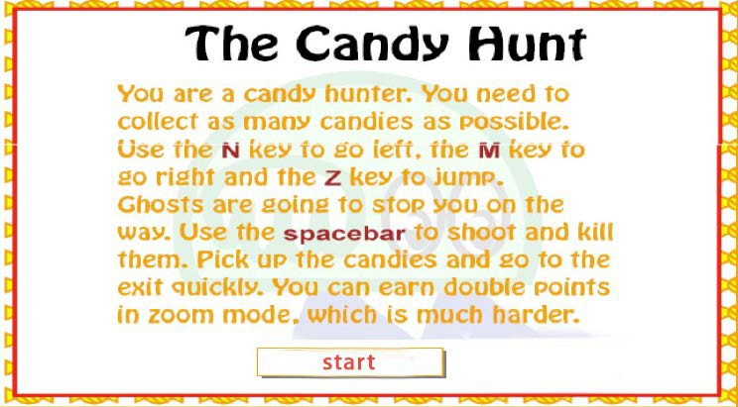
Include your Name and last four digits of your student (e.g. xxxx1234) when in the start-up screen

Slide 4
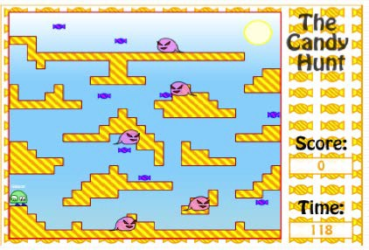
After user clicks the start button

Slide 5

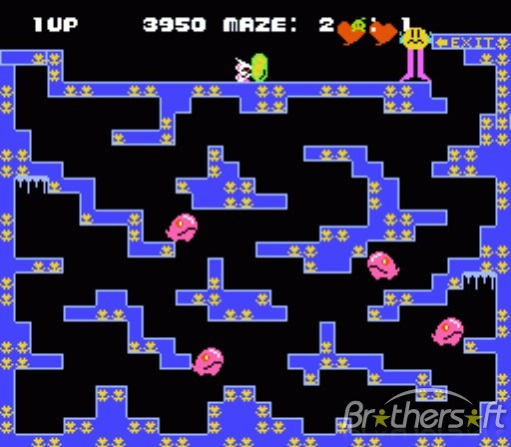
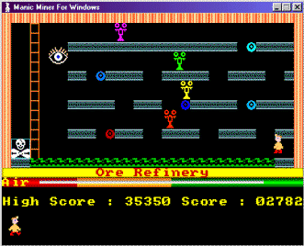
Chack’n Pop, from 1983 Manic miner, from the 1980’s
You can get ideas for your platform game arrangement by looking at other platform games available on the Internet

Slide 6
After the game starts, the ‘time left’ will start from 60 seconds
The ‘time left’ will be reduced by 1 every second
The player needs to reach a particular exit point (i.e. an exit) before the time becomes zero
If the time runs out before the player reaches the exit point, the player dies
If the player reaches the exit before the time runs out, the remaining time is added to the player’s score

Slide 7
Platforms
To get to the exit point, the player has to walk/jump on several platforms
Good things
There are good things near the platforms; when the player gets one he/she increases the score
The player has to collect all the good things before he/she can finish the level i.e. get them before going to the exit
Monsters
Monsters appear in random places; the player dies if it touches one
The player can shoot the monsters to get more scores

Slide 8

Use these keys in your game (different from the settings used in the labs):
w – jump
a – left
d – right
h – shoot

Slide 9

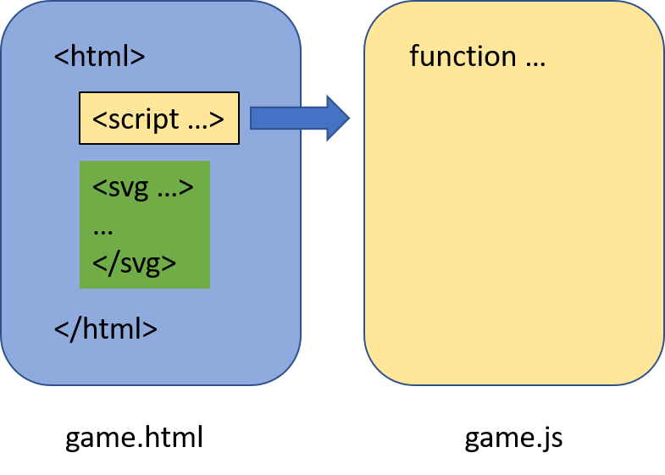
Use the same file arrangement as in the labs
Use SVG to implement all the interfaces (you can use prompt() for name input)

Slide 10

Open the game’s HTML webpage directly

Slide 11

Starting Screen
Handling of Player
Handling of Monsters
Handling of Good Things
Platforms
Transmission Portal
Shooting
Sound
7%
10%
12%
6%
9%
4%
9%
5%

Slide 12

Time Remaining
Level Handling
Game Quality
Score Update and Display
End of Game
4%
6%
8%
4%
8%
Handling High Score Table 8%
Total Mark = 100%

Slide 13
Game engine/ basic requirements No logical/ procedural errors Appropriate collision detection Correct jumping/walking behavior
Deductions for any use of bitmap images in the game Everything stored in the DOM
…and so on
Marks will be deducted for any problems encountered

Slide 14

The game area (where the game is taking place) has a size of 800 pixels by 600 pixels.
This is the same as the game we have in the lab.
You can change the background pattern as you like, but the platforms (except the color) should be consistent with the game we have in the lab.

Slide 15
Starting Screen 7%
When the SVG starts you need to give the player some information
● +2 Include the title of the game and your name. Give a general introduction to the game and tell the player what he/she needs to do
● +2 Say what keys the user needs to press to play the game (left/right/jump/shoot)
● +3 Display the start button and game only starts after clicking the start button
You can add anything else appropriate

Slide 16
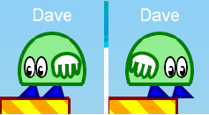
 +3 marks – ‘Flip’ player when move left/ right
 +3 marks – The player can jump/ move left/ move right/ shoot on any platform
 +2 marks – The player name is appropriately shown at the top of the player (as shown above) , with ‘Anonymous’ used as the name if the user enters an empty string
 +2 marks – The player dies if it touches any monster or is shot by a bullet.
Please use the SVG File we provided

Slide 17

There must be at least 6 monsters
The monsters can all look the same, if you want
● +2 marks – Some appropriate animation of monsters (using any SVG animation command(s)
● +2 marks – The monsters appear at random places at the start of the game but must not be very close to the player
● +2 marks – The monsters move smoothly from one random location to another random location during the game
● +3 marks – ‘Flip’ monster when move left/ right
● +3 marks – Exactly one special monster can shoot bullet; at any time, at most one bullet can be shot in the same game window.
Please use the SVG File we provided

Slide 18

There must be at least 8 good things in the game
+1 marks – The good things are generated at random places at the start of the game
+1 marks – The good things cannot appear within a platform, i.e. they should not overlap with any platforms
+2 marks – The player collects the good things by touching them. The collected good things are deleted from the DOM
+2 marks – The player needs to collect all good things before he/she can go to the next level
Please use the SVG File we provided

Slide 19

 +4 marks – There are one ‘vertical’ platform (platforms that move up and down in the y axis)
Notes:
“Vertical” means that this platform can move up and down in the y axis.

Slide 20
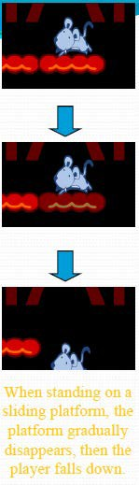
 +3 marks – There are three disappearing platforms. If the player stays on the disappearing platform after a certain period of time (i.e. 0.5 second), the disappearing platform will disappear and the player will fall down
 +2 marks – Good visual effect showing the disappearing platform is going to disappear (i.e. changing the opacity or the color)
After the platform has disappeared, it does not come back again.

Slide 21

 +2 marks – There should have two portals appeared on the screen (shape and location is freely defined).
 +2 marks – When player enters into one portal, it will appear at the position of another portal. (Positions of portals can be defined at will, e.g. upper-left and upper-right corners of the game interface)

Slide 22

Shooting 9%
 +3 marks – A player gets 8 bullets at the start of the game for each level and the number of remaining bullets is appropriately shown and updated in the GUI
 +3 marks –When facing left, the player shoots to the left (bullet is removed from DOM appropriately when it is off the screen on the left)
 +3 marks – When facing right, the player shoots to the right (bullet is removed from DOM appropriately when it is off the screen on the right)
 The SVG of the bullet is the same as the game we have in the lab

Slide 23

Use of sound
● +1 mark – Appropriate sound when the player shoots (shoot.mp3)
● +1 mark – Appropriate sound when the player reaches the exit point before the time runs out and successfully collects all the good things (win.mp3)
● +1 mark – Appropriate sound when the player dies (touches monster or runs out of time) (lose.mp3)
● +1 mark – Appropriate sound when a monster dies (is shot by the player) (kill.mp3)
● +1 mark – Appropriate continuous music during the game (bgm.mp3)

Slide 24



The player needs to reach the exit point within the specified time (See the "Basic Idea" slide)
The player will die if the player cannot reach the exit point within that time
 +4 marks - Time count down is updated and displayed appropriately every second (perhaps using a setInterval() )

Slide 25
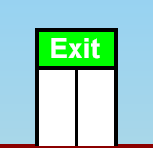

When the game first begins, it is level 1.
When the player reaches the exit point, the score from the remaining time is added and the game moves to the next level, which is harder (see other slides)
Don’t forget you have to collect all good things before you can finish the current level.
The upper limit of the level is 2.
+1 mark – Appropriate appearance of the exit (looks like an exit)
+2 marks – The current level is shown in the GUI, and is updated appropriately. It is incremented by one each time the player finishes a level and moves to the next level.
+3 marks – The game is correctly re-started when the next level is started (i.e. score continues and is not reset to zero, etc.)

Slide 26

How playable the game is
+8 marks – The game gets harder in level 2. This is achieved by adding four monsters per subsequent level. I.e. If level 1 starts with 6 monsters, then level 2 will start with 10 monsters (the player always starts with 8 bullets, whatever the level is)

Slide 27
 +1 Score is updated at the end of each level. Add L * 100 points for passing level L.
 +1 And also add X points for each second of remaining time, where you choose an appropriate value of X.
 +1 Score is updated when a monster is shot – add Y points when this happens, you choose an appropriate value of Y
 +1 Score is updated when a good thing is touched – add Z points when this happens, you choose the value of Z

Slide 28

If the player cannot reach the exit point during the required period of time, or touches a monster, or touches the bullets shot by the special monster, the player will die
+4 marks – Score & name are shown in a score table
+4 mark – Show a ‘Start again?’ button, if the player clicks on it the game begins again, and the user is asked for his/her name as usual, with the previously entered name used as the default text in the window (i.e. using prompt())

Slide 29
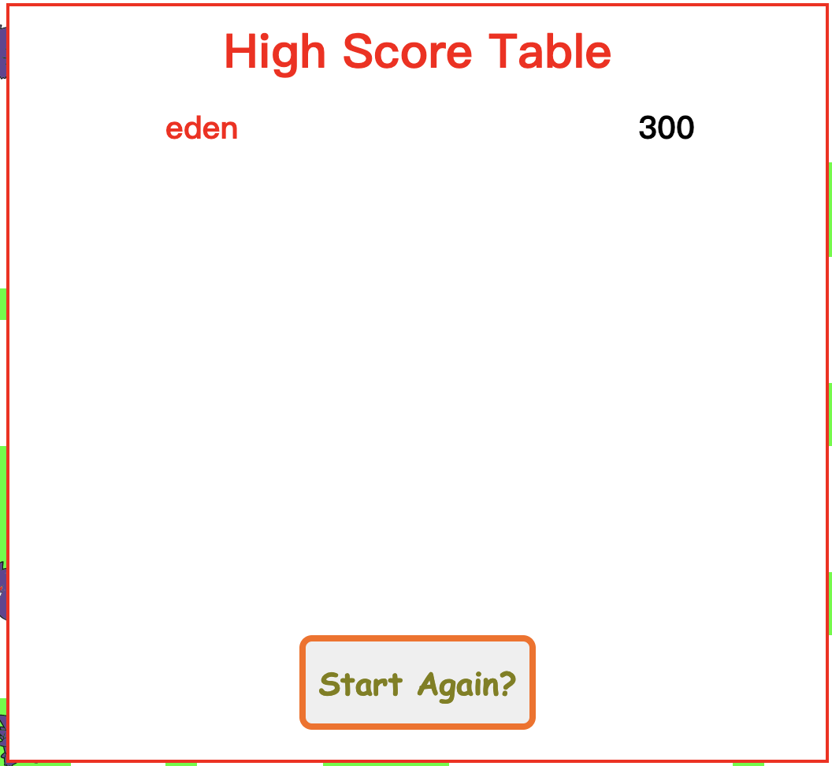
 +1 mark – Appropriate title is shown above the high score table i.e. ‘High Score Table’
 +4 mark – The score of the player is correctly shown in the table
 +3 marks – Show a ‘Start again?’ button, if the player clicks on it the game begins again
Example high score display

Slide 30

Make your project run on Chrome; if it runs on other browsers but not Chrome, 10 points will be deducted
You need to submit all the needed files and sounds
If you want to write any message to the marker, write them in a file called ” readme.txt “

Slide 31

Deadline: See Canvas comp 4021 -> Assignments
If you submit after the due date, your score will be penalized by 20% for each day after the due date.
Submissions are rejected 2 days after the due date.
Format of submissions
Put all the files into a single zip file.
Filename: StudentID_Name_svg_comp4021.zip

