Slide 1
The World’s Life Expectancy
Hypothesis: Life Expectancy of different countries is affected by variables such as: Pollution (CO2 emissions), GDP/person, % below Poverty line, Crime Index of the country, Healthcare Index of the country and Child Deaths per 1000.
Null Hypothesis: There is no correlation between Life Expectancy and each independent variable.

Slide 2

HELLO!
Group Members:
Tyler Fasulo
Luan Hajnaj
Paul Wolanski

Slide 3
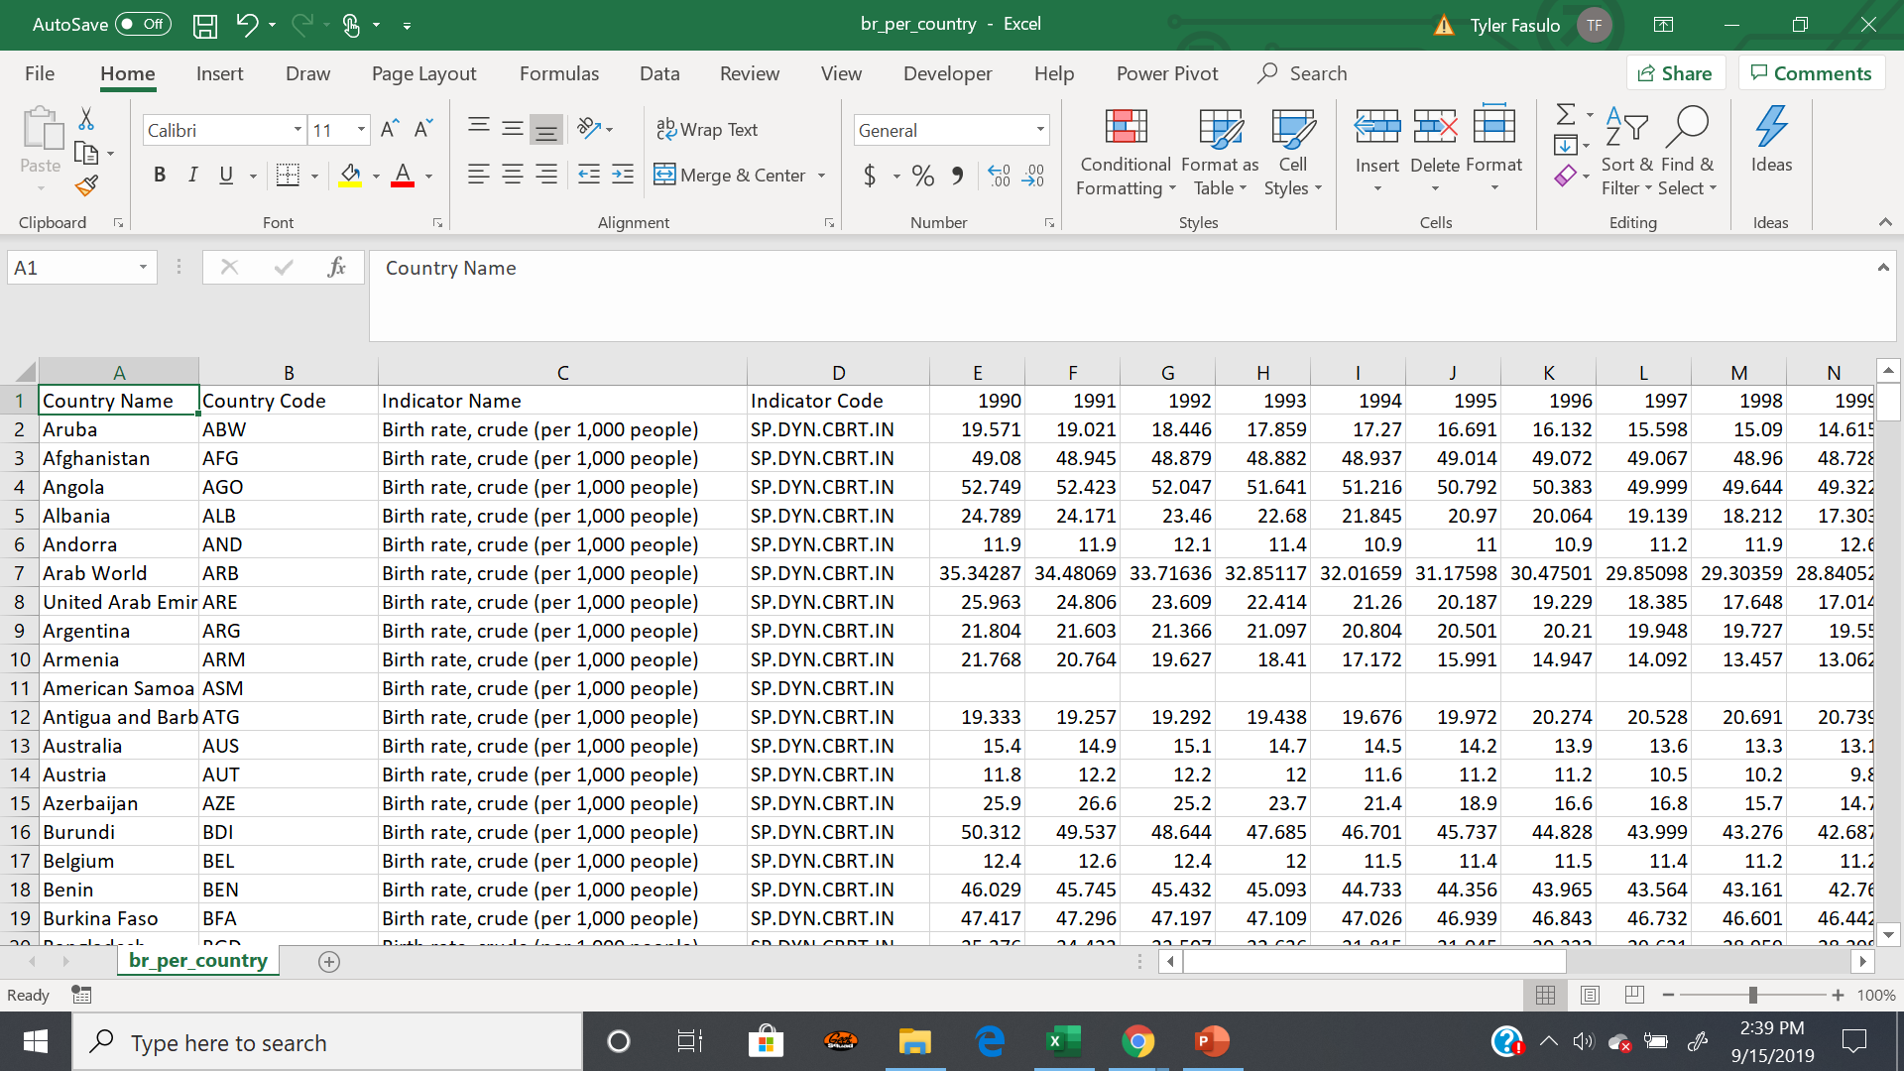
Data Mining from World Bank
Example

Slide 4
1.
WORLD BIRTH RATE AVERAGES
Birth rate, crude (per 1,000 people)

Slide 5
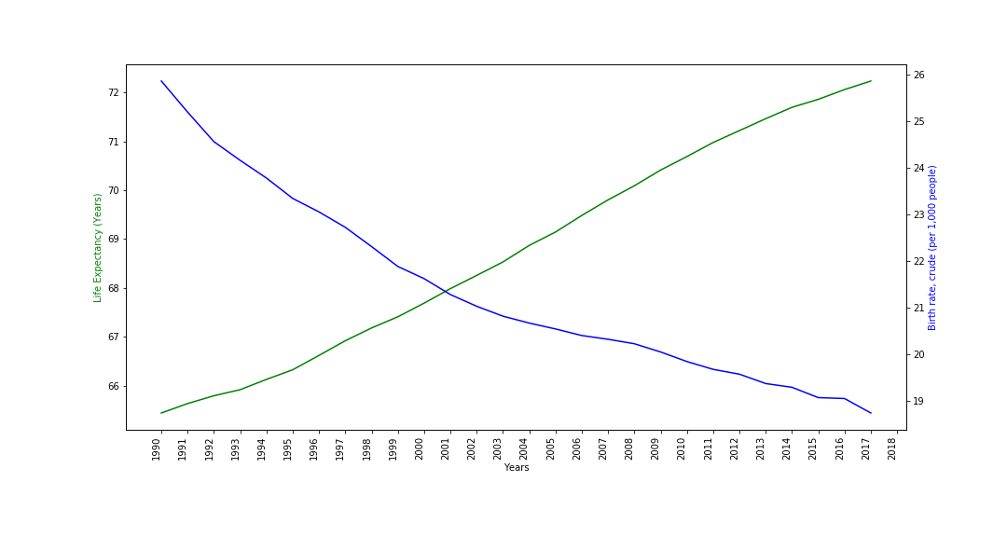
Birth Rate & Life Expectancy
R-Squared: 0.916443022728935
P-Value: 1.56169928862533E-15
Place your screenshot here

Slide 6
2.
WORLD DEATH RATE AVERAGES
Death rate, crude (per 1,000 people)

Slide 7
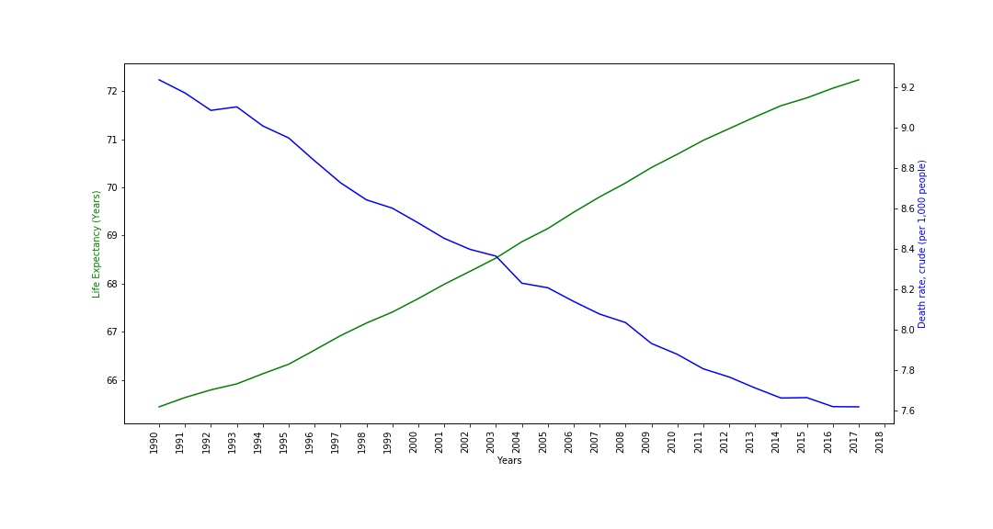
Death Rate & Life Expectancy
R-Squared: 0.988680085628955
P-Value: 2.12976706389872E-33
Place your screenshot here

Slide 8
3.
WORLD DEATH RATE CHILDREN UNDER 5
Deaths under 5 years old (per million)

Slide 9
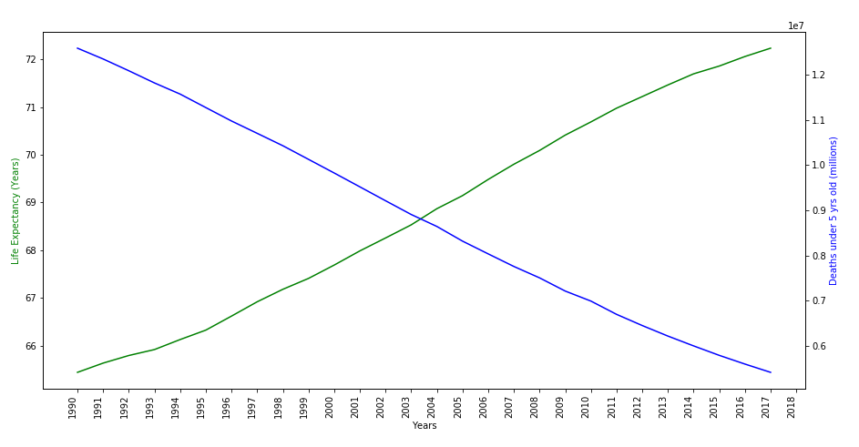
Death’s Under 5 & Life Expectancy
R-Squared: 0.996459814288680
P-Value: 7.80789625003750E-27
Place your screenshot here

Slide 10
4.
ACCESS TO ELECTRICITY
Access to electricity (% of population)

Slide 11
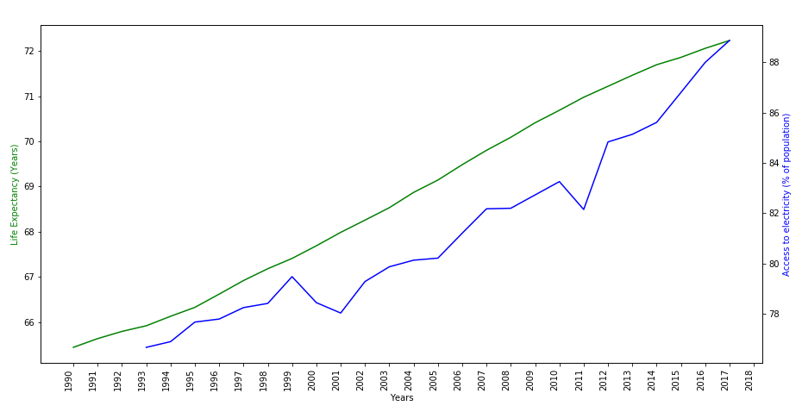
Access to Electricity & Life Expectancy
R-Squared: 0.916260309976558
P-Value: 7.03855446679479E-14
Place your screenshot here

Slide 12
5.
WORLD AVERAGE GDP
Gross Domestic Product (current US$)

Slide 13
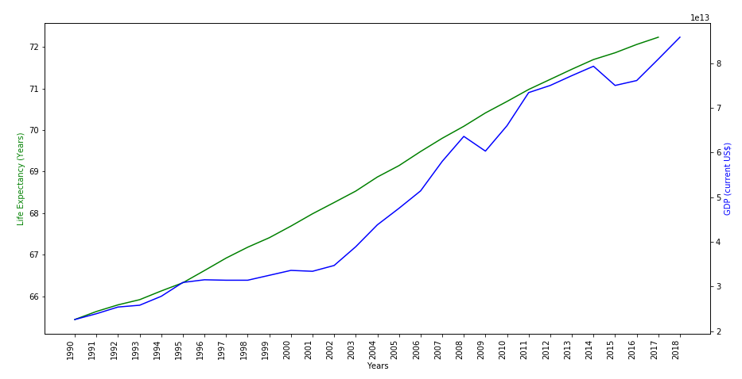
GDP & Life Expectancy
R-Squared: 0.954891955107018
P-Value: 5.06843130319356E-19
Place your screenshot here

Slide 14
6.
WORLD AVERAGE POLLUTION
CO2 emissions (metric tons per capita)

Slide 15
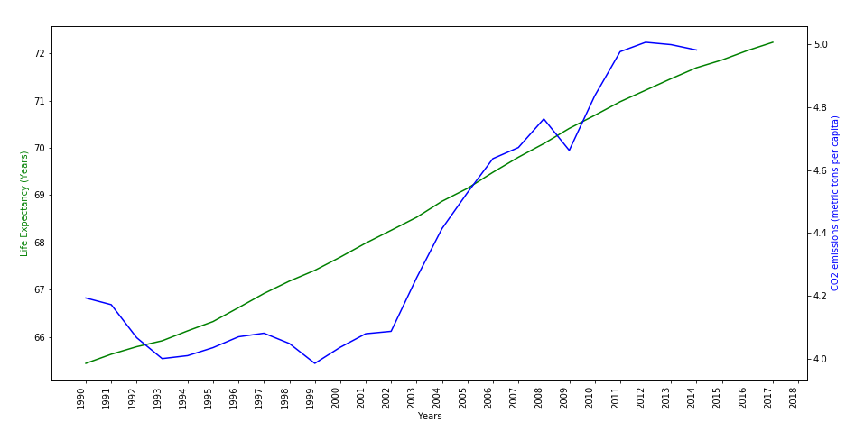
CO2 Emissions & Life Expectancy
R-Squared: 0.843862840857235
P-Value: 9.44890708619281E-11
Place your screenshot here

Slide 16
7.
UNDERNOURISHED POPULATION
Undernourished (% of population)

Slide 17
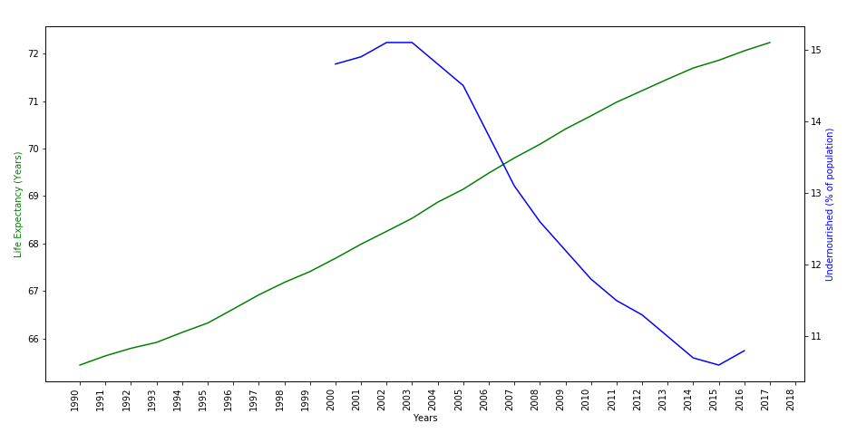
Undernourished & Life Expectancy
R-Squared: 0.953909647678448
P-Value: 1.96225905836121E-11
Place your screenshot here

Slide 18
8.
UNEMPLOYMENT
Percentage of total labor force

Slide 19
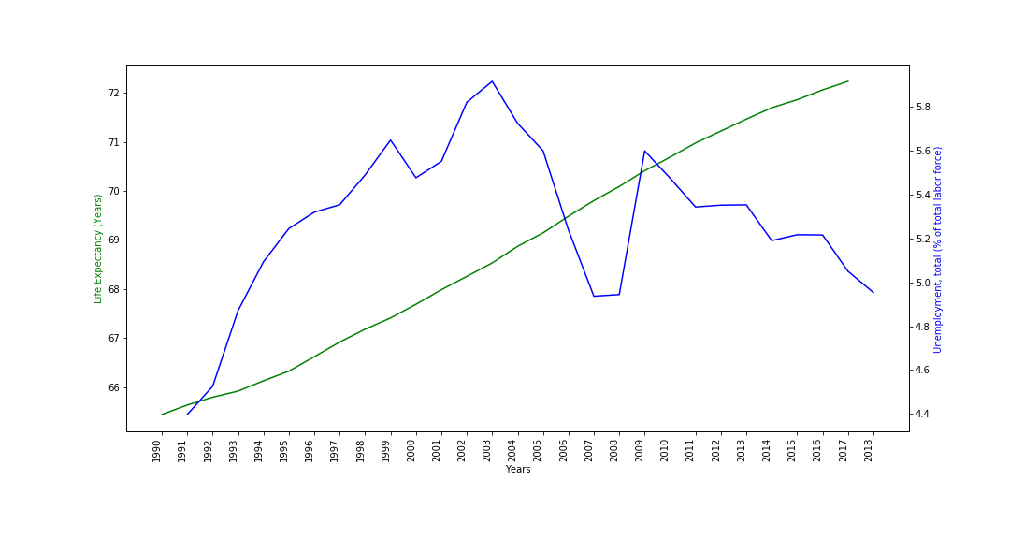
Unemployment & Life Expectancy
R-Squared: 0.014868609089310
P-Value: 0.536492571800191000
Place your screenshot here

Slide 20
Summary
 | R-Squared | P-Value
Deaths under 5 years old (millions) | 0.996459814288680 | 2.12976706389872E-33
Death rate, crude (per 1,000 people) | 0.988680085628955 | 7.80789625003750E-27
GDP (current US$) | 0.954891955107018 | 5.06843130319356E-19
Undernourished (% of population) | 0.953909647678448 | 1.96225905836121E-11
Birth rate, crude (per 1,000 people) | 0.916443022728935 | 1.56169928862533E-15
Access to electricity (% of population) | 0.916260309976558 | 7.03855446679479E-14
CO2 emissions (metric tons per capita) | 0.843862840857235 | 9.44890708619281E-11
Unemployment, total (% of total labor force) | 0.014868609089310 | 0.536492571800191000

Slide 21

WHAT ARE THE MAIN FACTORS IN OUR CURRENT GROWTH OF WORLD LIFE EXPECTANCY?
DECREASES IN DEATHS OF CHILDREN UNDER 5
DECREASES IN AVERAGE HUMAN DEATH RATE
INCREASES IN GROSS DOMESTIC PRODUCT
DESCREASES IN OVERALL UNDERNOURISHMENT
CONCLUSION: Based on our data and the variables chosen, we can reject the Null Hypothesis and accept the Hypothesis that there is a strong correlation between the Dependent and Independent variables.

Slide 22
THANKS!
Any questions?

