Slide 1
The World’s Life Expectancy

Slide 2

HELLO!
Group Members:
Tyler Fasulo
Luan Hajnaj
Paul Wolanski

Slide 3
1.
WORLD BIRTH RATE AVERAGES
Birth rate, crude (per 1,000 people)

Slide 4
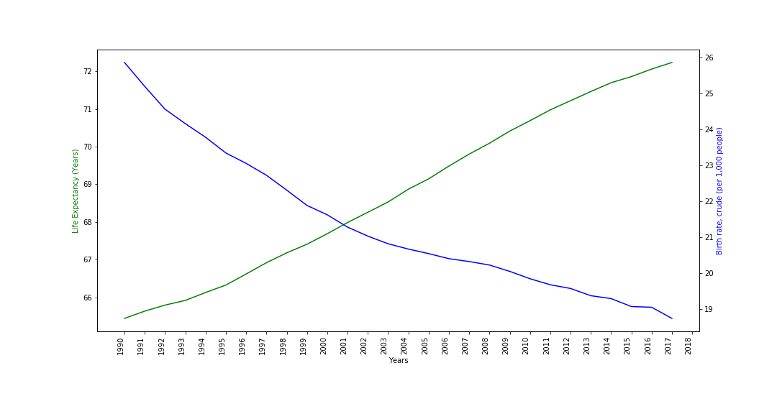
Birth Rate & Life Expectancy
R-Squared: 0.916443022728935
P-Value: 1.56169928862533E-15
Place your screenshot here

Slide 5
8.
UNEMPLOYMENT
Percentage of total labor force

Slide 6
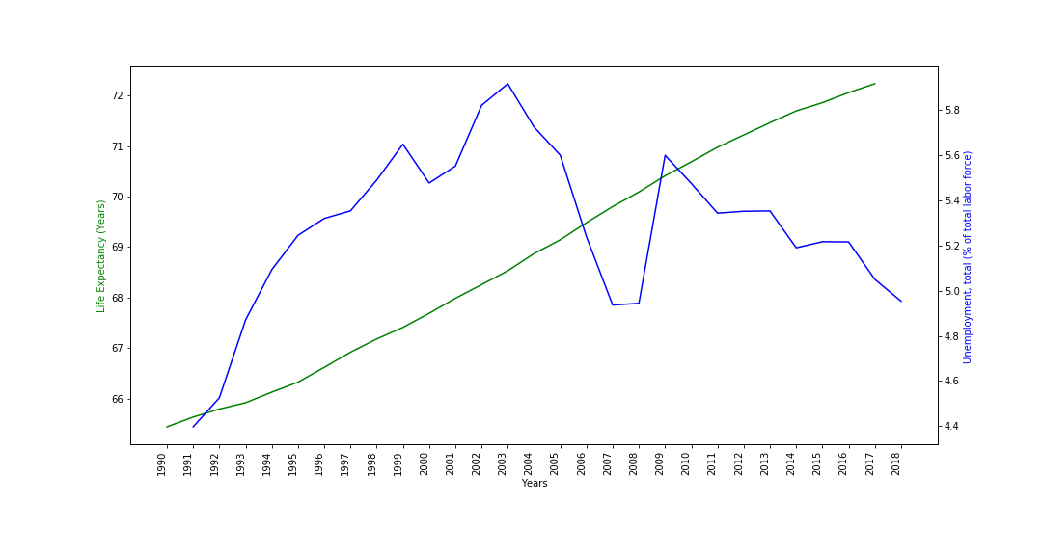
Unemployment & Life Expectancy
R-Squared: 0.014868609089310
P-Value: 0.536492571800191000
Place your screenshot here

Slide 7
Summary
 | R-Squared | P-Value
Deaths under 5 years old (millions) | 0.996459814288680 | 2.12976706389872E-33
Death rate, crude (per 1,000 people) | 0.988680085628955 | 7.80789625003750E-27
GDP (current US$) | 0.954891955107018 | 5.06843130319356E-19
Undernourished (% of population) | 0.953909647678448 | 1.96225905836121E-11
Birth rate, crude (per 1,000 people) | 0.916443022728935 | 1.56169928862533E-15
Access to electricity (% of population) | 0.916260309976558 | 7.03855446679479E-14
CO2 emissions (metric tons per capita) | 0.843862840857235 | 9.44890708619281E-11
Unemployment, total (% of total labor force) | 0.014868609089310 | 0.536492571800191000

Slide 8

WHAT ARE THE LEADING CAUSES TOWARDS THE INCREASE IN LIFE EXPEXTANCY?
DECREASES IN DEATHS OF CHILDREN UNDER 5
DECREASES IN HUMAN DEATH RATE
INCREASES IN GROSS DOMESTIC PRODUCT
DESCREASES IN OVERALL UNDERNOURISHMENT

Slide 9
THANKS!
Any questions?

