Slide 1

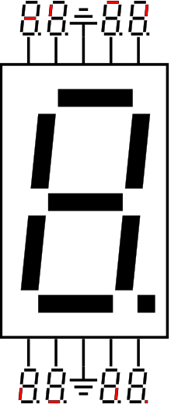

Clap Detector
clap_detected
XADC
State Machine to store intervals between claps
Display Logic
matched_patterns
Check Pattern
interval bank of claps/
number of intervals recorded

Slide 2
Clap State machine
LOG_INTERVAL
flush=0, load=1 interval_counter++ if (interval_counter=n_int):
{bank_overflowed=1}
clap_detected=‘1’
WAIT_FOR_NEXT_CLAP
flush=0, load=0
clap_detected=‘1’
IDLE
flush=1, load=0 interval_counter=0
bank_overflowed=0
pattern_finished=‘1’
CHECKING_PATTERN
flush=0, load=0
check_pattern_done=‘1’

Slide 3
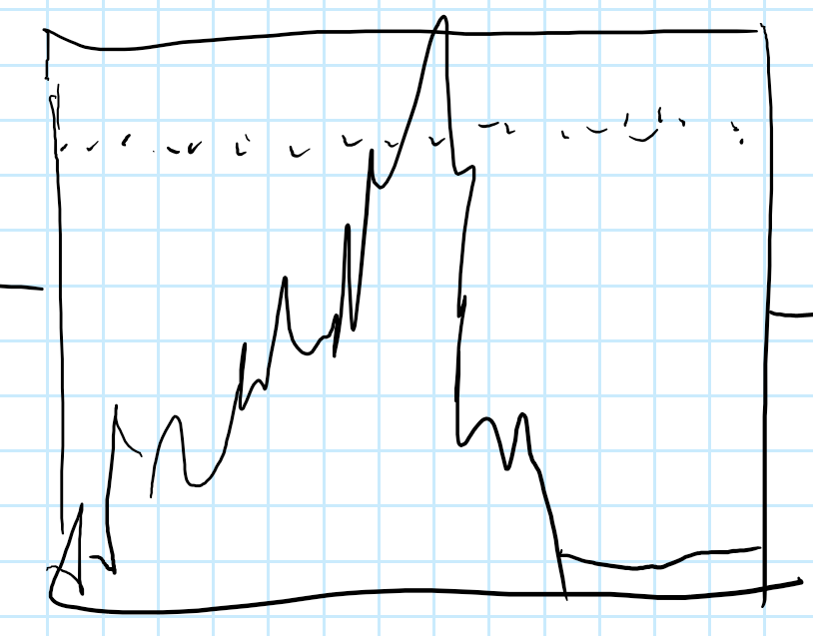
clk
clap_detector
clap_detected
clk_counter
clk_counter < T_END_SILENCE
XADC
pattern_finished
IDLE
clap_detected=‘1’
LOG_INTERVAL
pattern_finished!=‘1’
pattern_finished=‘1’
check_pattern_done=‘1’
CHECKING_PATTERN
input_state_machine
interval_bank_array
pattern_finished

Slide 4
CheckPattern overall arch
pattern_finished
min_not_zero
min_done
interval_bank
smallest
num_intervals
div_by_min
norm_done
norm_data
pattern_compare
check_pattern_done
patterns_matched

Slide 5
min_not_zero arch
-1
keep_going= idx > ‘1’
keep_going=‘1’
num_intervals
-1
idx
! keep_going
min_done
pattern_finished
bank_array
idx
bank(idx)
min_compare2
smallest

Slide 6
div_by_min
sub index if div_done_buf high
idx
bank(idx)
min_compare2
smallest

Slide 7
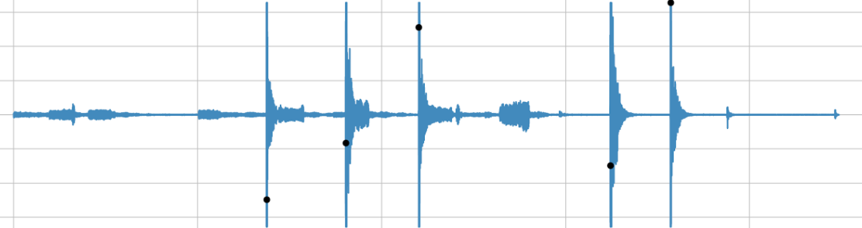
Clap Detector

Slide 8
Display Logic
Display Logic

Slide 9
