Slide 1
Cloud Basics
Wrocław, 19.04.2021, Krzysztof Sobkowiak

Slide 2
Cloud –NISC (National Institute of Standard and Technology)
Cloud computing is a model for enabling ubiquitous, convenient, on-demand network access to a shared pool of configurable computing resources (e.g., networks, servers, storage, applications, and services) that can be rapidly provisioned and released with minimal management effort or service provider interaction. This cloud model is composed of five essential characteristics, three service models, and four deployment models.
Cloud
Resource pooling
Broad network access
Rapid elasticity
On-demand self service
Measured service

Slide 3










On Premise – you provision and manage
Data & Access
Applications
Runtime
Operating system
Virtual machine
Compute
Networking
Storage

Slide 4
On Premise vs Cloud
On-Premise
Cloud
Hardware
IT Personnel
Maintenance
Electricity/Space
Training
OS, fixes, patches, upgrade
Performance tuning
Integration
Burden of IT
Maintain/upgrade hardware
Maintain/upgrade network
Maintain/upgrade security
Maintain/upgrade database
Pay as you use
Subscription fee
Implementation
Customization & Training

Slide 5
Benefits of cloud computing
LOW COST
PRODUCTIVITY
FLEXIBILITY
SECURITY
Cloud
SOFTWARE
UPDATES
DATA LOST
PREVENTION
MOBILITY

Slide 6
Cloud advantages
24/7 Support
Highly automated
Pay as you use
Easy and agile deployment
Lower TCO
Secure storage manager
Frees up internal resources
Device and location independent

Slide 7
Cloud Service Models
IaaS
PaaS
SaaS
XaaS
Receiving a service, getting subscription
Accessible over internet
Always available
Fixed cost per MB, per VM
Allocation based costs/Utilization

Slide 8
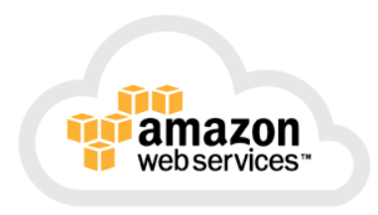
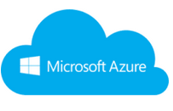
IaaS
Data Center Level Virtualization through the cloud portal
Customer requests VMs, selects OS, storage, computer power
Resources can be located anywhere in provider environment
Billed on demand basis (more computer power and storage generate more costs)
Applications
Data
Customer
Runtime
Middleware
Operating System
Virtualization
Servers
Provider
Storage
Networking

Slide 9
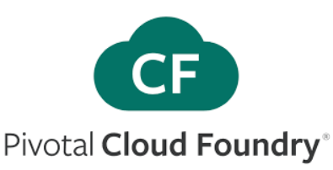
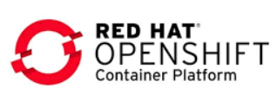
PaaS
Consumer are developers
Framework provides OS, runtime environment, database, web server
Patching OS is done by provider
Application design, development, testing, deployment, hosting, collaboration
Customer
Applications
Data
Runtime
Middleware
Operating System
Provider
Virtualization
Servers
Storage
Networking

Slide 10
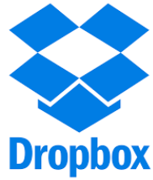
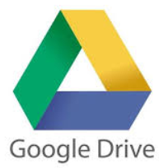
SaaS
Use provider applications running on a cloud infrastructure
Applications are accessible from various client devices
Customer does not manage or control the underlying cloud infrastructure
Applications may run partially or completely in the provider environment
Applications
Data
Runtime
Middleware
Provider
Operating System
Virtualization
Servers
Storage
Networking

Slide 11
Cloud Deployment Models
Owned by a single organization
Private Cloud
Shared by serveral organizations
Community Cloud
Used by one organization which sells cloud services
Public Cloud
Composition of the clouds
Hybrid Cloud

Slide 12
Public Cloud
IT services available to any subscriber on the Internet
IT services hosted on provider equipment – all costs covered by provider
Service is available 24/7
Easy and inexpensive for consumers – pay for what you use
Supports multiple customers
Suited for information that is not sensitive
Rapid scalability – on-demand provisioning
Data centers can replicate data
Provider makes capital investment in infrastructure
Consumers treat public cloud costs as operational expenses
Reduced local space use, energy consumption
Less local IT expertise required – maintained by external provider
Responsibility for IT service maintenance falls on provider
No full control over the data
Good scalibility

Slide 13
Private Cloud
IT services
Hosted on equipment owned by private organization within data centers belonging to the company
Responsi-bilities
Hardware
Full control
Delivered over a network
Available only to users within the organization
Software
Licenses
Installation, configuration, patching, troubleshooting
Data
Regulatory compliance
Fault tolerance
Scaling
Doas not scale as good as public cloud
Security and performance

Slide 14
Hybrid Cloud
Combines public and private cloud
Integrates on-premises IT services with cloud provider
Could be used as interim solution before moving to a public cloud
This approach allows the advantage of data security in private cloud and the scalibility of public cloud
Flexibility – the option to utilize resources from the private and public cloud
Control over spending - uses the cloud which offers cheaper resources
Deployment – a combination of strong sides ot the private and public cloud

Slide 15
Community Cloud
Community cloud
Pools computing resources to serve organizations with common needs
Regulatory comliance
Fast access to an application/data
Similar security requirements
The examples of community cloud deployments are: Healthcare or financial services that require special regulation

Slide 16
Cloud disadvantages
Limited control
Cloud infrastructure is entirely owned, managed and monitored by the service provider
The customer can only control and manage the applications, data and services operated on top of that, not the backend infrastructure itself
Key administrative tasks such as server shell access, updating and firmware management may not be passed to the customer or end user
Vendor Lock-In
Switching cloud services is something that hasn’t yet completely evolved
Organizations may find it difficult to migrate their services from one vendor to another
Hosting and integrating current cloud applications on another platform may throw up interoperability and support issues
Security
You need to provide your service provider with access to important business data
In a multi-tenant cloud architecture where multiple users are hosted on the same server, a hacker might try to break into the data of other users hosted and stored on the same server

