Slide 1
OpenGL

Slide 2
What OpenGL is:
A software interface to graphics hardware
A low-level graphics API to specify objects and operations for 3D graphics
OS/hardware independent
Supported by many, if not all, graphics cards
Descendant of GL (from SGI)‏
Used in many games such as ‘Quake’
250 distinct commands …

Slide 3
What OpenGL isn't:
A window manager / application framework
An input driver
A programming language

Slide 4
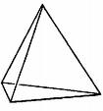
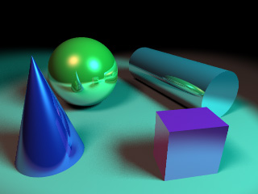





How does it work?
From the programmer’s point of view:
Specify geometric objects
Describe object properties
Define how they should be viewed
Move camera or objects around for animation

Slide 5
How does it work?
State driven!
  Set state variables: color, viewing position, line width, material properties, lighting, …
  These variables will apply to every geometric primitive drawing command: points, triangles, …
Via API calls, describe geometric objects in terms of simple primitives
OpenGL will translate this description into pixels to form an 2D image.

Slide 6
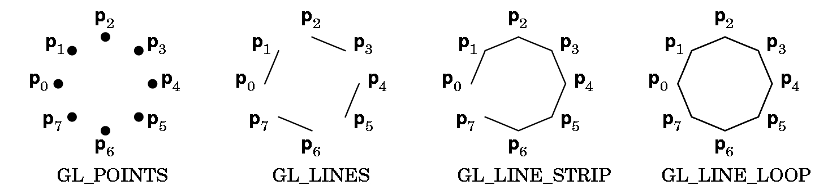
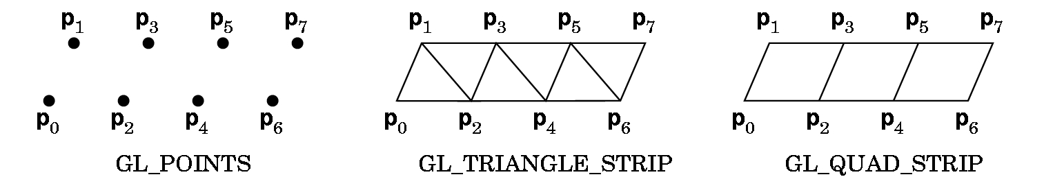
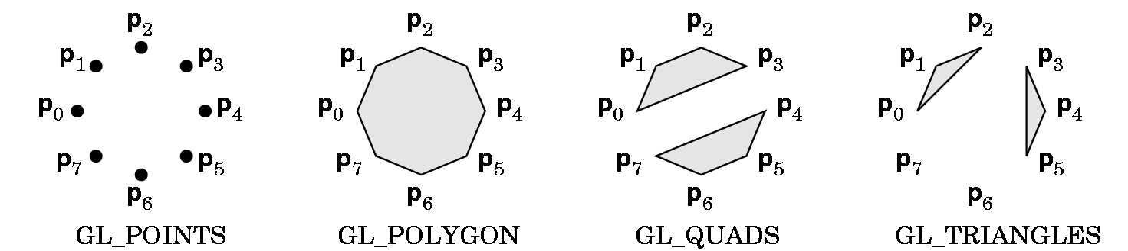
Primitives: points, lines, polygons
Example: shapes (from www.xmission.com/~nate/tutors.html)‏

Slide 7
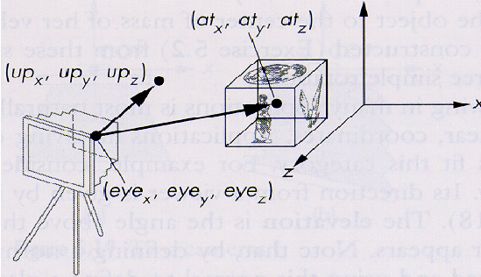
OpenGL - gluLookAt
gluLookAt(eye_{x}, eye_{y}, eye_{z}, at_{x}, at_{y}, at_{z}, up_{x}, up_{y}, up_{z});

Slide 8
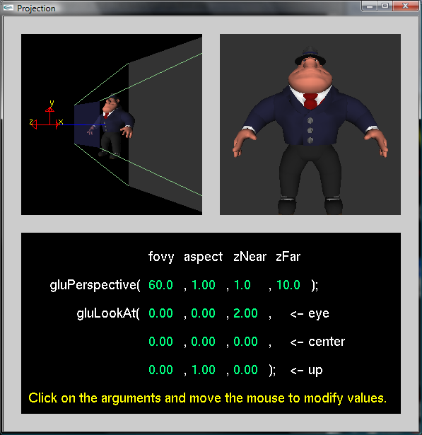
Projection Models – Ch. 3
Example: projection.exe (from www.xmission.com/~nate/tutors.html)‏
Jan 22, 2009
CMPSC 458: Computer Graphics

Slide 9
Basic OpenGL – Transformations – Ch. 3
Transformation matrices
  like the ones from the previous lectures
Remember M₁M₂ ≠ M₂M₁
Let M be the model/view matrix
glLoadIdentity(); // M = I
glTranslatef(…); // M = M.T = I.T = T
glRotatef(…); // M = M.R = T.R
glScale(…); // M = M.S = T.R.S
glBegin(..);
glVertex3f(p_{x},p_{y},p_{z}); // Q = M.P = T.R.S.p
glEnd();
Jan 22, 2009
CMPSC 458: Computer Graphics

Slide 10
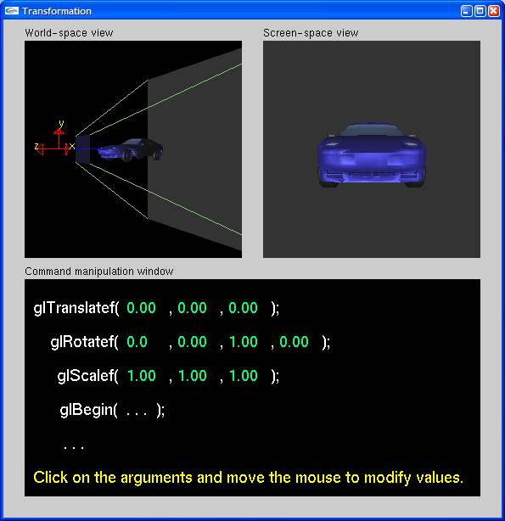
Transformations
Example: transformations.exe (from www.xmission.com/~nate/tutors.html)‏
Jan 22, 2009
CMPSC 458: Computer Graphics

Slide 11
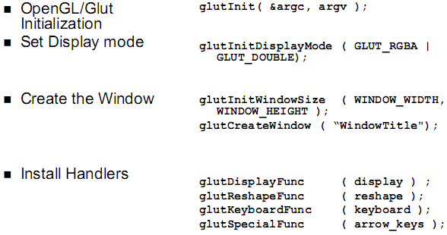
Structure of an OpenGL/GLUT program
Jan 22, 2009
CMPSC 458: Computer Graphics

Slide 12
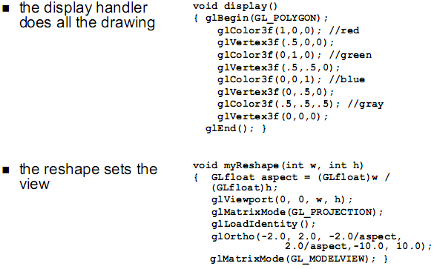
Structure of an OpenGL/GLUT program
Jan 22, 2009
CMPSC 458: Computer Graphics

Slide 13
OpenGL Golden Rules
Set the projection matrix
glMatrixMode(GL_PROJECTION);
gluPerspective(fovy, aspect, zNear, zFar);
glMatrixMode(GL_MODELVIEW);
Clear the Model View Matrix
glLoadIdentity();
Set an appropriate viewpoint
gluLookAt(eye_{x}, eye_{y}, eye_{z}, o_{x}, o_{y}, o_{z}, up_{x}, up_{y}, up_{z});
Transformations are similar to matrix multiplication
  Read them from bottom to top (right to left).
Jan 22, 2009
CMPSC 458: Computer Graphics

Slide 14
OpenGL – Common Questions
I created a shape/heightmap/anything but I see a black screen.
  Check you perspective parameters.
  Set the view so that the object is centered in it
  Reset the MODELVIEW matrix.
I perform a Rotation/Translation/Scaling but it does not work as I expected
  glRotate/glTranslate/glScale are just simple transformations centered on the origin.
  Work the algebra on paper.
Jan 22, 2009
CMPSC 458: Computer Graphics

Slide 15
What is expected from you
Some degree of proficiency in the language you choose for programming
  for most of you that means C++
Read the lecture slides
Read the red book
Explore OpenGL independently

Slide 16
Project Summary

Slide 17
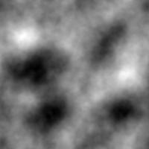
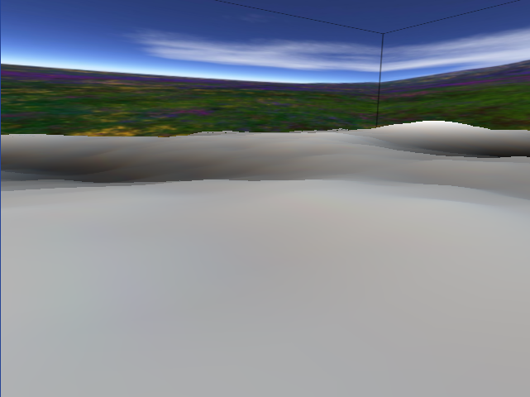
Programming Assignment 1: Height Map
Why?
  Get started with OpenGL
  Room for creativity
Jan 22, 2009
CMPSC 458: Computer Graphics

Slide 18
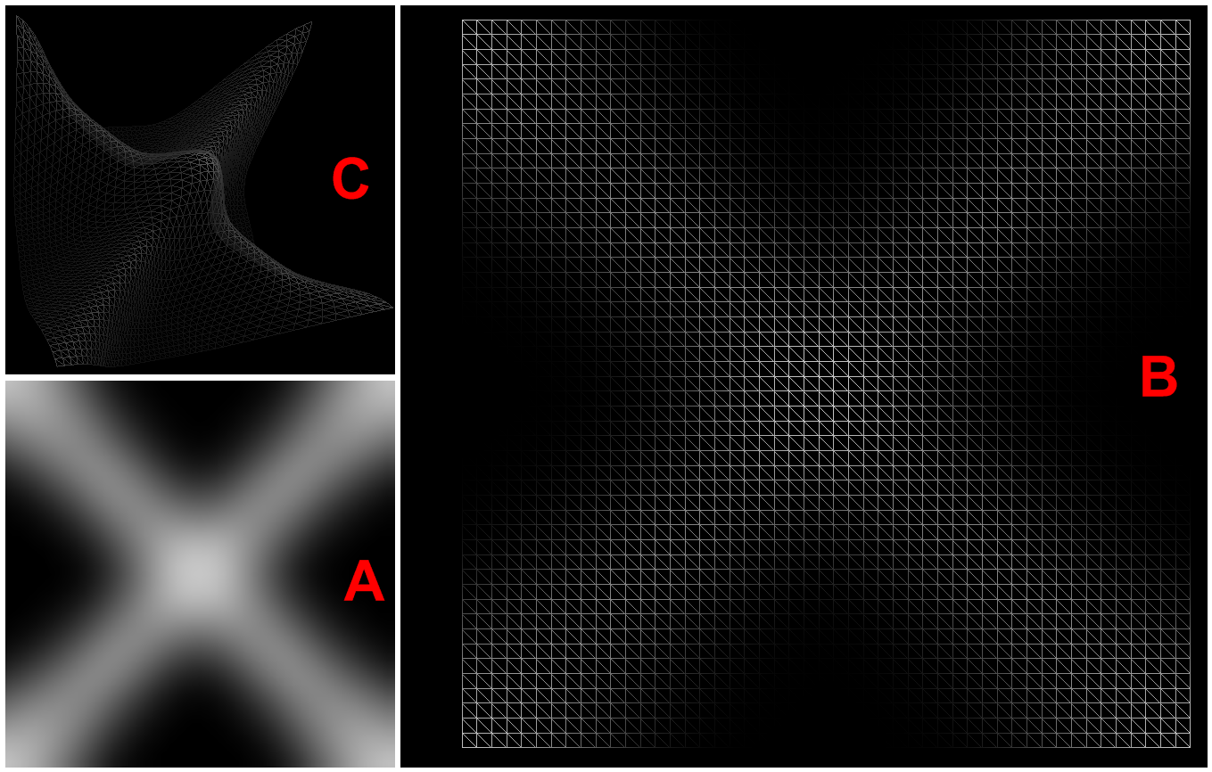
A Heightmap
A: input image
B: top view of heightmap: each pixel in A is like a node in a grid of triangles, the intensity (grayscale color) determines the height at that node
C: sample image of 3D surface of heightmap

Slide 19

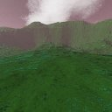
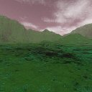
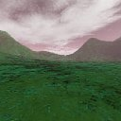
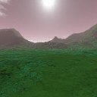
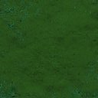
The Environment: A Skybox
This is just a texture mapped cube
You need some nice textures
to achieve a realistic effect.
Jan 22, 2009
CMPSC 458: Computer Graphics

Slide 20
SkyBox + Height Map
What OpenGL features do I use?
  Triangles
    glBegin(GL_TRIANGLES)
    glVertex3f(…)
    glEnd()
  Transformations (GL_MODELVIEW matrix mode)
    glTranslatef / glRotatef / glScalef
  Projection (GL_PROJECTION matrix mode)
    gluPerspective(...)
Jan 22, 2009
CMPSC 458: Computer Graphics

Slide 21
Other requirements
Intermediate submissions ARE REQUIRED.
  They do not have to be perfect, or complete but you have to submit them by their deadlines.
The program has to have a COMMAND LINE interface.
Images for the animation have to be 640x480 and at 15 fps
The program should be able to perform in real-time
Jan 22, 2009
CMPSC 458: Computer Graphics

Slide 22
Programming Assignment 1: Height Map
Recommendations
  Start Early
  Work incrementally
    The intermediate submission process is aimed at encouraging this approach
Extra credit
  Better lighting / Material properties (turn lighting on, set ambient / diffuse / specular…)
  Be creative: learn shadows, throw in some GLUT primitive shapes, show that you learned something about OpenGL or any math related to the course
Jan 22, 2009
CMPSC 458: Computer Graphics

