Slide 1
Programming Assignment 3: Raytracing
You will have 3 weeks to complete this project.
Intermediate submissions are due every week.
  No OpenGL is needed in this project.
  You can choose your programming language but be careful:
    Ray tracing is a CPU intensive task.
    Can be easily modularized using OO techniques
    Starter code (which includes a scene description language parser) will only be available in C++

Slide 2
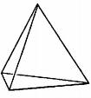
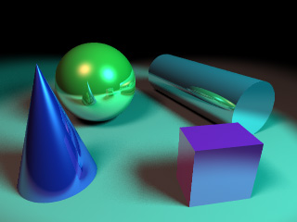




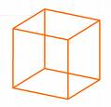
Programming Assignment 3: Raytracing
What does it do?
  Given:
    Camera parameters
    Object positions and material properties
    Light positions and properties
  Produces the image seen from that camera (sounds pretty similar to what OpenGL does, right?)

Slide 3
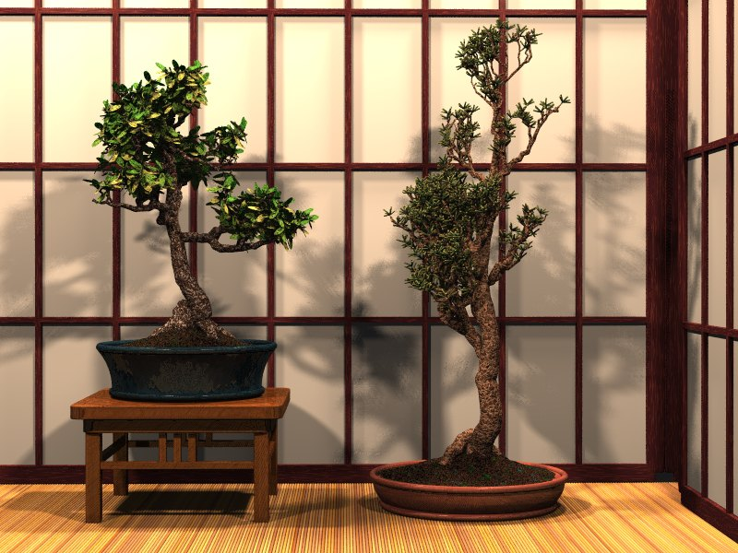


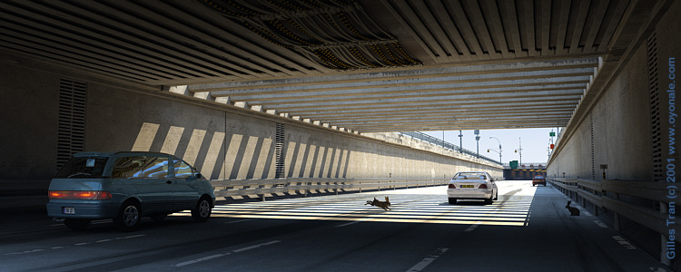
Programming Assignment 3: Raytracing
www.povray.org

Slide 4
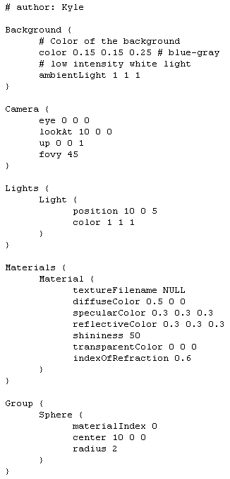

Programming Assignment 3: Raytracing
What will yours do?
  Given scene file (.ray), produce image

Slide 5
How does it work
1. Find ray from eye through a pixel
2. Test that ray for intersections with all objects
  Remember the closest intersection
3. Find the color of the object seen
  Follow the Phong illumination model

Slide 6
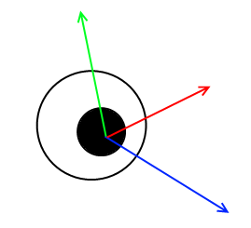
1. Find ray from eye through a pixel
You know camera position, point at which it is looking, and a vector in the up/view plane, so it is easy to determine view vector, vector to your left, and vector to your up.

Slide 7
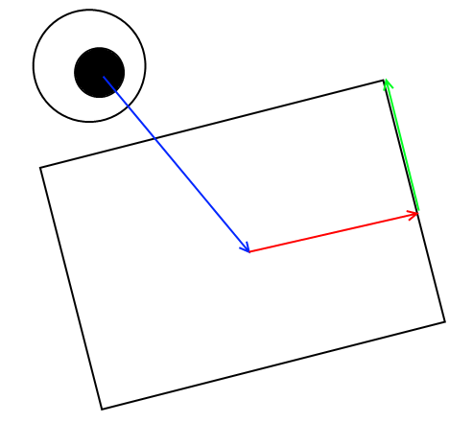
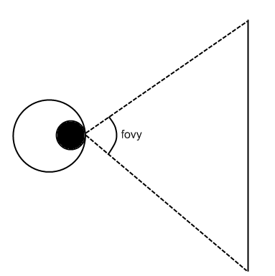
Image plane
Using the known camera coordinate system and the camera’s fovy (angular field of view) it is some simple trigonometry to determine three corners of the image plane

Slide 8
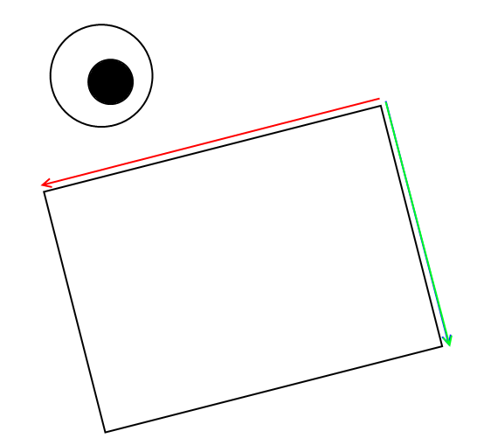
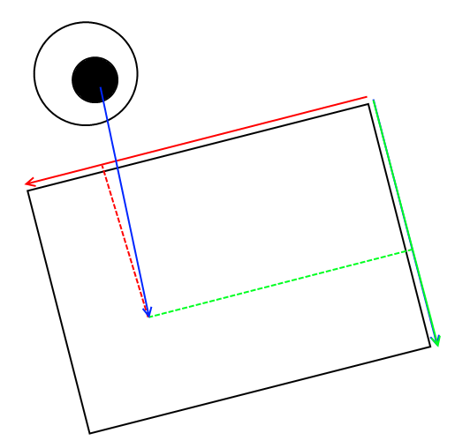
Casting Rays
Consider two vectors: one from the upper left corner to the upper right, one from the upper left to the lower left
By linear combinations of these two to the position at the upper left, we can get a position on the image plane (in 3d space) for any pixel
Subtracting the eye from the position yields the ray through that pixel

Slide 9
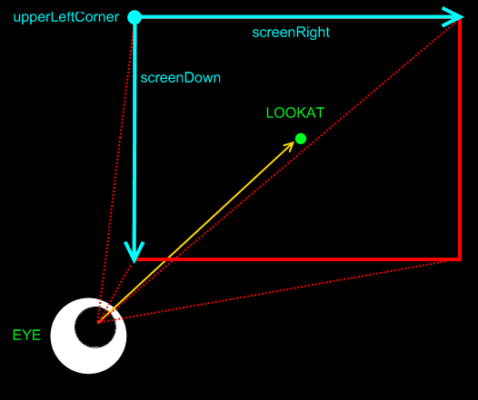
Setting up the view rectangle
Determine h and w (size of the view rect)‏
  use the fovy, the output image aspect ratio (given by W and H, the output image width and height). Assume the plane is located 1 unit away in the view direction

Slide 10
2. Test that ray for intersections with all objects
Sphere PAGE 205 (new book pg 76)
  Derive the formula
    A quadratic equation on t
    Understand the meaning of the determinant
Triangle PAGE 206 (new book pg 77)
  Solve simultaneously for the barycentric coordinates and the ray parameter (α, β, t)
  System of linear equations that can be solved by computing certain determinants. CRAMER’S RULE

Slide 11
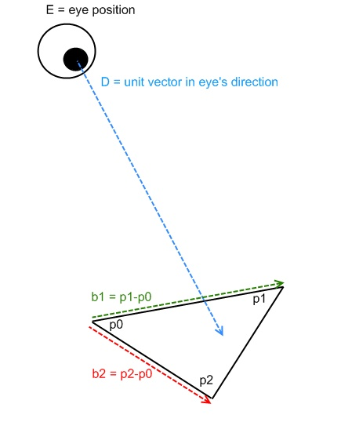
Intersection with triangle

Slide 12
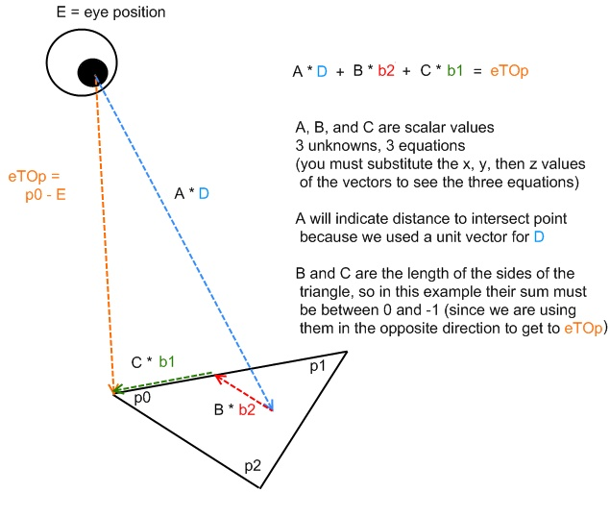
Intersection with triangle

Slide 13

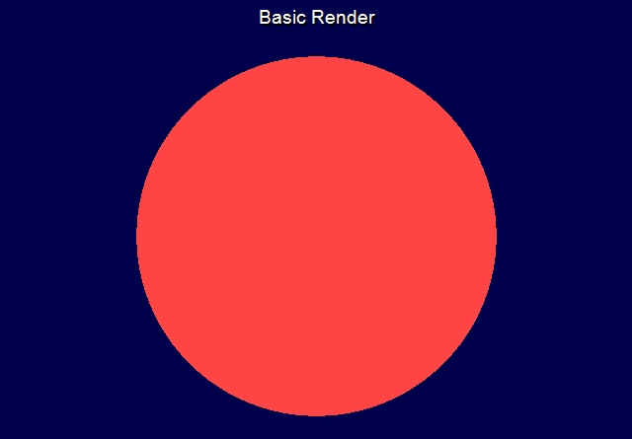
First Milestone:
Triangle/Sphere Intersections
(just colorize by background color or object ambient color)

Slide 14
3. Find the color of the object seen
Phong illumination model (basics)
1. Start your <R,G,B> vector at zeros
2. Add (ambient light of scene * ambient color of object)
3. For each light, test a ray from the light to the point seen on the object to see if that light hits that object
  If it does, add use the light and material properties and the surface normal at the point seen to compute the diffuse and specular colors seen
Continued…

Slide 15

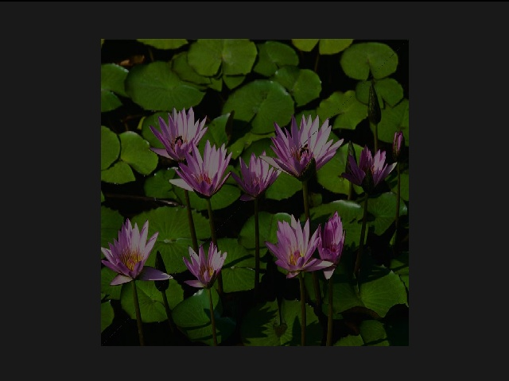
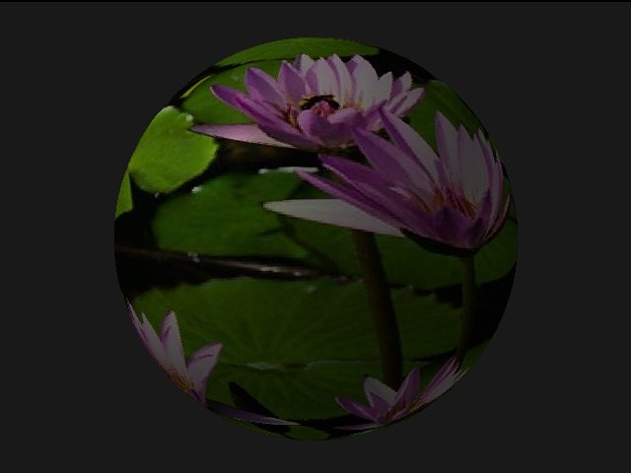
Second Milestone:

Slide 16
3. Find the color of the object seen
Phong illumination model (basics continued)
4. If that object was reflective, calculate the reflected ray direction and recursively raytrace to find the color along that ray, add it (times the material’s reflective property) to the color seen at the pixel
5. If that object was transparent (or semi-transparent) calculate the refracted ray, recursively raytrace along it, and add the color seen (times the material’s transparent property) to the color seen at that pixel

Slide 17
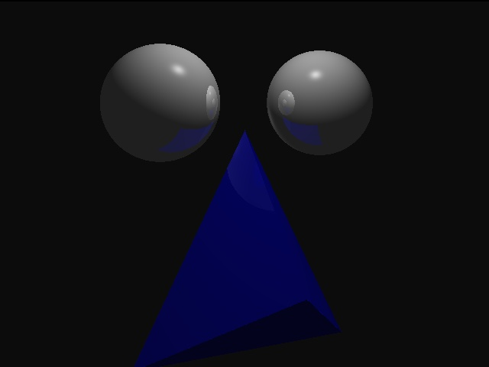
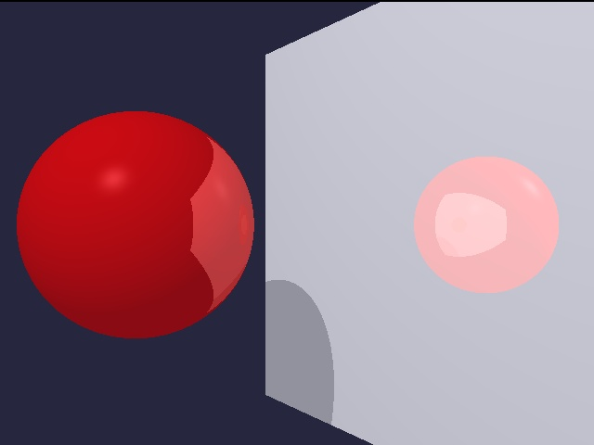
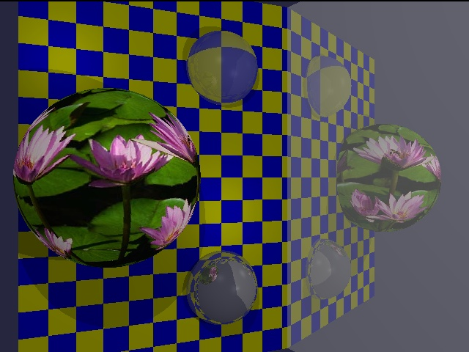
Final Submission:

Slide 18
Grade Breakdown: Required (100 pts)‏
10 pts- Sphere intersection.
10 pts- Triangle intersection.
10 pts- Triangle texture mapping.
10 pts- Sphere texture mapping.
10 pts- Diffuse and specular shading.
10 pts- Shadows.
10 pts- Recursive reflection/refraction.
10 pts- Code structure/Comments.
10 pts- Animation (or still) creativity.
10 pts- Two (or more) original scenes.

Slide 19
Grade Breakdown: Bonus Features up to 15 pts of Extra Credit
10 pts- Good antialiasing.
10 pts- Animation with motion blur.
15 pts- Depth of field.
15 pts- Blinn blobs.
15 pts- Multiple object groups with bounding spheres.
15 pts- BSP Tree for speed up.
7.5 pts- Up to two additional object types (7.5 each).
15 pts- Procedural texture mapping.
?? pts- Your idea/ talk to me to see how many pts.

Slide 20
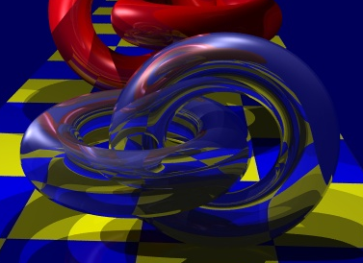
Bonus features: Recursive Refraction

Slide 21
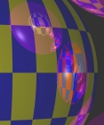
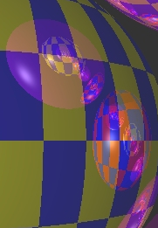
Bonus features: Anti aliasing

Slide 22
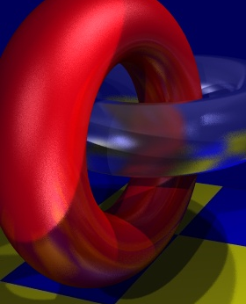
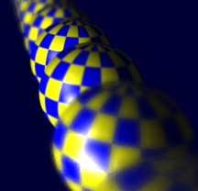
Bonus Features
Diffuse refraction
Depth of field.
Soft shadows
Diffuse reflection.

