Slide 1
Rollercoaster

Slide 2
P.A. #2
Project 2 is out today, due in three weeks
Starter code provided for this project is minimal, and you can use most of what you did for the first project

Slide 3
Roller Coaster
Why?
  Animation is an exciting area in computer graphics.
  You will learn the basics on first person animation.
  Realistic real-time animations can be achieved with
  simple (and not so simple) techniques using the object based rendering provided by OpenGL.
Recommendations
  Start Early.
  Work incrementally

Slide 4
You will need:
Camera Movements for first person simulation.
Texture Mapping in OpenGL.
Lighting and Shading in OpenGL.
Splines: both understanding their derivation and optionally the use of custom spline functions in OpenGL.

Slide 5
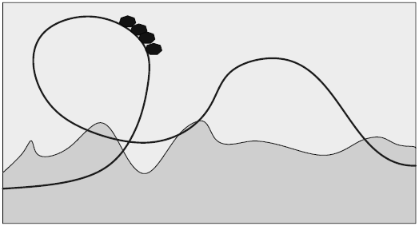
The track: A Catmull-Rom Spline
Catmull-Rom splines are interpolating
  Easier for track design

Slide 6
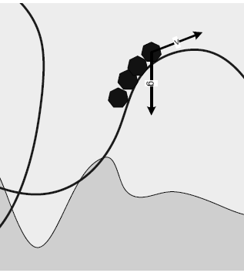
The motion: Physical dynamics on a 3D curve
Simple ideal physics
Conservation of energy.
Point Mass.
No friction.
Gravity is the only acting force.

Slide 7

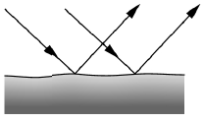
Shading and Lighting
Types of Light
  Ambient: scattered throughout environment
  Diffuse: reflected by opaque objects
  Specular: reflected by shiny objects
  Emissive: emitted by objects
Jan 22, 2009
CMPSC 458: Computer Graphics

Slide 8
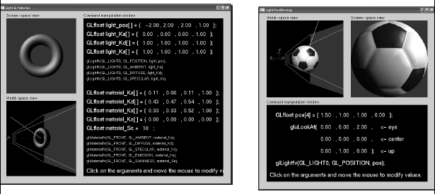
Material and Light Properties
Example: lightmaterial.exe and lightposition.exe (from www.xmission.com/~nate/tutors.html)‏
Jan 22, 2009
CMPSC 458: Computer Graphics

Slide 9
OpenGL – Display Lists – Ch. 7 (making your program run faster)‏
What are Display lists for?
  “compiling” the geometric models
  Faster: let the GPU store the object geometry
Steps:
  (at init) Create the display list
  Obtain an id: object = glGenLists(1);
  Create the geometry
  glNewList(object, GL_COMPILE);
  … // drawing commands: glBegin, etc…
  glEndList()‏
  at drawing time, just invoke the list… glCallList(object);
Jan 22, 2009
CMPSC 458: Computer Graphics

Slide 10
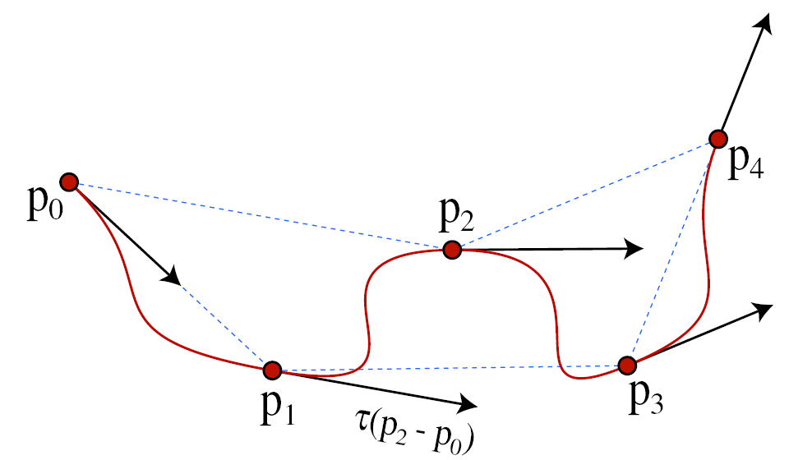
Catmull-Rom Splines
Are interpolating polynomials of degree 3
Jan 22, 2009
Feb 5, 2009
CMPSC 458: Computer Graphics
CMPSC 458: Computer Graphics

Slide 11
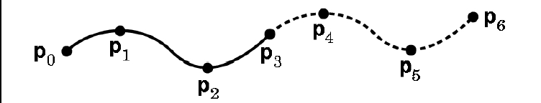
Joining segments
Divide the sequence into groups of 4 points
At join points
  C¹ continuous
  2nd Derivatives may not match (no C^2 continuity)‏
Jan 22, 2009
Feb 5, 2009
CMPSC 458: Computer Graphics
CMPSC 458: Computer Graphics

Slide 12
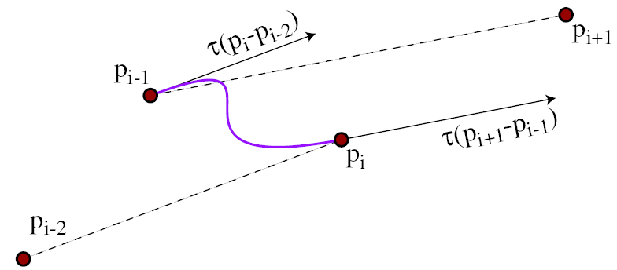
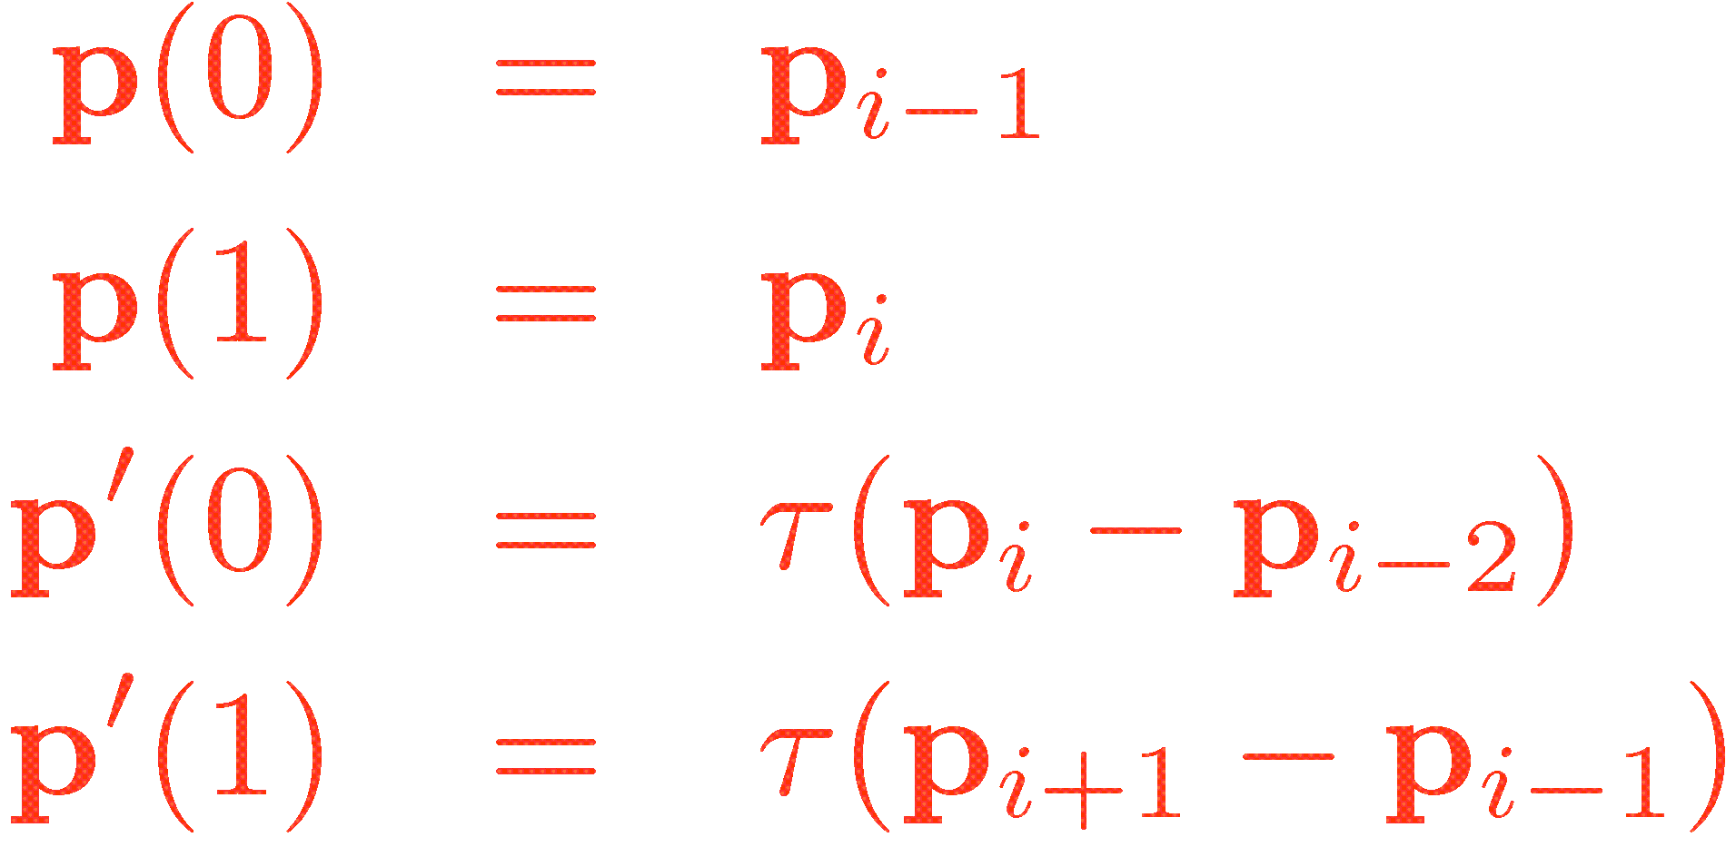
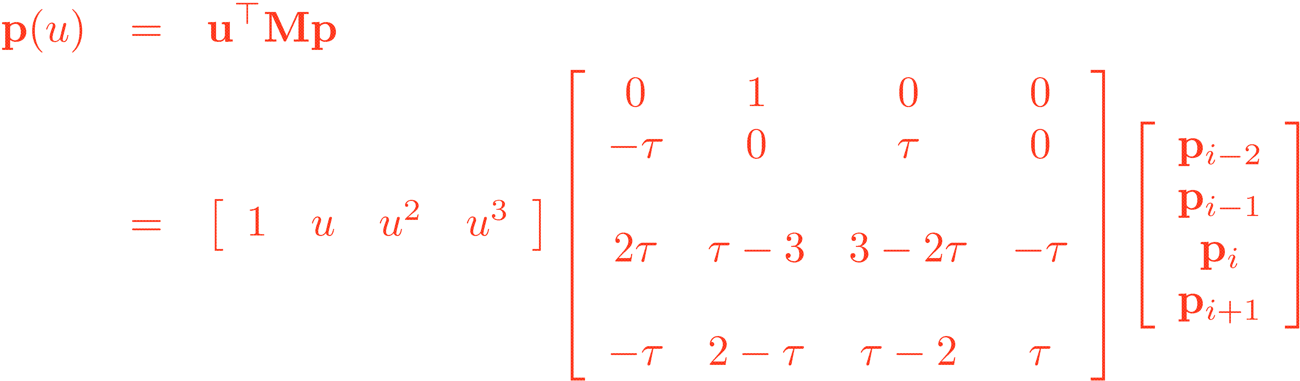
Catmull-Rom Splines (Derivation)‏
Set the constrains
Solve and get
Jan 22, 2009
Feb 5, 2009
CMPSC 458: Computer Graphics
CMPSC 458: Computer Graphics

Slide 13
Second Stop: Uniform motion
Distances along the curve
Jan 22, 2009
CMPSC 458: Computer Graphics

Slide 14
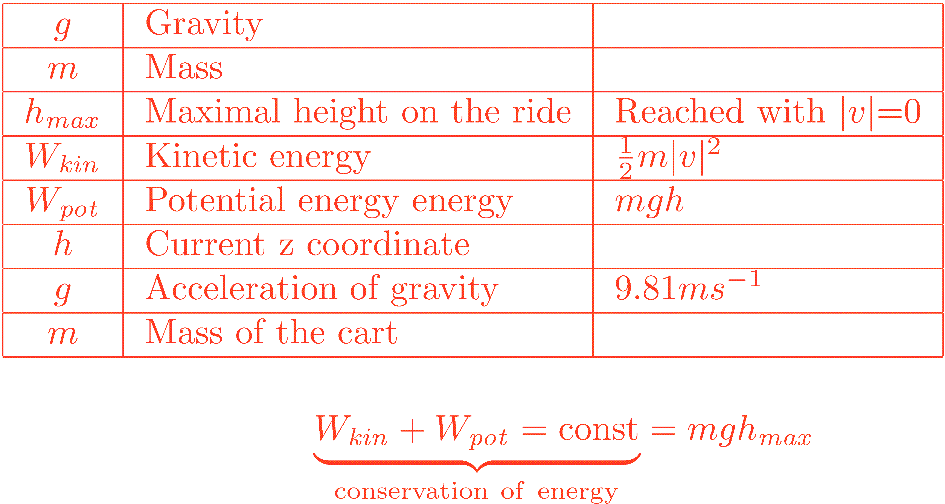
Mass point on a spline, frictionless model with gravity
Jan 22, 2009
Feb 5, 2009
CMPSC 458: Computer Graphics
CMPSC 458: Computer Graphics

Slide 15

Mass point on a spline, frictionless model with gravity
The velocity is a 3D vector pointing always in the direction of the tangent
Given the current z position (height) by the conservation of energy we can compute |v|
This is good news, there will be no approximation error on the velocity !!!
Jan 22, 2009
Feb 5, 2009
CMPSC 458: Computer Graphics
CMPSC 458: Computer Graphics

Slide 16
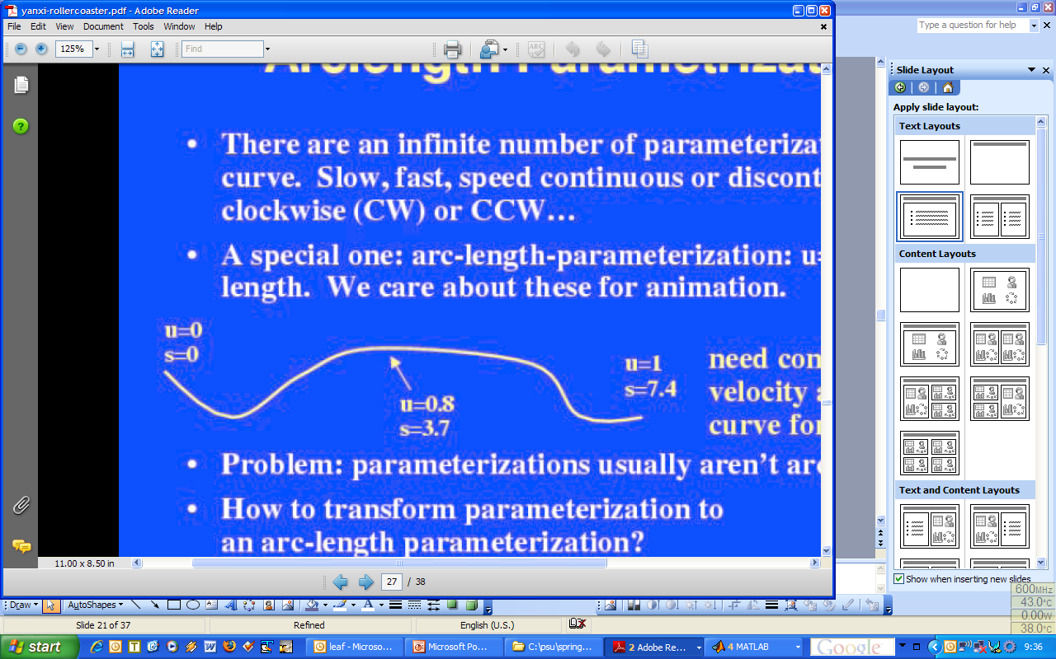
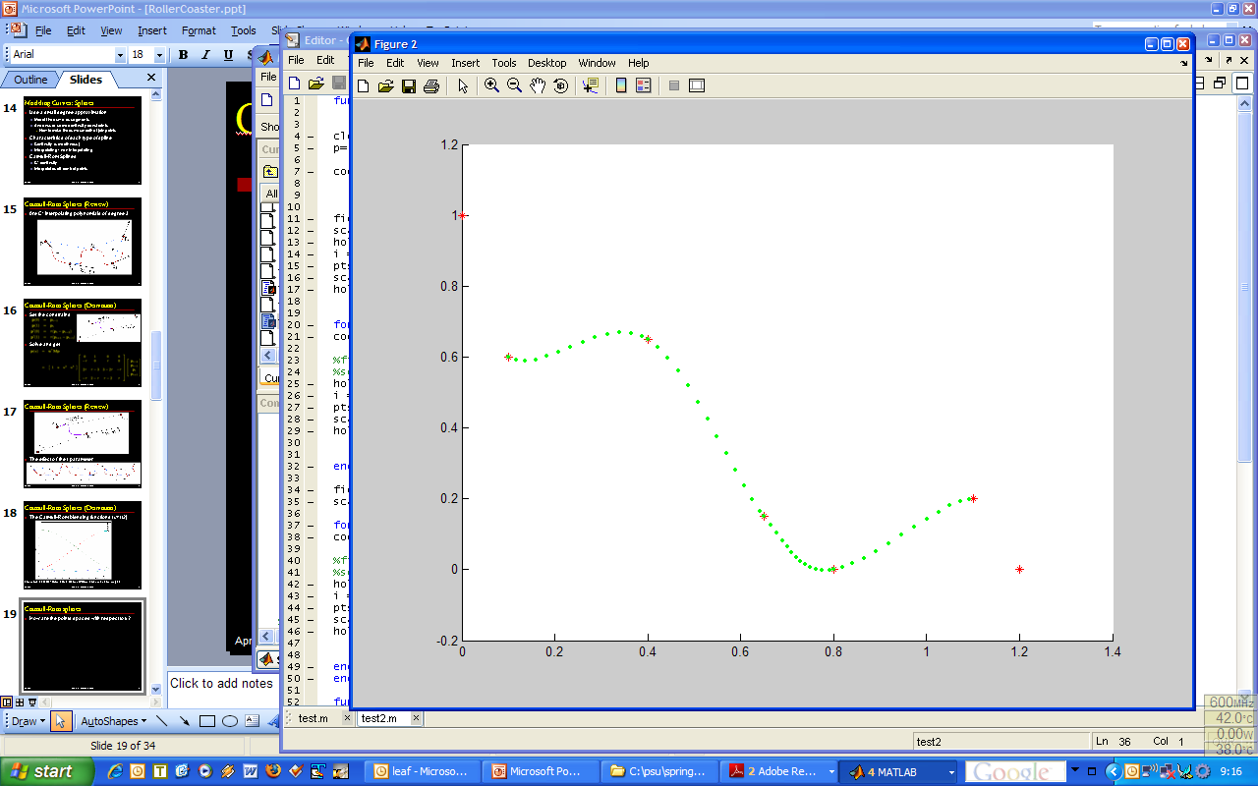
Distances along the curve
To implement the physics we will need a way to move along the curve in certain “physical distance preserving way”
How do we determine the relation between the curve intrinsic parameter u and the distance from p(u₀) to p(u₁)‏
Jan 22, 2009
Feb 5, 2009
CMPSC 458: Computer Graphics
CMPSC 458: Computer Graphics

Slide 17
Computing u (parameter) increase needed to move s (distance)
With an initial guess on the interval
Bisection(umin, umax, s)‏
// umin = min value of u
// umax =max value of u; umin <= u <= umax
// s = target length
Forever
{
u = (umin + umax) / 2 // Canditate solution
if |s(u) – s| < ε
return u
if s(u) > s
umax = u // u too big
else
umin = u // u too small
}
Jan 22, 2009
Feb 5, 2009
CMPSC 458: Computer Graphics
CMPSC 458: Computer Graphics

Slide 18
First Milestone:
Rendering Splines
  Either drawing the track
  or moving uniformly on the spline
Basic environment
  You should have a basic rendering of the environment in this week
Submission
  A couple of images showing your rendering
  A small clip if you implement motion (either .avi, .mpeg or a (small) bunch of .jpgs)
Jan 22, 2009
CMPSC 458: Computer Graphics
CMPSC 458: Computer Graphics

Slide 19
Second Milestone:
Reasonable physical motion on the spline
  Here you should have the arclength parametrization working
Texturing and lighting
Optionally
  A good track or set of tracks
  Improvements to the rendering of the structure
  Improvements on the environment
Submission
  A small clip portraying the motion and environment (either .avi, .mpeg or a (small) bunch of .jpgs)
Jan 22, 2009
CMPSC 458: Computer Graphics
CMPSC 458: Computer Graphics

Slide 20
Final Submission:
Test, test, test
Ensure that the motion along the track is reasonable
Implement your bonus requirements
  There is a fair amount (30) of extra credit points.
Execute the final animation.
  All your bonus features should be exhibited here.
Make sure you comply with all the stated requirements (eg. providing a README based on the template provided)
Jan 22, 2009
CMPSC 458: Computer Graphics
CMPSC 458: Computer Graphics

Slide 21
Grade Breakdown:
30 pts – Render track with Catmull-Rom splines
20 pts – Render texture-mapped environment
30 pts – Realistic movement
20 pts – Added track realism
20 pts – Interactive frame rates
15 pts – Code structure
5 pts – animation
5 pts – readme describing features and approaches
Jan 22, 2009
CMPSC 458: Computer Graphics

Slide 22
Extra Features
Additional track features, like supports
Secondary animations (on track or in surrounding world)‏
Better coaster normals
Interactive coaster generation
Anything else you feel like
Jan 22, 2009
CMPSC 458: Computer Graphics

