Slide 1




HACKMERIDIAN 2026 · LISBON
PLATFORM 01 / 10
TESTNET · TEST KEYS · NOT REAL CUSTODIANS
Radox Custody Rail
Know who holds the goods: every handover signed by both custodians.
Scan: the live shipment
rio-miami-rail.vercel.app
Toward a SWIFT-like custody standard on Stellar · Pilot corridor: Rio–Miami
RIO
MIAMI
October 2026
#HackMeridian26
© 2026 HackMeridian · Lisbon

Slide 2

PLATFORM 02 / 10
HACKMERIDIAN 2026 · LISBON
NEXT ▸ THE SOLUTION
PMF · THE PROBLEM
Who holds the cargo right now?
Between seller and buyer, a shipment changes hands several times.
US$2.5T
Global trade finance gap.
ADB Global Trade Finance Gap Survey, Dec 2025. It sizes the financing gap; it is not evidence of the custody problem.
Warehouse
Port
Carrier
Customs
Buyer
Handovers are mostly paper, or sit inside each operator's own system: no shared record crosses borders.
Our hypothesis: a financier cannot see who holds the goods before paying. No customer has confirmed it yet; we are testing it with mentors.
Context: our explainer video about a Rio–Miami trade-corridor initiative poses one possibility: a unique digital record for every shipment that both sides can check. This project is a custody layer for that record.
© 2026 HackMeridian · Lisbon · #HackMeridian26

Slide 3
PLATFORM 03 / 10
HACKMERIDIAN 2026 · LISBON
NEXT ▸ THE PRODUCT
THE SOLUTION
Both custodians sign, or nothing changes
Outgoing custodian
signs
One Stellar transaction
custody_registry.handover
Incoming custodian
signs
Either signature missing → the call fails.
— Each handover moves custody and extends an on-chain hash chain, the head.
— The token stays with its holder in transit; only custody changes.
— After Delivered, the operator burns the token with the existing redeem¹.
A custody record keyed to the container number. In production it would sit beside the carrier's bill of lading; not integrated in this build.
¹ Radox platform policy, not enforced on-chain by the registry; redeem still needs the holder's signature.
© 2026 HackMeridian · Lisbon · #HackMeridian26

Slide 4
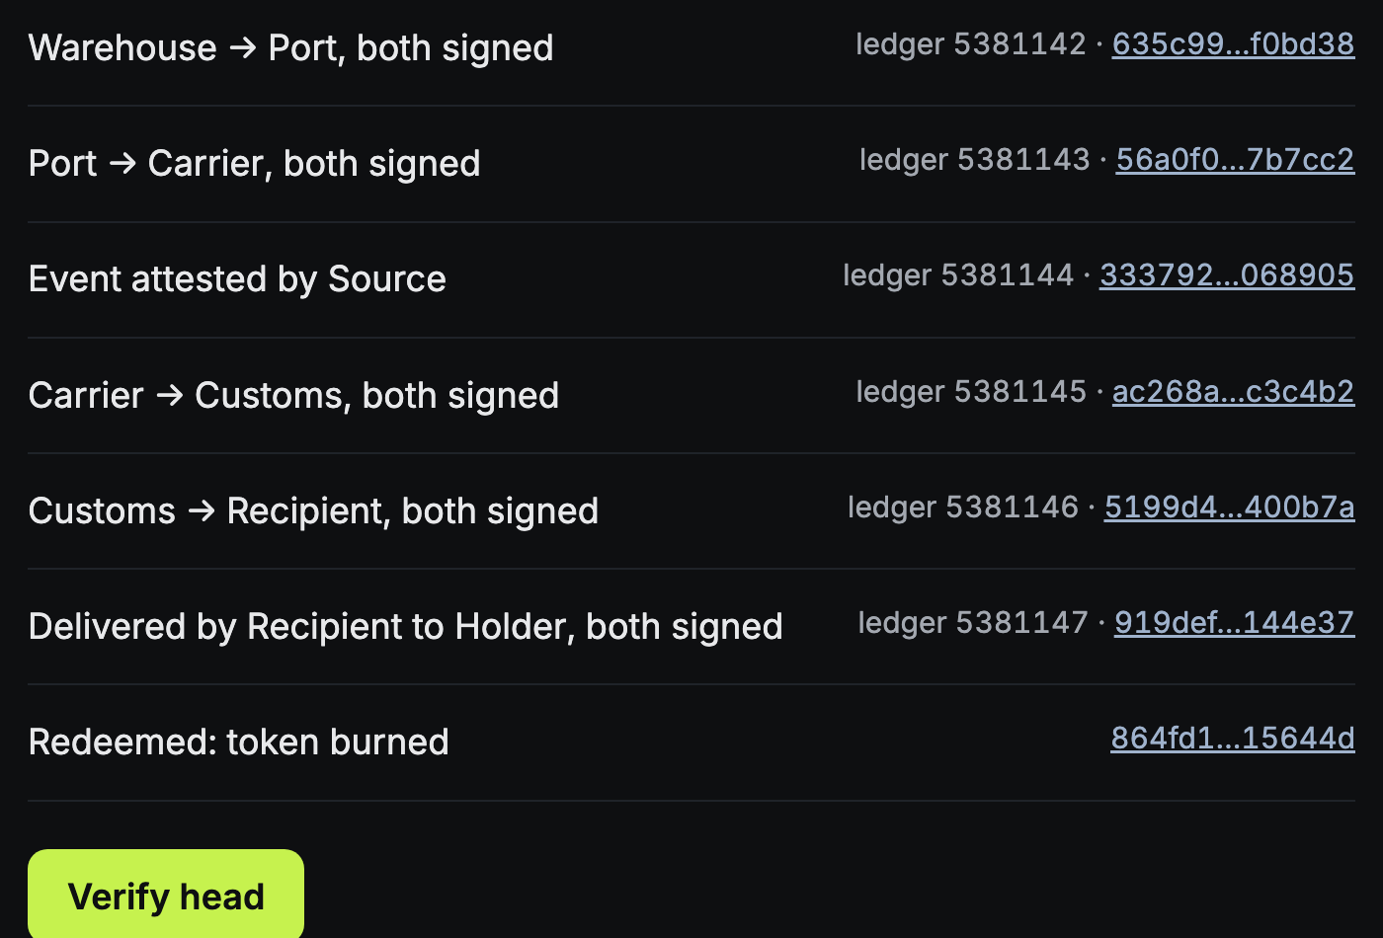
PLATFORM 04 / 10
HACKMERIDIAN 2026 · LISBON
NEXT ▸ TECHNICAL WORKFLOW
THE PRODUCT · LIVE ON TESTNET
Anyone can check the chain. No login.
Verify head recomputes the hash chain in the browser and compares it with the head stored in the contract.
MATCH
Clicked live on 25 Oct 2026.
Read-only: Stellar RPC and Horizon, no wallet.
rio-miami-rail.vercel.app
© 2026 HackMeridian · Lisbon · #HackMeridian26

Slide 5
PLATFORM 05 / 10
HACKMERIDIAN 2026 · LISBON
NEXT ▸ WHY STELLAR
TECHNICAL WORKFLOW
7 testnet transactions. All successful.
open
operator
handover 1
Warehouse → Port
handover 2
Port → Carrier
handover 3
Carrier → Customs
handover 4
Customs → Recipient
deliver
Recipient → Holder
burn
existing redeem
2b3d51f0
635c99ac
56a0f006
ac268a49
5199d4fb
919def8c
864fd164
7
9
24
MATCH
successful testnet transactions
invalid calls refused (simulated)
contract unit tests pass
verify-head rebuilds the chain
custody_registry CCBJVXMJYWPHTDJHDFPRGKPGXGEP24JOPJAMUS5C3BMZJTRTWR2H4LII
Plus one event attestation by a source custodian (33379211), also on chain. Full hashes: the repo's proofs/lifecycle.json.
Every actor is a test key held by one harness: this proves the mechanism, not independent custodians.
© 2026 HackMeridian · Lisbon · #HackMeridian26

Slide 6
PLATFORM 06 / 10
HACKMERIDIAN 2026 · LISBON
NEXT ▸ USERS AND MODEL
ECOSYSTEM · WHY STELLAR
Why Stellar: two signers, one call
01
Multi-party auth in one call
Soroban authorises both custodians inside one contract invocation: the handover is atomic.
02
Events plus an on-chain head
RPC keeps contract events about 7 days. The head stored in the contract lets anyone rebuild the full history later.
03
The token stays put, then burns
The shipment token never moves in transit; the existing Radox redeem burns it after delivery.
Nearest neighbours we found (LumenLoop, SCF, Scout; searched 24–25 Oct 2026): Kutana and Trustless Work release escrow on trade milestones. We found none that records a custody handover signed by two custodians, and no SEP for it.
Open source, Apache-2.0: a custody primitive other Stellar real-world-asset issuers can reuse.
© 2026 HackMeridian · Lisbon · #HackMeridian26

Slide 7
PLATFORM 07 / 10
HACKMERIDIAN 2026 · LISBON
NEXT ▸ BUILT THIS WEEKEND
USERS · BUSINESS MODEL
Custodians sign. Financiers check.
CUSTODIANS
Warehouse, port, carrier, customs: sign each handover.
MODEL · THE OPERATOR PAYS
SWIFT-style: the record format is public; Radox runs the rail and the API.
Revenue: a fee from the financial institution that operates the rail. Not priced yet.
Radox is the rail, never the issuer. Regulation and licences stay with the client and its local counsel.
EXPORTER · BUYER
See where the goods are and who holds them.
FINANCIER
Checks the custody chain before paying.
OPERATOR
A financial institution, the client, would run the rail for its trade flows.
© 2026 HackMeridian · Lisbon · #HackMeridian26

Slide 8
PLATFORM 08 / 10
HACKMERIDIAN 2026 · LISBON
NEXT ▸ VISION AND ASK
HACKATHON PROGRESS
Built this weekend, on disclosed prior work
PRIOR WORK · BEFORE SUN 25 OCT 09:00
BUILT AT HACKMERIDIAN
— Radox platform and 3 Soroban contracts on Stellar mainnet (public repo, created 2026-08-19)
— transfer_agent and its redeem (new testnet instance from the existing wasm)
— Planning files, 24–25 Oct
— custody_registry contract, 24 unit tests
— Lifecycle harness: 7 testnet transactions, 9 refused calls
— verify-head script and the public shipment page
— Radox API reads the registry: same head (closed backend, testnet)
AI attribution Code, tests and scripts were written with AI coding agents (Claude Code); the team decided scope and what ships. Per-file record in AI_USAGE.md. The video narration is an AI voice generated from Pedro's voice.
© 2026 HackMeridian · Lisbon · #HackMeridian26

Slide 9
PLATFORM 09 / 10
HACKMERIDIAN 2026 · LISBON
NEXT ▸ THE TEAM
VISION · NEXT · THE ASK
Vision: one custody standard, every corridor
Rio–Miami is the first corridor and the pilot. The goal is an open, SWIFT-like standard for tokenized goods moving on rails anywhere, built to integrate with the systems of chambers of commerce, ports and airports.
NOW
NEXT
PLANNED
FUTURE
Mechanism proven on testnet. No users or revenue yet.
One Rio–Miami pilot shipment (none agreed yet). Full test matrix.
SCF Build application, then a security audit (neither done). Mainnet.
More corridors on the same standard. A USD leg (not built).
Our ask Introductions to one financial institution and one logistics operator for a first pilot shipment, and a Stellar engineer's review of the design.
© 2026 HackMeridian · Lisbon · #HackMeridian26

Slide 10
PLATFORM 10 / 10
HACKMERIDIAN 2026 · LISBON
FINAL STOP
THE TEAM
Why us: a founder already on Stellar mainnet
Pedro Wakigawa Saragossy
Founder, captain. Built Radox: 3 Soroban contracts on Stellar mainnet.
Team photo
Leo Schlanger
Developer: custody_registry, the testnet harness and the proofs.
Vhendala
QA and product review: reads every deliverable as a judge would.
Leo and Vhendala joined for the hackathon.
Rio–Miami first. Then one custody standard for every corridor.
Live page rio-miami-rail.vercel.app Code github.com/pwsaragossy/rio-miami-rail (Apache-2.0)
AI Code written with AI coding agents (Claude Code). Narration: an AI voice from Pedro's voice. No AI-generated images in this deck.
© 2026 HackMeridian · Lisbon · #HackMeridian26

