Slide 1
565 final project
Giorgia Fiscaletti, Peiyun Wu

Slide 2
Problem Overview
List scheduling: map operations to time slots (clock cycles); greedy algorithm for MR-LCS and MR-LCS
Its objective is to minimize/maximize a certain parameter while satisfying predefined constraints
Two main problems:
Minimize the resources, subject to latency constraints (MR-LCS)
Minimize the latency (i.e. maximize performance), subject to resource constraints (ML-RCS)
NOP
X
X
X
X
+
1
X
X
+
<
2
_
3
_
4
NOP
2

Slide 3
Problem Overview
ML-RCS: minimize latency, subject to resource constraints
The list scheduling for ML-RCS is very similar to the Hu’s algorithm: they have the same time complexity (i.e. O(nlogn)) and the nodes are selected by criticality
Difference w.r.t. Hu’s algorithm: it allows to define resource constraints for each resource type
How to break “criticality ties”? Lookahead of Resource-based Earliest Scheduling Time (REST).
1 (cc)
+
5
+
5
X
6
2 (cc)
X
4
div
4
+
4
X
2
+
1
div
3
5 (cc)
6 (cc)
L = 8 cc
nop
9 (cc)
2 (cc)
1 (cc)
+
5
+
5
X
6
3 (cc)
X
4
div
4
+
4
3 (cc)
X
2
+
1
div
3
5 (cc)
L = 7 cc
nop
8 (cc)
3

Slide 4
Project Structure
Our steps:
Study of benchmarks and MR-LCS implementation
Implementation of input parser: from txt files to data structures
Implementation of basic utility functions to compute useful parameters for our algorithm (e.g. ALAP and ALAP times)
Implementation and testing of basic ML-RCS list scheduling
Implementation and testing of REST/e-REST algorithm
Integration of REST/e-REST with ML-RCS
Implementation of the MR-LCS algorithm to get the resource constraints
Implementation of checker and benchmarks evaluation
4

Slide 5
List Scheduling
Input ----MR_LCS
Run—ML_RCS with computed
recourse constraints *parameter_recourse_constraints

Slide 6
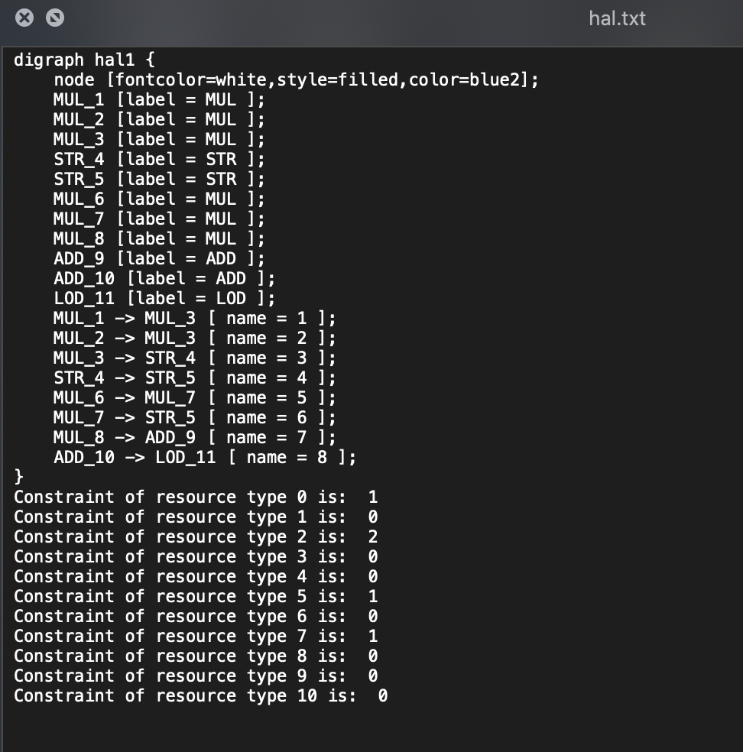
Run MR_LCS first
Append result to every input .txt

Slide 7
ML_RCS
LIST_L (G(V,E), a) { // a is a vector of avail. res. of each type
Compute the ALAP times t^{L} w.r.t. an upper bound latency L. /* alap times “inverse” of but correlated to max-path-delay or length label */
l = 1 // the current cc
repeat {
for each resource type k {
U_{l,k} = available vertices in V.
T_{l,k} = operations in progress.
Compute the slacks { s_{i} = t_{i}^{L} - l, ∀ v_{i}∈ U_{l,k} }.
/* Note slack also is inv. prop. to length label */
Select minimal slack S_{k} ⊆ U_{l,k} such that
|S_{k}| + |T_{l,k}| ≤ a_{k} /* break ties arbitrarily */
Schedule the S_{k} operations at step l
}
l = l + 1
} until v_{n} is scheduled.
} // Note: Does not do lookahead using e-rest as in the prev. example. Can do so for a better ML-RCS algorithm, i.e., choose opers to schedule w/minimal e-rest rather than minimal slack.
apply REST here

Slide 8
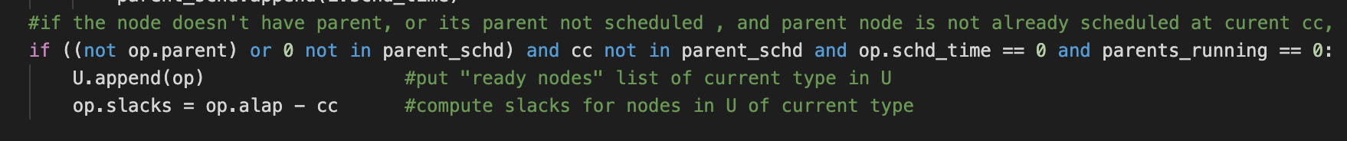
ML_RCS
For each cc:
For each FU type:
U = [] #available operands(nodes) of current resource type
Traverse the DFG graph:
calculate slacks for each node in U

Slide 9
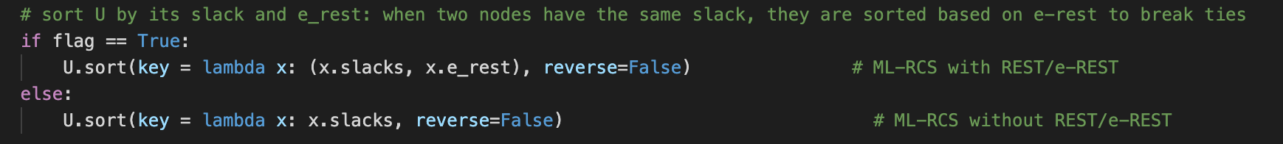
Sort the slacks
Flag is True ---with REST
Flag is False – without REST

Slide 10
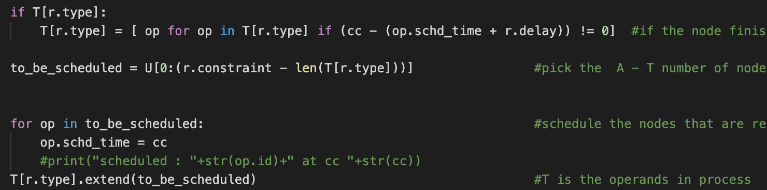
Update T
Pick the smallest A-T number of operands to schedule
T = defaultdict(list) #list of operations in progrees of the same type

Slide 11
REST/e-REST
The problem: resource idling. Having idling FUs impacts negatively the latency.
Constraints: 1+(1cc), 1x(2cc), 1÷(3cc)
The sooner we can get the result of this adder, the earlier we will be able to schedule the division
1 (cc)
2 (cc)
+
5
Sched. time
1 (cc)
+
5
X
6
+
5
+
5
X
6
2 (cc)
Distance
label
3 (cc)
critical path
(*)
X
4
div
4
+
4
X
div
+
(*)
4
4
4
3 (cc)
X
2
+
1
div
3
X
+
div
5 (cc)
2
1
3
6 (cc)
5 (cc)
L = 8 cc
nop
9 (cc)
nop
8 (cc)
L = 7 cc
The multiplier takes 2 cc to finish the computation, so the second multiplication (*) cannot be scheduled before the 3rd clock cycle. For this reason, we want to break the tie between the two additions in favor of the operation that can be scheduled earlier, i.e. the division.
The REST/e-REST algorithm allows us to break the ties between nodes with the same distance metric from the NOP node (in our specific case, slack ties). In case of a tie, the REST allows to schedule an operation later if it is not going to affect the scheduling of any critical successors.
11

Slide 12
REST/e-REST
Our implementation Utility functions:
ASAP(): to compute the ASAP time of each node
get_levels(): to get the level of the nodes in the DFG
Initialization (first level, i.e. k=1):
Set REST and e-REST of each node in the first level to 1
Initialize the resource flow graph
1
1
+
5
1
+
5
X
6
X
4
div
4
+
4
X
2
+
1
div
3
L = 7 cc
nop
12

Slide 13
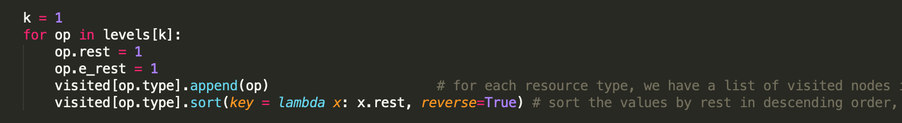
REST/e-REST
13

Slide 14
REST/e-REST
Our implementation (2): top-down for k = 2 until the last level of the graph:
for each node u of type r in level k:
1) select a_{k} (= resource constraint for type a) nodes from previous levels with max REST (we have a data structure – dictionary – that keeps track of the visited nodes in the previous levels for each type and from which we can select the a_{k} nodes with max REST) and assign them as parents of u in the resource flow graph. If there are no such nodes, add a dummy node with REST = 1 2) compute the REST of u as: max{min{resource parents’ REST + delay}, u’s ASAP time} for this purpose, we build a list of values for the sum of REST and delay
of each resource parent of u, and just compare the max() of the list with u’s ASAP time 3) set u’s e-REST = u’s REST
- once done with all the nodes in level k, update the dictionary with the new visited nodes of level k, since they are eligible to be picked as resource parent nodes of any of the nodes in the following level
14

Slide 15
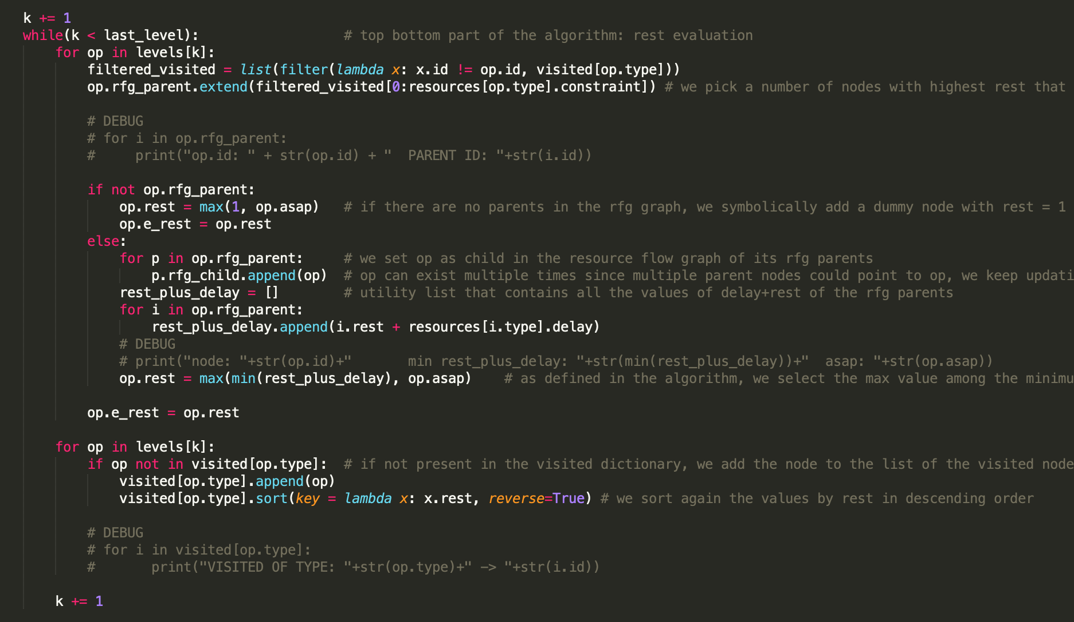
REST/e-REST
15

Slide 16
REST/e-REST
Constraints: 1+(1cc), 1x(2cc), 1÷(3cc)
1
+
5
1
+
5
1
X
6
#1
#2
#3
Current level = 2
X
4
div
4
+
4
#4
#5
#6
X
2
+
div
1
3
#7
#8
#9
nop
L = 7 cc
16

Slide 17
REST/e-REST
Constraints: 1+(1cc), 1x(2cc), 1÷(3cc)
1
+
5
1
+
5
1
X
6
#1
#2
#3
Current level = 2
X
4
div
4
+
4
#4
#5
#6
X
2
+
div
1
3
#7
#8
#9
nop
Eligible resource parents per type:
- x: {#3}
- +: {#1, #2}
- ÷: {}
L = 7 cc
17

Slide 18
REST/e-REST
Constraints: 1+(1cc), 1x(2cc), 1÷(3cc)
1
+
5
1
+
5
1
X
6
#1
#2
#3
Current level = 2
X
4
div
4
+
4
#4
#5
#6
REST = max(3, 2) = 3
X
2
+
div
min(parents’ REST+delay), i.e. 1+2
1
3
#7
#8
#9
nop
Eligible resource parents per type:
- x: {#3}
- +: {#1, #2}
- ÷: {}
L = 7 cc
18

Slide 19
REST/e-REST
Constraints: 1+(1cc), 1x(2cc), 1÷(3cc)
1
+
5
1
+
5
1
X
6
#1
#2
#3
Current level = 2
3
div
X
4
4
+
4
#4
#5
#6
X
2
+
div
1
3
#7
#8
#9
nop
Eligible resource parents per type:
- x: {#3}
- +: {#1, #2}
- ÷: {}
L = 7 cc
19

Slide 20
REST/e-REST
Constraints: 1+(1cc), 1x(2cc), 1÷(3cc)
1
delay = 0
1
+
5
1
+
5
1
X
div
6
#1
#2
#3
Current level = 2
3
div
X
4
4
+
4
#4
#5
#6
REST = max(1, 2) = 2
X
2
+
div
1
3
#7
#8
#9
nop
Eligible resource parents per type:
- x: {#3}
- +: {#1, #2}
- ÷: {}
L = 7 cc
20

Slide 21
REST/e-REST
Constraints: 1+(1cc), 1x(2cc), 1÷(3cc)
1
delay = 0
1
+
5
1
+
5
1
X
div
6
#1
#2
#3
Current level = 2
3
2
X
4
div
4
+
4
#4
#5
#6
X
2
+
div
1
3
#7
#8
#9
nop
Eligible resource parents per type:
- x: {#3}
- +: {#1, #2}
- ÷: {}
L = 7 cc
21

Slide 22
REST/e-REST
Constraints: 1+(1cc), 1x(2cc), 1÷(3cc)
1
1
1
1
+
5
+
5
X
6
div
#1
#2
#3
Current level = 2
ties are broken arbitrarily
3
2
X
4
div
4
+
4
#4
#5
#6
REST = max(2,3) = 3
X
2
+
div
1
3
#7
#8
#9
nop
Eligible resource parents per type:
- x: {#3}
- +: {#1, #2}
- ÷: {}
L = 7 cc
22

Slide 23
REST/e-REST
Constraints: 1+(1cc), 1x(2cc), 1÷(3cc)
1
1
1
1
+
5
+
5
X
6
div
#1
#2
#3
Current level = 2
ties are broken arbitrarily
3
2
3
X
4
div
4
+
4
#4
#5
#6
X
2
+
div
1
3
#7
#8
#9
nop
Eligible resource parents per type:
- x: {#3, #4}
- +: {#1, #2, #6}
- ÷: {#5}
L = 7 cc
23

Slide 24
REST/e-REST
Our implementation (3): bottom-up
for k = last level to 1:
for each node u of type r in level k:
for each node w that is a parent of u:
- update the e-REST (effective REST) of node w as:
max{min{e-REST of w’s children – w’s delay}, e-REST of w}
- for this purpose, we build a list of values for the difference between the e-REST of w’s child and w’s delay for each DFG child of u, and just compare the min() of the list with w’s e-REST - if the effective REST changes, the change is propagated to its parent nodes until the root thanks to the bottom-up approach
24
[Lamoureux and Wilton, ACM, 2003]

Slide 25
REST/e-REST
Constraints: 1+(1cc), 1x(2cc), 1÷(3cc)
1
1
1
1
+
5
+
5
X
6
div
#1
#2
#3
Current level = 3
3
2
3
X
4
div
4
+
4
#4
#5
#6
5
5
5
X
2
+
div
1
3
#7
#8
#9
nop
L = 7 cc
25

Slide 26
REST/e-REST
Constraints: 1+(1cc), 1x(2cc), 1÷(3cc)
1
1
1
1
+
5
+
5
X
6
div
#1
#2
#3
Current level = 3
3
2
3
X
4
div
4
+
4
#4
#5
#6
5
5
5
X
2
+
div
1
3
#7
#8
#9
nop
L = 7 cc
26

Slide 27
REST/e-REST
Constraints: 1+(1cc), 1x(2cc), 1÷(3cc)
1
1
1
1
+
5
+
5
X
6
div
#1
#2
#3
Current level = 3
3
2
3
X
4
div
4
+
4
#4
#5
#6
e-REST =
max(4,3) = 4
5
5
5
X
2
+
div
1
3
min(children’s REST- parent delay), i.e. 5-1
#7
#8
#9
nop
L = 7 cc
27

Slide 28
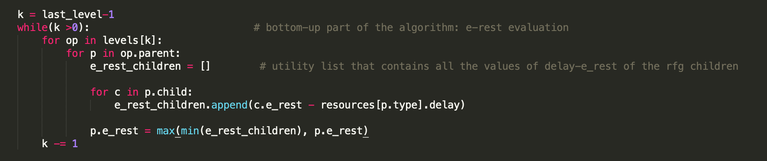
REST/e-REST
28
[Lamoureux and Wilton, ACM, 2003]

Slide 29
Results
Latency result for all benchmarks
Comparison between with/without REST applied
Detailed result on particular graphs

Slide 36
node ID | 1adder | 2adder | 3mul | 4mul | 5div | 6adder | 7mul | 8adder | 9div | -1
asap | 1 | 1 | 1 | 3 | 3 | 5 | 7 | 9 | 7 | 13
alap | 23 | 23 | 21 | 25 | 25 | 25 | 29 | 31 | 27 | 33
REST | 1 | 1 | 1 | 5 | 3 | 5 | 9 | 9 | 9 | -1
E_REST | 3 | 1 | 3 | 5 | 3 | 7 | 9 | 9 | 9 | -1
schd_time without rest | 1 | 3 | 1 | 5 | 5 | 5 | 9 | 11 | 7 | 13
schd_time with rest | 3 | 1 | 1 | 5 | 3 | 5 | 9 | 9 | 7 | 13
REST w/
update ro E-REST
Res. dependency arcs (blue)
Longest
path
label
1
1
div
 | adder | div | mul
Resource cons | 1 | 2 | 1
delay | 2 | 4 | 6
1 → 2
+
5
+
5
X
6
2 (cc)
3 → 4
3
X
4
2
div
4
+
4
dummy
oper.
node
5
5
X
2
4 → 5
+
1
div
3
nop

Slide 37
node ID | 1adder | 2adder | 3mul | 4mul | 5div | 6adder | 7mul | 8adder | 9div | -1
REST | 1 | 1 | 1 | 5 | 3 | 5 | 9 | 9 | 9 | -1
E_REST | 3 | 1 | 3 | 5 | 3 | 7 | 9 | 9 | 9 | -1
schd_time without rest | 1 | 3 | 1 | 5 | 5 | 5 | 9 | 11 | 11 | 17
schd_time with rest | 3 | 1 | 1 | 5 | 3 | 5 | 9 | 9 | 9 | 15
REST w/
update ro E-REST
Res. dependency arcs (blue)
Longest
path
label
1
1
div
1 → 2
+
5
+
5
X
6
2 (cc)
 | adder | div | mul
Resource cons | 1 | 1 | 1
delay | 2 | 4 | 6
3 → 4
3
X
4
2
div
4
+
4
dummy
oper.
node
5
5
X
2
4 → 5
+
1
div
3
nop

Slide 38
Extensions
Different Coefficient:
parameter_resource_constraints = 0.01 0.05 0.1 0.2 0.3 … 0.9 1
Considering the total energy of the put and energy delay product(EDP)
We extended List scheduling algorithm with a selection metric. And sort the available nodes in U by: metric_selection * slacks + (1- metric_selection)* e_REST

Slide 39
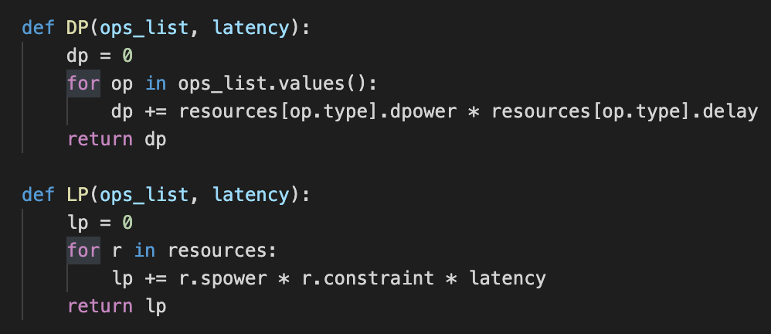
Energy calculation
Total_energy = dp + lp

Slide 41
Energy Delay Product

Slide 42
Energy Delay Product
We added energy delay product(EDP) to show which resource constraint parameter is more optimal.
Turns out when resource constraint parameter is 0.3 has less total energy but energy delay product(EDP) is not optimal. When resource constraint parameter = 0.8,0.9,1 the result is more optimal

Slide 44
Energy Delay Product

Slide 45
Energy Delay Product
For jpeg_fdct_islow_dfg__6.txt we can tell the total energy is increasing when the parameter increases. However, energy delay product decreases when the parameter increases. This is because when resource constrain is loose, the delay decrease dramatically(decrease to half), hence the EDP decreases too.

Slide 46
Extended LS with selection metric
Selection_metric = 0 0.1 0.2 0.3 … 0.9 1
When selection metric = 0, select base on e_rest
When selection metric = 1, select base on slacks
Otherwise, select base on slack * metric + (1-metric) * e_rest

Slide 47
Latency Results
The results varies for different benchmarks

Slide 48
For idctcol_dfg__3.txt, the selection is more optimal based on e_rest

Slide 49
For h2v2_smooth_downsample_dfg__6.txt is more optimal when selection metric is 0.7 or 0.8

Slide 50
For hal.txt result is more optimal based on slacks

Slide 51
For example.txt result is more optimal based on e_rest

Slide 52
For arf.txt result is more optimal based on slacks

Slide 53
For jpeg_fdct_islow_dfg__6.txt result is the same

Slide 54
Latency Results for all benchmarks
selection more optimal on slacks (metric ~1) | selection more optimal between middle | selection more optimal on e_rest (metric ~0) | No change
idctcol_dfg__3.txt hal.txt arf.txt write_bmp_header_dfg__7.txt | ewf.txt ( metric = 0.3~0.5) h2v2_smooth_downsample_dfg__6.txt(0.7,0.8) motion_vectors_dfg__7.txt(0.9~1 or 0~0.3) | example.txt interpolate_aux_dfg__12.txt feedback_points_dfg__7.txt | collapse_pyr_dfg__113.txt horner_bezier_surf_dfg__12.txt smooth_color_z_triangle_dfg__31.txt matmul_dfg__3.txt jpeg_fdct_islow_dfg__6.txt

