Slide 1
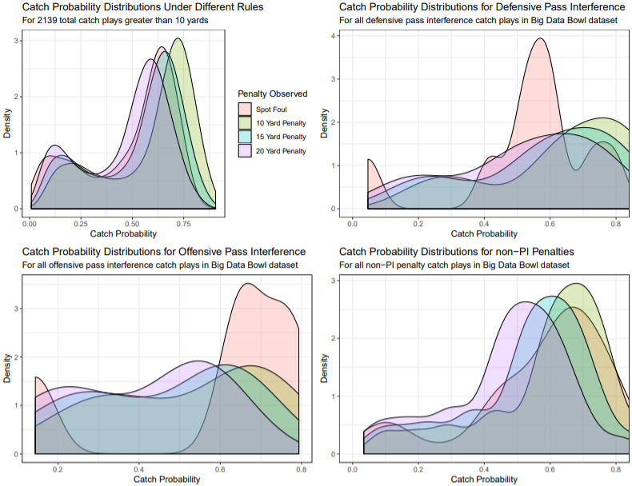
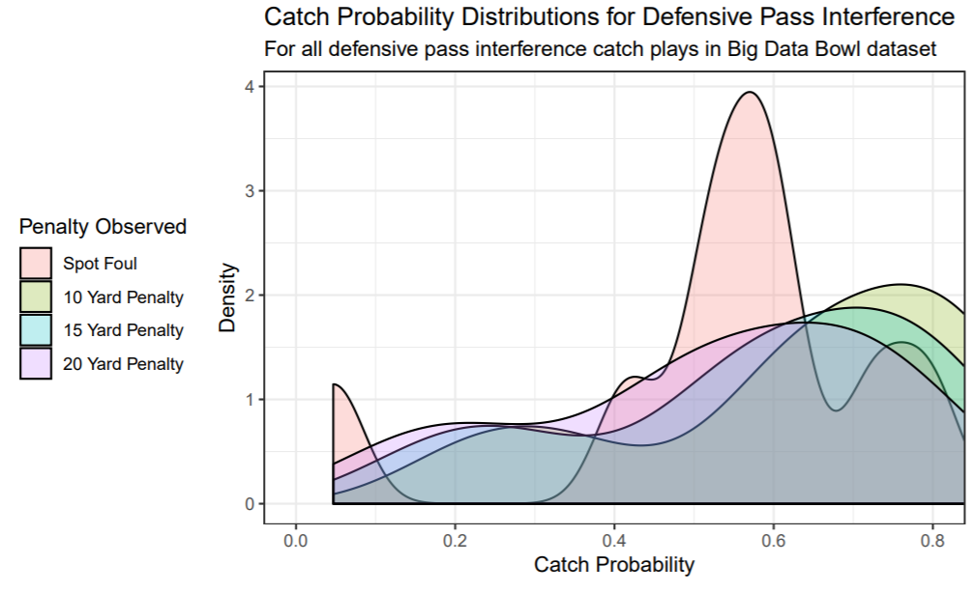
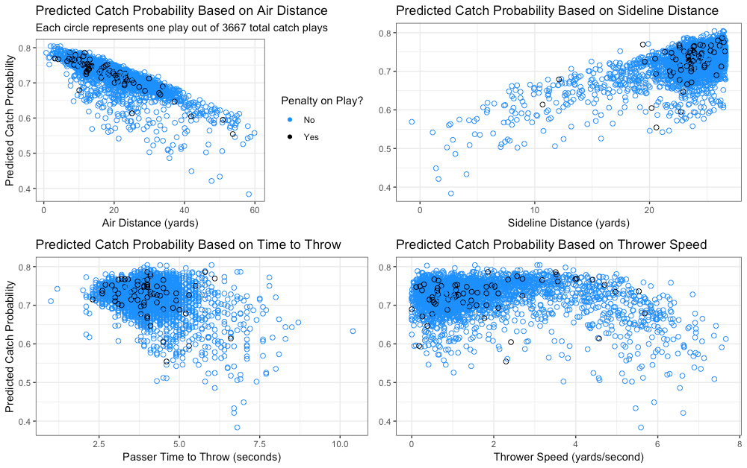


A Two-Level Model for Defensive Pass Interference
Peter Wu (Carnegie Mellon University), Brendon Gu (Carnegie Mellon University)
Our Proposal
Catch probability on penalties
Bimodal spot foul distribution in the top right plot
10-yard penalty and right peak of the spot foul align at the 75% catch probability mark, making a 10-yard penalty for the first level of a DPI appropriate.
First Level of DPI: “Common Foul”
10-Yard Penalty
Left peak - “flagrant foul”
(defender not playing ball)
[57% catch probability]
Right peak - “common foul”
(defender playing ball)
[75% catch probability]
Second Level of DPI: “Flagrant Foul”
Spot Foul
Reviewable/Challengeable
Pass Interference Calls
Methodology
To predict catch probability, we focused on:
We fit a multiple logistic regression model (see equation) to the variables.
air distance
time to throw
separation
sideline distance
passer speed
Contact Info
Conclusion
Peter Wu – peterwu@andrew.cmu.edu
@statsman005
Brendon Gu – bkgu@andrew.cmu.edu
@bgu7_
We identified weaknesses in how pass interference is presently officiated and proposed ways to remedy them. The data and our models support a two-level system for defensive interference (a “flagrant foul” and a “common foul” version of the foul) as an effective way of improving the call.

