Slide 1
CSE2215 Computer Graphics Ray Tracing Final Project
31 October 2019
Group 22
Lazar Nenovski
Moshiur Rahman
Jacob Roeters van Lennep
Shivani Singh
Joaquin van Loon
Yanqing Wu

Slide 2
Project Structure
triangle
flyscene
box
hitable
sphere
light
ray
scene
spherelight
triangleList
multithreading

Slide 3
Agenda
Features Implemented
Acceleration structure statistics
Example 1: Minimum Requirements
Example 2: Acceleration Structure
Example 3: An illustration of corner cases
Final Image

Slide 4
Feature Implementation
Status
Extrainformation
Minimum Requirements
Finished all minimum requirements
Most minimum requirements will be show in example XX
Features
A more complex scene hierarchy
Using bounding volume hierarchy to speed up the raytracing.
Recursively splitting boxes on the longest axis at the median of the triangle’s centroids
Extended debugger ray
We created a debugger ray to show the Xth reflection
This will be shown in example XX
Support refactoring for transparent objects
Some comments onn this
xxx
Multicore support
We use a multithreading technique with a queue
Numerical evaluation of performance
We show the amount of time the raytracing takes in milliseconds.
This is also used with the acceleration structure statistics.
An illustration of corner cases
We took care of corner case XX
This will be shown in example XX

Slide 5
Agenda
Features Implemented
Acceleration structure statistics
Example 1: Minimum Requirements
Example 2: Acceleration Structure
Example 3: An illustration of corner cases
Final Image

Slide 6
Acceleration structure statistics
Bounding Volume Hierarchy speed up
Model 1
Model 2
Model 3
Vertical cut using the median centroid
Model 1: Cube
Vertices:
Faces:
Model 2: Doll
Vertices:
Faces:
Model 3: Bunny
Vertices:
Faces:
Without any structure
xx
xx
xx
With basic list structure
xx
xx
xx
With our tree structure
xx
xx
xx
In minimal seconds, on resolution XX x XX, tested on a X1 Carbon

Slide 7
Agenda
Features Implemented
Acceleration structure statistics
Example 1: Minimum Requirements
Example 2: Acceleration Structure
Example 3: An illustration of corner cases
Final Image

Slide 8
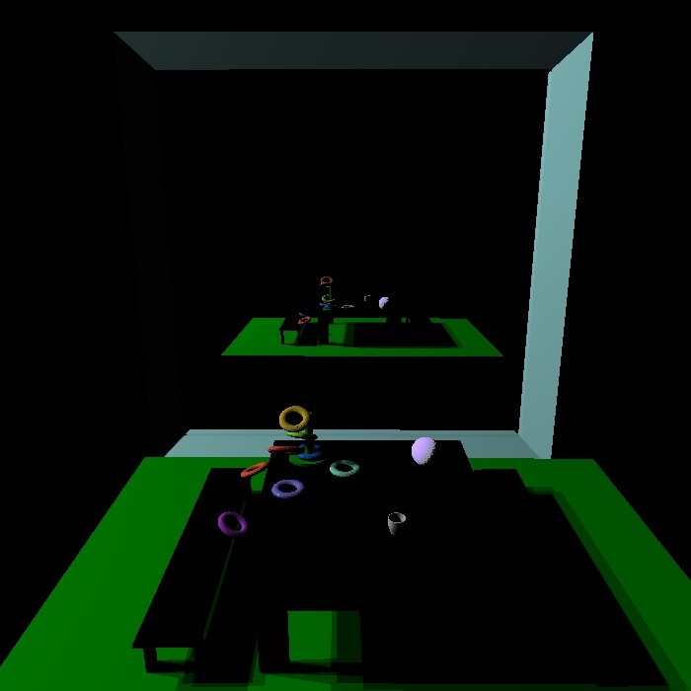
Example 1: Minimum Requirements
Hard shadow
Soft shadow
Reflection
Refraction

Slide 9
Agenda
Features Implemented
Acceleration structure statistics
Example 1: Minimum Requirements
Example 2: Acceleration Structure
Example 3: An illustration of corner cases
Final Image

Slide 10
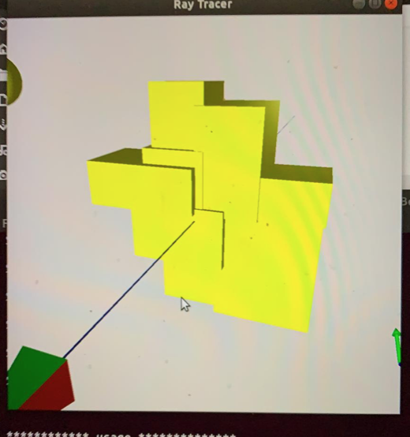
Example 2: Acceleration structure
Acceleration Structure
Debug ray

Slide 11
Agenda
Features Implemented
Acceleration structure statistics
Example 1: Minimum Requirements
Example 2: Acceleration Structure
Example 3: An illustration of corner cases
Final Image

Slide 12
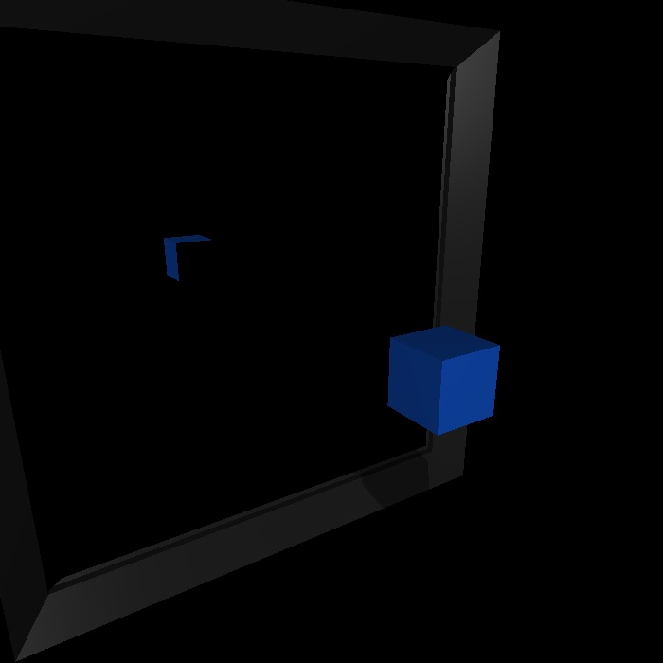
Example 3: An illustration of corner cases
An illustration of interesting test or corner cases
Soft shadows
Hard shadows
reflection
Here you see the structure of the boxes
Here is the ray that shoots
This extra
Here you can seee this

Slide 13
Agenda
Features Implemented
Acceleration structure statistics
Example 1: Minimum Requirements
Example 2: Acceleration Structure
Example 3: An illustration of corner cases
Final Image

Slide 14
Final Image

