Slide 1


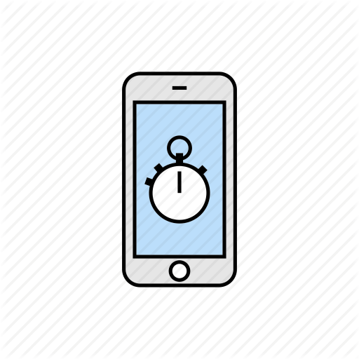

Team: Destructinator
Task calendar – Time management app
Team members: Pham Quang Minh
Nguyen Ngoc Linh Chi
This project aim to reduce wasted time and increase working efficiency
Arrange events/timetable in the calendar, showing tasks and workload in the calendar
Display tasks list for each day and suggest next task to do during free time
Setting up the timer to record working/studying time while the phone is not used
Statistically calculated time spent working each day and number of completed tasks

