Slide 1
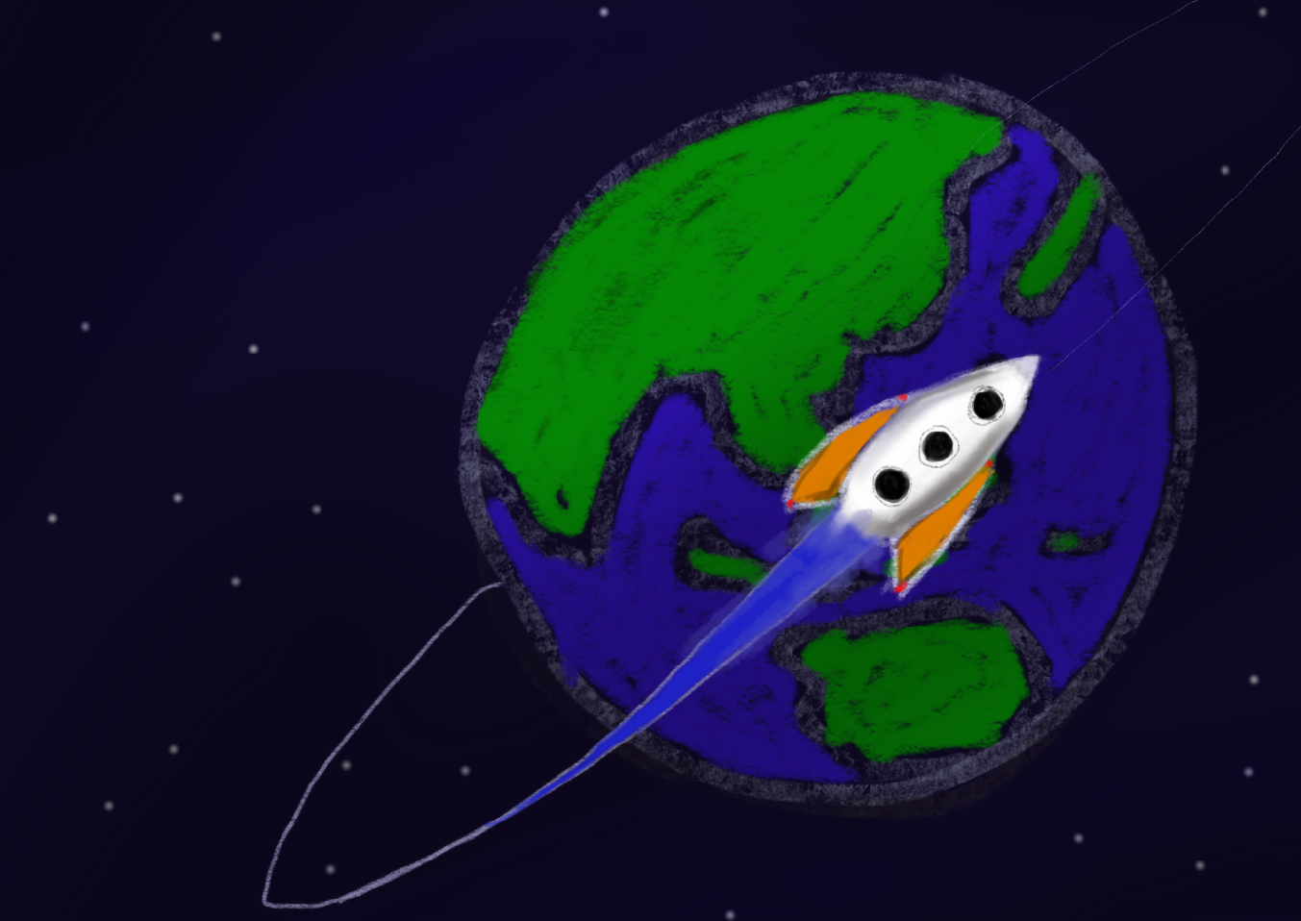
NUS Orbital 2018
Welcome to Orbital!

Slide 2
A Million Dollar Question
Why are you taking Orbital?
Notes:
Interact with the students: For the MC? Learn technology? Gain experience in software engineering? Build something that you like? Get testimonials for internship / NOC...
We can give swags to students who answer this questino.

Slide 3
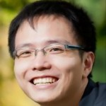
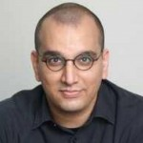
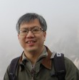
Our Team
Dr. Zhao Jin (Main coordinator)
zhaojin@comp.nus.edu.sg
Dr. Anand Ramchand (Mentorship coordinator)
anand@comp.nus.edu.sg
Prof. Kan Min-Yen (Creator and facilitator)
kanmy@comp.nus.edu.sg
as well as ~40 advisors and ~30 mentors.

Slide 4
Overview of Orbital
CP2106: Independent Software Engineering Project
Project team
Project ideas
Levels of achievements
The people factor: advisors, peers, mentors
Timeline of events
Liftoff
Resources

Slide 5
Project Team
Team of 2: Good teamwork and communication required.
Find your partner at “Find-a-copilot” session at 1pm today if you haven’t.
Have you named your team?
Notes:
Communicate and cooperate with your partner.
Take ownership of your team by naming it. Past team names: pewpew, running man icon, Maximum Red Stone of Aja Star Platinum OVERDRIVE

Slide 6
Project Ideas
- “Solve your own problem” (NUS / SoC centric - e.g., module bidding, meeting scheduler)
- “I had always wanted to try…” (Personal Interest - e.g., mobile app and game development)
- “Gonna win it this time” (submission to a SW competition, e.g., Kaggle, Apps4SG)
- “Getting my hands dirty” (projects with HW, Lego Mindstorms, Arduino)
- “It’s so me...” (Quirky, describes the team - e.g., clothes matcher)
Notes:
Work on any project as long as it is related to computing. Solve your own problem. Anything is possible.
Does not matter whether it has been done before.

Slide 7



Levels of Achievement
Three levels:
Vostok (easy / beginner)
Project Gemini (intermediate)
Apollo 11 (difficult / advanced)
Update any time in Skylab
What you have done by Splashdown is what you get.
(We shamelessly hope more of you will be sucked into higher levels.)
Feel free to discuss with us if you are unsure.
Eligible for mentorship
Notes:
Three levels. Get 4 MC no matter which level you choose.
Concern: too difficult, takes a lot of time?
Expectation: Project Gemini: Students with some programming background, 10 hours per week. The workload is no more than any introductory programming module you have cleared. Comfortable completion.
Vostok: Students with no background, very unsure about themselves.
Apollo 11: Students who are capable or want some challenge.

Slide 8

The People Factor: Advisors
Each advisor takes 5~6 teams and serves 3 roles:
Notes:
Independent but not alone. Most of you should have known who your advisor is by now. Remember to say hi to your advisor and introduce yourself on Slack.
Advisors are serve three roles: Evaluator: evaluate the progress report you submit at the end of every month, Project manager: ensure that you are making good progress and provide assistance as necessary, Cheerleader: keep you motivated. Basically your advisor is here to take care of your team. Please feel free to approach them if you need anything.

Slide 9
The People Factor: Peers
Other teams under the same advisor
Meet up during group meetings, communicate via the Slack channel, etc.
Discuss about ideas, share resources, give comments and feedback directly, etc.
Teams under a different advisor
Give comments and feedback via Milestone Peer Evaluation
Notes:
All teams under the same advisor are in the same evaluation group. We have already created a channel on Slack for each evaluation group. You can make use of the channel to discuss able ideas and share resources.
In addition, you are required to give comments and feedback to teams outside your evaluation group. In this way, you will get to see how other teams are doing and you can get comments and feedback for your own project.

Slide 10
The People Factor: Mentors
Mentors are senior students, faculty members and industry experts who want to pitch in and help guide student teams
They are able to provide more insights, resources and opportunities than advisors.
Mentors are only available to Apollo 11 teams which are committed to finish Orbital.
More details later at 1pm today
Notes:
Lastly, we have our team of mentors who are senior students, alumni and experts from the industry. They are here to help you achieve a higher ground. Compared to advisor, more experienced in software development, more knowledgeable about the latest technology used in the industry, more resourceful and able to provide more opportunities. You can definitely learn more from them and perhaps get internship opportunities at their company.

Slide 11
Orbital Timeline: Mandatory Events
14-15 May - Liftoff Workshop (Crash course on basic tech)
4 June - Evaluation Milestone 1 - Ideation
2 July - Evaluation Milestone 2 - Prototyping
30 July - Evaluation Milestone 3 - Extension
5 September - Splashdown - Refinement
(Poster session and award ceremony)
Notes:
Opening workshop.
Complete the project in 3 phases (Ideation, Prototyping and Extension)
Submit progress reports at the end of each phase, and present your project in early September.
More details about the Milestones will be released after Liftoff.

Slide 12
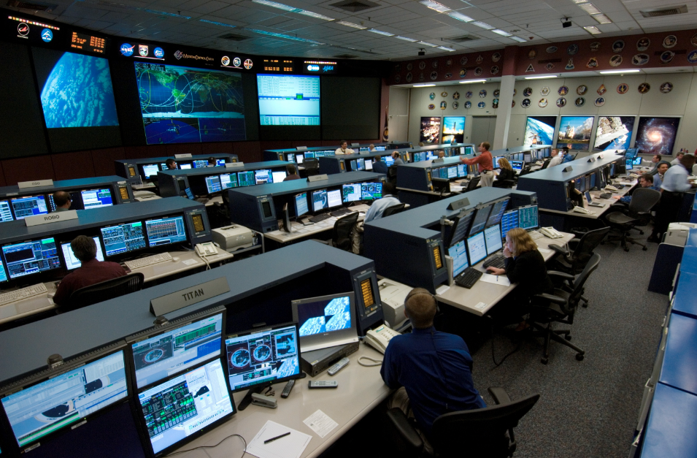
Orbital Timeline:
Optional Events
19/26 May, 2/9/16/23 June - Mission Control Workshops
(Saturday workshops on advanced topics with hacking time, team meetings and catered lunch in between)
Topics: iOS Development, Game Development, PHP/RoR, UI/UX, Machine Learning, Web App Deployment, Web Security
Time: 10:00-15:00
Venue: The Hangar
Notes:
We are also going to organize optional workshop sessions on Saturdays to cover advanced topics, such as Game development and Web Security. You can also make use of these sessions to have meetings with your partner and your advisor.

Slide 13
Liftoff
A two-day intensive workshop event aiming to help you answer the following questions:
What is your project idea?
- What features are important to your project?
- What is your development plan?
- What is the type of your project? Is it a mobile app, web app or something else?
- What technologies and tools are you going to use?

Slide 14
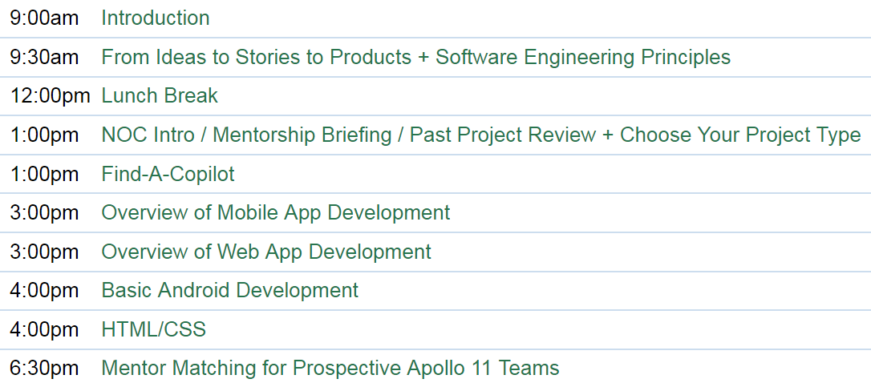
Today’s Schedule
Notes:
Now to 3pm, project idea and the development process. Decide the project type by then.
After 3pm, move on to technical workshops related to each specific type of project.
The technical workshop ends at 6pm today. But there is a Mentor matching for Apollo 11 Teams at 6:30pm.

Slide 15
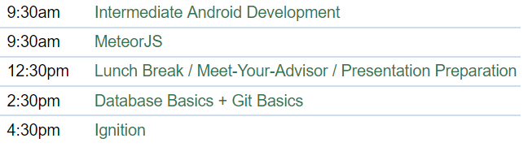
Tomorrow’s Schedule
Notes:
Continue with the technical workshop on the second day.
Use the lunch break to meet your advisor and prepare for the presentation
The final segment is Ignition which starts at 4:30pm.

Slide 16
Your Deliverables
Give a short presentation about your project during Ignition
One minute, one slide
Must be succinct and persuasive
Google “elevator pitch”, or “one minute madness” for more information
Video from last year: https://goo.gl/2YP2oC
Update the link to your slide in Skylab by tomorrow 2:30pm
(More details can be found on Slack)
Notes:
1. Create a slide using Power Point.
2. Save it as a JPG/PNG/...
3. Upload it into a image hosting website: imgbb.com
4. Visit the image at the hosting website
5. Right click on the image to save the image link
6. Update link in Skylab

Slide 17

Resources
Emails
Slack
Orbital website
Skylab
Notes:
Email: Announcements and reminders
Slack: Announcements, reminders, resources, discussions with advisors and tutors
Orbital website: General information, Calendar.
Skylab: Team information, Milestone submission and evaluation

Slide 18
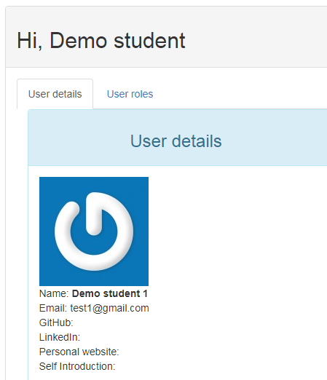
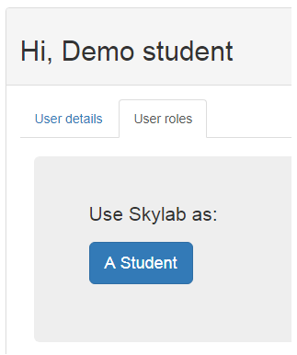
Demo on Skylab
Notes:
Steps for update name, LoA, and link to Ignition slide. User Roles -> A student
@Min: Please use Demo Student X for your session.

Slide 19
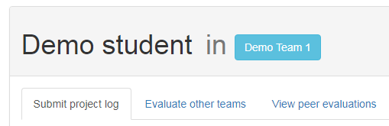
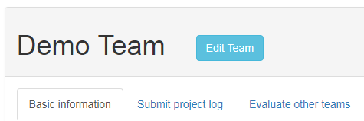
Demo on Skylab
Notes:
Team name -> Edit Team

Slide 20
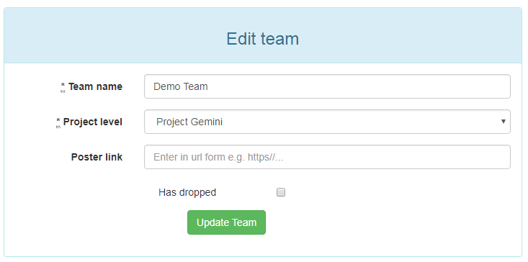
Demo on Skylab
Submit your poster link here for Ignition by 2:30pm on 15 May!
Notes:
Update the information accordingly. Remember to click “Update Team” to save the information.
Remind the students about the submission deadline.
Any Questions?
Next up:
(Aud) From Ideas to User Stories to Products (ThoughtWorks) → Software Engineering Principles (PayPal)
(Hangar) Software Engineering Principles (PayPal) → From Ideas to User Stories to Products (ThoughtWorks)

