Slide 1
B.TECH PROJECT REPORT • JANUARY – MAY 2026
Python CI/CD using
Docker Agents
A fully automated, containerised delivery pipeline for a Python microservices application, orchestrated across three isolated Amazon EC2 instances.
Submitted by
Priyanshu Kumar
Registration No. 12407370 • Course Code: PETV137
Under the guidance of
Ms. Priyanka Gupta • Prof. (Dr.) Harpreet Kaur
School of Computer Science
and Engineering
Lovely Professional University
Phagwara, Punjab

Slide 2
AGENDA
What We’ll Cover
A structured walkthrough from concept to a live, quality-gated deployment.
01
02
Introduction & Objective
Why a containerised CI/CD pipeline, and what problem it solves.
System Architecture & DFD
How code, quality checks and deployment commands flow across servers.
03
04
Implementation
Jenkins pipeline stages — build, static analysis, and SSH deployment.
Testing & Results
Live evidence from AWS, Jenkins, SonarQube and the deployed application.
05
06
Key Highlights
What makes this pipeline reliable, secure and reproducible.
Conclusion
Outcomes achieved and the value delivered.
PYTHON CI/CD USING DOCKER AGENTS
01

Slide 3
01 – INTRODUCTION
Project Abstract
This project automates the delivery of a Python-based microservices application — a web front end and a rendering backend — using Jenkins and Docker.
The infrastructure is deliberately distributed across three isolated Amazon EC2 instances, so that build orchestration, code-quality analysis and production hosting never share the same failure domain.
Every commit is automatically built inside ephemeral Docker containers, analysed by SonarQube against a quality gate, and — once it passes — deployed to production over SSH with zero manual steps.
3
ISOLATED EC2 SERVERS
4
AUTOMATED PIPELINE STAGES
0
MANUAL DEPLOYMENT STEPS
Result: consistent environments, enforced quality, and reproducible, low-risk releases.
PYTHON CI/CD USING DOCKER AGENTS
02

Slide 4
01 – INTRODUCTION
Distributed Infrastructure
Three purpose-built EC2 instances keep build, analysis and hosting fully decoupled.
JK
SQ
DP
Jenkins Server
SonarQube Server
Deployment Server
Runs the declarative pipeline. Each stage spins up its own short-lived Docker agent — no shared global build environment.
Performs static inspection of every commit — bugs, vulnerabilities and code smells are caught before they ship.
Hosts the production containers. Reached only via SSH from Jenkins after the quality gate has passed.
PYTHON CI/CD USING DOCKER AGENTS
03

Slide 5
02 – SYSTEM ARCHITECTURE
Data Flow Diagram
How a single commit travels from a developer’s machine to a running container.
Push
Webhook
Deploy (SSH)
Developer
GitHub Repo
Jenkins Server
Deployment Server
Analyse
code quality
QUALITY GATE
Deployment proceeds only if SonarQube reports a passing quality gate on the analysed commit — otherwise the pipeline stops.
SonarQube Server
PYTHON CI/CD USING DOCKER AGENTS
04

Slide 6
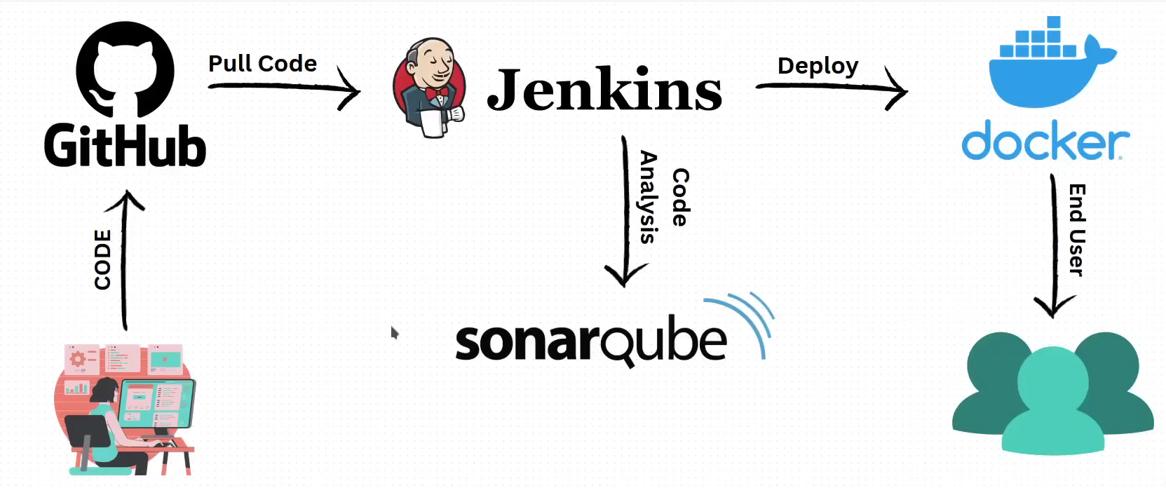
02 – SYSTEM ARCHITECTURE
Project Architecture
End-to-end topology: source control, orchestration, quality analysis and the containerised runtime.
PYTHON CI/CD USING DOCKER AGENTS
05

Slide 7
03 – IMPLEMENTATION
The Jenkins Pipeline
A declarative pipeline with agent none — every stage runs inside its own disposable Docker container.
1
2
3
4
Web: Install
Renderer: Check
SonarQube
Deploy
NODE:18-ALPINE
PYTHON:3.11-SLIM
SONAR-SCANNER-CLI
MAIN BRANCH ONLY
Installs the frontend dependencies with npm ci inside a clean Node.js container.
Installs backend requirements and syntax-checks auto_video.py & renderer_api.py.
Runs static analysis against web & renderer sources and enforces the quality gate.
SSH into the deployment EC2, git pull, then docker compose up -d --build.
PYTHON CI/CD USING DOCKER AGENTS
06

Slide 8
04
SECTION 04
Testing & Results
Live evidence captured directly from the running infrastructure.
PYTHON CI/CD USING DOCKER AGENTS
07

Slide 9
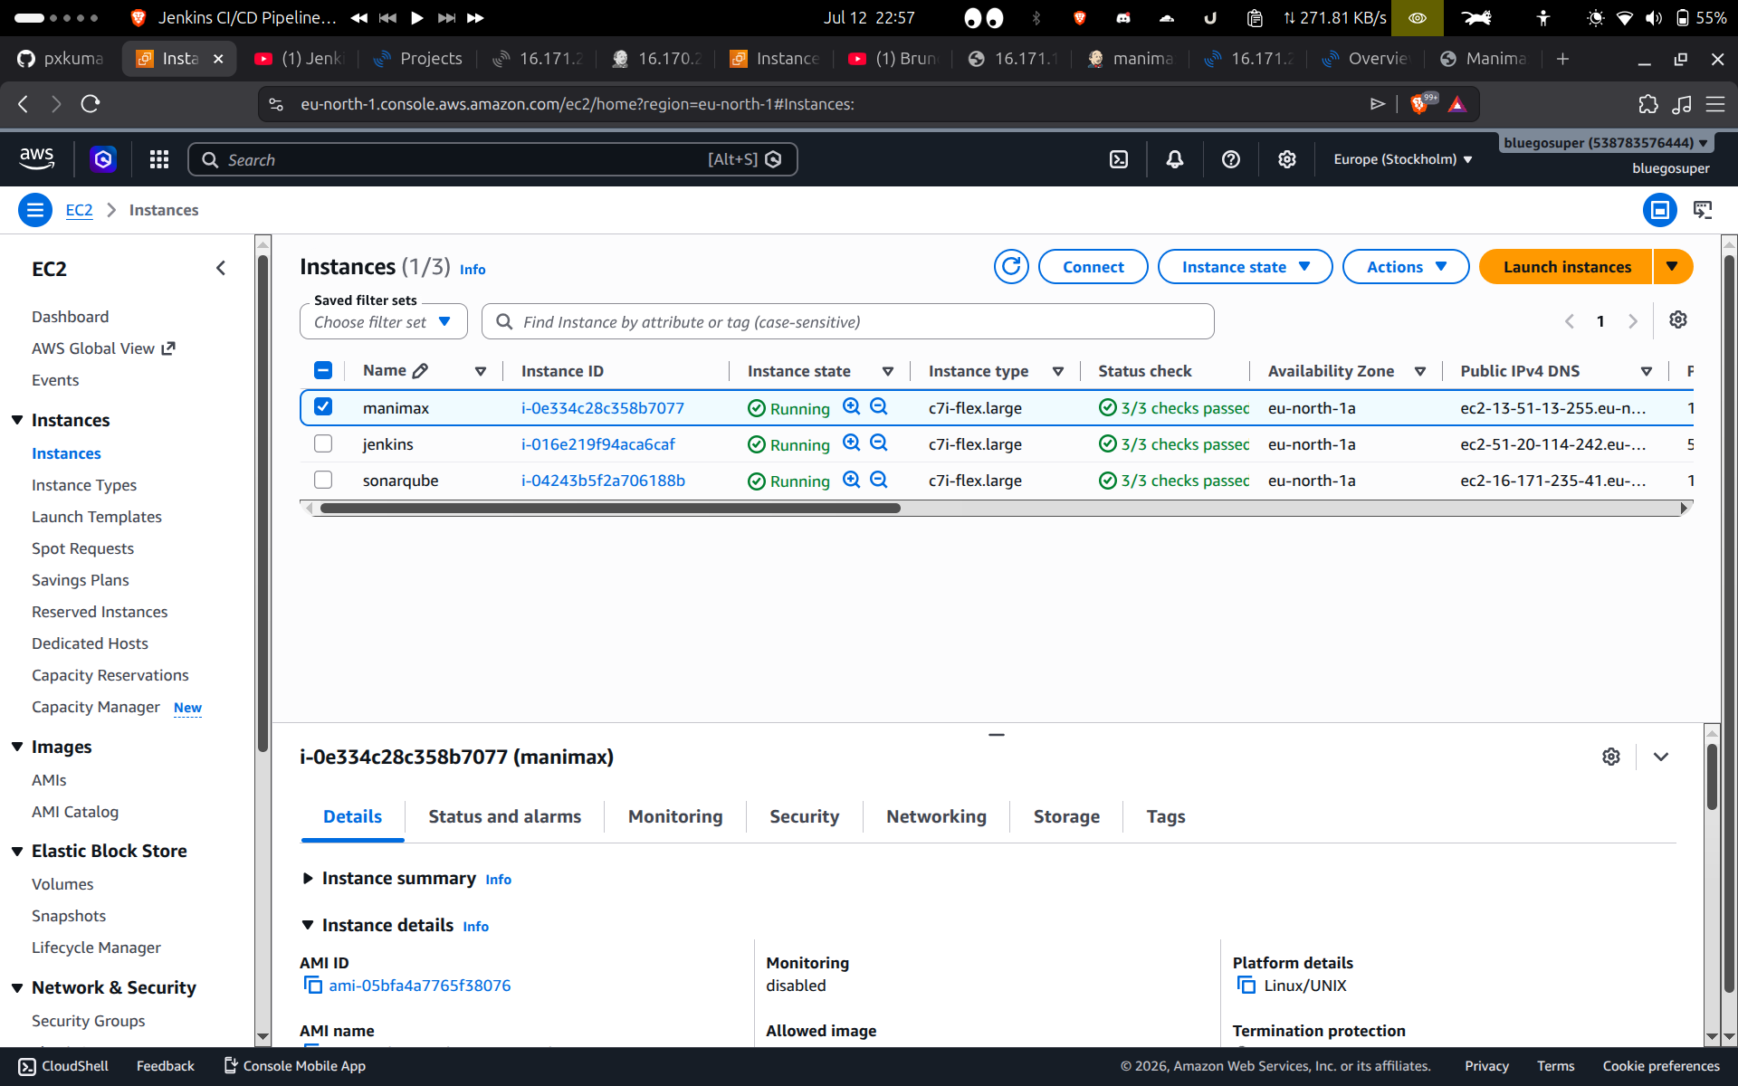
04 – TESTING & RESULTS
AWS EC2 Instances
Three isolated servers, each with a single responsibility, all healthy.
3 / 3 RUNNING
▪ manimax, jenkins and sonarqube instances all report Running with 3/3 status checks passed.
▪ Provisioned in the eu-north-1 (Stockholm) region on c7i-flex.large instance types.
▪ Separation of concerns: a failure or compromise on one server cannot cascade to the others.
PYTHON CI/CD USING DOCKER AGENTS
08

Slide 10
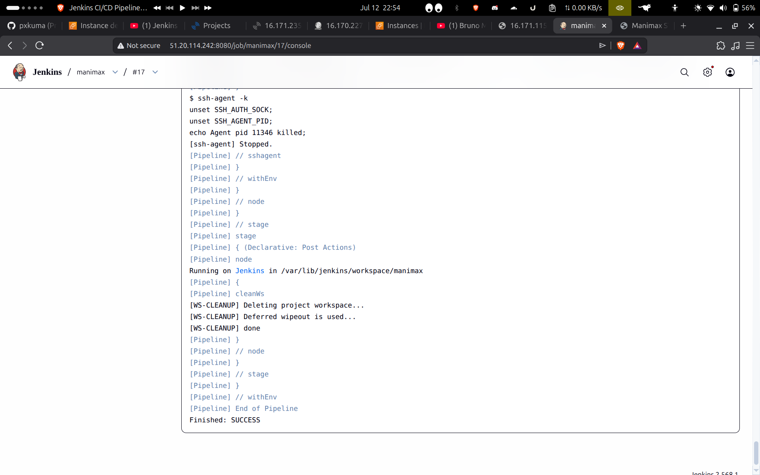
04 – TESTING & RESULTS
Jenkins Pipeline Execution
Every stage of the declarative pipeline completed cleanly.
BUILD SUCCESS
▪ The build ran through Web Install, Renderer Check, SonarQube and Deploy without intervention.
▪ Ephemeral Docker agents mean each run starts from a clean, reproducible workspace.
▪ Console output confirms cleanWs() ran and the pipeline reported Finished: SUCCESS.
PYTHON CI/CD USING DOCKER AGENTS
09

Slide 11
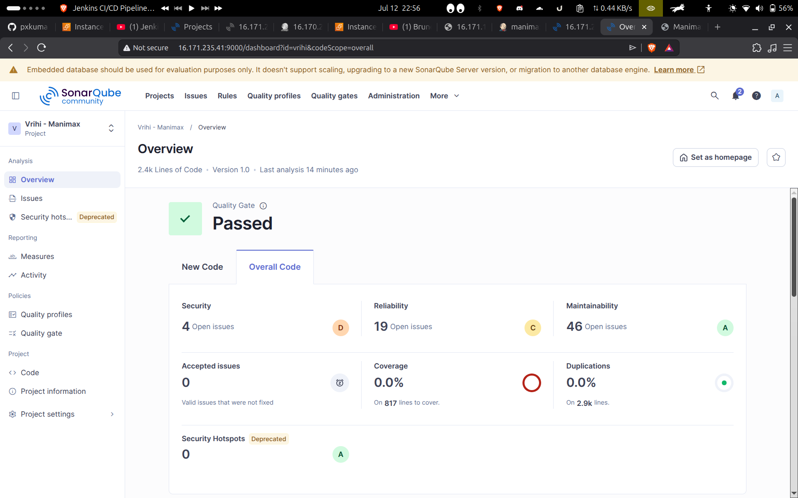
04 – TESTING & RESULTS
SonarQube Quality Gate
Static analysis enforced before a single line reaches production.
GATE PASSED
▪ 2.4k lines of code analysed across the web and renderer modules.
▪ Quality Gate: Passed — the mandatory checkpoint before the Deploy stage is allowed to run.
▪ Security, reliability and maintainability metrics are tracked on every analysis.
PYTHON CI/CD USING DOCKER AGENTS
10

Slide 12
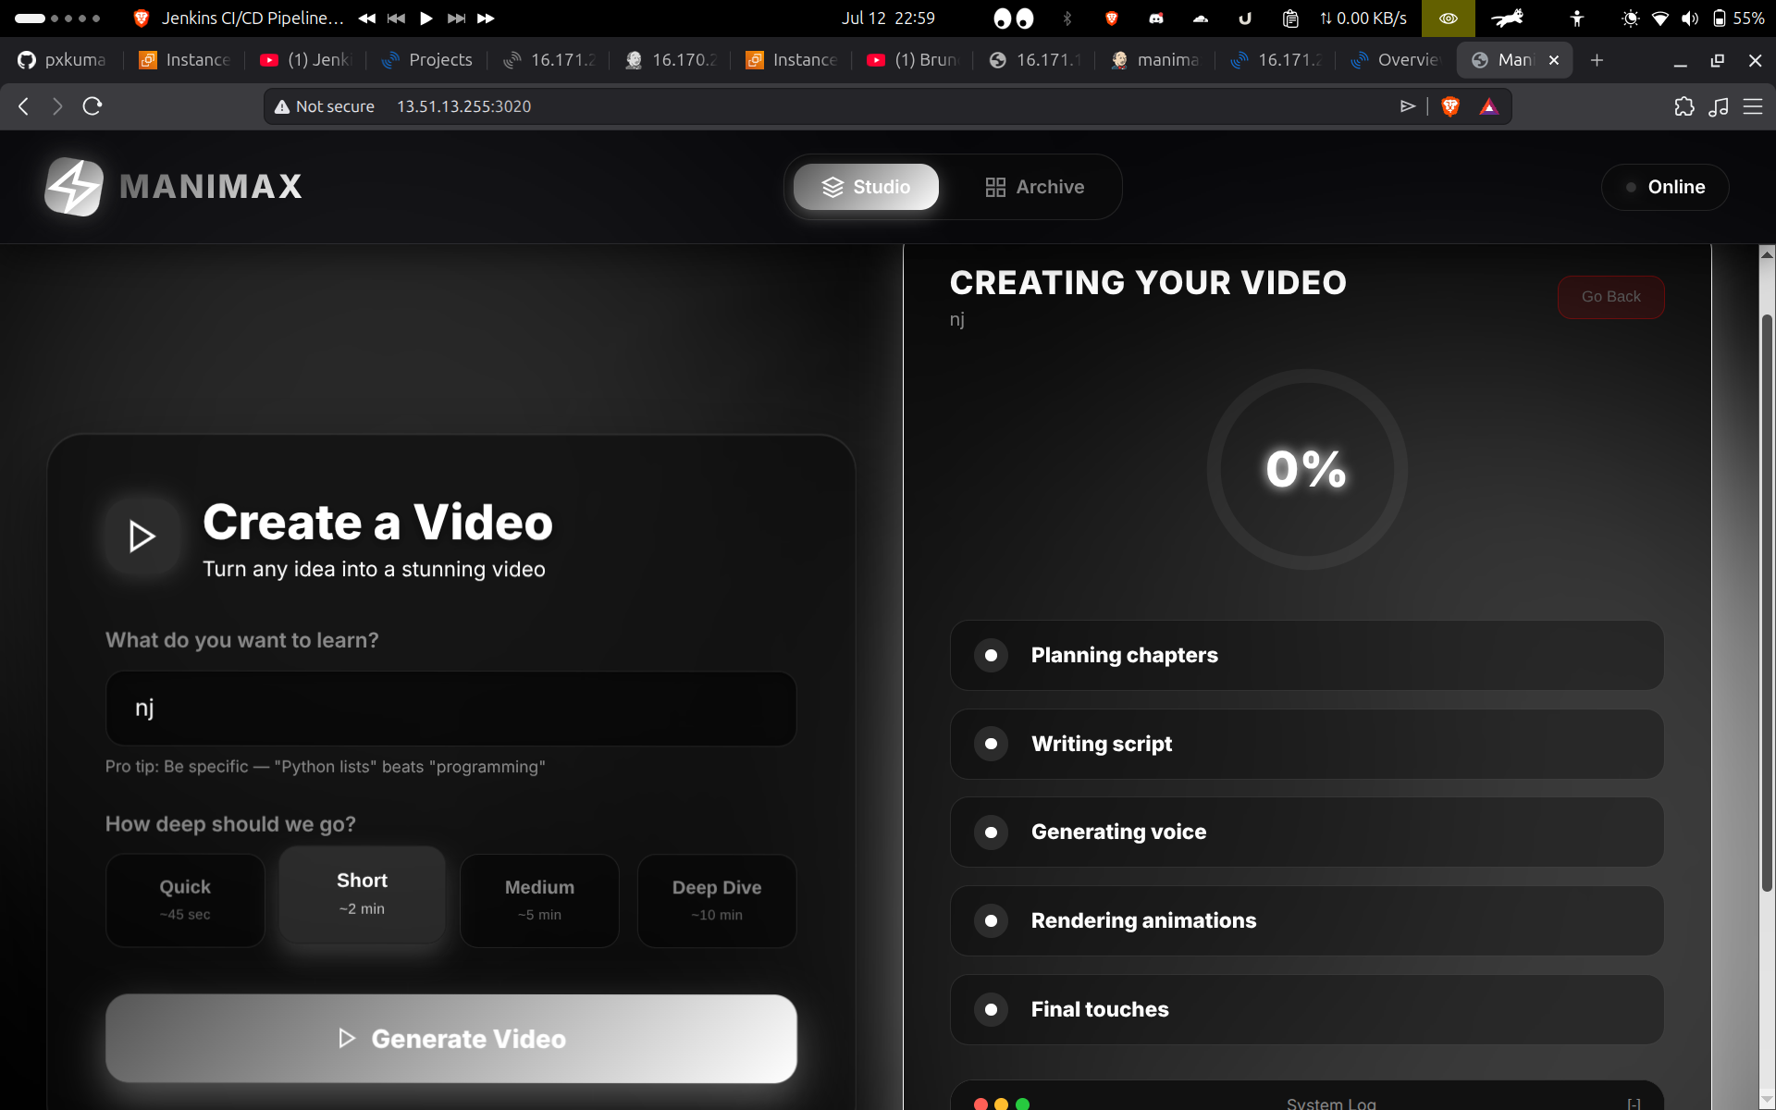
04 – TESTING & RESULTS
Application Deployed
The Dockerised application is live and serving traffic.
LIVE
▪ Containers were rebuilt and restarted on the deployment server via docker compose up -d --build.
▪ The production UI (Manimax) is reachable and fully functional after the automated release.
▪ From git push to a live update — with zero manual deployment steps.
PYTHON CI/CD USING DOCKER AGENTS
11

Slide 13
05 – KEY HIGHLIGHTS
What Makes This Pipeline Reliable
Isolated Infrastructure
Ephemeral Build Agents
Enforced Quality Gate
Jenkins, SonarQube and production run on three separate EC2 hosts — no shared blast radius.
Every stage runs inside a fresh, purpose-built Docker container that is discarded afterwards.
SonarQube must pass before the Deploy stage is even reachable in the pipeline.
Branch-Aware Deployment
Secure SSH Delivery
Zero Manual Steps
The Deploy stage runs only when the main branch changes, preventing accidental releases.
Credentials are injected via Jenkins’ sshagent — no keys are stored in the pipeline code.
git pull, image rebuild and container restart all happen automatically on every merge.
PYTHON CI/CD USING DOCKER AGENTS
12

Slide 14
06 – CONCLUSION
A Modern, Scalable Delivery Model
▪ Decoupling build, analysis and hosting across three EC2 instances delivers superior fault tolerance and security.
▪ SonarQube guarantees a consistent code-quality bar on every single commit, not just at release time.
▪ Jenkins automates the entire delivery path, cutting manual overhead and integration risk to near zero.
▪ The result is a modern, reproducible CI/CD workflow — ready to scale as the application grows.
PYTHON CI/CD USING DOCKER AGENTS
13

Slide 15
Thank You
Questions & Discussion
Priyanshu Kumar • 12407370 • Python CI/CD using Docker Agents

