Slide 1

xD-69 Hardware Description
This amazing logo was designed by someone called kilésengati on Discord :)

Slide 2
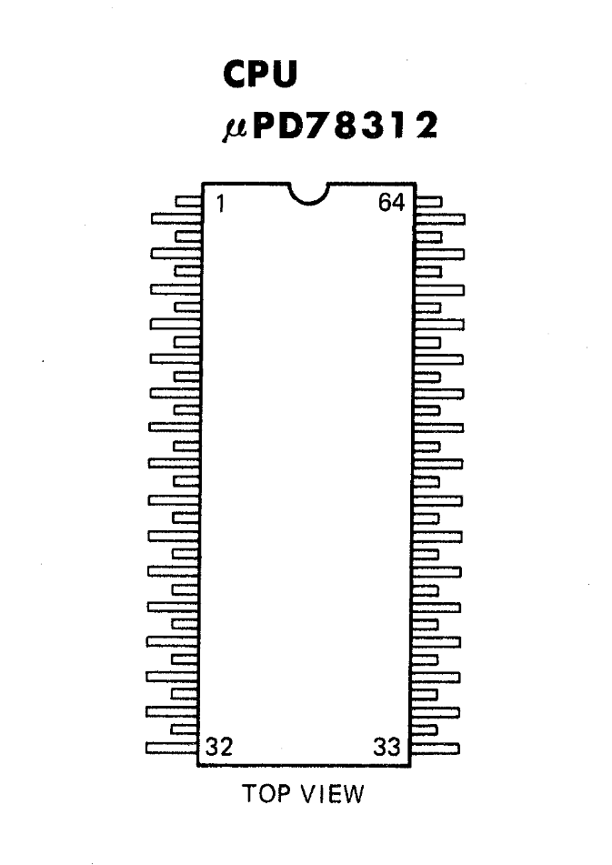
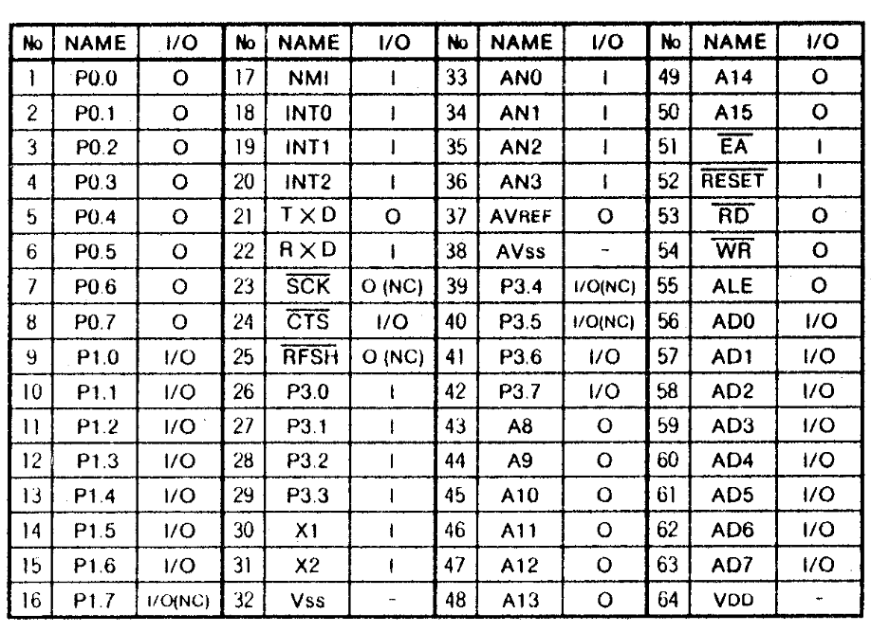
CPU: NEC uPD78312 – 8/16 bit embedded microcontroller

Slide 3
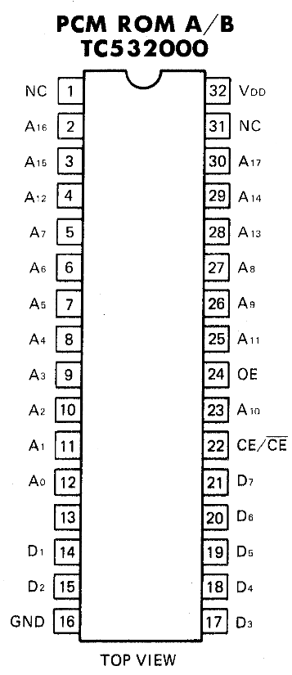
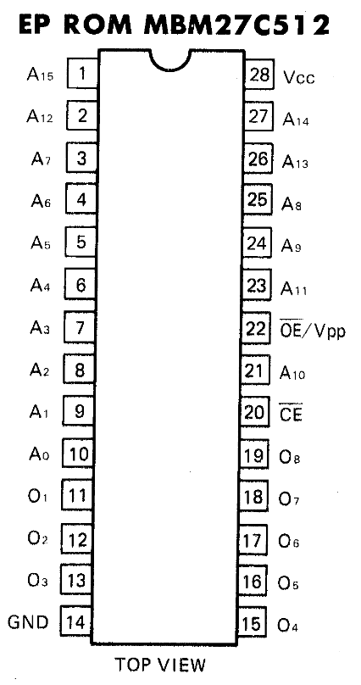
Read-Only Memories
PCM storage ROM – contains PCM partials for the preset playback. Has been ROM dumped
OS ROM - This is where the D-50 runs its code from for the D-50 operating system.
Has also been ROM dumped

Slide 4
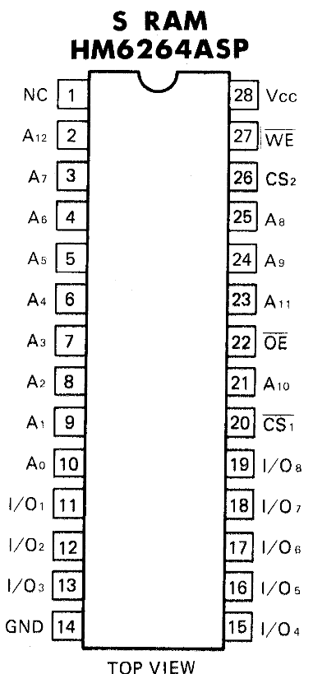
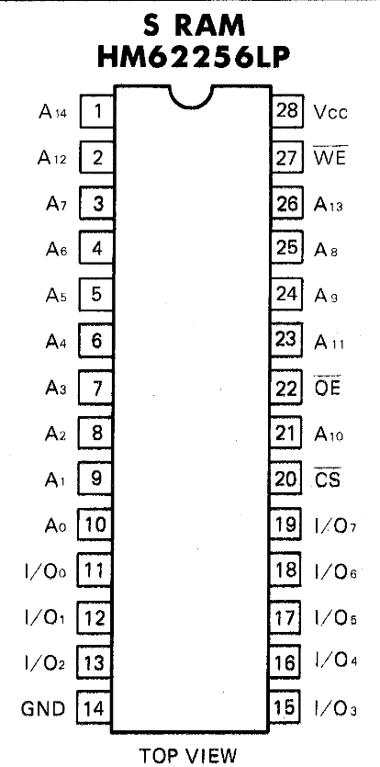
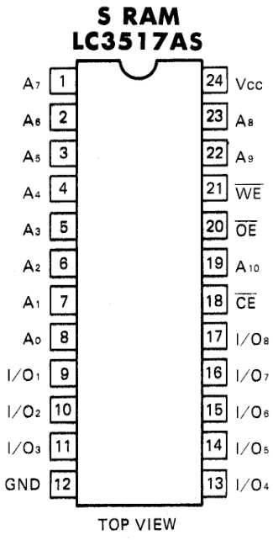
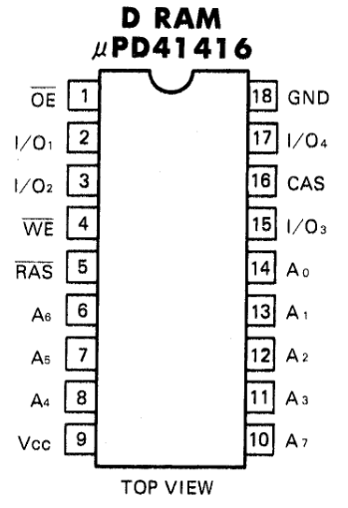
Random-Access Memories

Slide 5
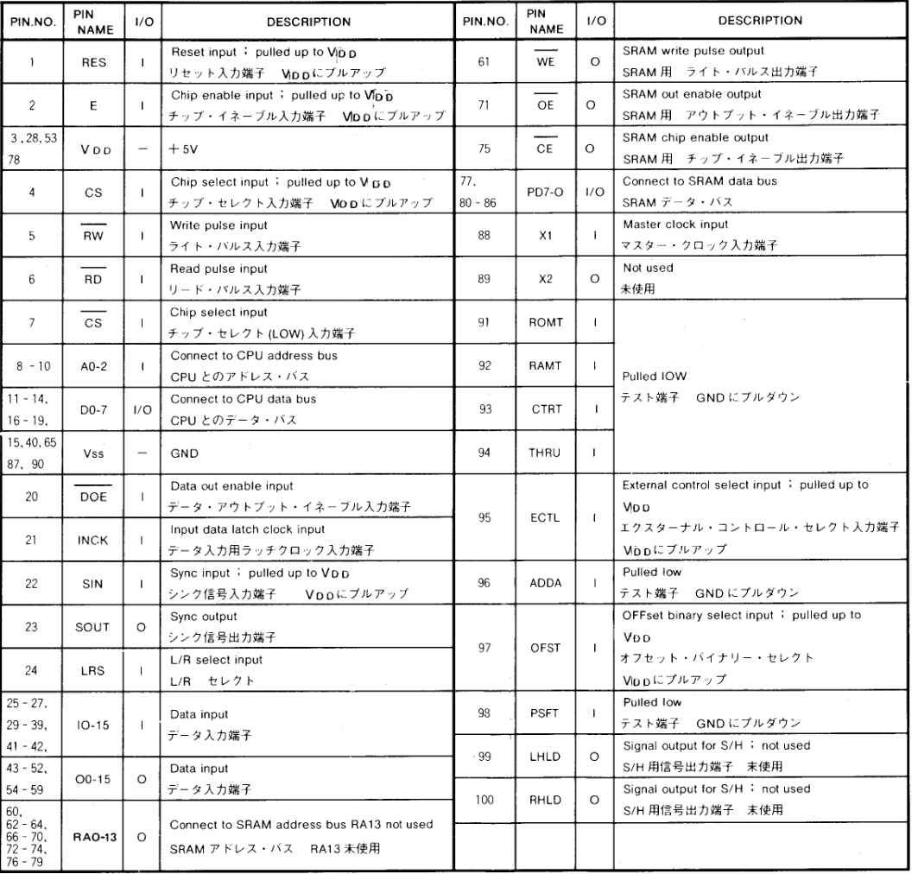
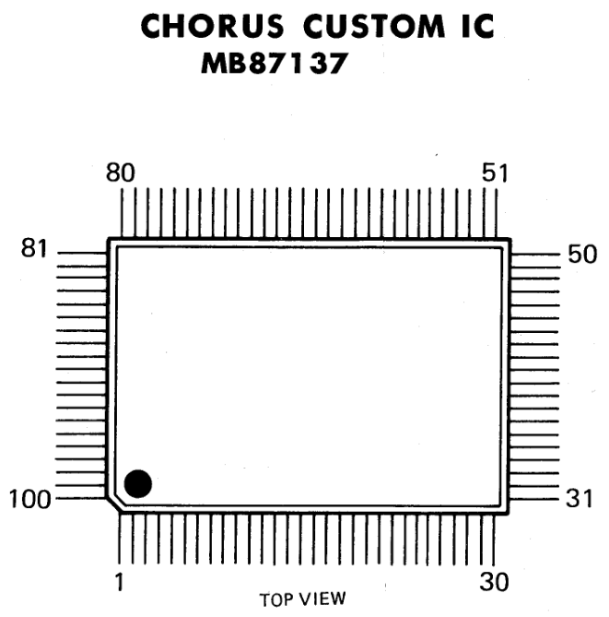
Target Custom ASIC – Chorus DSP
Please see:
https://github.com/pxlsr/FujiCells
for a detailed and comprehensive documentation of the ASICs

Slide 6
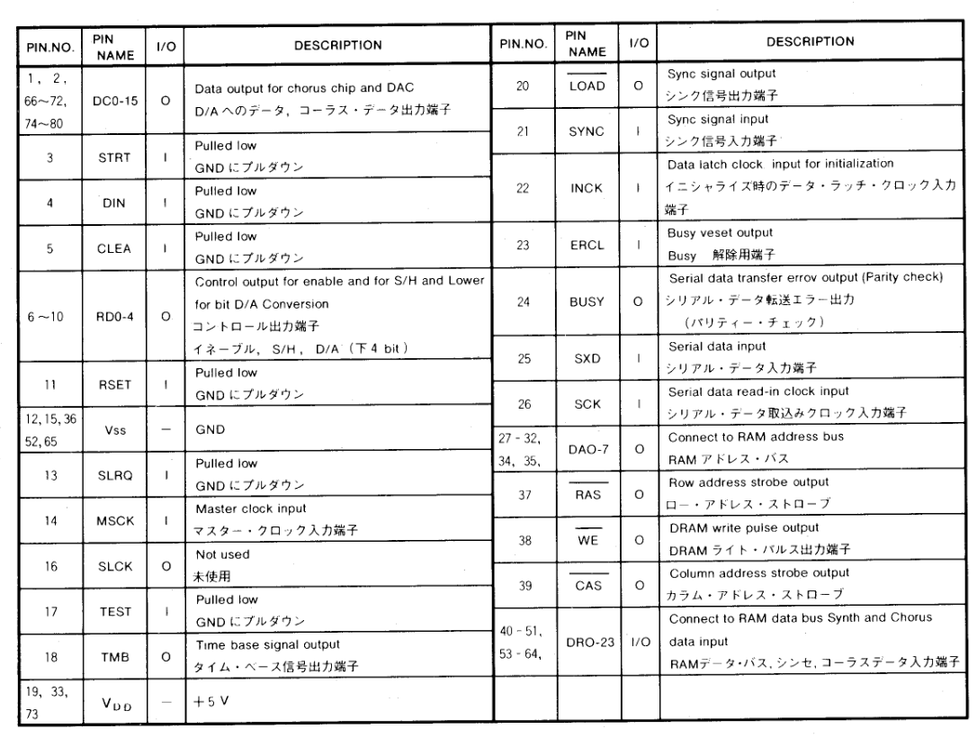
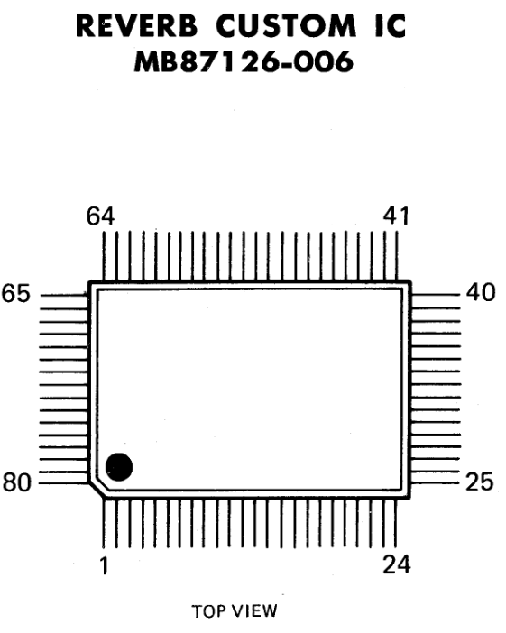
Target Custom ASIC – Reverb DSP
Please see:
https://github.com/pxlsr/FujiCells
for a detailed and comprehensive documentation of the ASICs

Slide 7
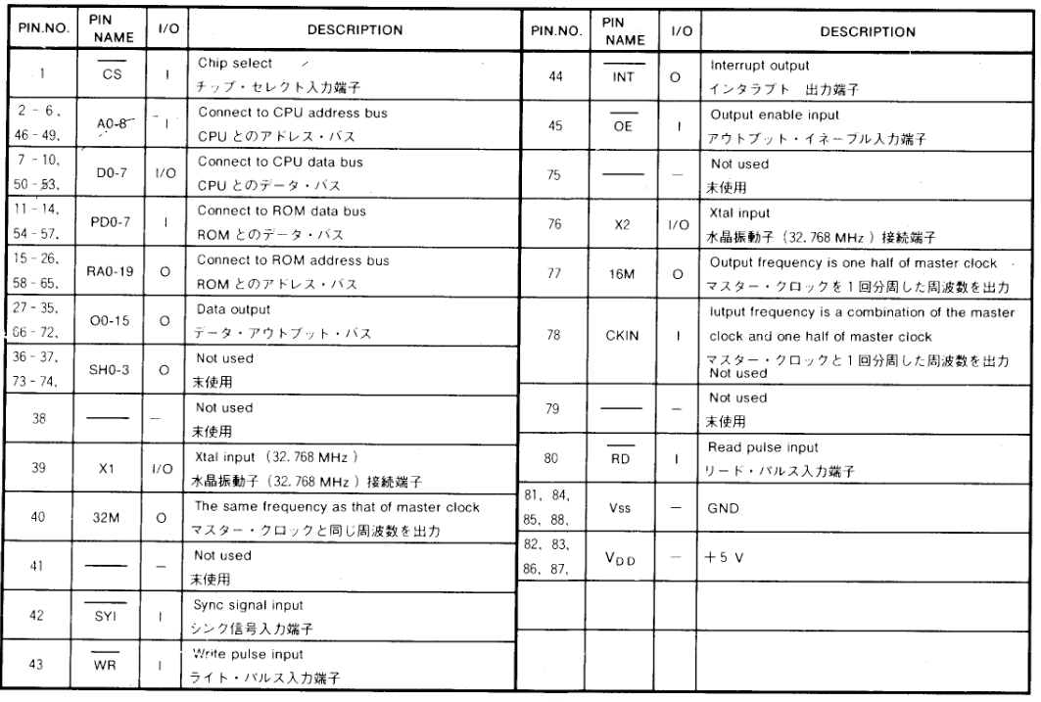
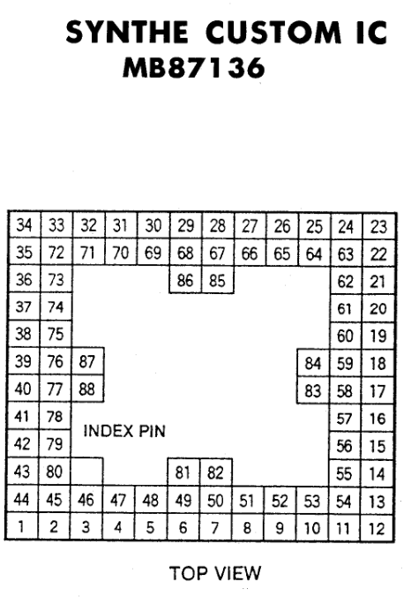
Target Custom ASIC – Synth (DSP core)
Please see:
https://github.com/pxlsr/FujiCells
for a detailed and comprehensive documentation of the ASICs

Slide 8
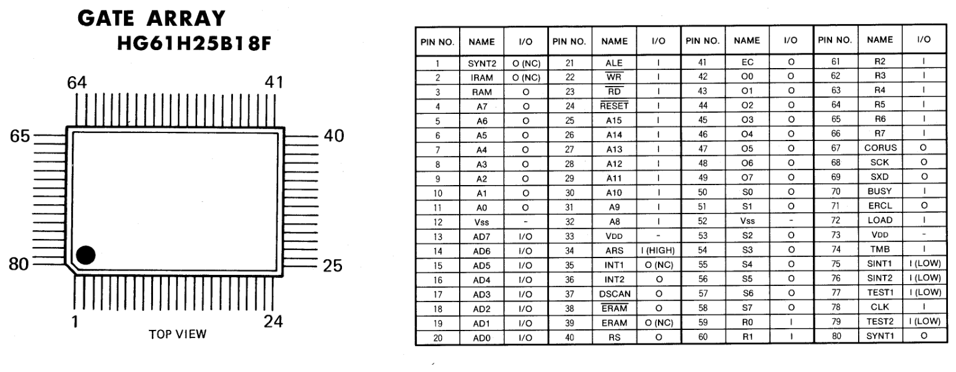
Target Custom Gate Array – LCD controller with possible peripheral control logic?

Slide 9
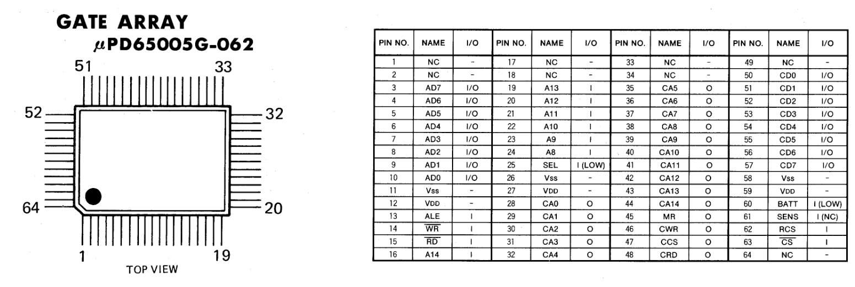
Target Custom Gate Array – Memory card controller

Slide 10
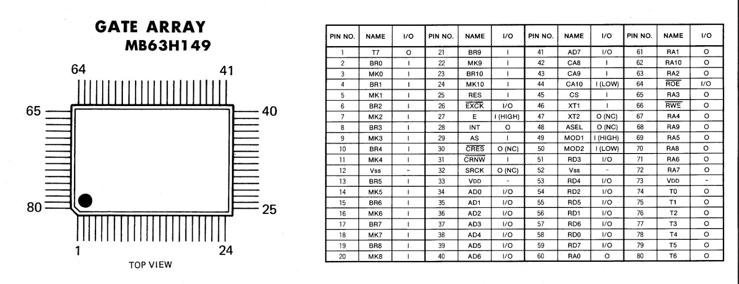
Target Custom Gate Array – Keyboard controller

