Slide 1
Tekton/Chains
Notes:
Boxboat recently got acquired by IBM
We deal with containerization, managing cloud infrastructure, various Kubernetes platforms and general automation
We are always focusing on security – recently with secure supply chain for software

Slide 2
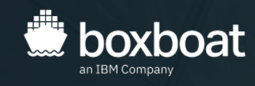
Introduction
Name: Parth Patel
Title: Devops Engineer
Company: BoxBoat
Recently got acquired by IBM
Containerization, managing cloud infrastructure, utilizing various Kubernetes platforms and tools
We are always focusing on security – recently with secure supply chain for software
Notes:
Tekton – open souce cloud native CD/CD system. Can be used on any cloud provider and on-premise system

Slide 3

Tekton
Tekton is a
open-source framework for creating Cloud Native CI/CD systems, allowing developers to build, test, and deploy across cloud providers and on-premise systems.
Notes:
Tekton – open souce cloud native CD/CD system. Can be used on any cloud provider and on-premise system

Slide 4
Multi-part
Tekton consists of multiple projects that build on each other.
Tekton Pipelines
Tekton CLI
Tekton Dashboard
Tekton Catalog/Hub
Tekton Chains
Notes:
Tekton mutlti project:
Pipelines – is used to create the CI/CD pipelines. It is a combination of tasks and pipelines. We will discuss these in the coming slides
CLI – is a command line interface (tkn) that you can interact using the terminal. Can be used to run pipelines or view current status
DashBoard – is a GUI for tekton. If you prefer to view and modify the tekton from a web browser, this can be very helpful – I will show this in the coming demo
Catalog/hub – is a collection of pre-made pipelines and tasks that user can utilize or modify for their needs. A great starting point. We will be using the buildpacks pipeline from today’s demo
Chains – This is the piece we will focus most of our discussion on. It monitors the taskruns in tekton pipeline, converts them to a standard format and signs it.

Slide 5
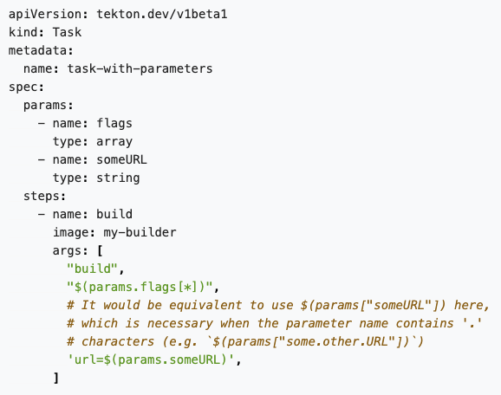
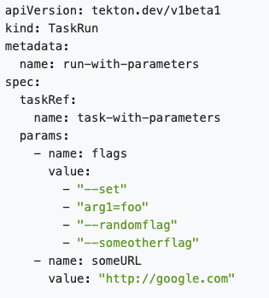
Task and Taskrun
Notes:
Example of a simple Task and Taskrun
Task defines the steps that will occur within that task and parameters that are passed to it.
Taskrun is used to initialize and run the task. It specifies the task that is called and the paramters that the task needs to run.

Slide 6
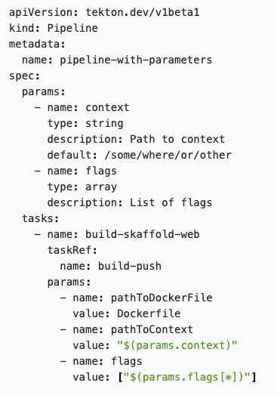
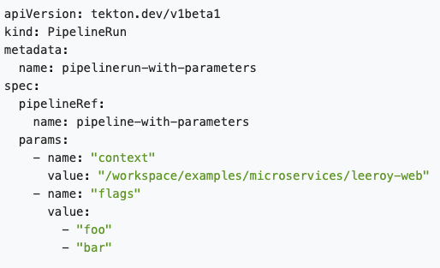
Pipeline and PipelineRun
Notes:
This is an example of a simple pipeline and pipelinerun
- The pipeline is a collection of tasks that need to be run. You can specify the order and ensure that one task runs before another. Similar taskrun before, it defines the task and the parameters associated with it. You can share a workspace between the tasks to share values.
– Pipelinerun initializes the pipeline and passes in the parameters associated for it to run. If there are shared workspace (persistent volume claims) they would be defined here.

Slide 7
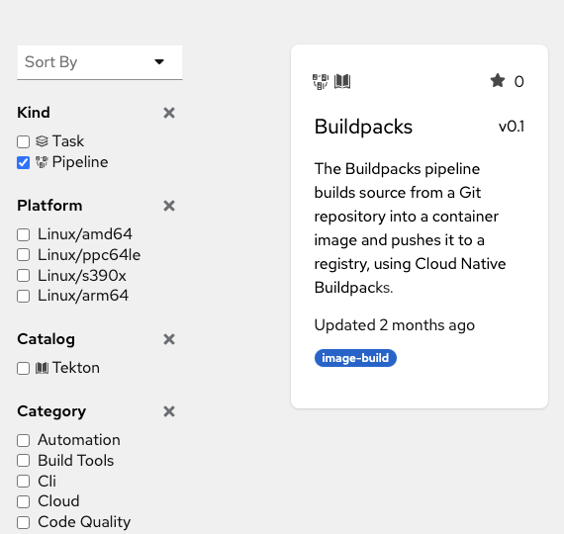
Tekton Catalog/Hub
Tekton Catalog/Hub allows users to discover, search and share Tasks and pipelines that have been created.
Great starting place for new users to start using tasks, modifying existing to fit their needs or creating their own from examples.
We will use the buildpacks pipeline from the catalog for the demo.

Slide 8
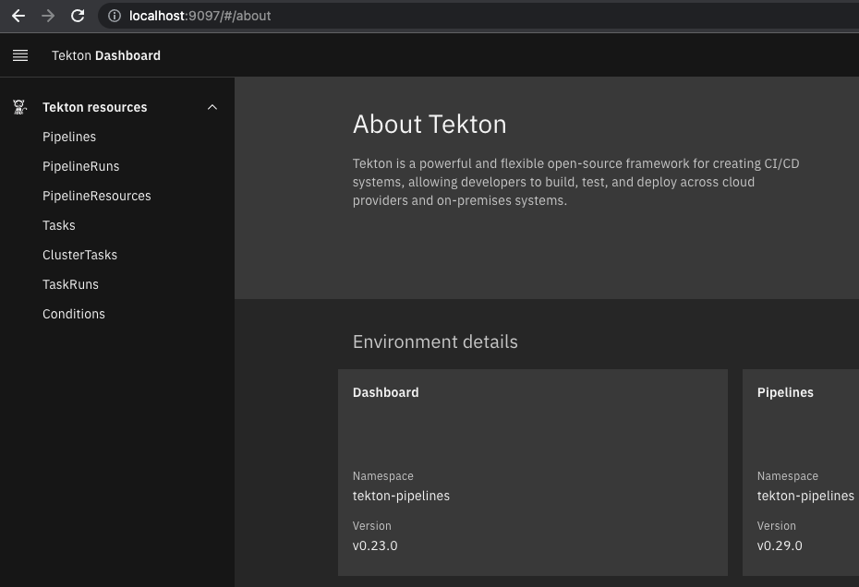
Tekton Dashboard
Tekton Dashboard, as a general-purpose, web-based UI for Tekton Pipelines, which allows developers to:
View and manage taskRuns and pipelineRuns
View and manage resources associated with taskRuns and pipelineRuns in their creation, execution, and completion

Slide 9
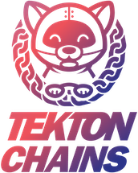
Tekton Chains
Observing all TaskRuns executions in your cluster.
Current features include:
Signing TaskRun results with user provided cryptographic keys, including TaskRuns themselves and OCI Images
Attestation formats like SLSA
Signing with a variety of cryptograhic key types and services (x509, KMS)
Support for multiple storage backends for signatures
Future Releases:
Integration with SPIFFE SPIRE for non-falsifiable provenance

Slide 10
SLSA (Supply-chain Levels for Software Artifacts)
Level | Description | Example
1 | The build process must be fully scripted/automated and generate provenance. | Unsigned provenance
2 | Requires using version control and a hosted build service that generates authenticated provenance. | Hosted source/build, signed provenance
3 | Prevents extra resistance to specific threats | Security controls on host, non-falsifiable provenance
4 | Highest levels of confidence and trust | Two-party review + hermetic builds
Notes:
Tekton Chains allows us to meet Level 1 and Level 2 of SLSA with the current release.
Once SPIFFE Spire is added (which adds short lived, verified certs) – that will bring Chains closer to Level 3 with non-falsifiable provenance. This is still work in progress.

Slide 11
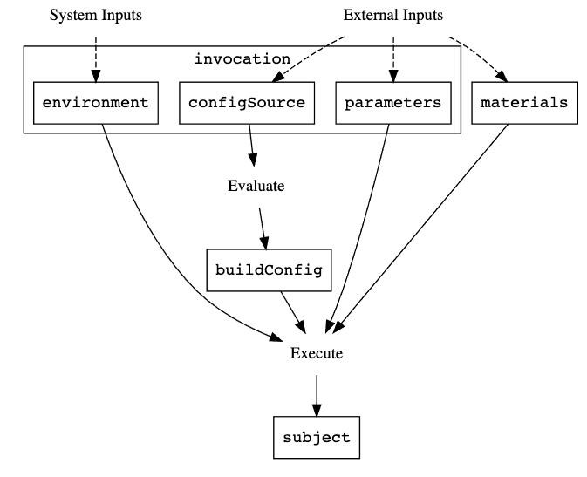
SLSA Provenance
Provenance is an attestation that some entity (builder) produced one or more software artifacts (the subject of an in-toto attestation Statement) by executing some invocation, using some other artifacts as input (materials). The invocation in turn runs the buildConfig, which is a record of what was executed.

Slide 12
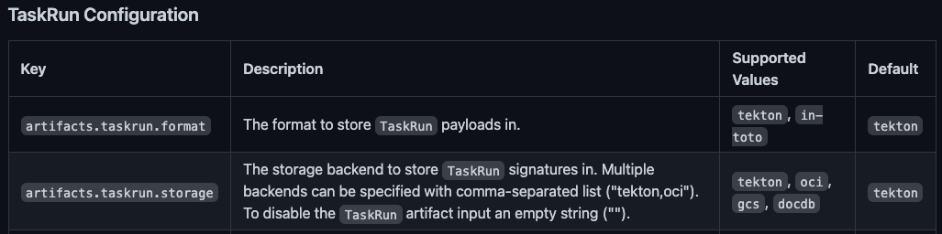
Tekton Chains – Configuration
Example:
kubectl patch configmap chains-config -n tekton-chains -p='{"data":{"artifacts.taskrun.format": "in-toto"}}'
kubectl patch configmap chains-config -n tekton-chains -p='{"data":{"artifacts.taskrun.storage": "oci,tekton"}}'

Slide 13
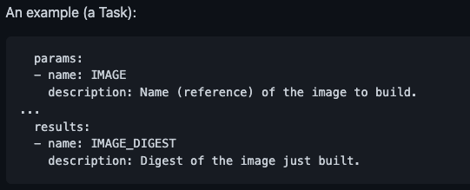
Tekton Chains – Capture Artifacts
Type Hinting
When outputting an OCI, Chains will look for the following Results:
*IMAGE_URL - The URL to the built OCI image
*IMAGE_DIGEST - The Digest of the built OCI image
where * indicates any expression. For example, if both MYIMAGE_IMAGE_URL AND MYIMAGE_IMAGE_DIGEST are correctly formatted to point to an OCI image, then chains will pick up on it and try to sign the image.

Slide 14
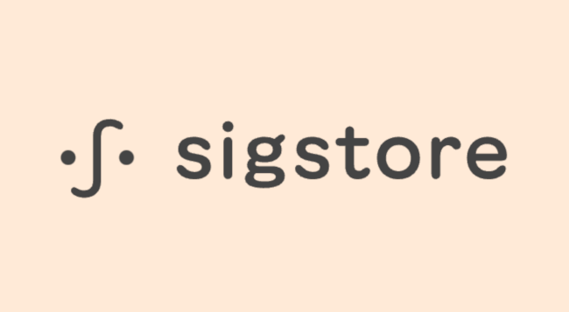
Tekton Chains – Cosign
Cosign is used for Container Signing, Verification and Storage in an OCI registry.
For cosign, Chains expects the encrypted private key to be stored in a secret called signing-secrets with the following structure:
cosign.key (the cosign-generated private key)
cosign.password (the password to decrypt the private key)
To create a cosign keypair, cosign.key and cosign.pub, install cosign and run the following:
cosign generate-key-pair k8s://tekton-chains/signing-secrets

Slide 15
Tekton Installation
To install Tekton and Tekton Pipelines run the following command:
kubectl apply --filename https://storage.googleapis.com/tekton-r
To install the latest version of Chains to your Kubernetes cluster, run:
kubectl apply --filename https://storage.googleapis.com/tekton-releases/chains/latest/release.yaml
Install Cosign
$ go install github.com/sigstore/cosign/cmd/cosign@latest
$ brew install cosign
Installing the binary based on your system.

Slide 16
Demo!
Let’s go through an example with the buildpacks pipeline and show how to:
Create the signing secret with cosign
Explain what the buildpacks example is doing
Review attestation (SLSA vO.2) from taskrun
Verify signature of image and attestation using cosign

Slide 17
BuildPacks
We will be using the buildpacks example from tekton catalog with slight modification:
The buildpacks task will be replaced with the below:
https://github.com/buildpacks/tekton-integration/tree/main/task/buildpacks/0.4
This has the necessary results fields needed by chains to capture the IMAGE_URL and IMAGE_DIGEST

