Slide 1
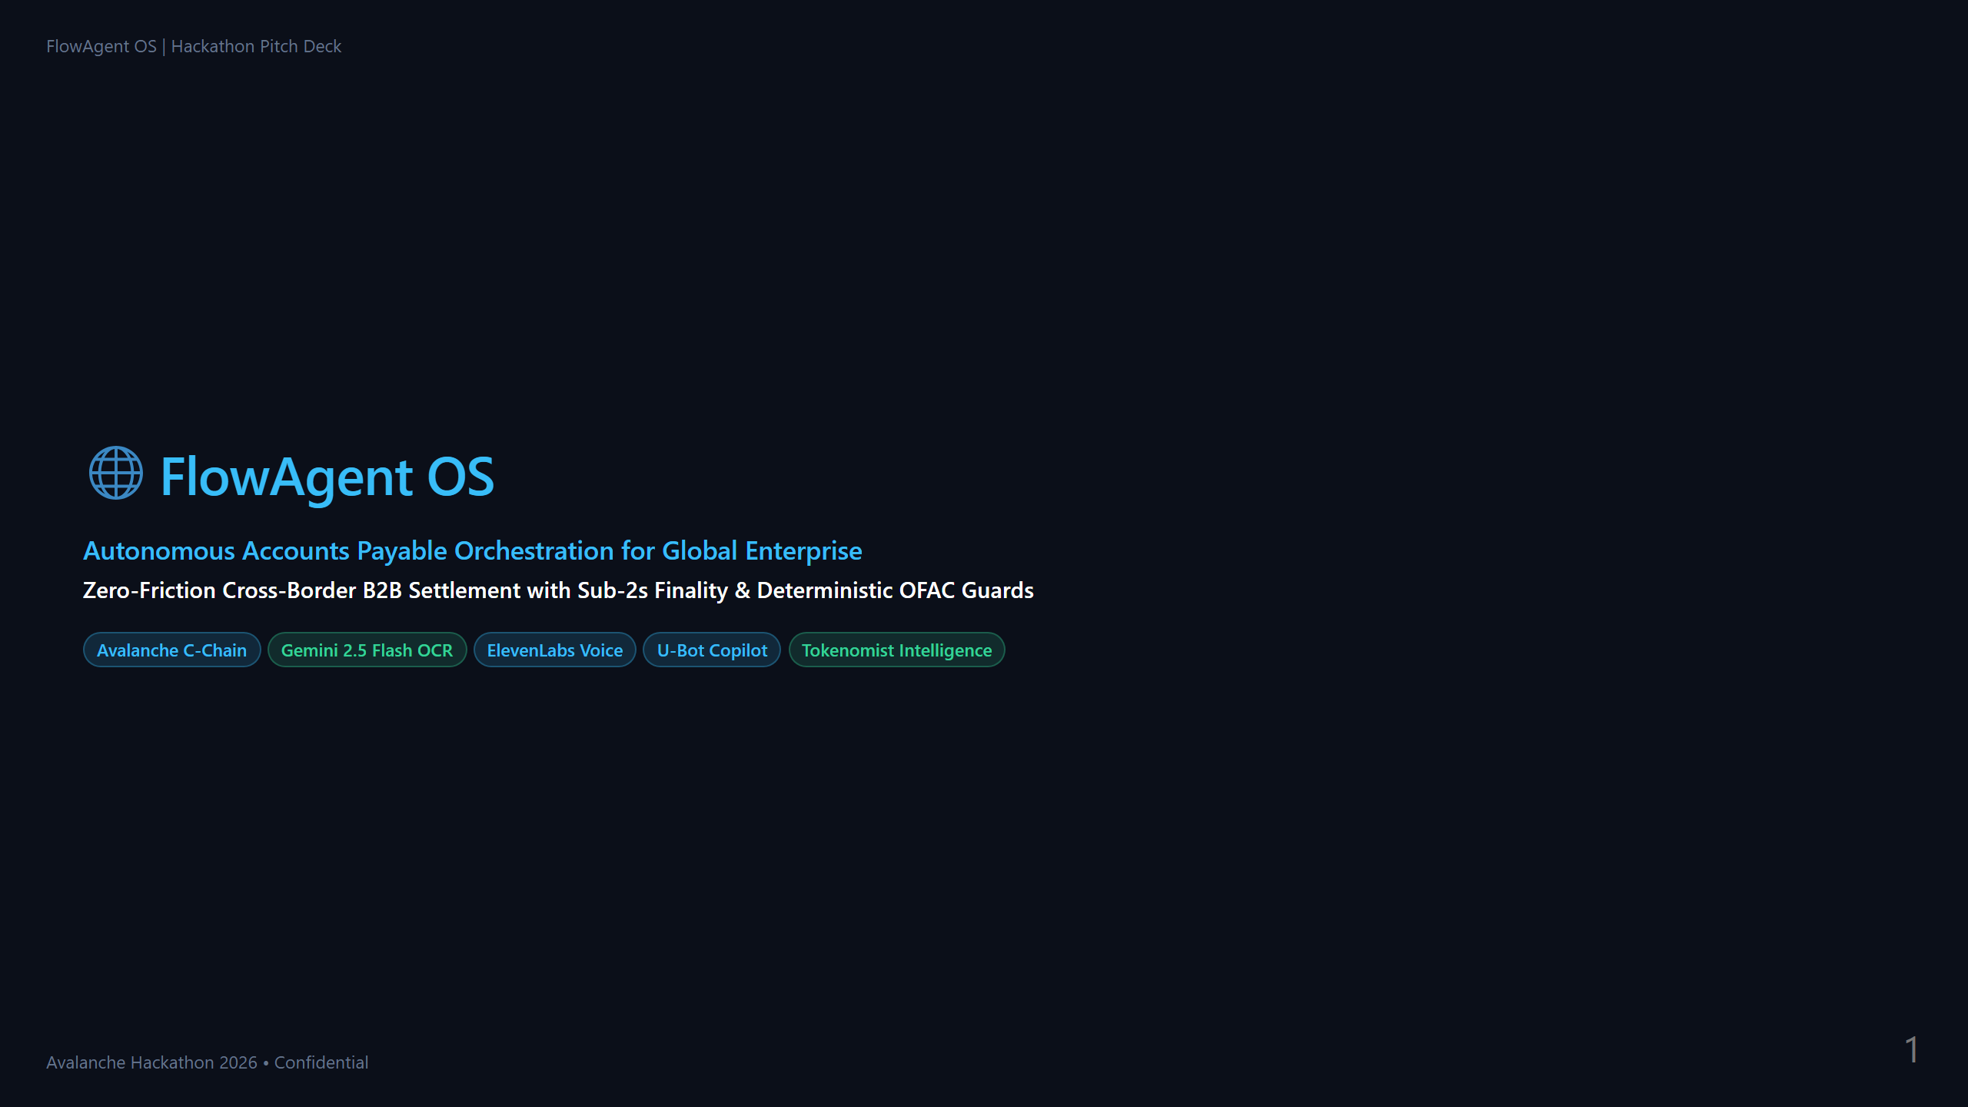

Slide 2
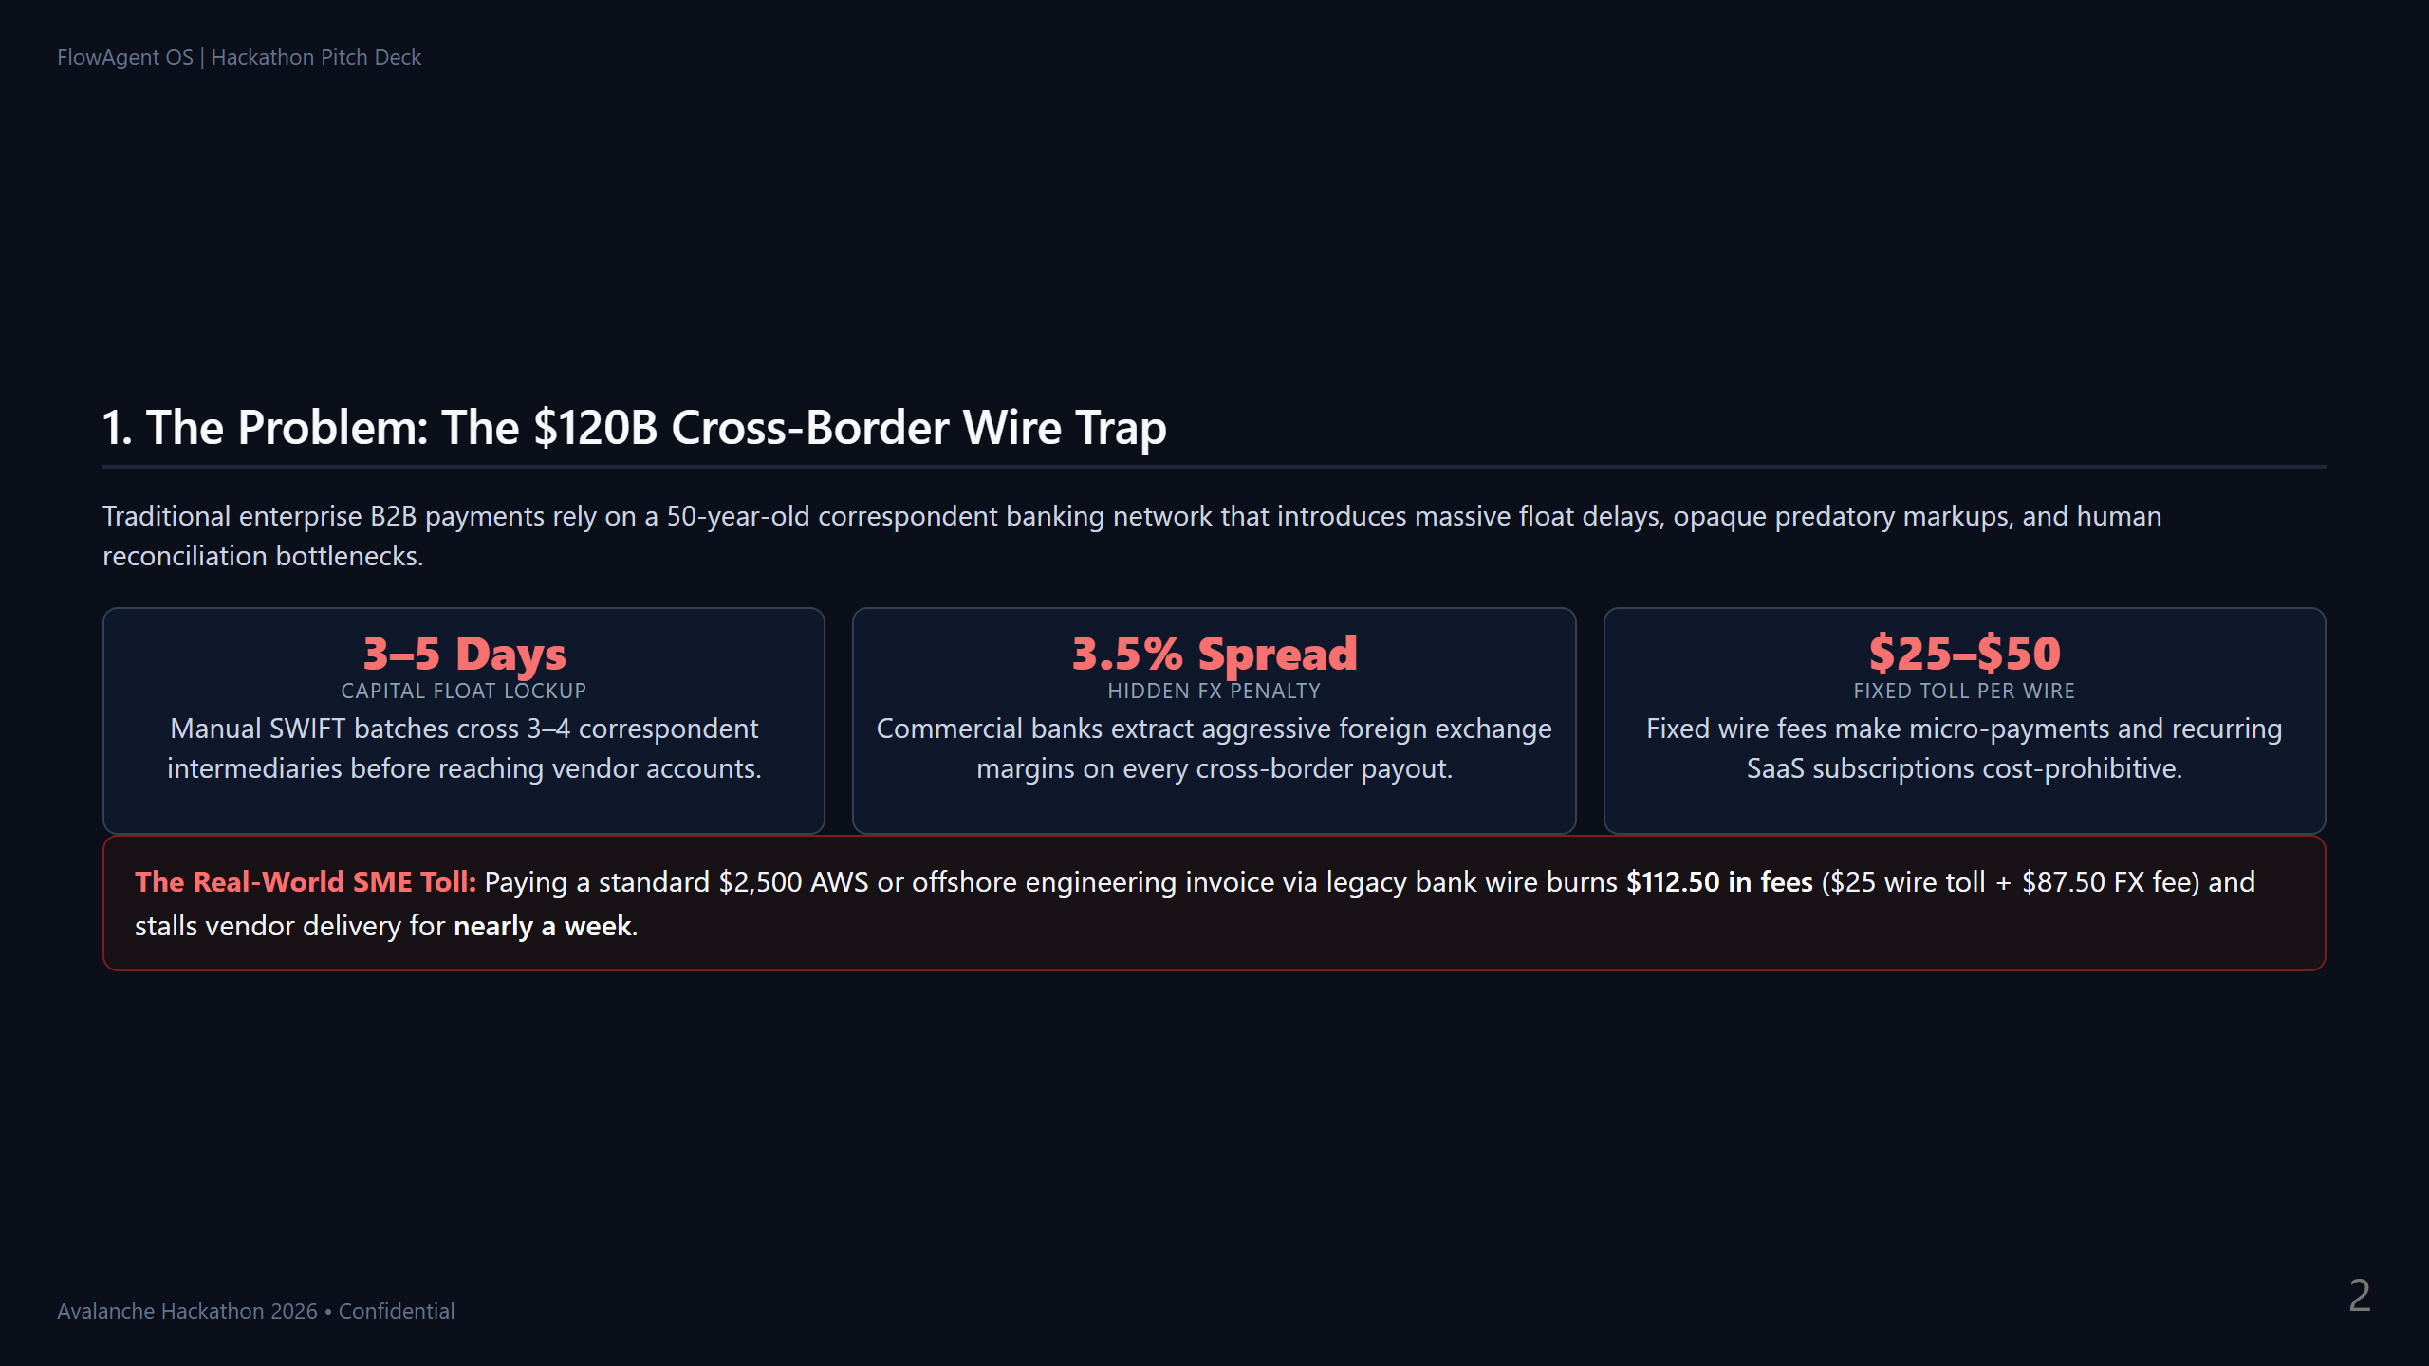
Notes:
Slide 1
Presenter Cue (0:00 - 0:30):
"Judges, every global business faces the same multi-day nightmare: sending money across borders means losing 3.5% in predatory FX markups, paying $25 per wire, and waiting 3 to 5 business days for funds to clear. For a simple $2,500 AWS bill, that is $112 wasted and zero real-time visibility. Today, we introduce FlowAgent OS to replace this obsolete legacy banking chain."

Slide 3
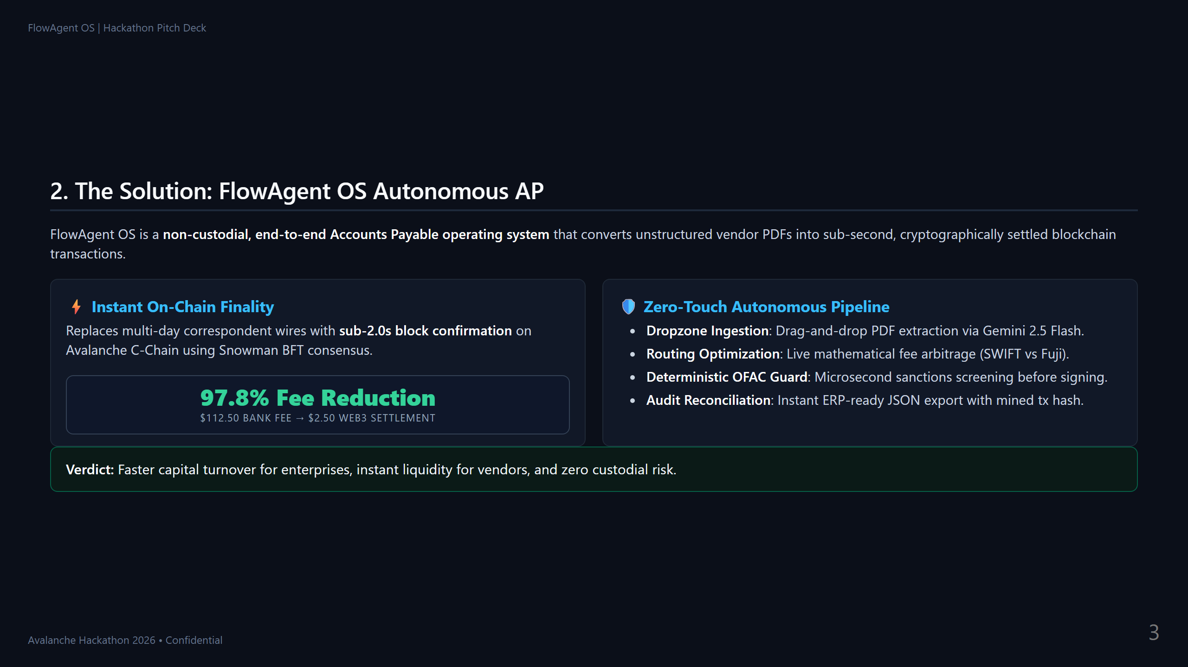
Notes:
Slide 2
Presenter Cue (0:30 - 1:00):
"FlowAgent OS transforms accounts payable into an autonomous, sub-2-second experience. By orchestrating invoice extraction directly to the Avalanche C-Chain, we cut processing fees by up to 98%—dropping a $112 bank fee down to just $2.50. The finance team drops a PDF, our pipeline optimizes the route, verifies compliance, and executes settlement with non-custodial cryptographic certainty."

Slide 4
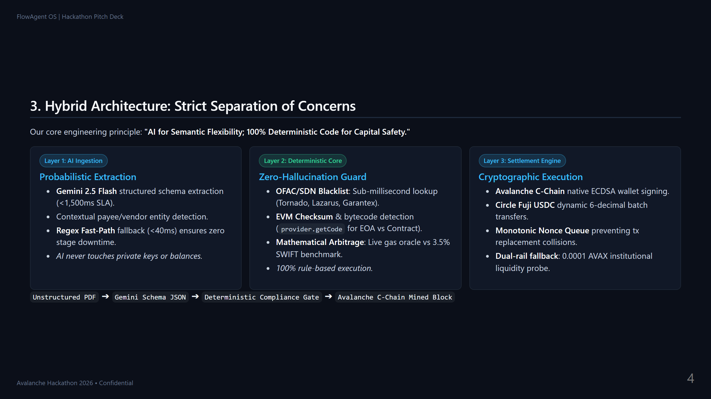
Notes:
Slide 3
Presenter Cue (1:00 - 1:30):
"Notice our architectural separation of concerns. We never let probabilistic AI handle fund routing. We use Gemini 2.5 Flash strictly for semantic extraction—parsing unstructured invoices in under 1.5 seconds. But compliance and money movement belong to a 100% deterministic code engine. Our compliance core executes sub-millisecond OFAC checks, and the Avalanche engine signs non-custodial transactions with zero risk of AI hallucination."

Slide 5
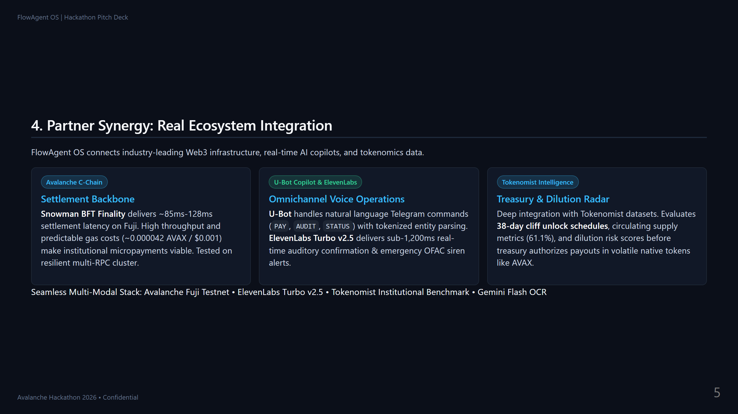
Notes:
Slide 4
Presenter Cue (1:30 - 2:00):
"Our partner integrations solve real enterprise workflows. Avalanche provides the sub-second Snowman BFT consensus and low gas fees required for enterprise settlement. U-Bot lets finance directors approve payments directly through Telegram with tokenized intent parsing, while ElevenLabs delivers immediate auditory verification. Finally, Tokenomist guards corporate treasury by auditing token cliff unlock risks before payouts are authorized."

Slide 6
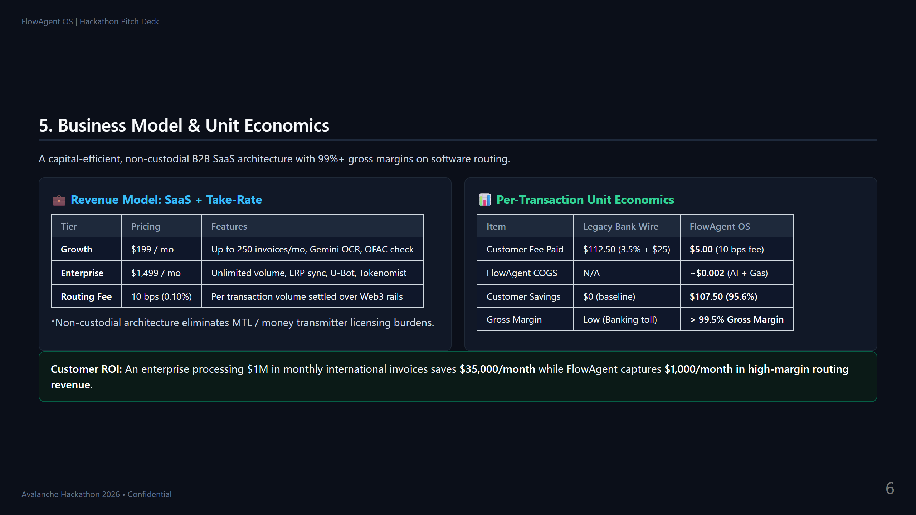
Notes:
Slide 5
Presenter Cue (2:00 - 2:30):
"Our business model is pure non-custodial middleware. We charge a standard monthly SaaS tier alongside a 10 basis point volume take-rate. Look at the unit economics: on a $5,000 invoice, the client saves over $107 compared to traditional wire fees, while our marginal cost to process via Gemini and Avalanche is a fraction of a cent. That translates to greater than 99.5% gross margin on software routing without holding user funds."

Slide 7
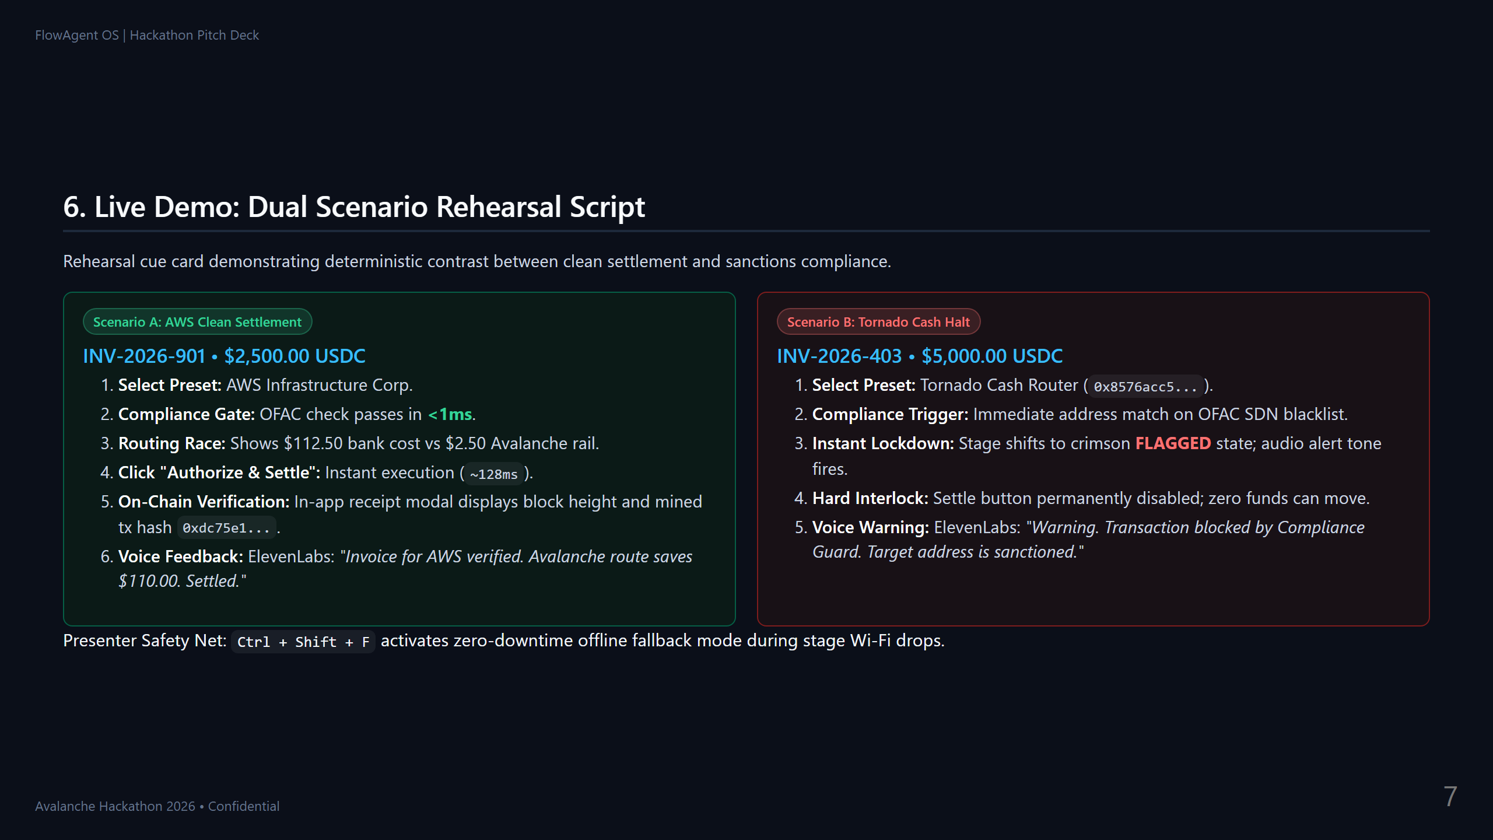
Notes:
Slide 6
Presenter Cue (2:30 - 3:00):
"Now let's see the live demo. First, we load the AWS invoice. In milliseconds, our compliance check confirms a clean OFAC record, our routing engine calculates $110 in savings, and with one click, the transaction is confirmed on Avalanche with a cryptographic receipt and voice confirmation. Next, we load an invoice addressed to Tornado Cash. Instantly, our deterministic compliance gate slams shut, disabling the settlement button and sounding an alert. Clean transactions settle in seconds; sanctioned transactions can never leak capital. That is FlowAgent OS."

