Slide 1
K Nearest Neighbors (KNN)

Slide 2
What is KNN?
KNN is a simple
supervised machine learning (ML) algorithm
that can be used for classification or regression tasks
frequently used in missing value imputation.

Slide 3
What is KNN?
It is based on the idea that the observations closest to a given data point are the most "similar" observations in a data set, and we can therefore classify unforeseen points based on the values of the closest existing points. By choosing K, the user can select the number of nearby observations to use in the algorithm.

Slide 4
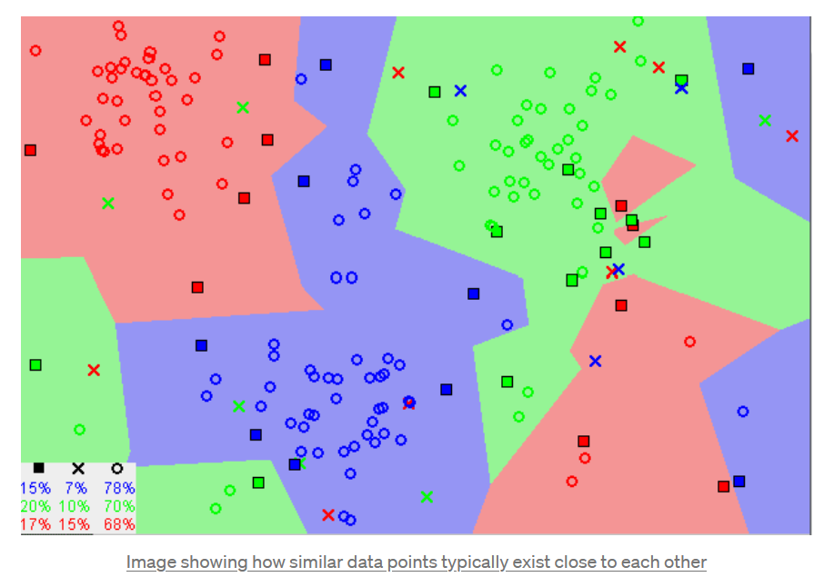
How Does KNN
Algorithm Work

Slide 5
How Does KNN Algorithm Work
1
Load the data
5
Pick the first K entries from the sorted collection
2
Initialize K to your chosen number of neighbors
6
Get the labels of the selected K entries
For each example in the data
Calculate the distance between the query example and the current example from the data.
Add the distance and the index of the example to an ordered collection
3
7
If regression, return the mean of the K labels
4
Sort the ordered collection of distances and indices from smallest to largest (in ascending order) by the distances
8
If classification, return the mode of the K labels

Slide 6
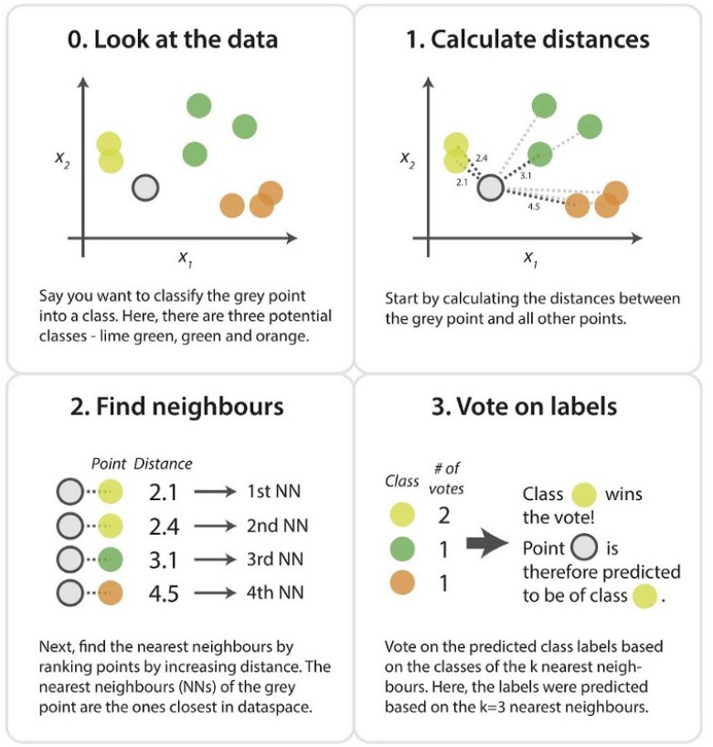

Slide 7
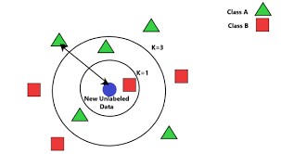

Choosing the right value for K
There are no pre-defined statistical methods to find the most favorable value of K.
Initialize a random K value and start computing.
Taking a low k will increase the influence of noise and the results are going to be less generalizable. On the other hand, taking a high k will tend to blur local effects which are exactly what we are looking for.
It is also recommended to take an odd k for binary classes to avoid ties.
The optimal K value usually found is the square root of N, where N is the total number of samples.

Slide 8
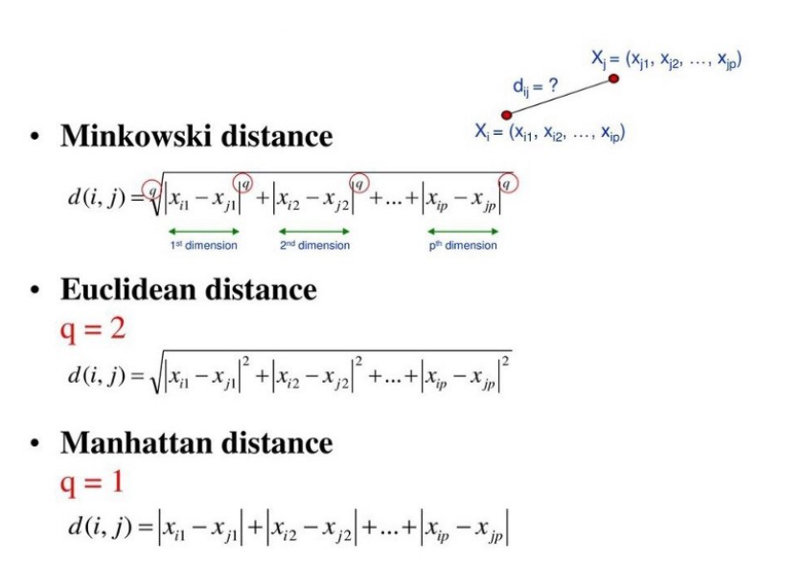
How to calculate the distance?

Slide 9
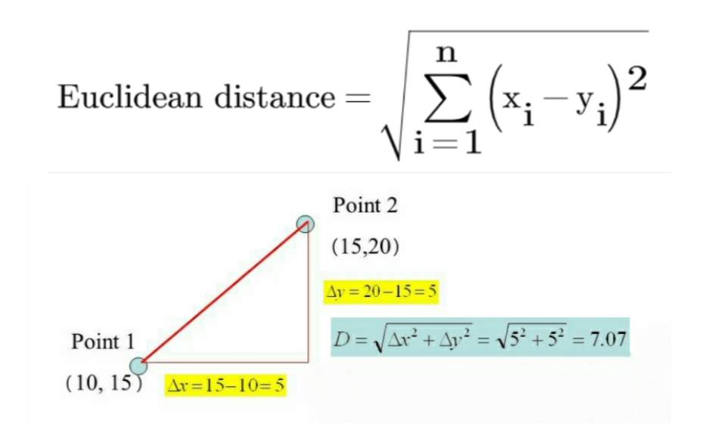
Euclidean distance

