Slide 1
TrustResume — Live Demonstration
Evidence-based resume generation that would rather fail than lie
Peng Fei Xu | MSAI 699 Capstone — Week 8: Project Demonstration
Notes:
Hi, I'm Peng Fei Xu. This is the Week 8 demonstration of TrustResume. Everything you're about to see is the live application running against a real production model — not slides, not a mock-up. In one sentence: TrustResume generates a resume grounded in the candidate's own documents, and then an independent agent checks every claim against that evidence before any score is shown to anyone.

Slide 2
The Idea in One Sentence
• AI can write a polished resume in seconds — and just as easily overstate scope, seniority, or a metric the evidence doesn't support.
• TrustResume splits the job in two: a Writer agent drafts from the candidate's own documents; an independent Trust Harness then checks every claim against that same evidence.
• The writer never grades its own homework — that separation is what makes a claim checkable, not just plausible.
• The design bet you'll see proven live: the system would rather fail a candidate than lie for them.
TrustResume | MSAI 699 Capstone — Week 8 Demonstration
Notes:
Here's the whole idea before we open the app. Generative AI writing a convincing resume is a solved problem — the hard part is trust. Nothing stops a model from quietly stretching the truth to make a draft look better. So TrustResume splits generation from verification into two separate agents. The writer drafts from the candidate's real documents; an independent Trust Harness then checks every single claim against that evidence. The writer never scores itself. The bet the whole project rests on is that the system should rather fail a candidate than lie for them — and I'll show that happening on a real run in a moment.

Slide 3
What You'll See in This Demo
• Documents — upload a résumé; it's parsed, chunked, and embedded into the candidate's private, user-scoped evidence store.
• Jobs — a job is a persisted entity: extract the posting once, then reuse that extraction for every generation against it.
• Generate — hybrid retrieval → Writer → Trust Harness → ATS scoring, always rewriting at least once and keeping the best-scoring draft.
• The result — real Trust and ATS scores, missing keywords, flagged claims, and a downloadable PDF/Markdown résumé.
TrustResume | MSAI 699 Capstone — Week 8 Demonstration
Notes:
Quick roadmap for the next few minutes. Four tabs. First, Documents: I'll upload a résumé and you'll see it ingested — parsed, chunked, embedded — into an evidence store scoped to just this user. Second, Jobs: a job here is a saved entity; the posting is extracted once and reused, so we're not re-parsing it every run. Third, Generate: this kicks off the pipeline — hybrid vector-plus-keyword retrieval, the Writer drafting from evidence, the Trust Harness checking each claim, and ATS keyword scoring. It always rewrites at least once more and keeps whichever draft actually scored best, not the first that passed. Finally the result: the real scores, the gaps, any flagged claims, and an actual exportable document.

Slide 4
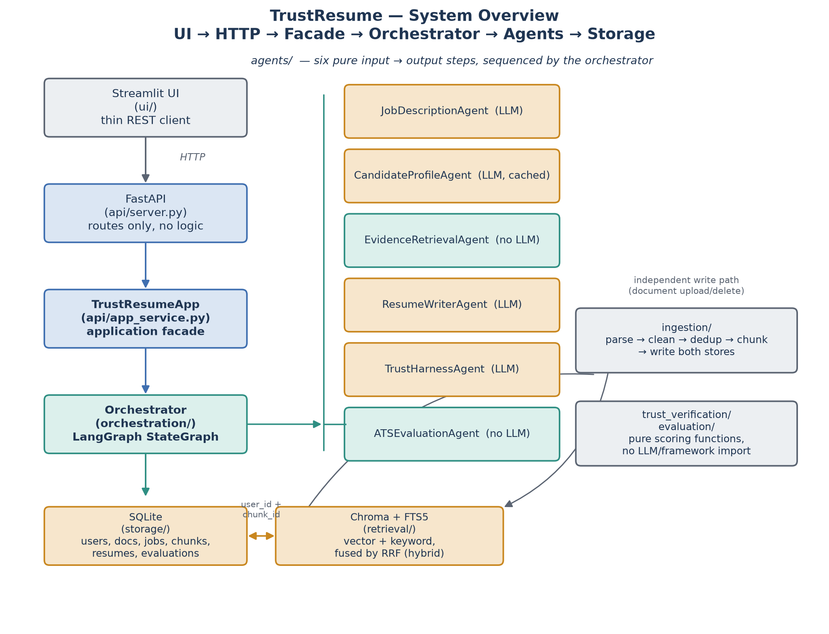
Under the Hood: Six Agents, One Quality Loop
TrustResume | MSAI 699 Capstone — Week 8 Demonstration
Streamlit UI → FastAPI → LangGraph orchestrator driving the agents over a hybrid Chroma + SQLite/FTS5 evidence store.
Notes:
Before we dive in, one architecture slide so the demo makes sense. The Streamlit UI talks over HTTP to a FastAPI backend, which drives a LangGraph orchestrator. The orchestrator sequences the agents: Job Description and Evidence Retrieval run once, then a loop of Resume Writer, Trust Harness, and ATS Evaluation, with a cached Candidate Profile feeding the writer. Retrieval is hybrid — part vector similarity for paraphrases, part keyword search for exact product names — over a Chroma vector store plus SQLite full-text search, everything filtered to one user's own data. That's the isolation boundary the trust story depends on.

Slide 5
LIVE DEMO
Switching to the running application
Notes:
Okay — switching to the live app now. This is the real system against a real Bedrock model. I'll walk through Documents, Jobs, and a generation, and then we'll look at what came out.

Slide 6
The Moment to Watch For
• When the evidence doesn't match the job, the Writer does NOT invent experience to close the gap.
• Instead: a high Trust score (every claim is true) alongside a low ATS score (the résumé honestly doesn't match the posting).
• Trust 100 / ATS 0 on the same résumé isn't a bug — it's the entire product thesis, visible in two numbers.
• A run that doesn't pass is shown anyway, labeled honestly, never hidden or silently upgraded.
TrustResume | MSAI 699 Capstone — Week 8 Demonstration
Notes:
As I run this, here's the one moment I want you to watch for. When a candidate's evidence doesn't actually match the job, a naive generator would just invent the missing experience to score higher. This system won't. You'll see it produce a high Trust score — because every claim it made is genuinely supported — right next to a low ATS score, because the résumé honestly doesn't match the posting's keywords. Trust high, ATS low, on the very same résumé. That's not a failure of the system; that is the system working exactly as designed. And when a run doesn't clear the quality gate, we show it anyway, labeled plainly — never hidden, never quietly upgraded.

Slide 7
Grounded, then independently verified
Separating the agent that writes from the agent that checks is what makes this trustworthy rather than merely plausible — and you just saw it choose an honest result over a flattering, fabricated one.
Thank you — questions welcome.
Notes:
To close: separating the agent that writes from the agent that checks is what makes this trustworthy rather than merely plausible — and you just watched a real run choose an honest, capped result over a flattering, fabricated one. That's the whole point. Thank you — happy to take any questions.

