Slide 1
TrustResume
Evidence-Based Resume Generation Using RAG, Multi-Agent AI, and Trust Verification
If AI writes your resume — who verifies that every claim is true?
Peng Fei Xu | MSAI 699 Capstone Final Presentation | University of the Cumberlands
Notes:
Let me start with a question. If an AI tool writes your resume in seconds — who checks that every claim in it is actually true? Right now, nobody does. That gap is what my project closes. I'm Peng Fei Xu, and this is TrustResume, my MSAI 699 capstone: it generates a resume from real evidence, and then independently verifies every claim before delivering it. I'll cover the problem, how it works, the results, and what it means for the people who use it.

Slide 2
The Problem — and Why It Matters
• Generative AI writes a polished resume in seconds — but nothing stops it from overstating scope, seniority, or a metric.
• A fabricated claim looks identical to a real one. There is no built-in way to tell them apart.
Why it matters — to everyone in hiring:
Candidates
Lose credibility when a claim can’t be backed up.
Employers
Waste time and money on bad hires.
Organizations
Face legal & reputational risk from unverifiable AI content.
TrustResume | MSAI 699 Capstone Final Presentation
Notes:
Generative AI can write a convincing resume in seconds — that part is solved. The real problem is trust. Nothing stops the model from stretching the truth, and a fabricated claim looks exactly like a real one. Why does this matter? For candidates, one claim they can't back up can cost them their credibility. For employers, it means wasted time and bad hires. And for organizations, unverifiable AI content is a real legal and reputational risk. So this isn't just a technical problem — it affects everyone in hiring.

Slide 3
The Innovation: Generate First, Verify Independently
Every claim is independently verified against the candidate’s own evidence — before the resume is delivered.
Writer Agent
Generates the resume
Independent Verifier
Checks every claim against the evidence
✗ The Writer never verifies its own claims.
Independent Verification Layer
TrustResume | MSAI 699 Capstone Final Presentation
Notes:
Here is the core innovation — and it is NOT the tech stack. It is this one idea: every claim in the resume is independently verified against the candidate's own evidence, before the resume is delivered. Most AI tools let the model write, and then effectively trust itself. We split those two jobs. A Writer agent generates the resume. Then a completely separate Verifier checks every single claim against the evidence. The writer never grades its own homework. That independent verification layer is the whole point of this project.

Slide 4
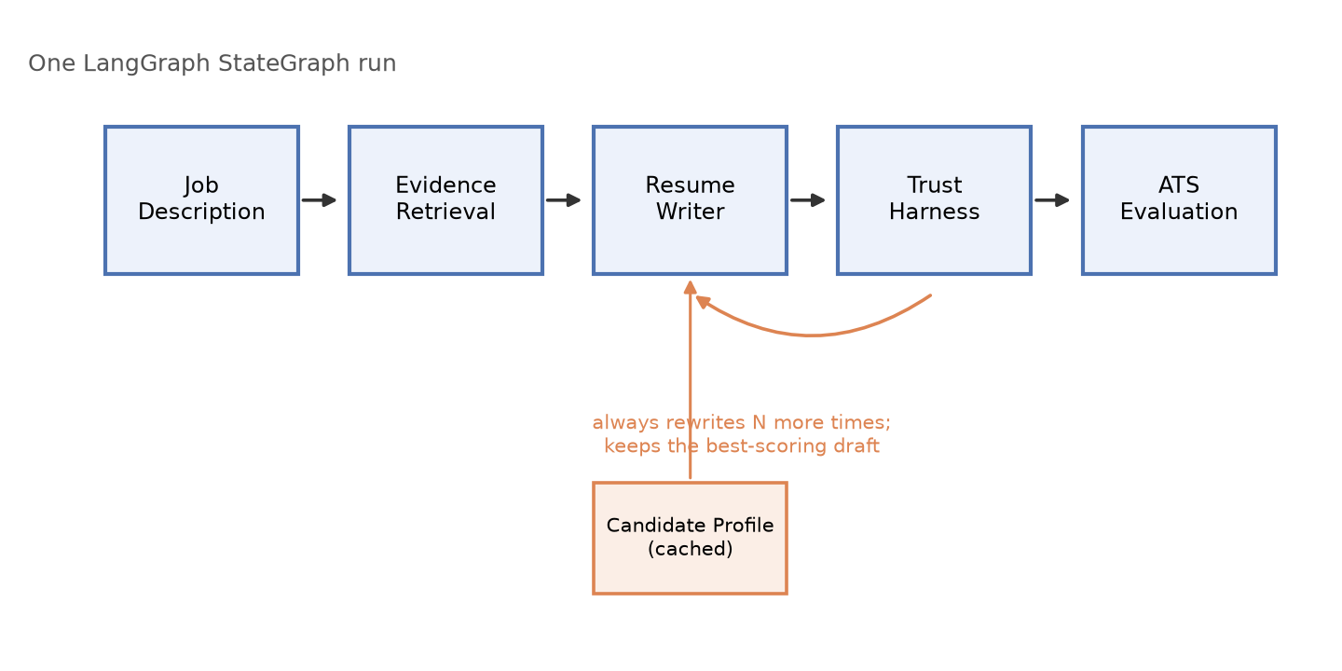
How It Works: Six Agents, One Quality Loop
The Writer drafts, the Verifier and an ATS check score it, the system rewrites — then keeps the best-scoring draft.
TrustResume | MSAI 699 Capstone Final Presentation
Notes:
Here is the method in one picture. Two steps run once: we read the job, and we retrieve the candidate's evidence. Then a loop begins. The Writer drafts. The Verifier — our Trust Harness — scores every claim as supported, partly supported, or unsupported. An ATS check scores keyword coverage against the job. The system writes feedback from whatever is weakest, tries again, and in the end keeps the best-scoring draft, not just the last one. Generation and verification are always separate steps in that loop.

Slide 5
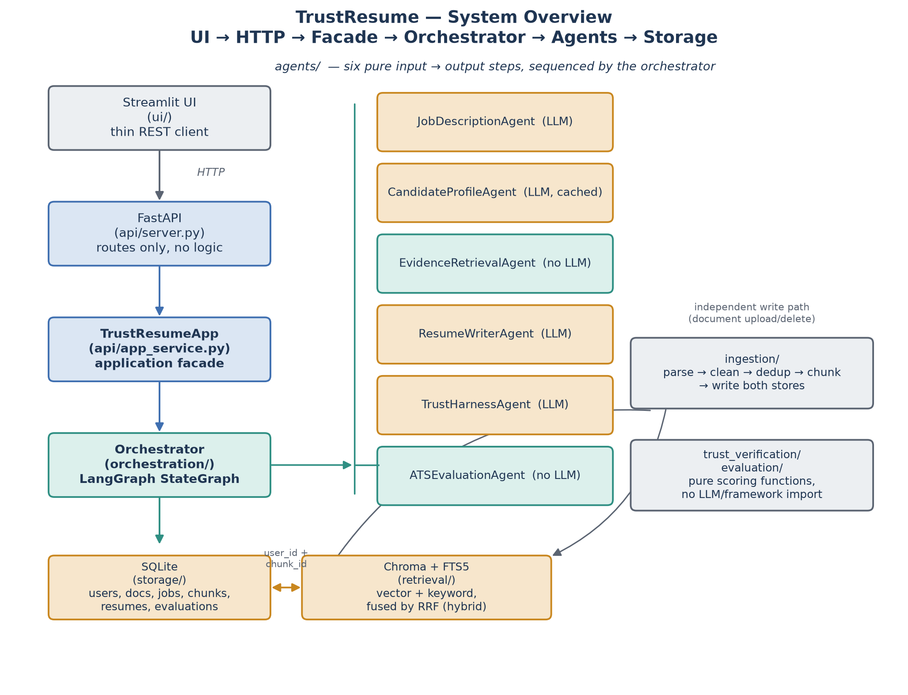
System Architecture: How the Pieces Fit
TrustResume | MSAI 699 Capstone Final Presentation
Notes:
A quick architecture walkthrough. On the left is the path a request takes: the web UI talks over HTTP to a thin API layer, which calls one application service, which calls the Orchestrator. In the middle are the six agents the Orchestrator runs in order — the green ones use no AI model at all, so retrieval and scoring are plain, testable code, not a black box. At the bottom is storage, with hybrid search that combines meaning-based and keyword search. The key design point for stakeholders: every search is scoped to one user's own data, and the scoring logic has no AI model inside it — so the trust score is deterministic and auditable.

Slide 6
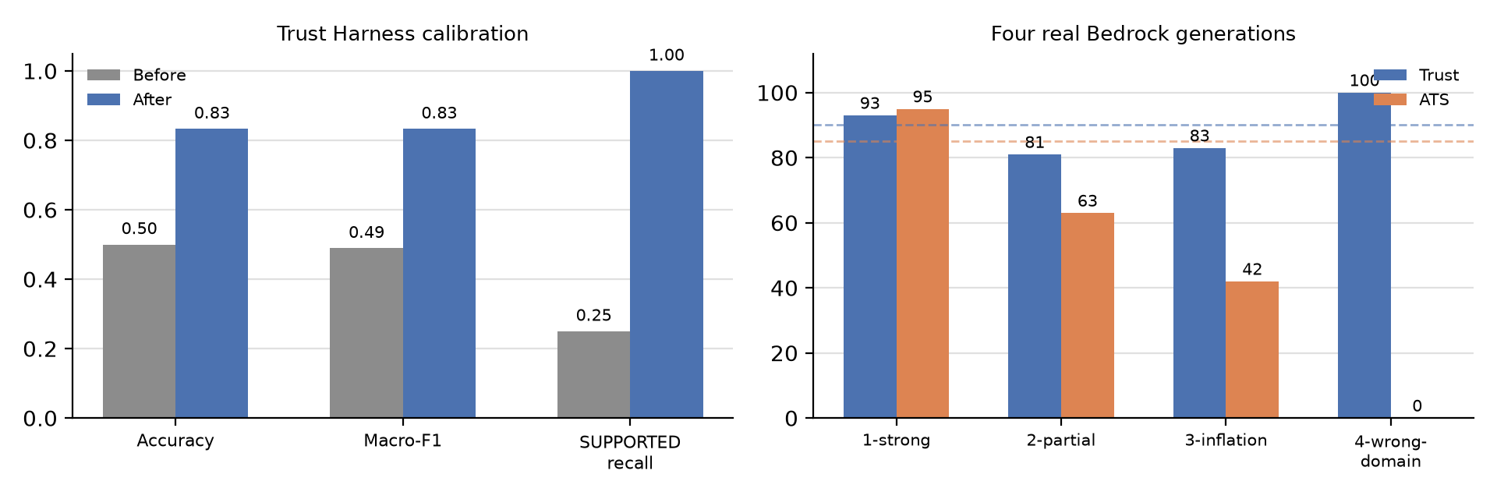
Results: Measured, Not Assumed
100%
Retrieval Recall@8
Finds the right evidence, every time
83.3%
Trust Harness Accuracy
Up from 50% after we fixed the rules
99.2%
Test Coverage
500 automated tests, on every change
Data analysis, in one line:
We tested our own verifier, caught it at only 50% accuracy, and calibrated it to 83.3% — while the dangerous error (a false claim marked true) stayed at 0%.
TrustResume | MSAI 699 Capstone Final Presentation
Notes:
Now the results — and the point here is that we measured, we didn't assume. Three headline numbers. One: retrieval finds the right evidence 100 percent of the time on our labeled test set. Two: the verifier is 83.3 percent accurate. And here's the honest data-analysis story behind that number — the first version scored only 50 percent, because we just told it to 'be strict' without defining what that meant. We caught that with our own evaluation harness and calibrated it up to 83.3 percent. And the dangerous error — a false claim marked as true — stayed at zero the whole time. Three: 99.2 percent test coverage, 500 automated tests on every change.

Slide 7
The Proof: It Chose Honesty Over a Fake Match
Backend Engineer résumé → applied to an iOS Developer job (zero iOS experience)
Trust Score
100
Every claim was true
ATS Match
0
No matching experience
✓ Every claim it made was true
✗ No iOS experience — and it refused to invent any
✓ Reported an honest failure instead of a fabricated pass
It would rather fail you than lie for you.
TrustResume | MSAI 699 Capstone Final Presentation
Notes:
This is the slide I most want you to remember. We took a backend engineer's real resume and applied it to an iOS Developer job — a candidate with zero iOS experience. Look at the two numbers. The Trust Score is 100: every claim the system made was true. The ATS match is 0: there was no matching experience, and the writer refused to invent any. So instead of faking an iOS background to pass, the system reported an honest failure. It would rather fail you than lie for you. That is the entire thesis of this project, proven on a real production model.

Slide 8
Responsible AI & What’s Next
Responsible by design
Security — every input is treated as data, not instructions (prompt-injection defense).
Privacy — every user’s data is isolated and filtered on the server.
Fairness — the same verification stops the system from rewarding whoever embellishes best.
What’s next — four focus areas
1. Authentication & Security — real login, rate limiting
2. Retrieval Quality — a relevance threshold on search
3. Trust Accuracy — a larger labeled dataset
4. Scalability & Language Support — scale-out, more export languages
TrustResume | MSAI 699 Capstone Final Presentation
Notes:
Two quick things, because this touches real careers. First, responsible design: every outside input is treated as data, never as an instruction, which defends against prompt injection; every user's data is isolated; and the same verification that catches fabrication also keeps the system fair — it won't reward whoever embellishes best. Second, what's next, in four areas: real authentication and security; better retrieval with a relevance threshold; higher trust accuracy from a larger labeled dataset; and scalability plus more export languages. I'll be honest — real login isn't built yet, and it's the top priority.

Slide 9
Conclusion
AI-generated content can be useful — without sacrificing trust.
The key is independent verification.
✓ Proven on a real model — it chose an honest score over a fabricated resume.
For candidates: a resume they can stand behind. For employers: claims they can trust.
The pattern — grounded generation + independent verification — fits any AI content where truth matters.
TrustResume | MSAI 699 Capstone Final Presentation
Notes:
To conclude. The big idea is simple: AI-generated content can be useful without sacrificing trust — and the key is independent verification. We didn't just claim that; we proved it on a real model that chose an honest score over a fabricated resume. For candidates, that means a resume they can stand behind. For employers, claims they can actually trust. And this pattern — grounded generation plus independent verification — reaches far beyond resumes, to any AI-generated content where the truth matters. Thank you.

Slide 10
Thank You
Questions?
Notes:
Thank you very much for your time. I'd be glad to take any questions.

