Slide 1


Additivity of quantum capacities in simple non-degradable quantum channels
Peixue Wu
Institute for Quantum Computing, University of Waterloo
Joint work with Graeme Smith
arXiv:2409.03927
To appear in IEEE Transaction in Information Theory

Slide 2
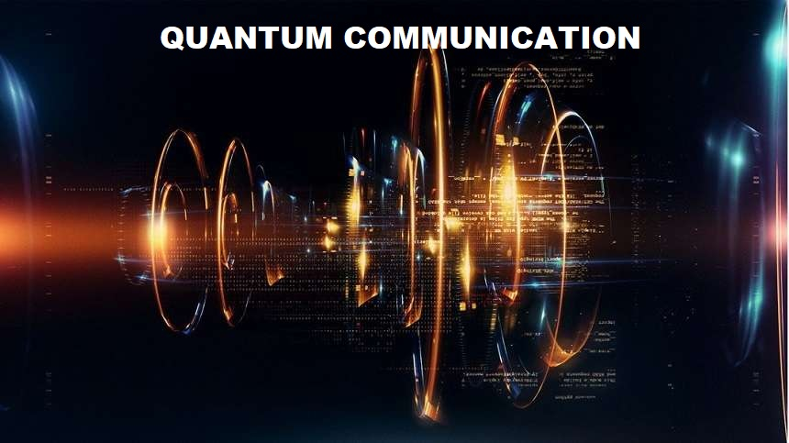
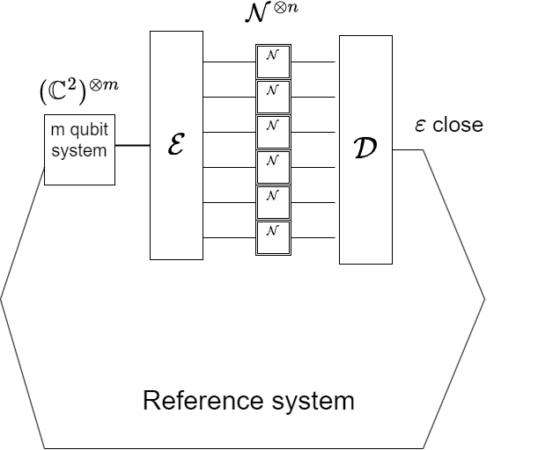
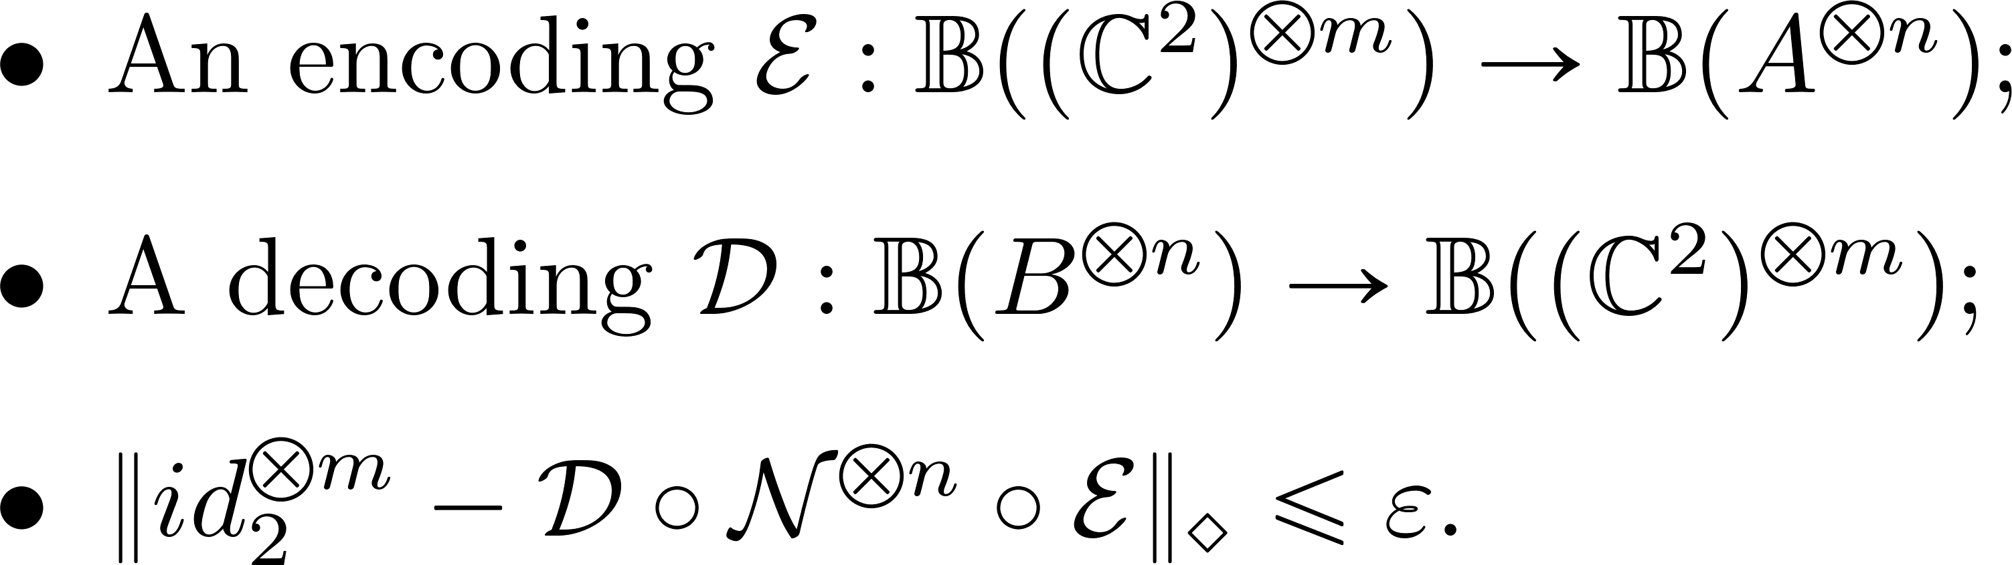
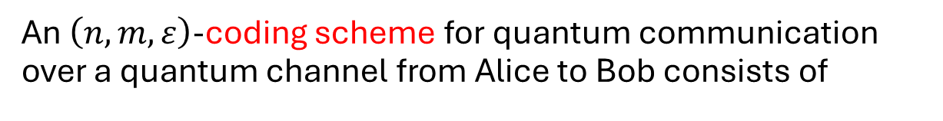
Quantum communication
An $\left(n,m,ε\right)$-coding scheme for quantum communication over a quantum channel from Alice to Bob consists of

Slide 3
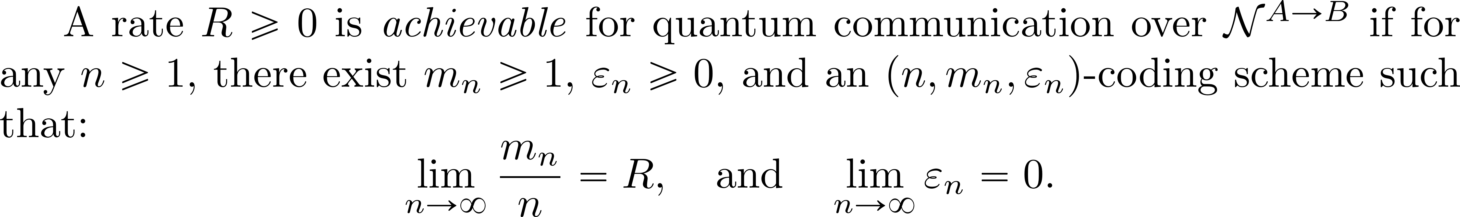
Achievable rate and quantum capacity
The quantum capacity of a channel is the supremum of all achievable rates for quantum communication over this channel.
It represents the maximum code rate of reliable quantum communication (approximate quantum error correction), considering i.i.d. noise and arbitrary uses of the channel.

Slide 4
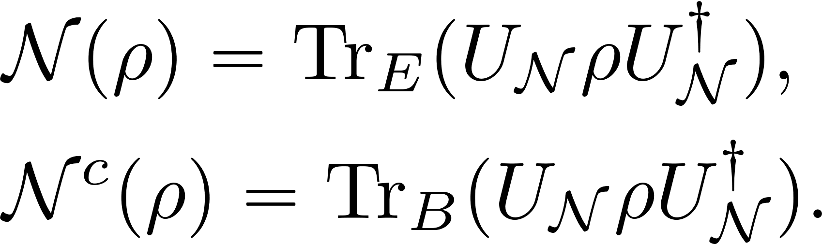
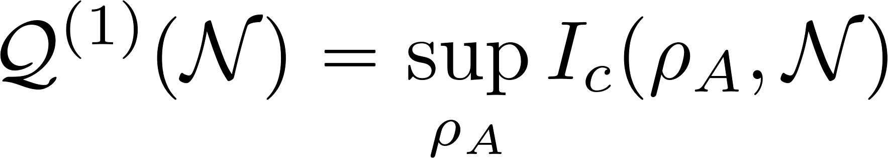
Evaluation of quantum capacity
A quantum channel arises from sharing quantum information with the environment, which is subsequently lost by tracing out.
An isometry from Alice to the joint system of Bob and Eve generates a pair of quantum channels (they are complementary to each other) :
Coherent information: “Advantage” of Bob over Eve:
Bob
Alice
Eve

Slide 5
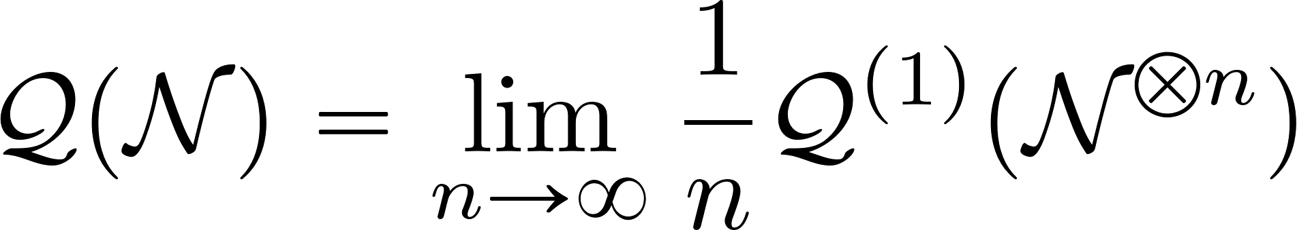
Evaluation of quantum capacity:
Llyod-Shor-Devetak(LSD) theorem
The quantum capacity can be calculated as:
Hayden-Horodecki-Winter-Yard theorem
The quantum capacity is the supremum of all achievable rates for entanglement generation over the channel

Slide 6
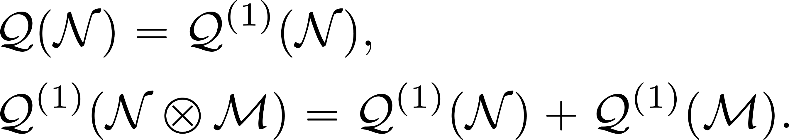
Degradable channels
Degradable channel: Bob knows more than Eve.
Anti-degradable channel: Eve knows more than Bob. Quantum capacity is zero by no-cloning.
For degradable channels, we have
Devetak, Igor, and Peter W. Shor. "The capacity of a quantum channel for simultaneous transmission of classical and quantum information." Communications in Mathematical Physics 256 (2005): 287-303.

Slide 7
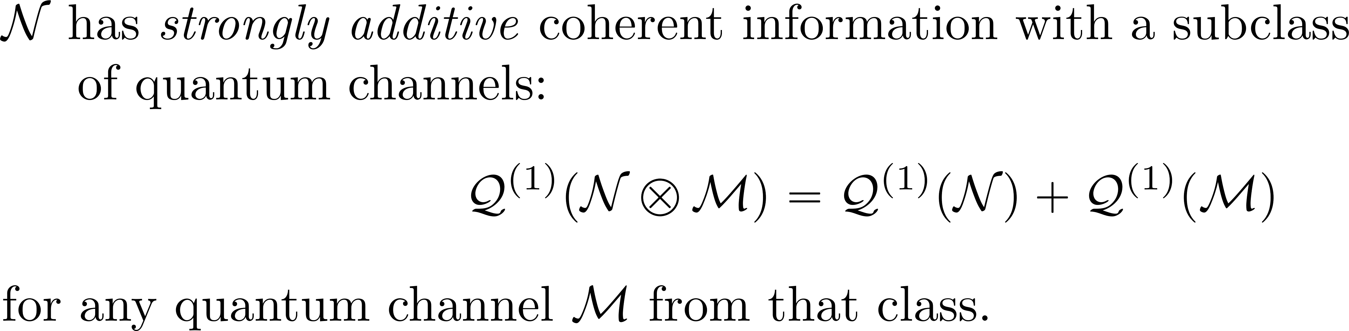
Strong and weak additivity problems
Strong and weak additivity:
Main Question for today: which class of channels has strong and weak additivity properties apart from degradable and anti-degradable channels?

Slide 8
What is known?
PPT channels (zero capacity) have weak additive coherent information, but strong additivity with degradable channels fails. This is also called Smith-Yard effect.
There are a few examples of non-degradable and non-anti-degradable channels with weak additive coherent information. We claim that these examples are essentially degradable.
Smith, Graeme, and Jon Yard. "Quantum communication with zero-capacity channels." Science 321.5897 (2008): 1812-1815.
Gao, Li, Marius Junge, and Nicholas LaRacuente. "Capacity estimates via comparison with TRO channels." Communications in Mathematical Physics 364 (2018): 83-121.
Chessa, Stefano, and Vittorio Giovannetti. "Quantum capacity analysis of multi-level amplitude damping channels." Communications Physics 4.1 (2021): 22.

Slide 9
What is known?
There are channels with conjectured weak additivity, while strong additivity with degradable channels fails. Rigorous proof of weak additivity is based on spin alignment conjecture.
Weaker notion of degradability implies certain additivity property. Rigorous proof of explicit examples is yet to be given.
Leditzky, Felix, et al. "Generic nonadditivity of quantum capacity in simple channels." Physical review letters 130.20 (2023): 200801.

Slide 10
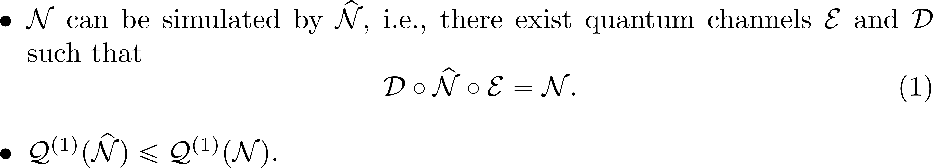
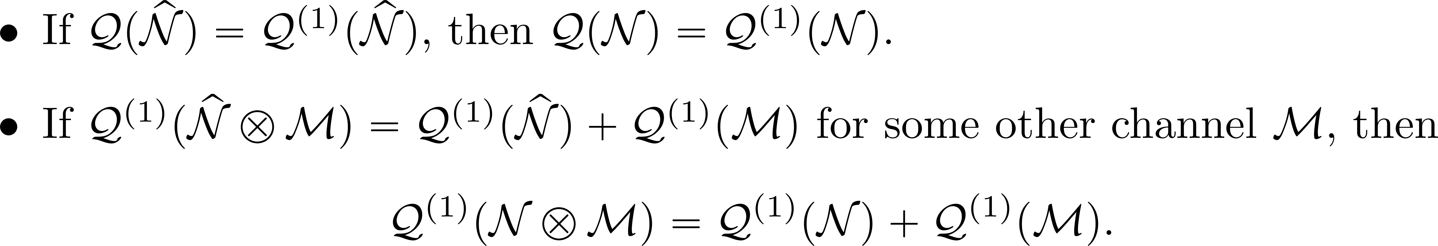
“Trivial” class of non-degradable channel with additivity property.
A channel inherits the additivity property from another channel: suppose
Then

Slide 11
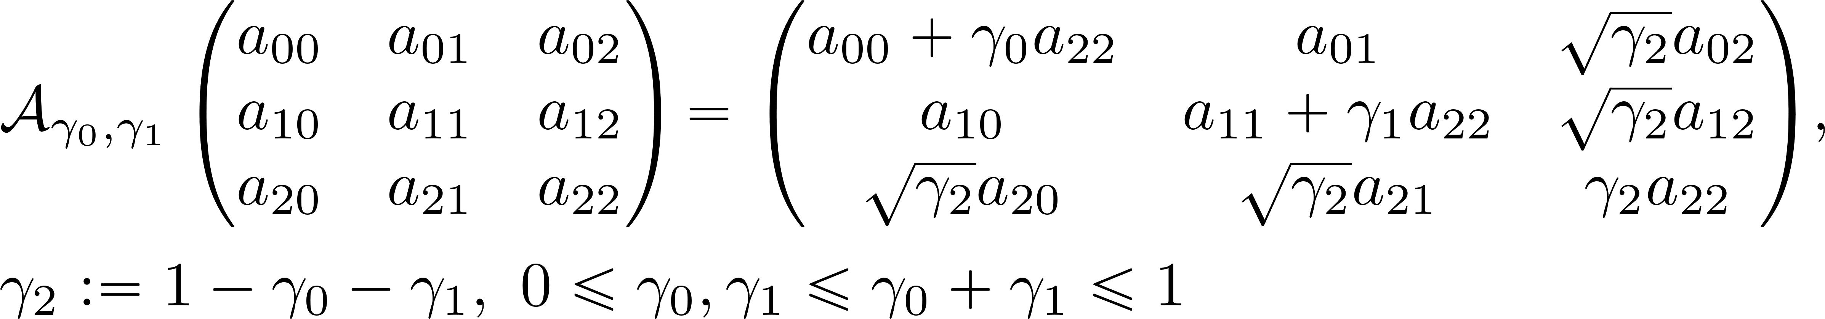
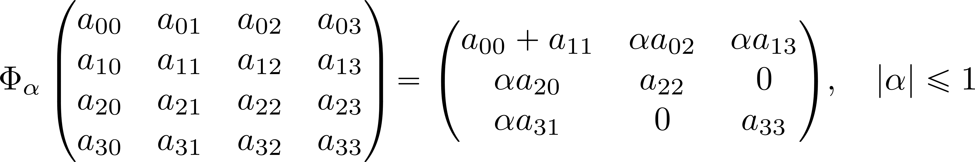
Examples
Direct sum of degradable and anti-degradable channels.
Multi-level amplitude damping.
Dephasing like channels.
Gao, Li, Marius Junge, and Nicholas LaRacuente. "Capacity estimates via comparison with TRO channels." Communications in Mathematical Physics 364 (2018): 83-121.
Chessa, Stefano, and Vittorio Giovannetti. "Quantum capacity analysis of multi-level amplitude damping channels." Communications Physics 4.1 (2021): 22.

Slide 12
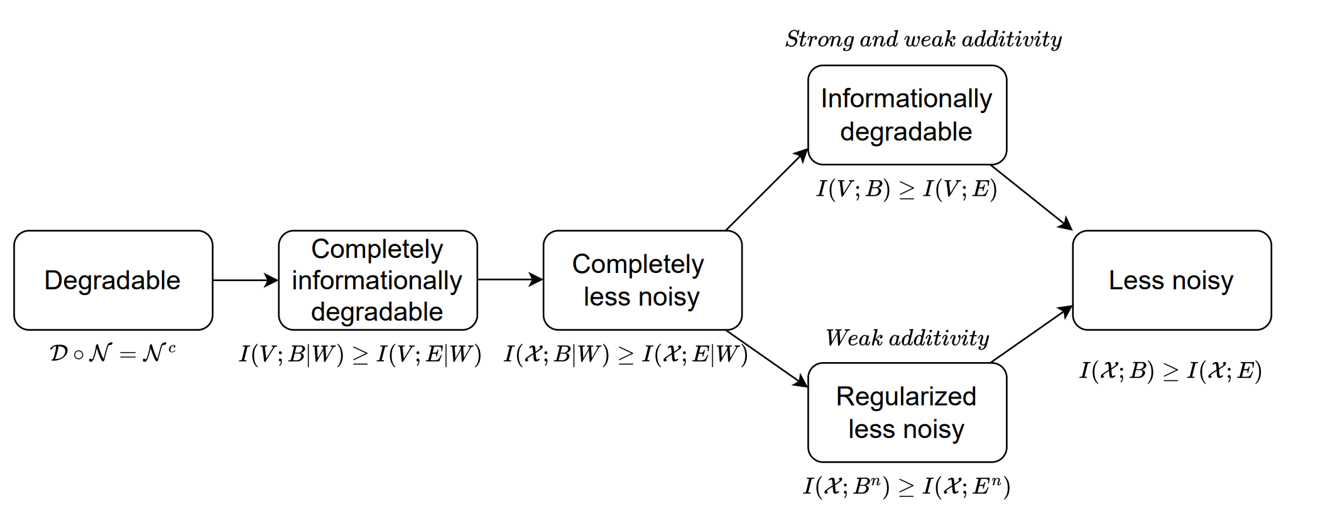
“Non-trivial” class of non-degradable channels with additivity property
Class 1: Weaker notions of degradability implies additivity:

Slide 13
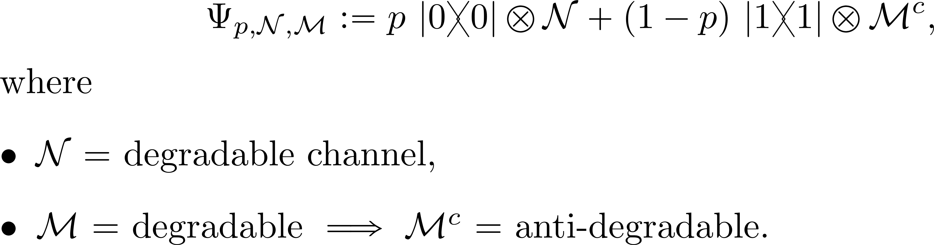
Typical example: Flagged mixtures of degradable and anti-degradable channels
Rigorous proof is still missing.

Slide 14
“Non-trivial” class of non-degradable channels with additivity property
Class 2: PPT-like channels (privacy induced channels, Platypus channels) have weak additivity but strong additivity fails.
Entropy minimization problem in n qudit systems!

Slide 15
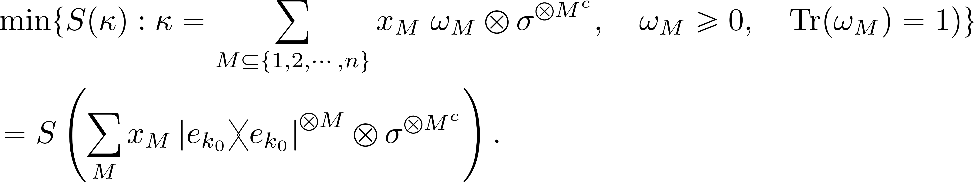
Entropy minimization problem in n qudit systems.
Spin alignment conjecture:
Alhejji, Mohammad A., and Emanuel Knill. "Towards a resolution of the spin alignment problem." Communications in Mathematical Physics 405.5 (2024): 119.

Slide 16
Conclusion
Weaker degradability notions help show additivity of coherent information.
Flagged and direct sum constructions yield channels without any degradability but additivity of coherent information may preserve.
Non-trivial classes of channels with additivity property need new ideas. Even partial progress is exciting.

Slide 17
Thank you for listening!

