Slide 1


Quantum capacity amplification via Privacy
Peixue Wu
Institute for Quantum Computing, University of Waterloo
Joint work with
Yunkai Wang

Slide 2
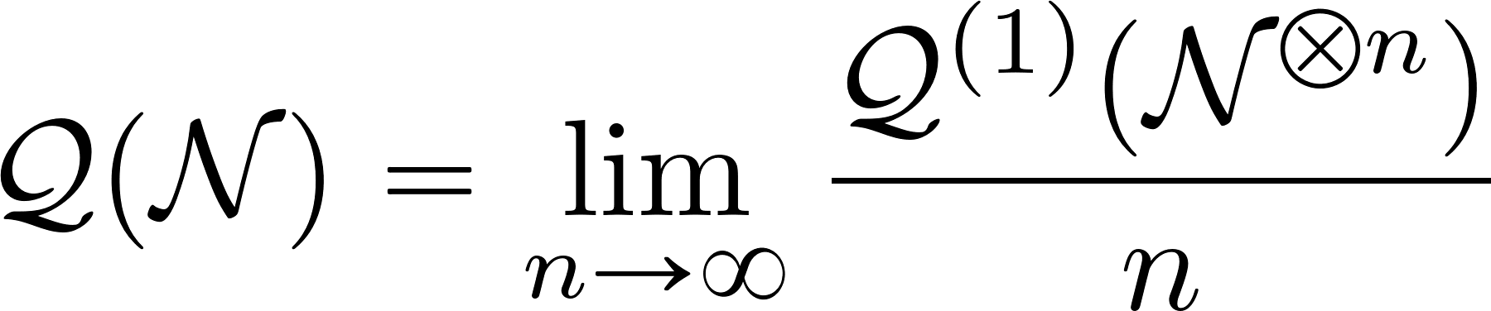
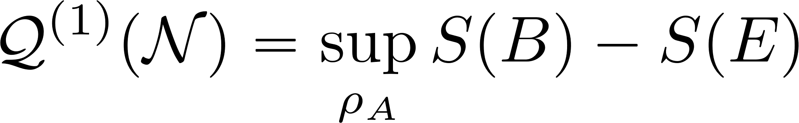
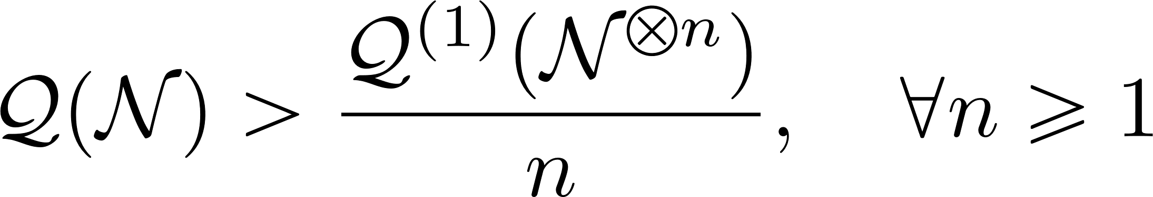
Quantum capacity
The maximum achievable rate for quantum communication over many independent uses of a noisy quantum channel.
Lloyd-Shor-Devetak:
Still open: is there an example of channel:

Slide 3
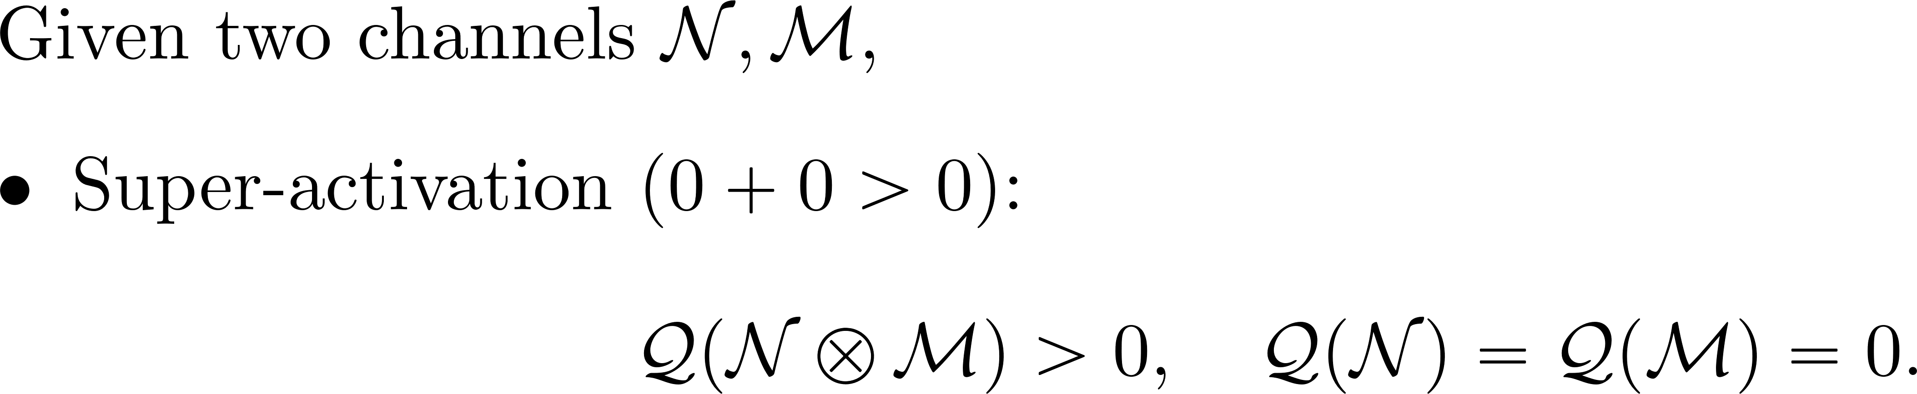
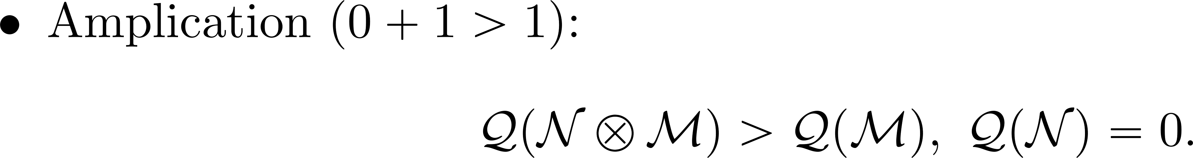
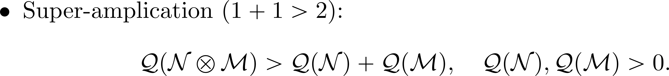
Today’s task: Quantum capacity amplication

Slide 4
Today’s task: Quantum capacity amplication
Smith-Yard effect (2008)
PPT channel + erasure channel
Leditzky et al. (2023) Platypus channel
Smith, Graeme, and Jon Yard. "Quantum communication with zero-capacity channels." Science 321.5897 (2008): 1812-1815.
Leditzky, Felix, et al. "Generic nonadditivity of quantum capacity in simple channels." Physical review letters 130.20 (2023): 200801.

Slide 5
Today’s task: Quantum capacity amplication
This work:
Private channel

Slide 6

Private states
Alice holds key $a_{0}$​ and shield $A_{0}$​ ; Bob holds key $b_{0}$ and shield $B_{0}$
Security criterion – Measure the key in the computational basis, discard the shield; if Eve’s residual state is independent of the outcome, the state contains privacy.

Slide 7
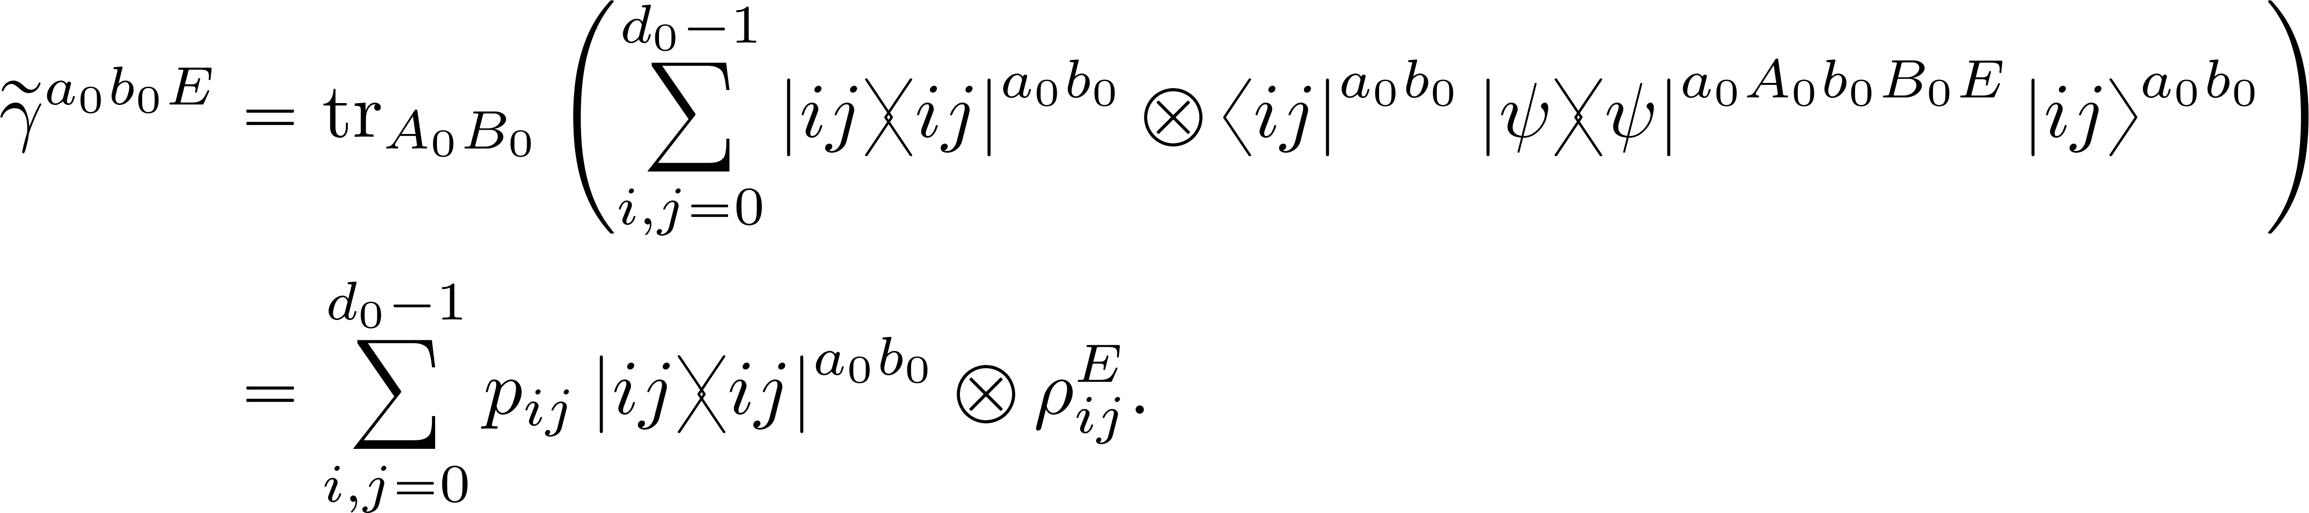
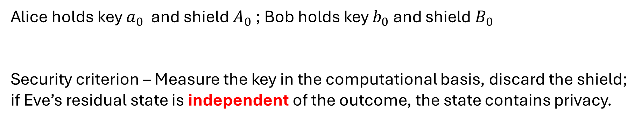
Private states
Alice holds key $a_{0}$​ and shield $A_{0}$​ ; Bob holds key $b_{0}$ and shield $B_{0}$
Security criterion – Measure the key in the computational basis, discard the shield; if Eve’s residual state is independent of the outcome, the state contains privacy.

Slide 8
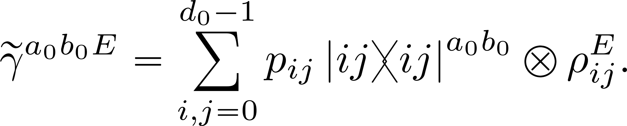
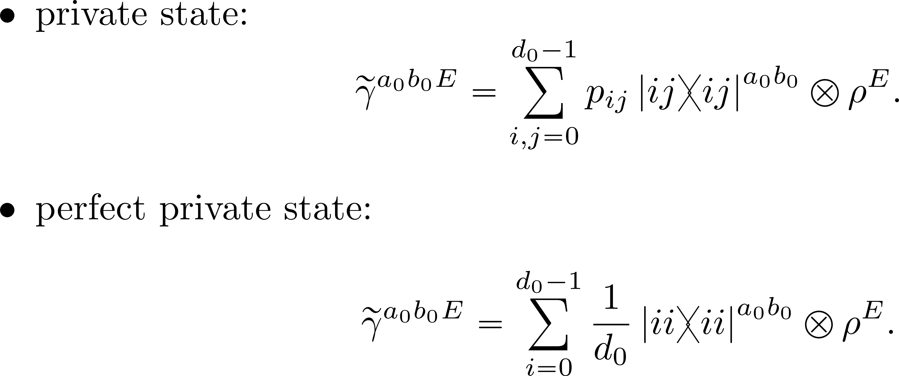
Private states
Horodecki, Karol, et al. "General paradigm for distilling classical key from quantum states." IEEE Transactions on Information Theory 55.4 (2009): 1898-1929.

Slide 9
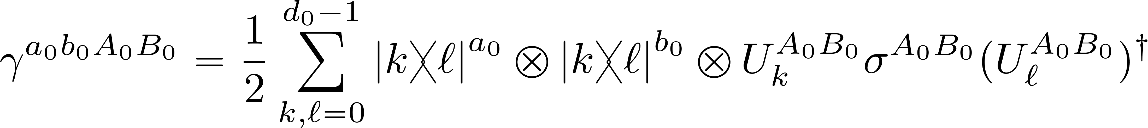
Perfect private state
General form of perfect private state:
A special class: flagged private bit
Horodecki, Karol, et al. "General paradigm for distilling classical key from quantum states." IEEE Transactions on Information Theory 55.4 (2009): 1898-1929.

Slide 10
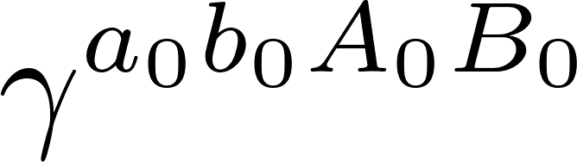
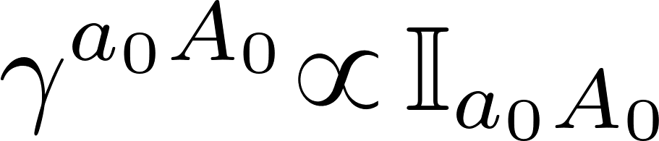
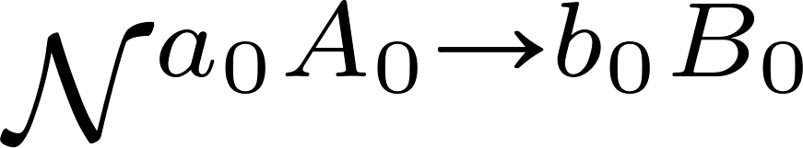
(Perfect) Private channel
Consider private state , with
It induces a quantum channel via Choi isomorphism
This class of channel exhibits quantum capacity amplification:

Slide 11
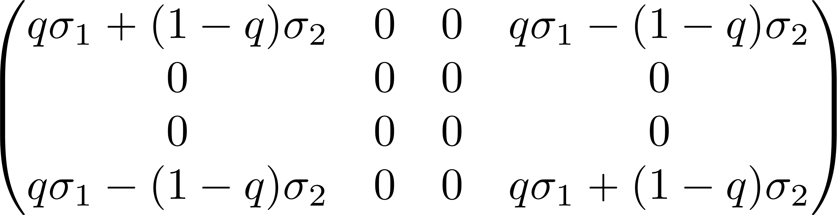
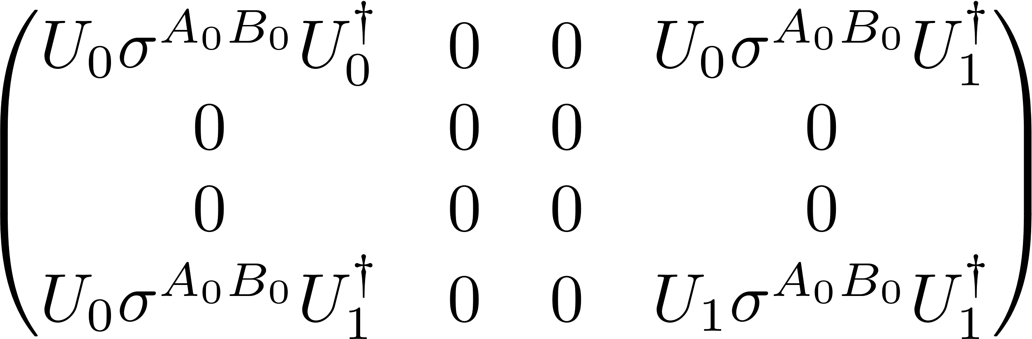
Main result: quantum capacity amplification for private channels
We consider private channel induced by flagged private bit
General form of this perfect private state :
obtained via SVD:

Slide 12
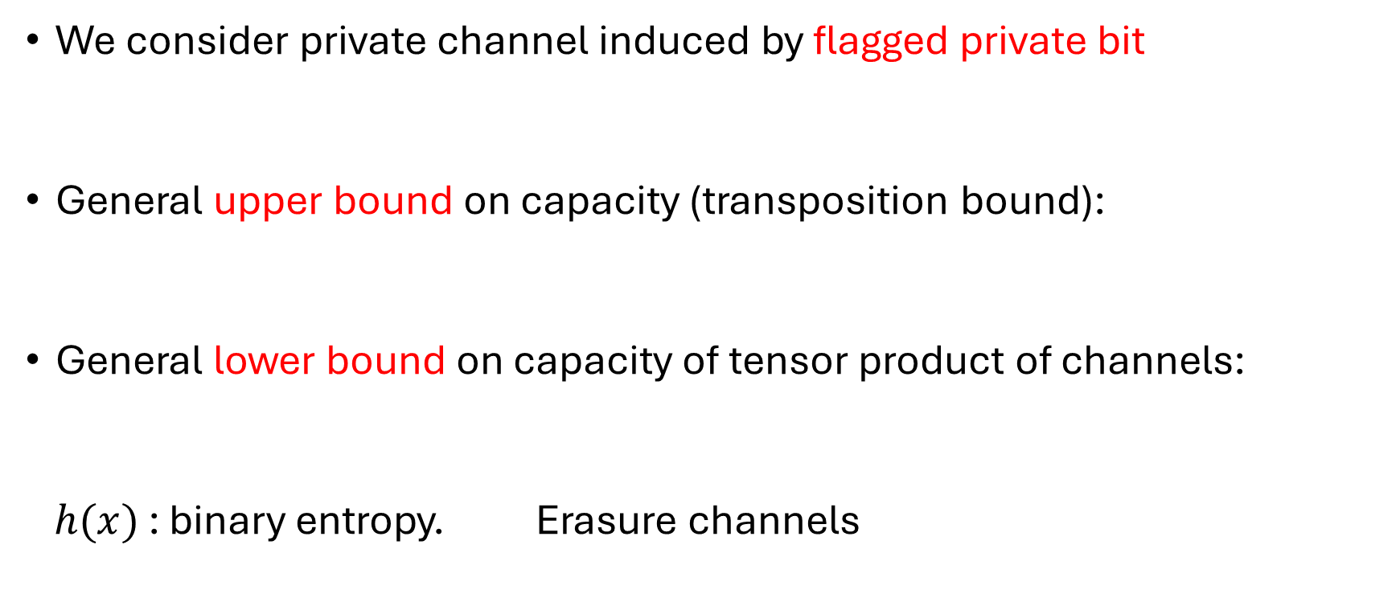
Main result: quantum capacity amplification for private channels
We consider private channel induced by flagged private bit
General upper bound on capacity (transposition bound):
General lower bound on capacity of tensor product of channels:
$h(x)$ : binary entropy. Erasure channels

Slide 13
An example: Werner state
Symmetric state
Anti-symmetric state
It induces a channel:
Apply the main result to this case, we have capacity amplification when
Werner, Reinhard F. "Quantum states with Einstein-Podolsky-Rosen correlations admitting a hidden-variable model." Physical Review A 40.8 (1989): 4277.

Slide 14
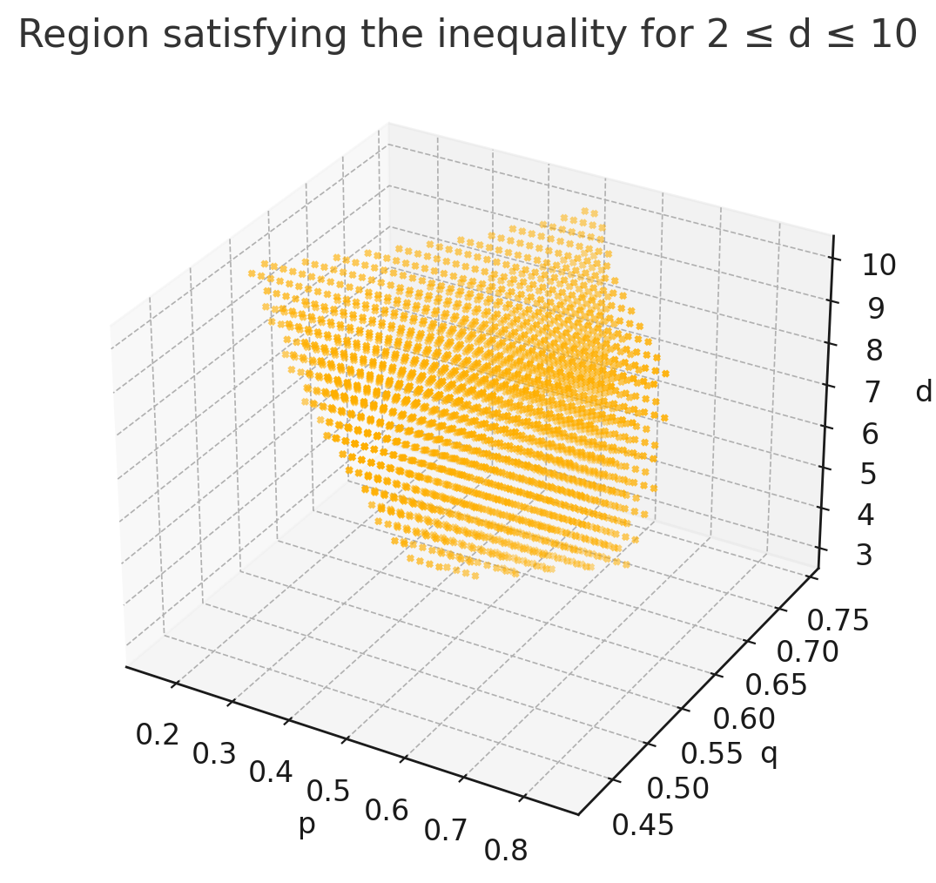

Slide 15
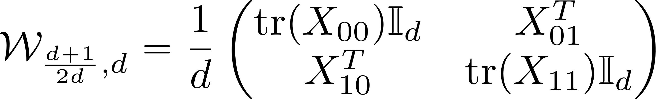

Special case:
This channel has computable capacity $\frac{1}{d}$ , if we assume spin alignment conjecture is correct.
This channel exhibits quantum capacity amplification.
Leditzky, Felix, et al. "The platypus of the quantum channel zoo." IEEE Transactions on Information Theory 69.6 (2023): 3825-3849.

Slide 16
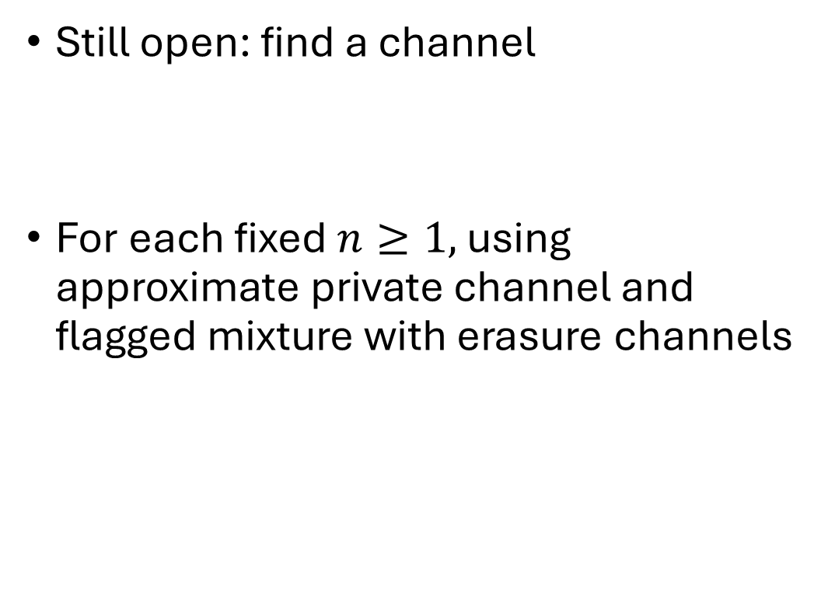
Is quantum capacity really uncomputable?
Still open: find a channel
For each fixed $n≥1,$ using approximate private channel and flagged mixture with erasure channels
Cubitt, Toby, et al. "Unbounded number of channel uses may be required to detect quantum capacity." Nature communications 6.1 (2015): 6739.

Slide 17
Thanks for listening!

