Slide 1
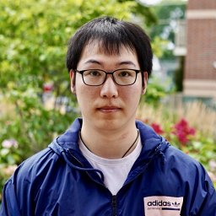
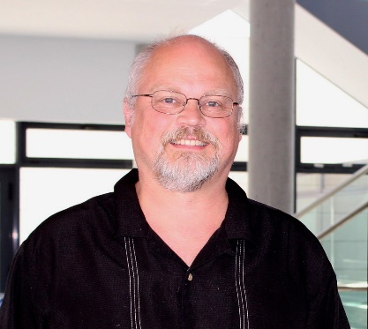
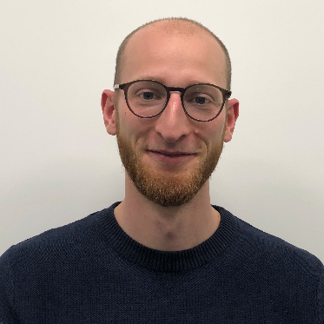

Lower bound for simulation cost of open quantum systems
Lipschitz continuity approach
Peixue Wu
Institute for Quantum Computing, University of Waterloo
Joint work with Zhiyan Ding(UC Berkeley), Marius Junge(UIUC), and Philipp Schleich(Toronto)
Paper link: 2407.15357

Slide 2
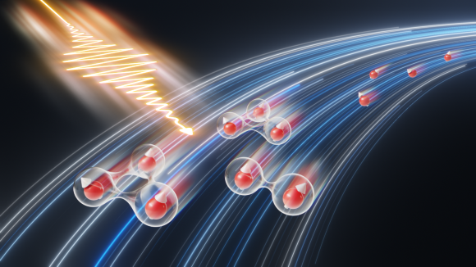
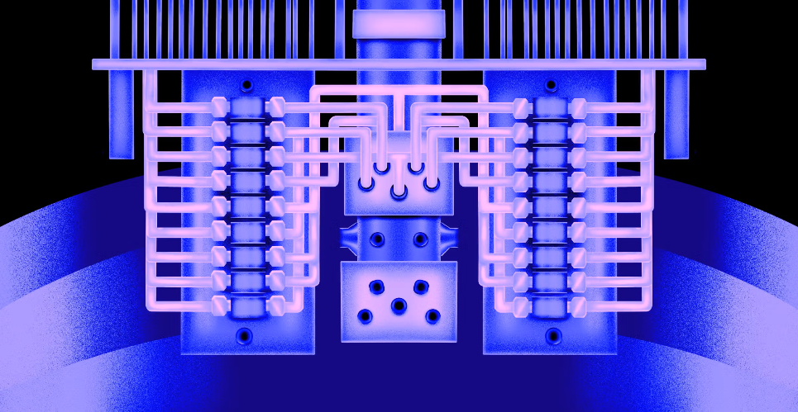
Why open quantum systems?
Understanding Physics: open quantum system captures the realistic behavior when your system is interacted with the environment.
Quantum Algorithm Design: design open system algorithm to prepare Gibbs/ground state efficiently.
Chi-Fang Chen. “Quantum Gibbs Sampling,” Caltech, 2024.
Zhiyan Ding, Chi-Fang Chen, and Lin Lin. "Single-ancilla ground state preparation via Lindbladians." Physical Review Research 6.3 (2024): 033147.

Slide 3
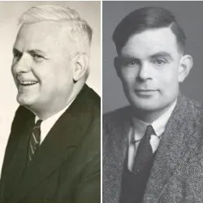
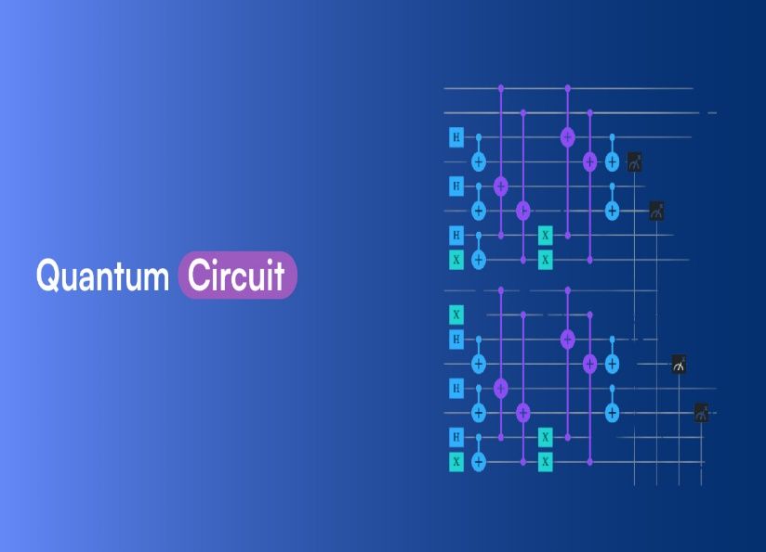
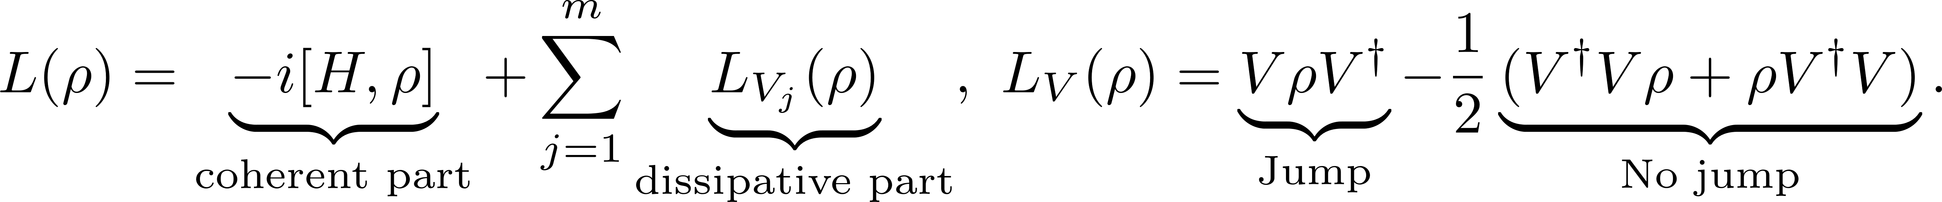
Simulation of open quantum systems
Strong quantum Church-Turing thesis:
Every quantum mechanical computational process can be simulated efficiently in the unitary circuit model of quantum computation.
Lindbladian generator:
Q: Given a set of accessible unitary circuits (gates), what is the minimum number of gates (simulation cost) required to approximate an open quantum system at a target time T?

Slide 4


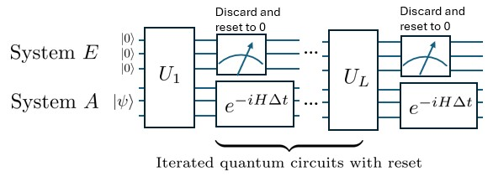

Simulation method:

Slide 5
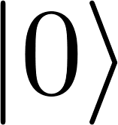
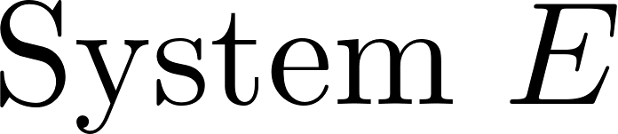


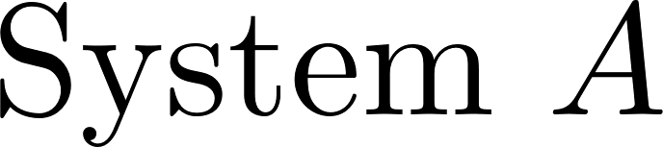
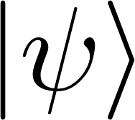
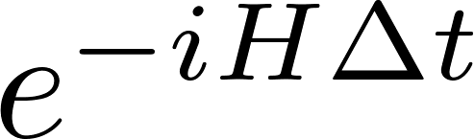
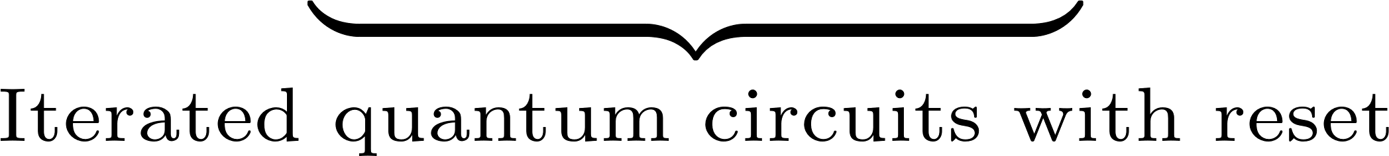
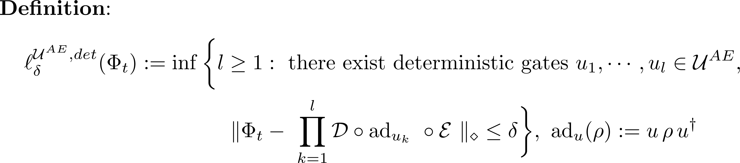
Simulation cost
Discard and reset to 0
Discard and reset to 0
…
…

Slide 6
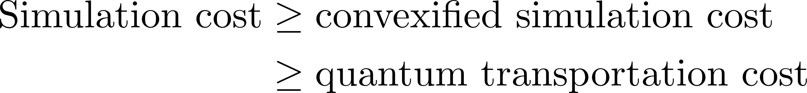
How to find a lower bound on the simulation cost?
Simulation cost is a quantity with no convex property that is hard to deal with. Our key arguments are the following two-step relaxation:
Step I: Relax the original simulation cost to its convexified(randomized) version.
Step II: Establish a lower bound on the convexified simulation cost using the quantum transportation cost, a naturally convex quantity.
What we calculate

Slide 7
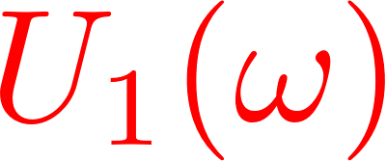
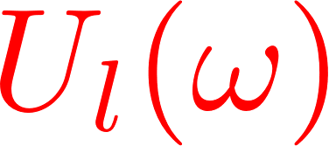
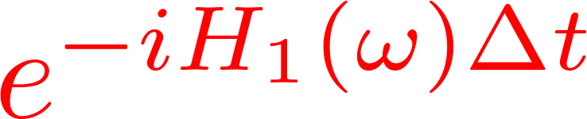
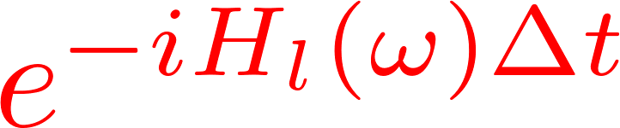
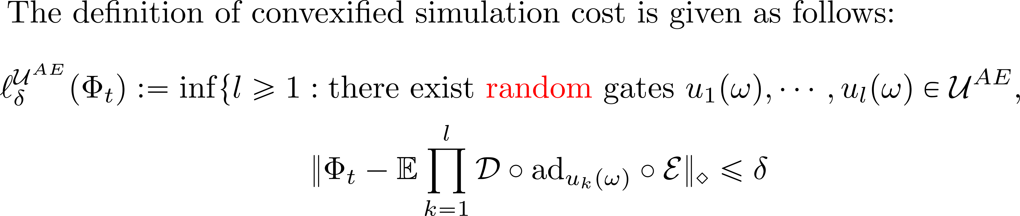
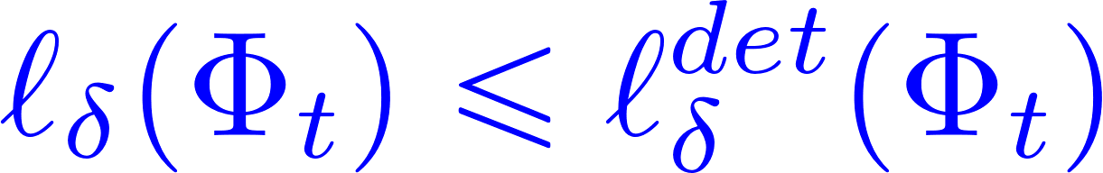
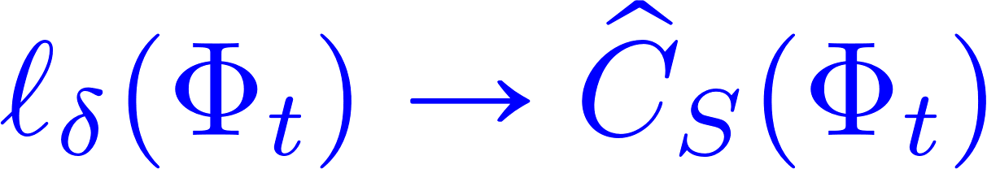
Convexified simulation cost
Discard and reset to 0
Discard and reset to 0
…
…
Randomization can reduce the simulation cost.
It is easier to handle theoretically.
Transportation cost
Campbell, Earl. "Random compiler for fast Hamiltonian simulation." Physical review letters 123.7 (2019): 070503.
Childs, Andrew M., Aaron Ostrander, and Yuan Su. "Faster quantum simulation by randomization." Quantum 3 (2019): 182.
Chen, H., Li, B., Lu, J., & Ying, L. "A randomized method for simulating lindblad equations and thermal state. "2024.
Kato, J., Wada, K., Ito, K., & Yamamoto, N. “Exponentially accurate open quantum simulation via randomized dissipation with minimal ancilla.” 2024.

Slide 8
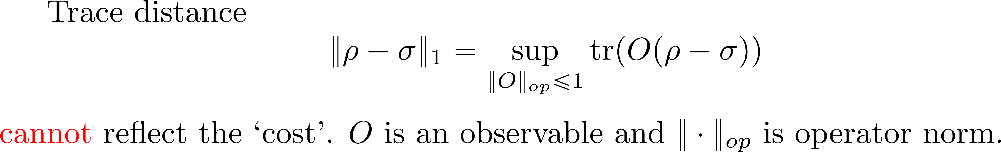


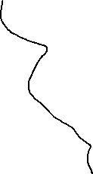
Quantum transportation cost
De Palma, G., Marvian, M., Trevisan, D., Lloyd, S. (2021). The quantum Wasserstein distance of order 1. IEEE Transactions on Information Theory, 67(10), 6627-6643.

Slide 9
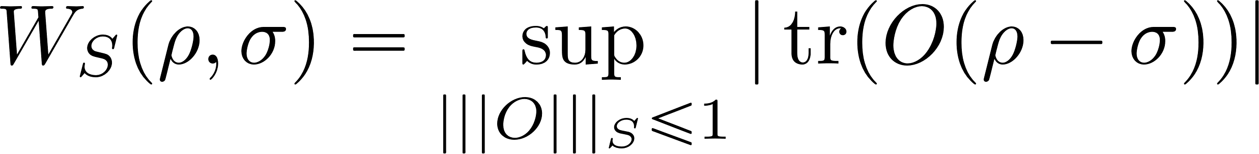
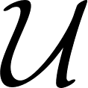
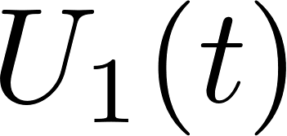
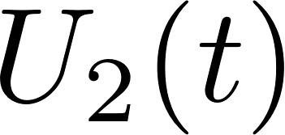
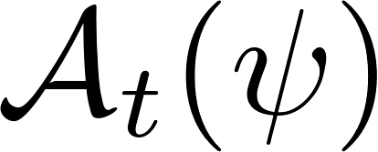
Quantum transportation metric for states
A natural quantum transportation metric is given by
Transportation information is encoded in the semi-norm!
Choice of $S$: Generating set of
Ex: Hamiltonians.
Perfect simulation of amplitude damping noise with time change.

Slide 10
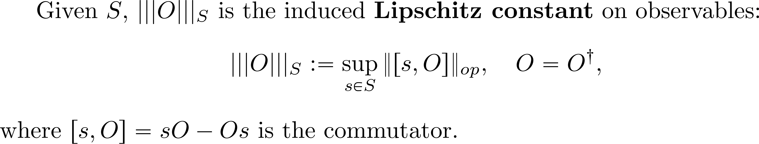
Quantum transportation metric for states
A natural quantum transportation metric is given by
Transportation information is encoded in the semi-norm!
Rieffel, Marc A. "Compact quantum metric spaces." 2003.
Gao, Li, and Cambyse Rouzé. "Coarse Ricci curvature of quantum channels." Journal of Functional Analysis 286.8 (2024): 110336.

Slide 11
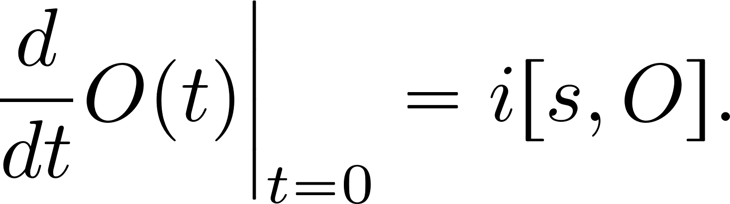
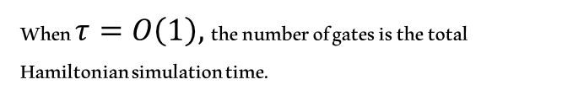
Why Lipschitz semi-norm?
The Lipschitz constant represents the maximal rate at which the observable changes with time under the dynamics generated by the Hamiltonians in $S$.
When $τ=O\left(1\right),$the number of gates is the total Hamiltonian simulation time.

Slide 12

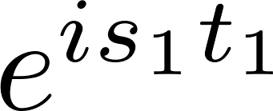
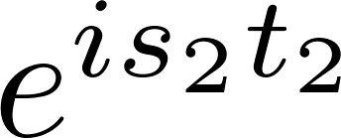
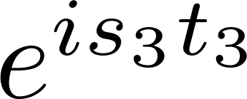
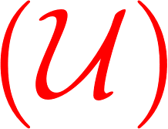
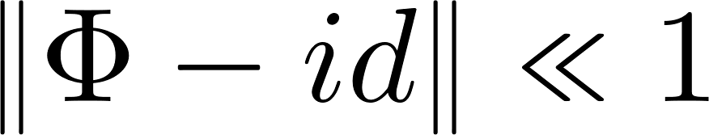
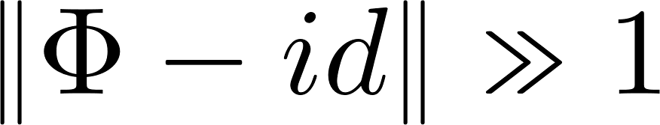
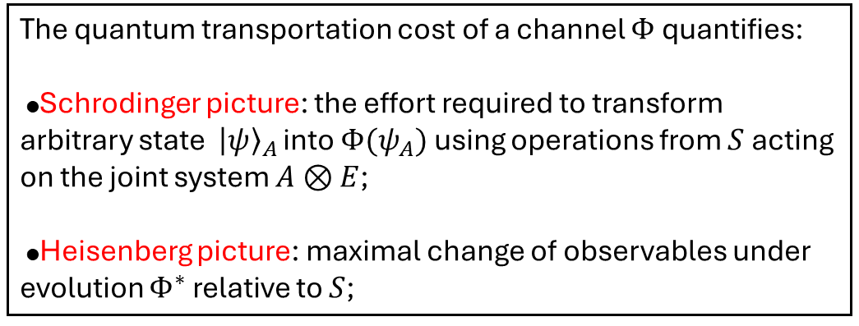


Quantum transportation cost for channels
Non-unitary
The quantum transportation cost of a channel $Φ$quantifies:
●Schrodinger picture: the effort required to transform arbitrary state ${\left|ψ\right\rangle }_{A}$ into $Φ(ψ_{A})$ using operations from $S$acting on the joint system $A⊗E$;
●Heisenberg picture: maximal change of observables under evolution $Φ^{∗}$ relative to $S$;
$$Φ$$
$Φ(ψ_{A})$
$Φ(ψ_{A})$
Intuition:
Low cost
High cost

Slide 13
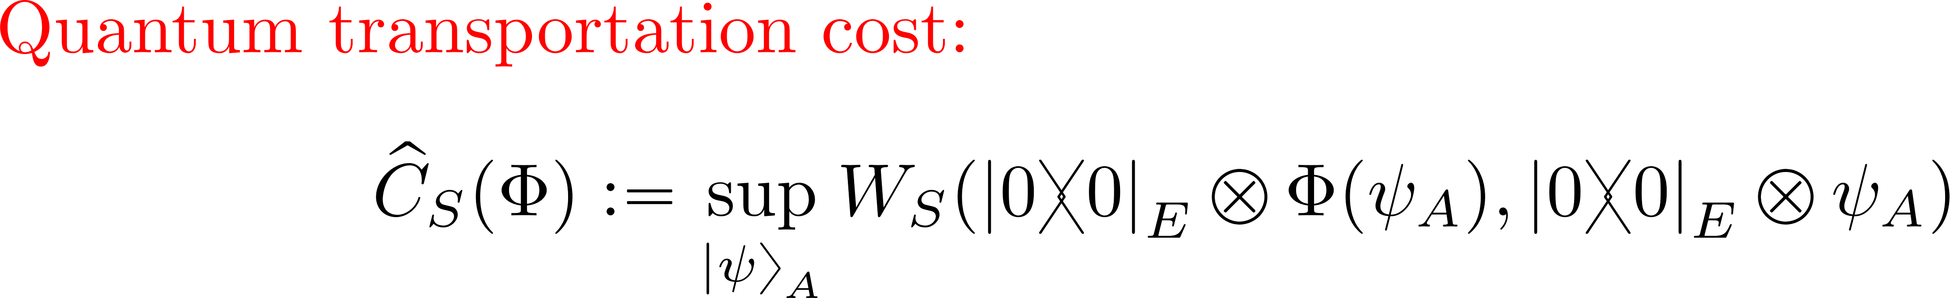
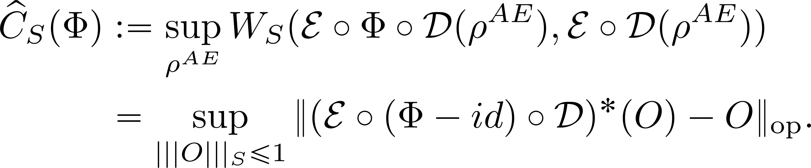
Quantum transportation cost for channels
Non-unitary
The quantum transportation cost of a channel $Φ$quantifies:
●Schrodinger picture: the effort required to transform arbitrary state ${\left|ψ\right\rangle }_{A}$ into $Φ(ψ_{A})$ using operations from $S$acting on the joint system $A⊗E$;
●Heisenberg picture: maximal change of observables under evolution $Φ^{∗}$ relative to $S$;
$$Φ$$
$Φ(ψ_{A})$
$Φ(ψ_{A})$
It is an environment-assisted version of the complexity introduced in:
For more general encoding and decoding:
Araiza, Roy, Yidong Chen, Marius Junge, and Peixue Wu. "Resource-dependent complexity of quantum channels." 2023.
Li, L., Bu, K., Koh, D. E., Jaffe, A., Lloyd, S. “Wasserstein complexity of quantum circuits”. 2022.

Slide 14
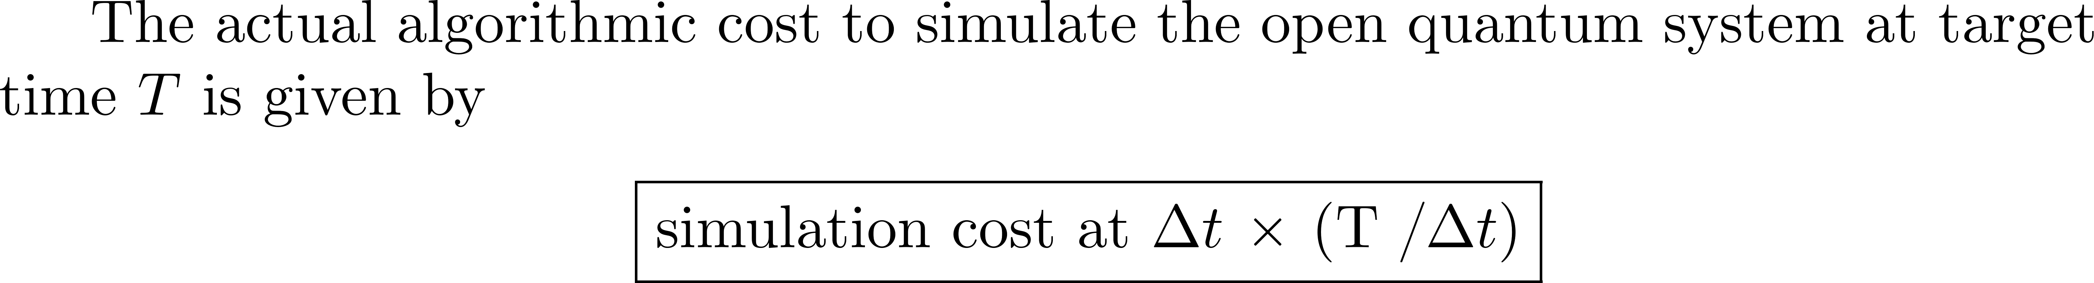
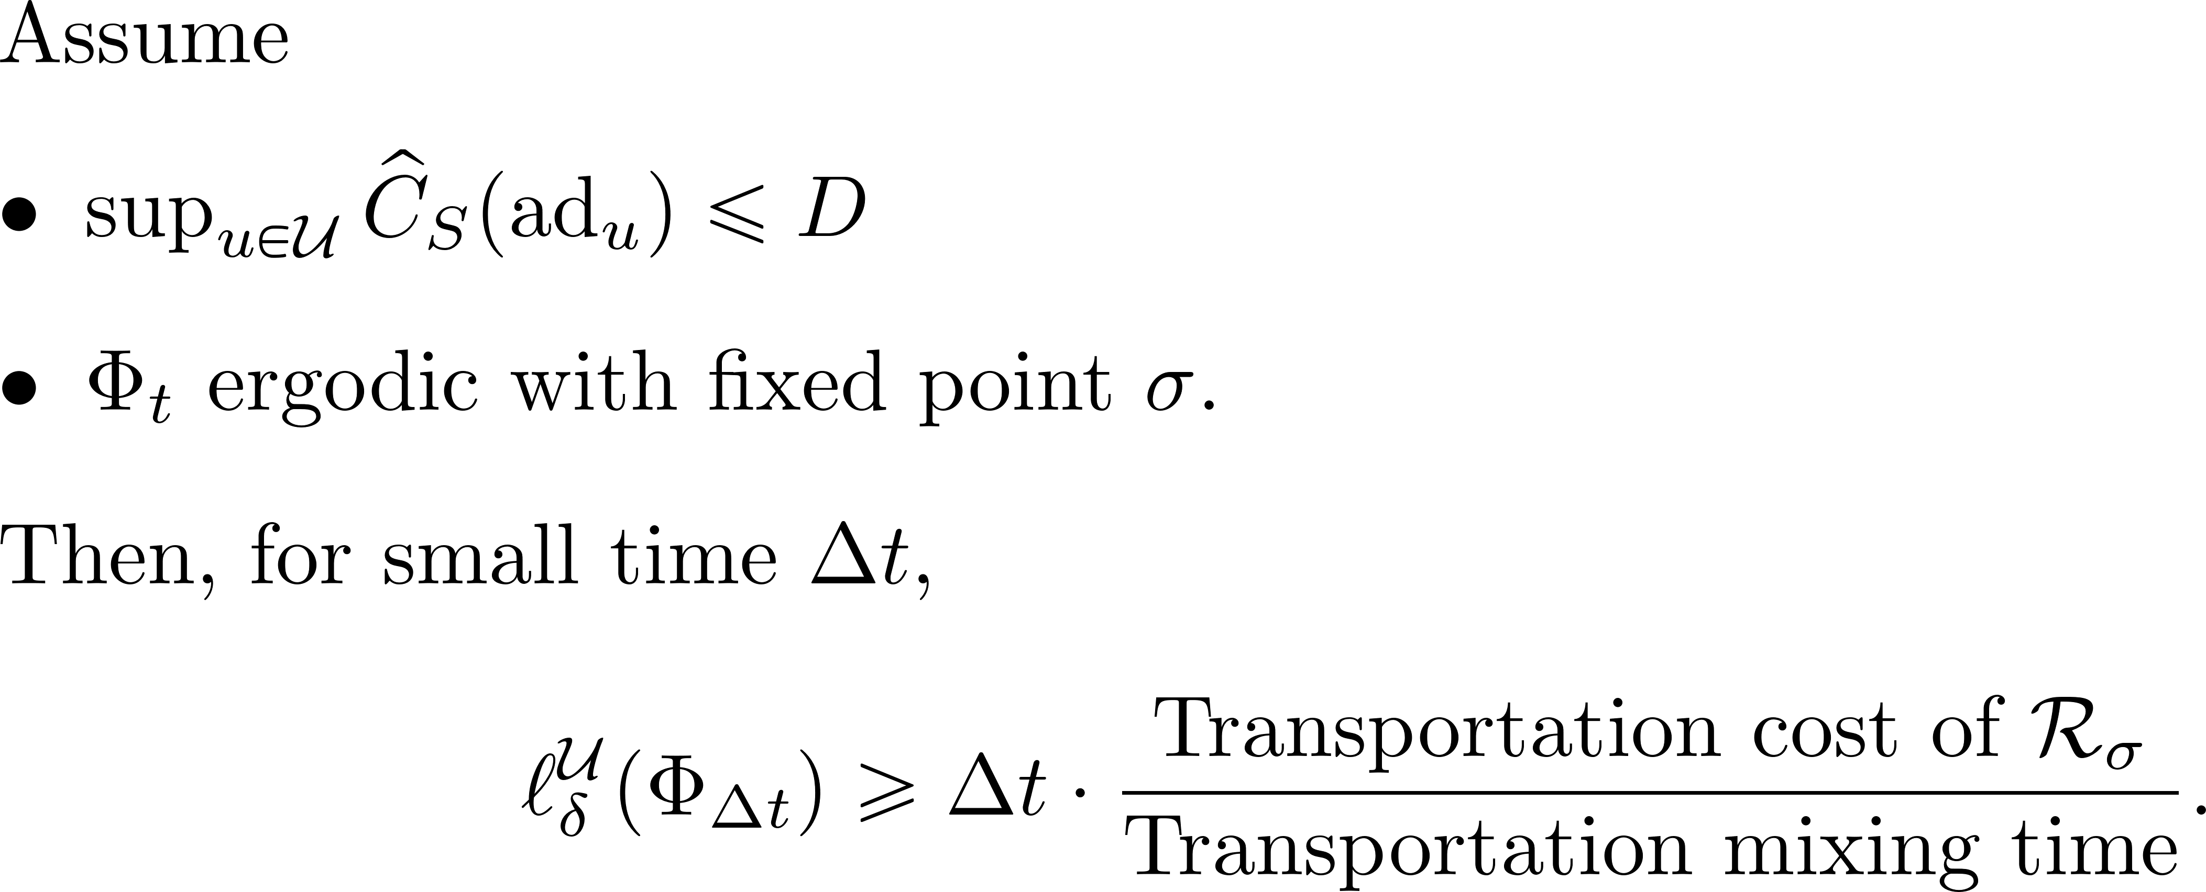
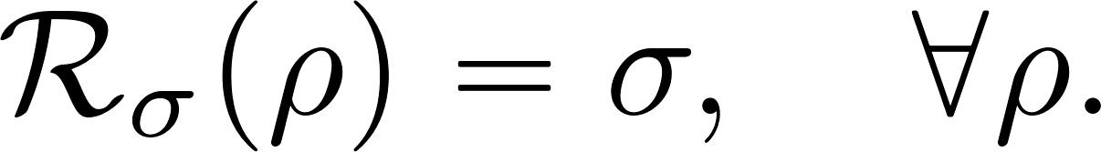
Main Theorem

Slide 15
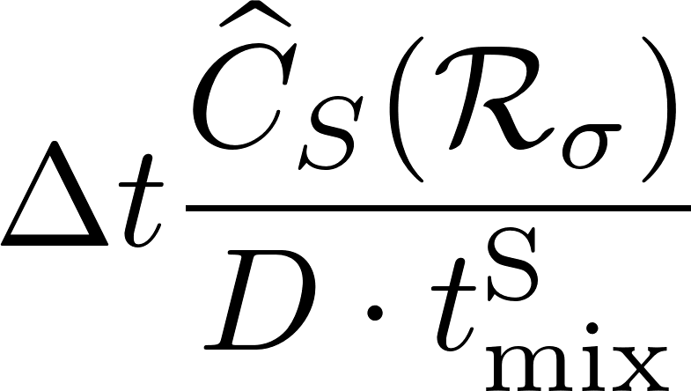
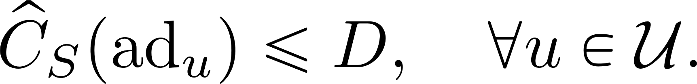
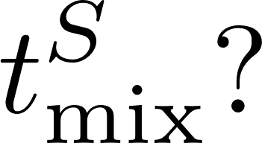
More details on the lower bound
Linear in time.
Maximal transportation cost per unitary:
Q: How to upper bound
Note: Usual mixing time is an upper bound.

Slide 16
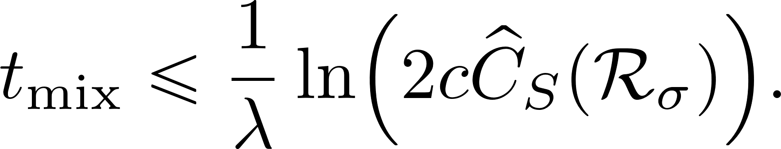

More details on the lower bound
Linear in time.
Maximal transportation cost per unitary:
Exponential decay for transportation metric:
Usual mixing time
Transportation mixing time
Rouzé, Cambyse, Daniel Stilck França, and Álvaro M. Alhambra. "Optimal quantum algorithm for Gibbs state preparation." 2024.
Capel, Ángela, Paul Gondolf, Jan Kochanowski, and Cambyse Rouzé. "Quasi-optimal sampling from Gibbs states via non-commutative optimal transport metrics." 2024.

Slide 17


Key ideas of the proof of the main result
A key relation between simulation cost and transportation cost, derived by Lipschitz continuity:
transportation cost of the system
simulation cost of the system
Using the semigroup property:

Slide 18
Summary and outlook
We build a lower bound framework for simulation cost of any ergodic open quantum systems.
We introduce a convex quantity called quantum transportation cost, which plays a key role.
Our ongoing work adapts this framework to provide lower bound on the depth of the circuit rather than volume.
Thank you!

