Slide 1


Transportation cost and contraction coefficient for channels on von Neumann algebras
Peixue Wu
Institute for Quantum Computing, University of Waterloo
In Honor of the Retirement of Professor Vern Paulsen
Joint work with Roy Araiza and Marius Junge

Slide 2
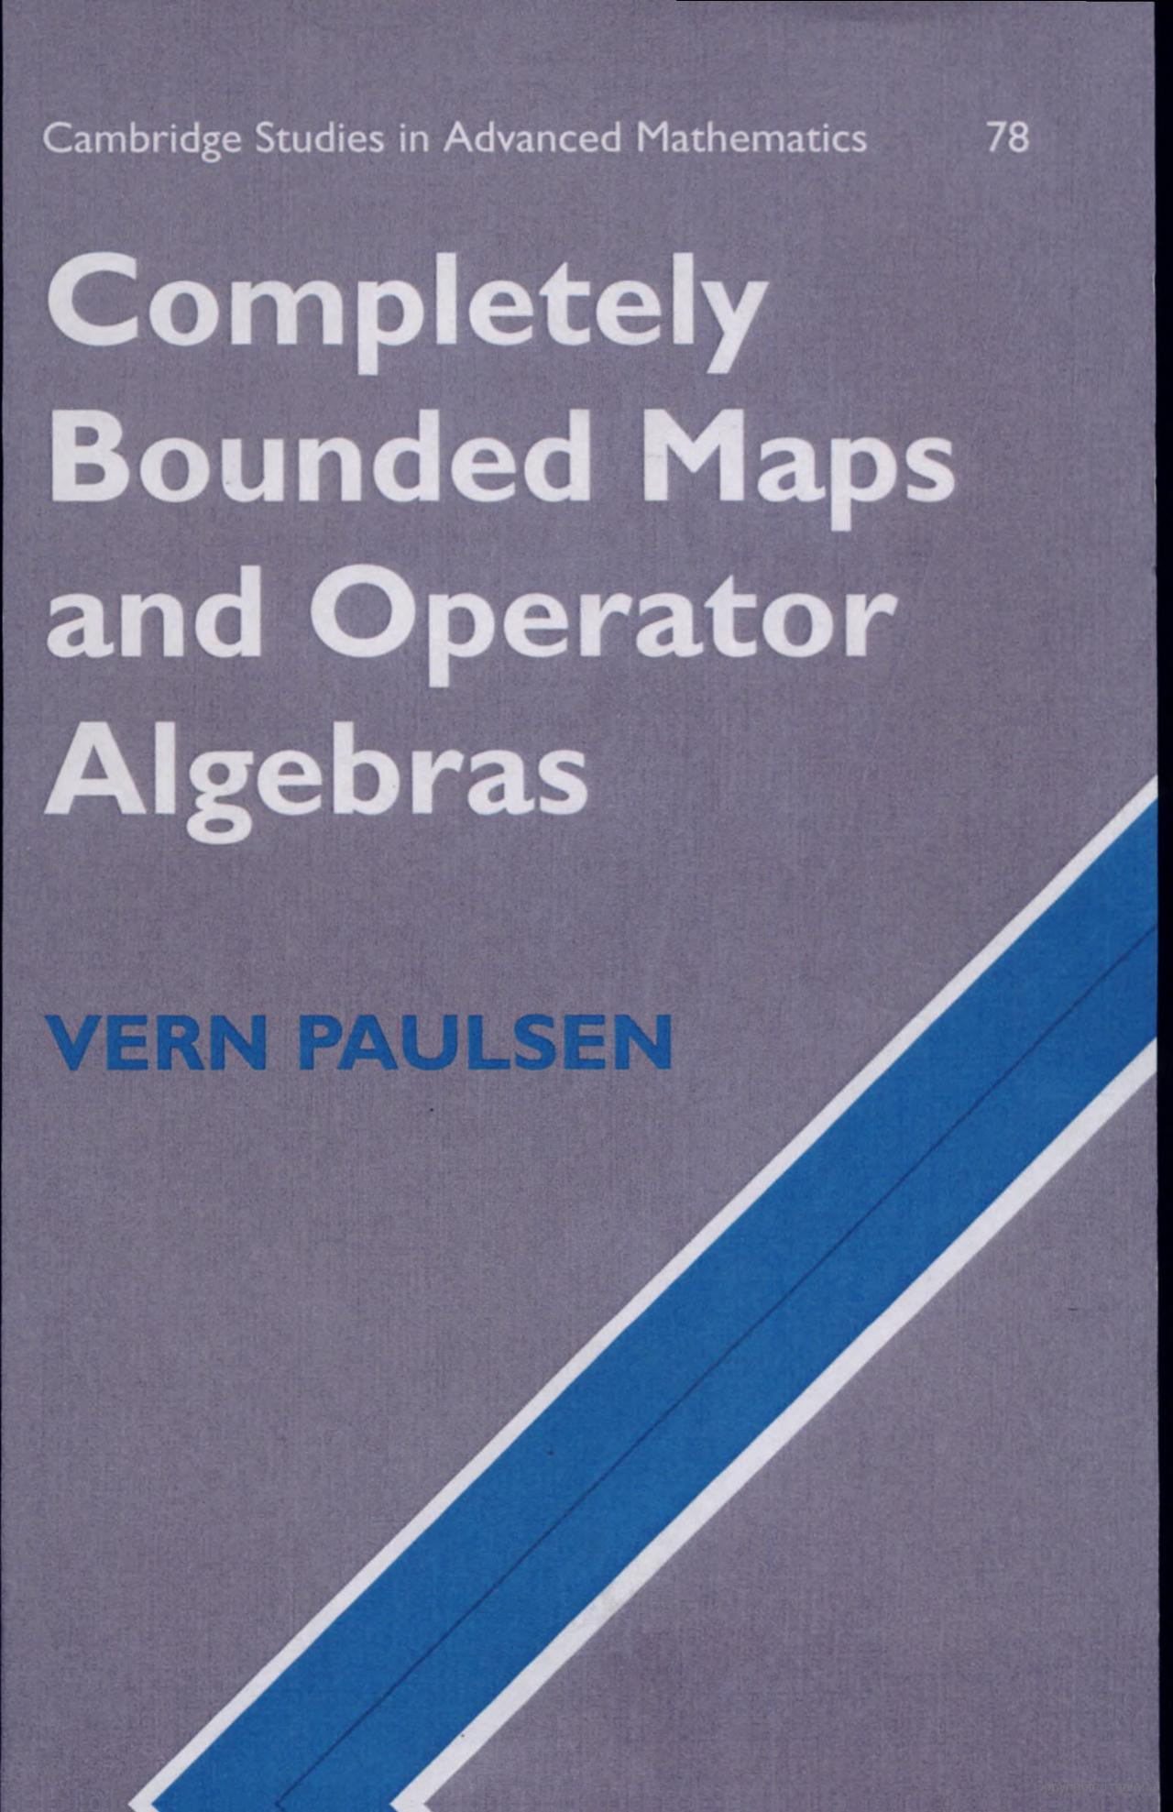
Paulsen taught us to measure maps between operator algebras with the completely bounded norm
In this talk, we explore its geometric cousin.
Measure channels using Lipschitz geometry.
We discuss applications of this measure in quantum information.

Slide 3
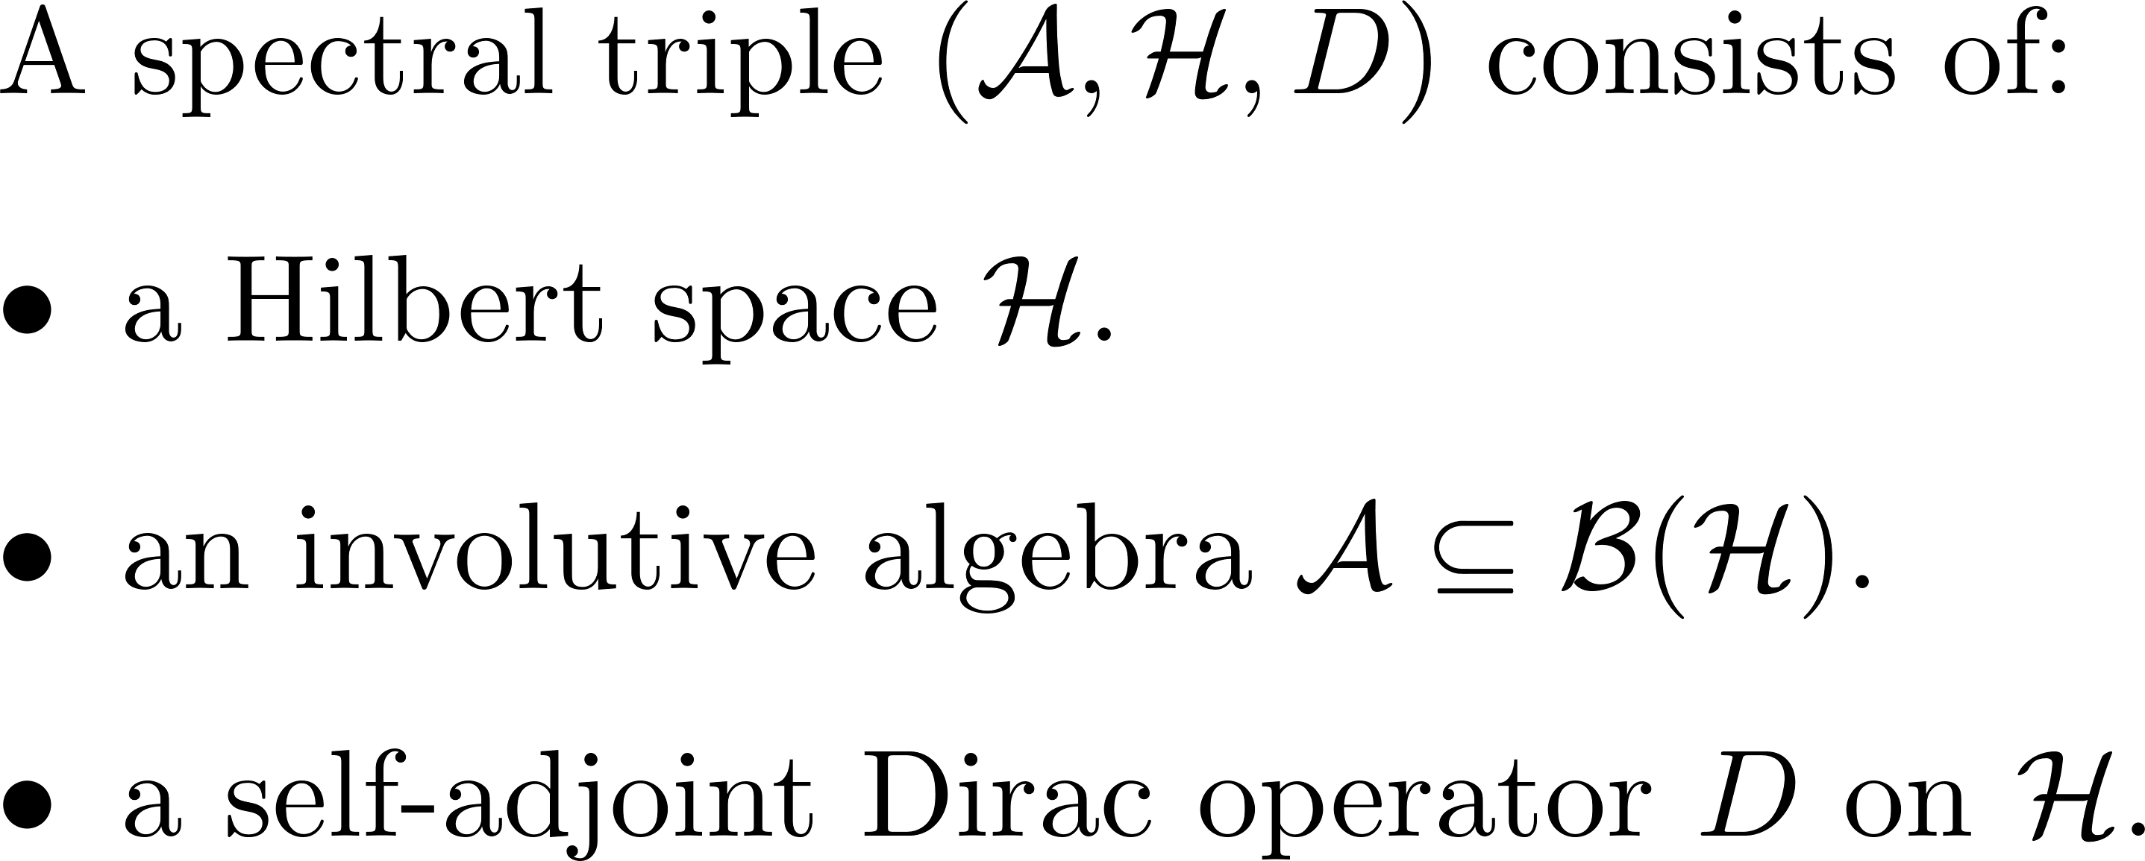
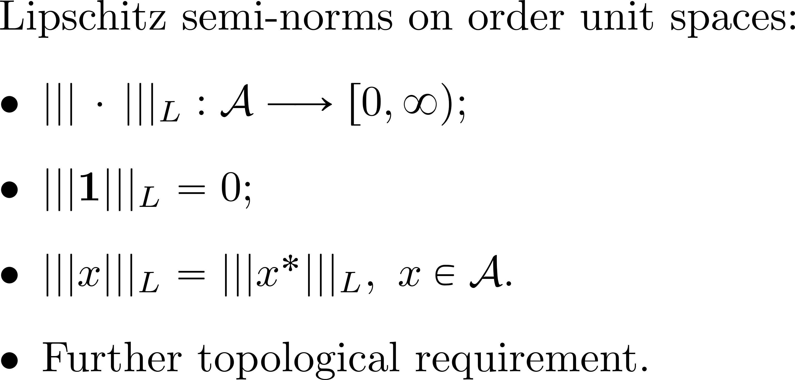
Lipschitz Geometry: From Connes and Lott (1989) to Rieffel (1999)
Connes-Lott
Rieffel
Encoded distances on the (normal) state space:

Slide 4
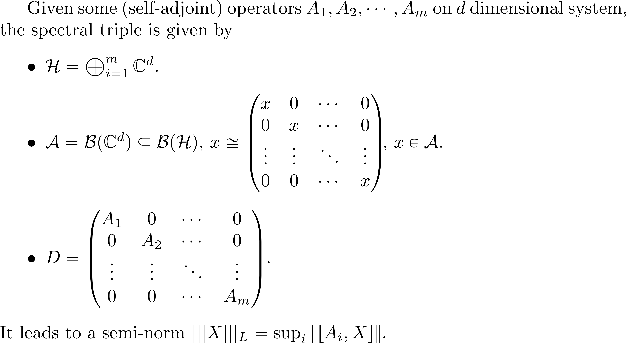
1. Matrix algebras:

Slide 5
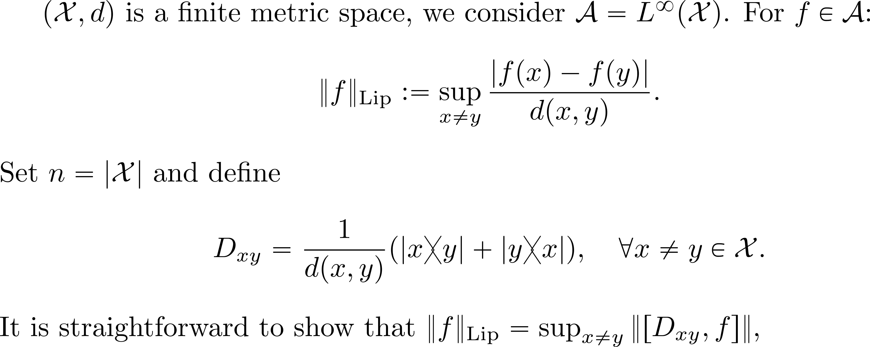
2. Commutative case

Slide 6
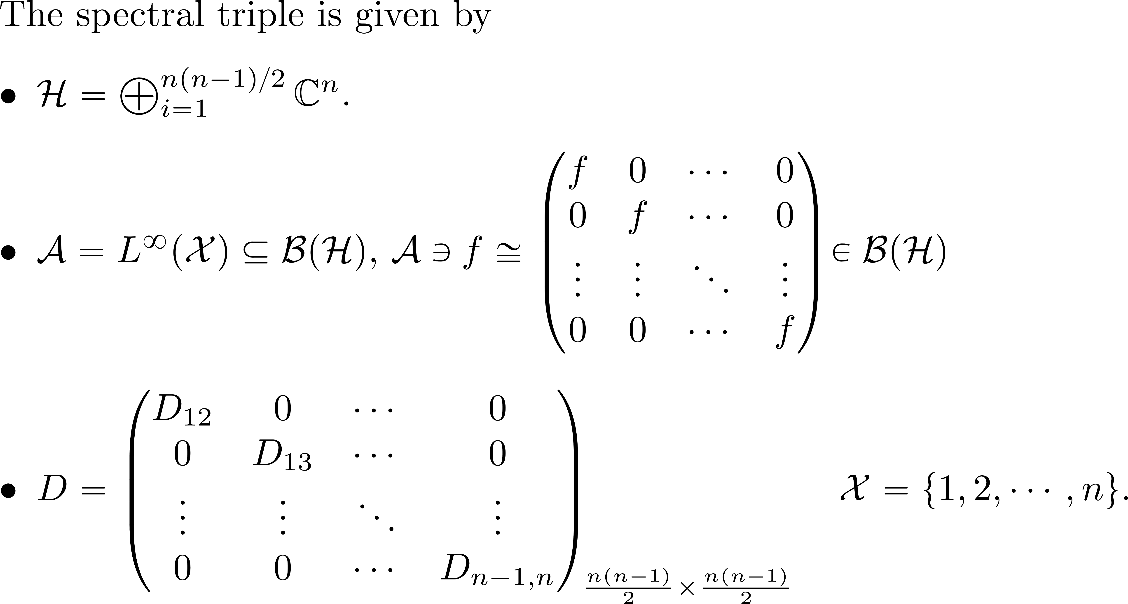
2. Commutative case

Slide 7
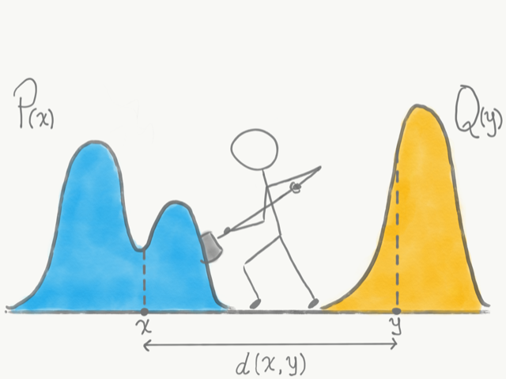
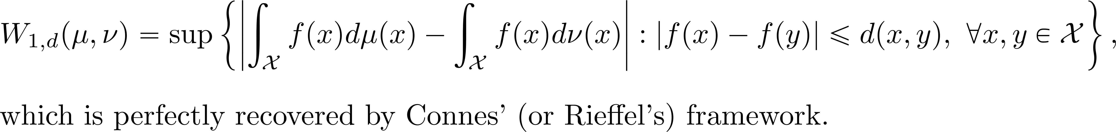
Optimal transport theory
What is the least “work” needed to reshape one probability distribution(state) into another?
In the noncommutative setting, states are density operators(positive with trace 1) on a Hilbert space.
Monge-Kantorovich duality

Slide 8
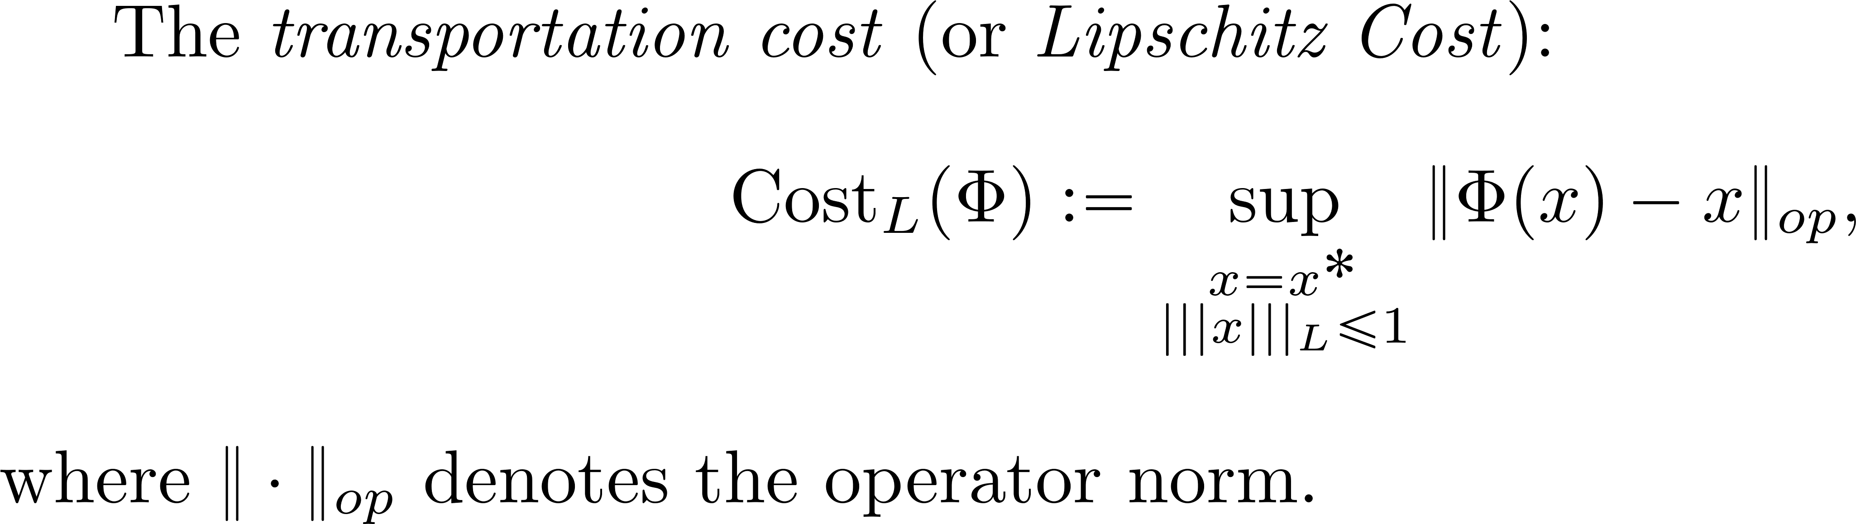
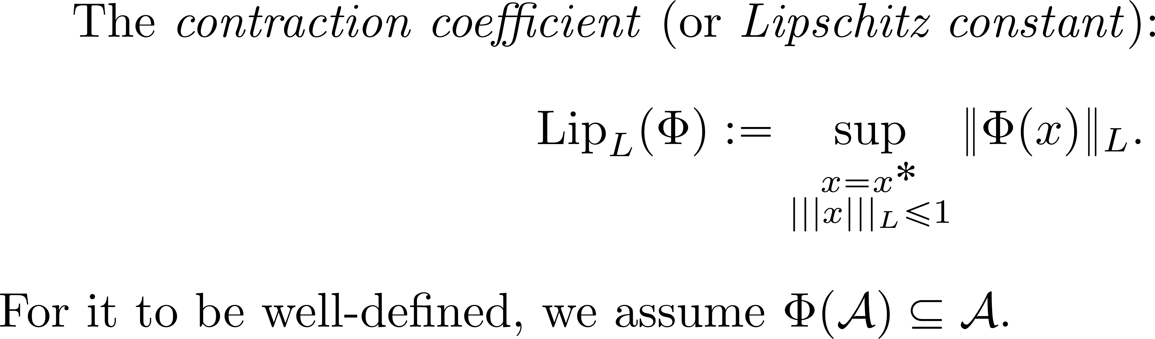
Two Lipschitz measures for channels

Slide 9
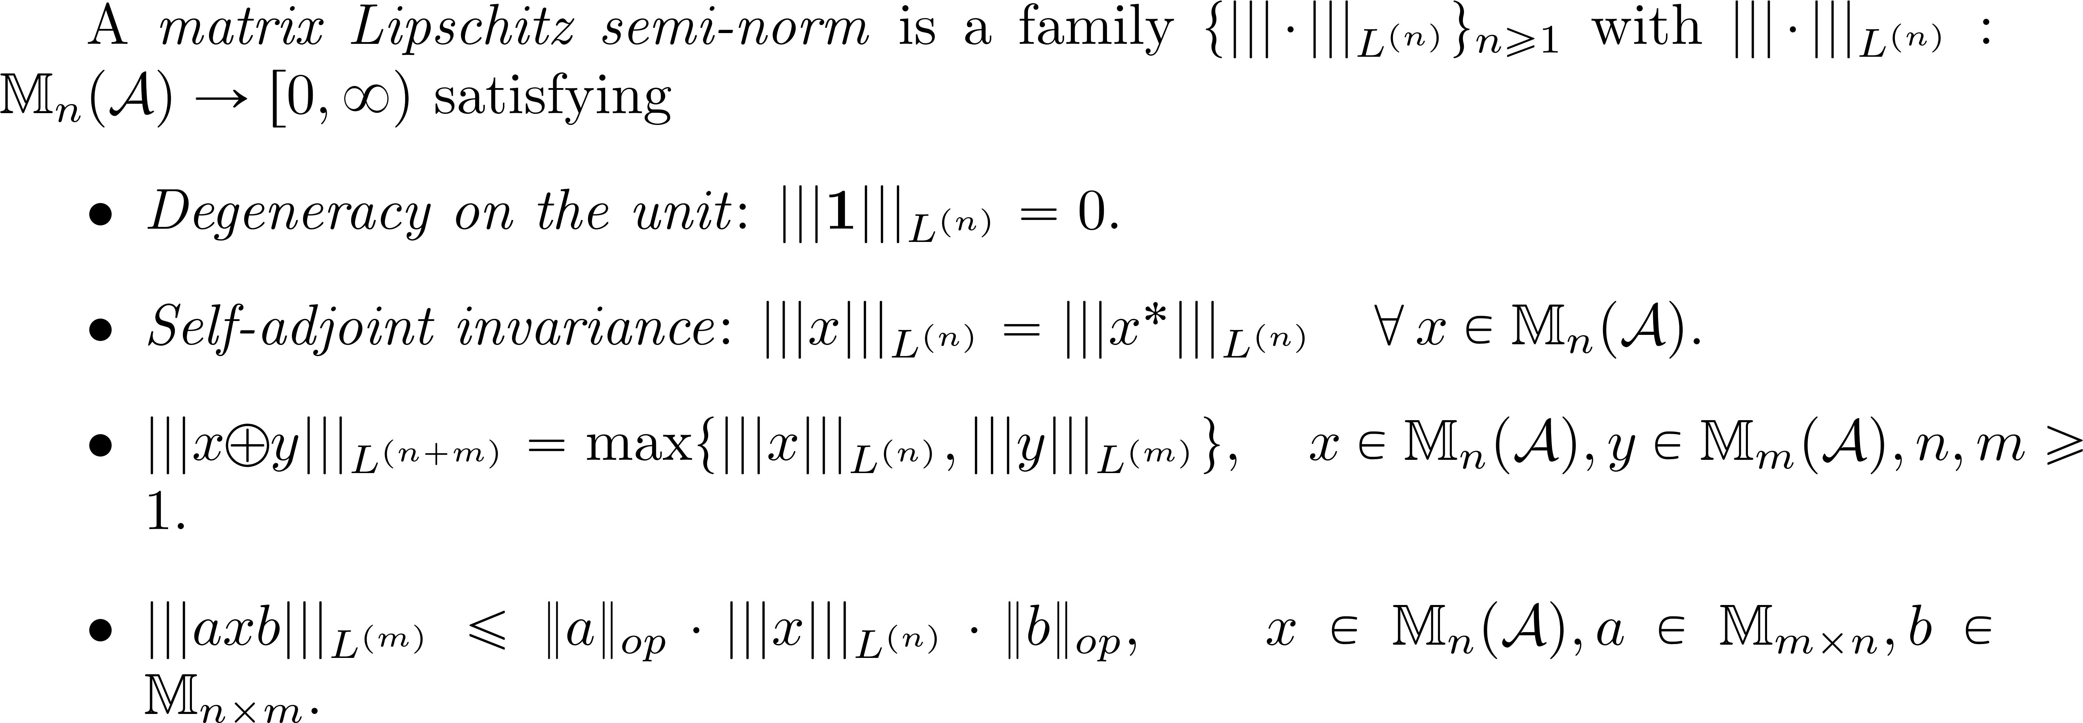
Completely bounded version

Slide 10
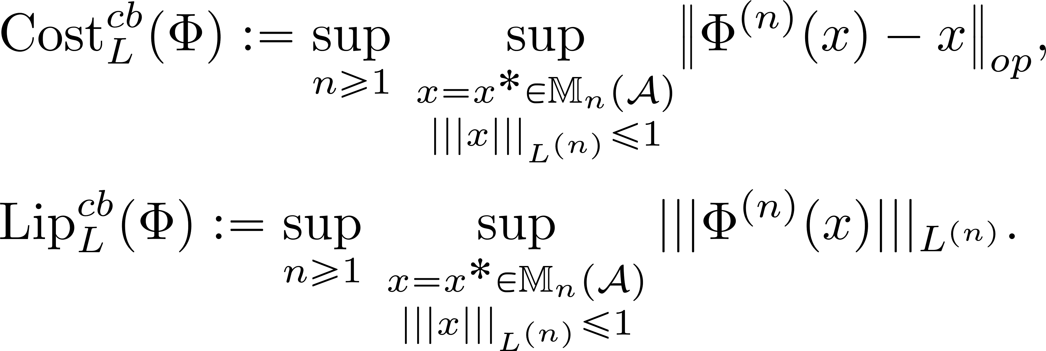
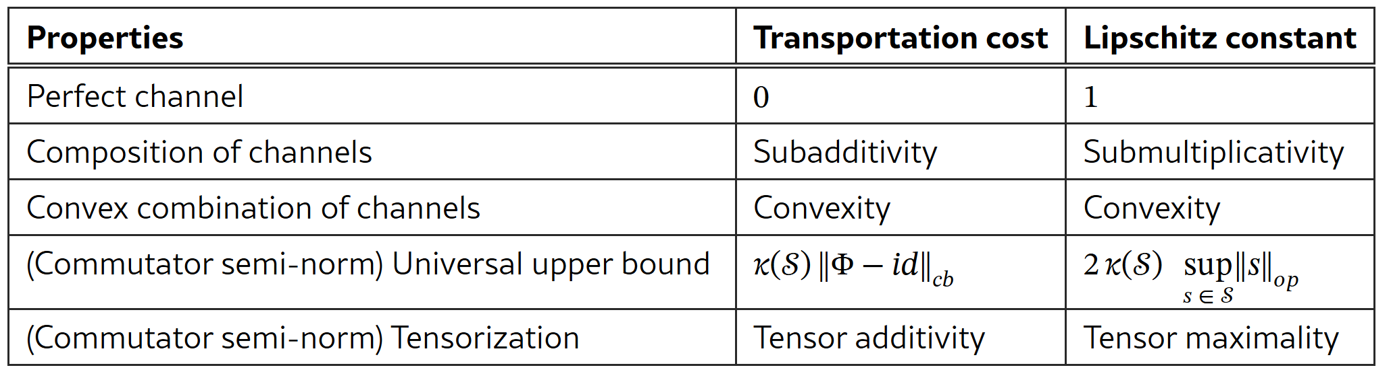
Completely bounded version

Slide 11
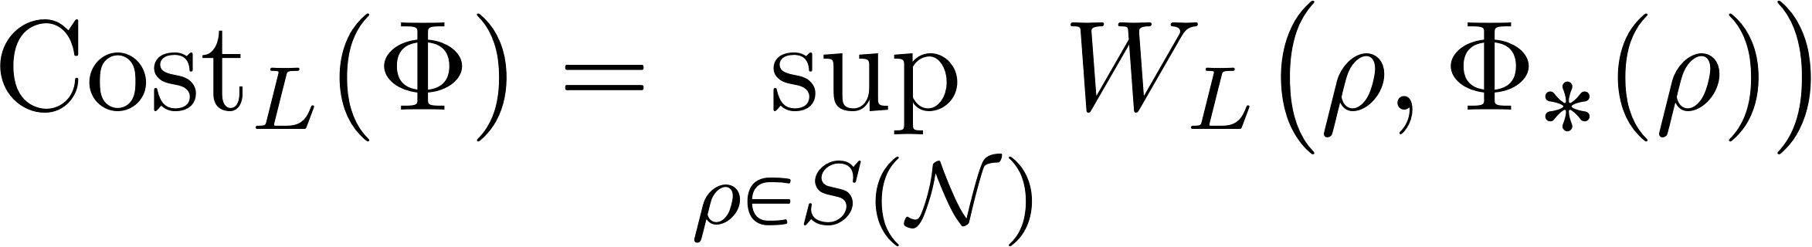

Intuition:
Transportation cost reflects the minimal resources required to implement the quantum transformation
Limitations of quantum simulation!
Check it here:

Slide 12
Intuition:
Lipschitz constant quantifies how strongly the channel can expand or contract a prescribed Lipschitz seminorm, or the Wasserstein metric:

Slide 13
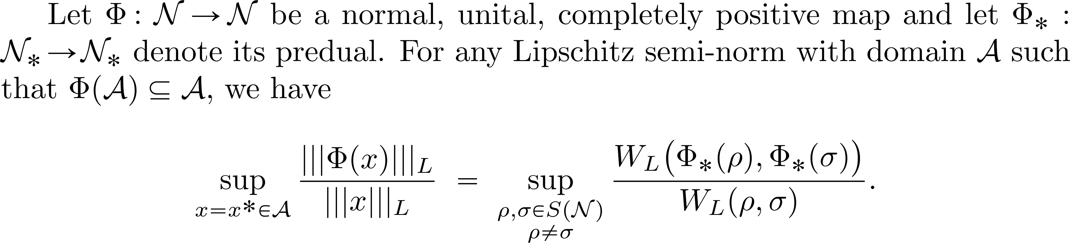
Proposition 3.1 here:
One direction is easy: see Tron Omland’s talk

Slide 14
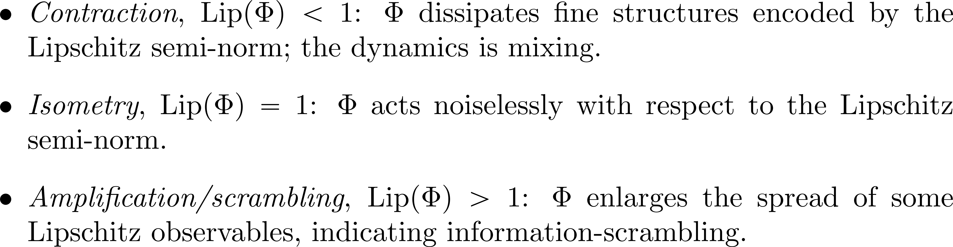

Slide 15
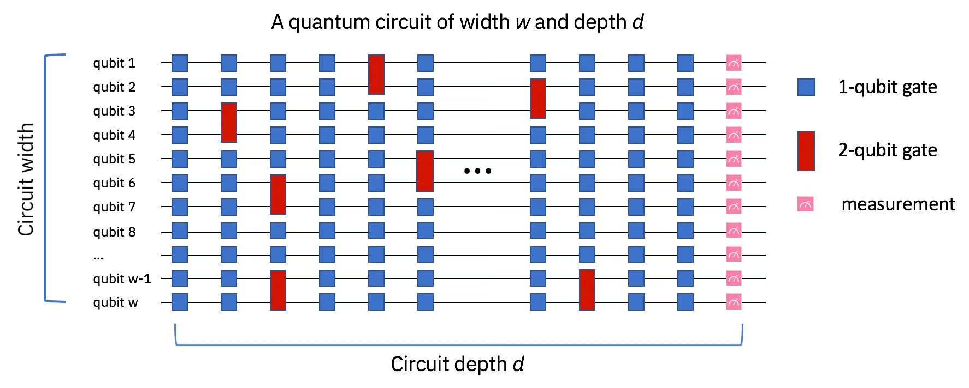
Application to Quantum computation
Given an initial “easy” state and a target state, what is the minimal number of unitary operators to transform one to another?

Slide 16
Lower bound on quantum computation: a summary
Commutator (Triangle inequality) bound
Geometric (Nielsen) approach: Geodesic length.
Volume and covering arguments
Schmidt-rank: lower bound on depth
Lieb-Robinson velocity(continuous setting) and light cone argument(discrete setting)

Slide 17
Lower bound on quantum simulation: a summary
Commutator (Triangle inequality) bound
Geometric (Nielsen) approach: Geodesic length.
Volume and covering arguments
Schmidt-rank: lower bound on depth
Lieb-Robinson velocity(continuous setting) and light cone argument(discrete setting)
This work!

Slide 18
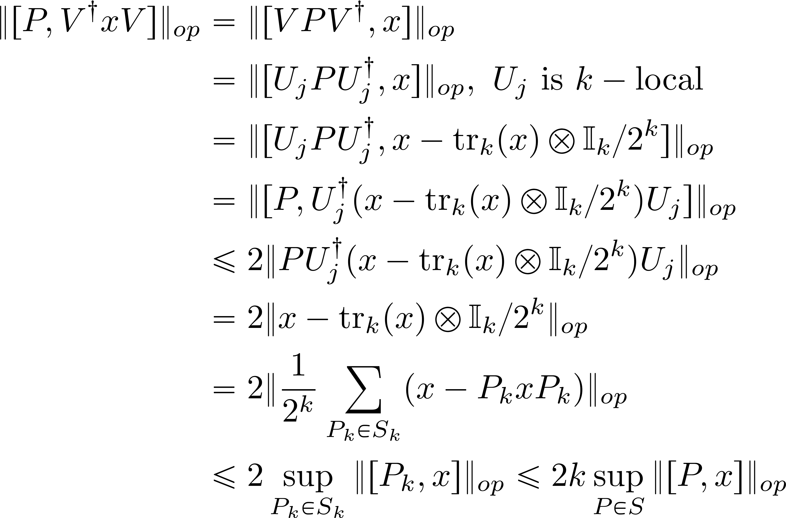
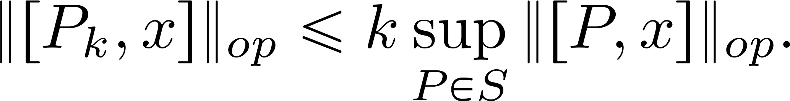
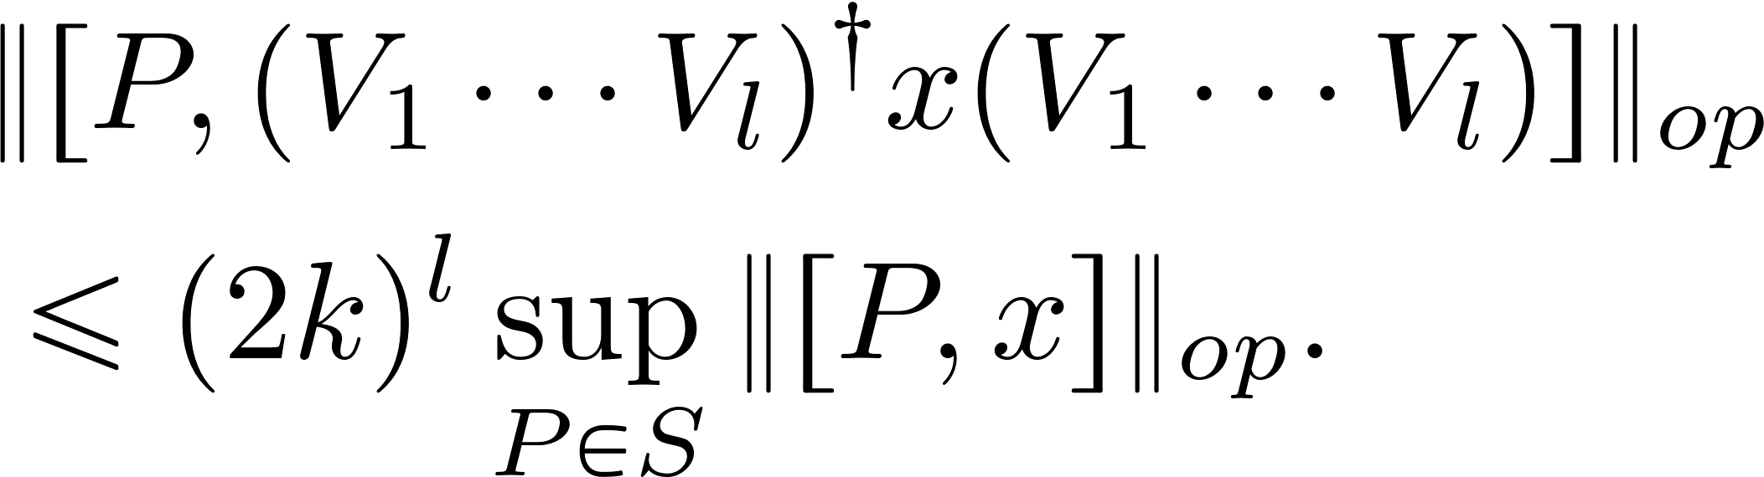

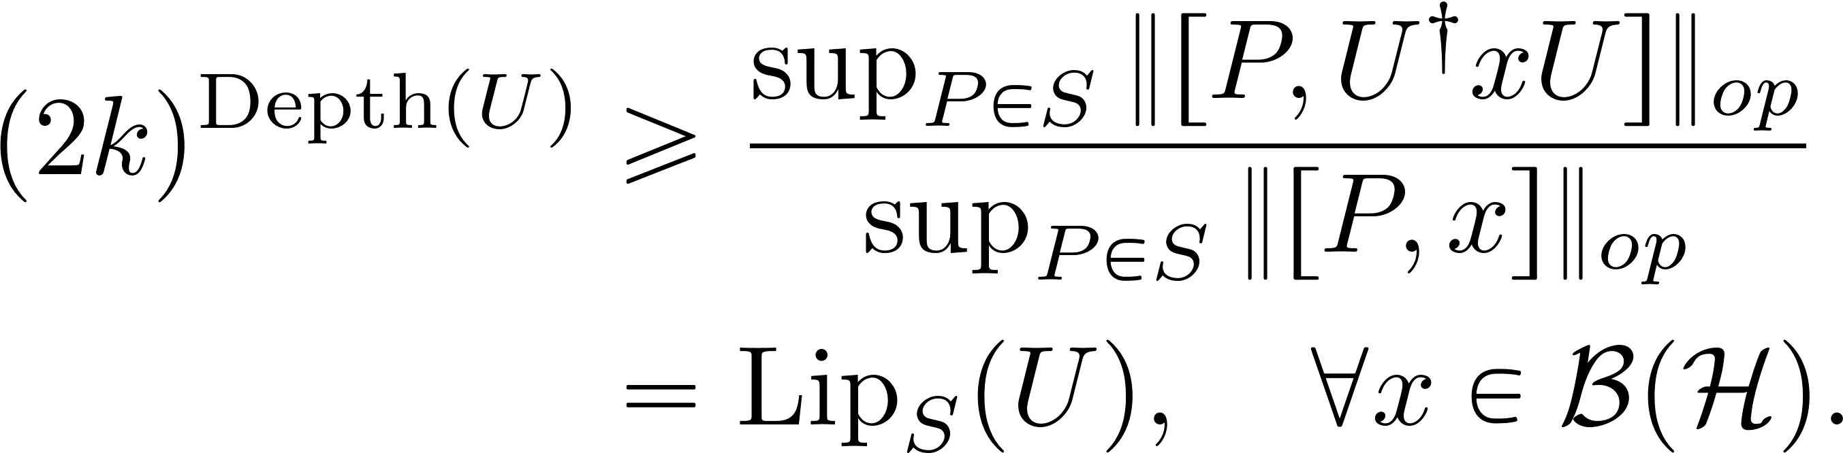
Connection: from Lieb-Robinson bound(light cone argument) to Lipschitz geometry
Discrete version of (3.27) in

Slide 19

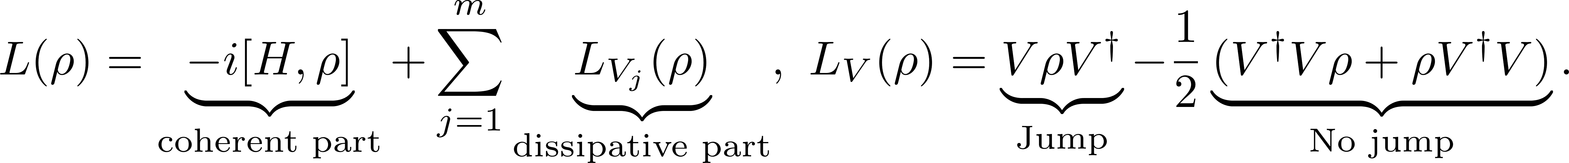
Limitations on simulation of Lindblad dynamics
Strong quantum Church-Turing thesis:
Every quantum mechanical computational process can be simulated efficiently in the unitary circuit model of quantum computation.
See the paper for a review:
Lindbladian generator:
Q: Given a set of accessible unitary circuits (gates), what is the minimum number of gates (simulation cost) required to approximate an open quantum system at a target time T?

Slide 20
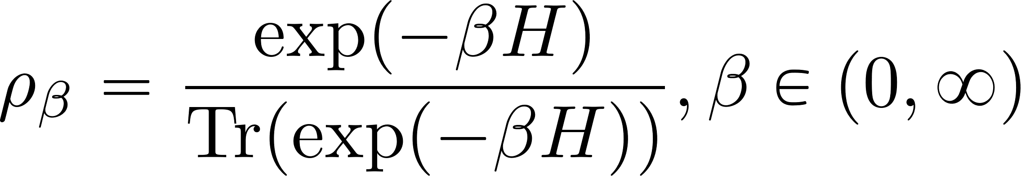
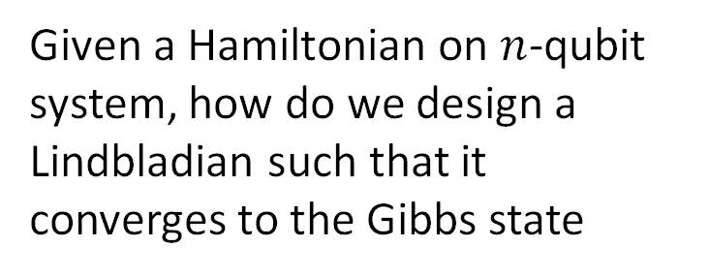
Preparing Gibbs state via Lindbladians
Given a Hamiltonian on $n$-qubit system, how do we design a Lindbladian such that it converges to the Gibbs state
Idea: design a Lindbladian admitting the Gibbs state as the unique fixed state. To ensure mixing fast, we assume symmetry property.

Slide 21
Gibbs state sampler: KMS and GNS symmetry
There are two typical choices for the Gibbs sampler:
GNS symmetry:
KMS symmetry:

Slide 22
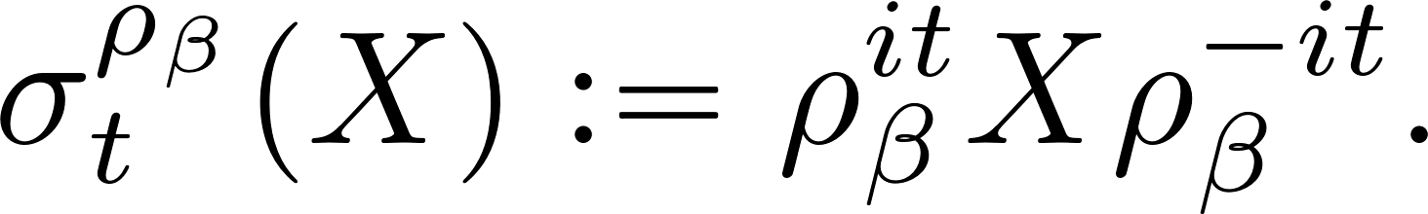
The issue with GNS Gibbs sampler
GNS detailed balance is equivalent to the Lindbladian generator commuting with the modular automorphism group:
The jump operators must be the eigen-operators of the modular automorphism group.
Physically, it means the dissipation channel must “know about” the entire spectrum of the Hamiltonian.
By energy-time uncertainty principle, it requires exponential time to implement.

Slide 23
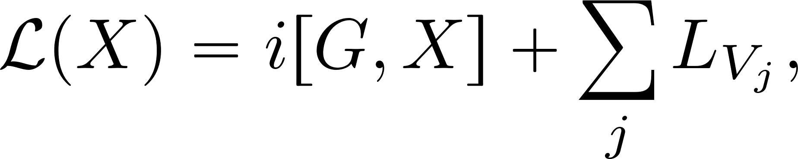
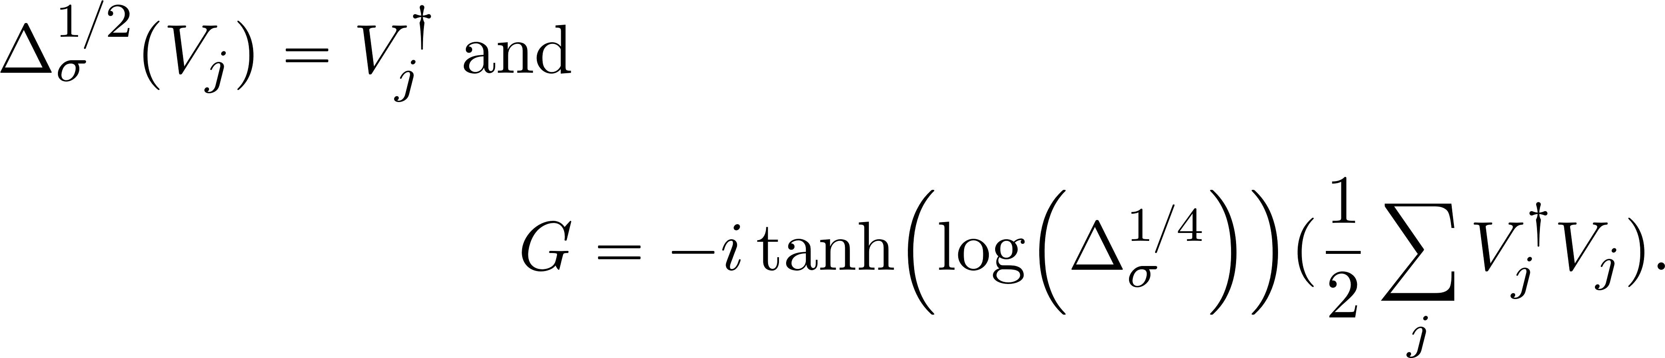
KMS Gibbs sampler
Recall that a Lindbladian generator satisfies KMS-symmetry, if and only if

Slide 24
KMS Gibbs sampler
To design a KMS Gibbs sampler, we choose the jump operator as
The function is a nicely chosen function, usually Gaussian type.
We choose the Hamiltonian part to make sure the Lindbladian is KMS symmetric. Implementing this Lindbladian only needs Hamiltonian evolution + energy-gap filters which have polynomially many circuits.

Slide 25
Theorem(Ding, Junge, Schleich, W.): Limitations of Lindbladian simulation algorithm
Using Hamiltonian simulations and energy-gap filters(single Pauli operators), any Lindbladian-based simulation algorithm with a guarantee to converge to Gibbs state must incur similation cost
when the temperature is high and for constant time.

Slide 26
Reference
Araiza, R., Chen, Y., Junge, M., and Wu, P. (2023). Resource-dependent complexity of quantum channels. arXiv preprint arXiv:2303.11304
Araiza, R., Junge, M., and Wu, P. (2023). Transportation cost and Contraction coefficient for channels on von Neumann algebras, 2025, arXiv preprint arXiv:2506.04197
Ding, Z., Junge, M., Schleich, P., and Wu, P. (2025). Lower bound for simulation cost of open quantum systems: Lipschitz continuity approach. Communications in Mathematical Physics, 406(3), 60
Ding, Z., Junge, M., Schleich, P., and Wu, P. (2025). From noncommutative optimal transport to limitations of quantum computation, 2025, preprint.

