Slide 1
Hardware and Python
Steve Granda

Slide 2

Why would I want to do this?
You want to make something interactive.
You want to recreate sputnik.
You want to measure data from hardware or sensor.
You want to begin reverse engineering hardware.
You want to create a robotic army of minions.
Yeah, well, you know, that's just, like, your opinion, man.

Slide 3

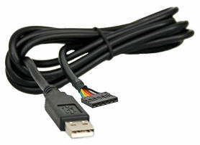
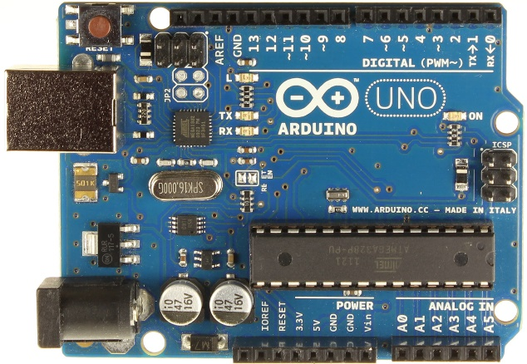
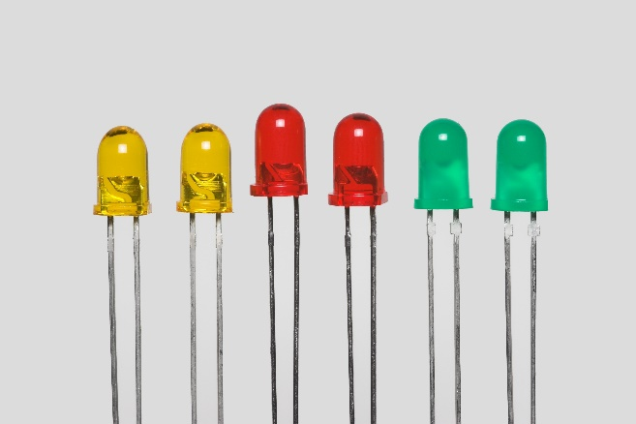
What are we using today?
Python
FTDI Cable (Serial to USB)
Arduino Duemilanove
LED’s

Slide 4
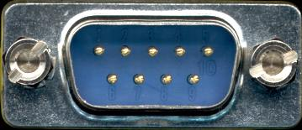
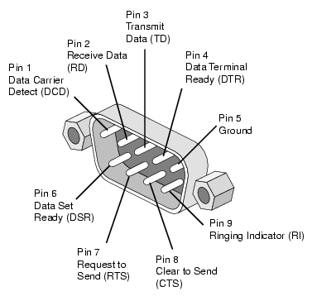
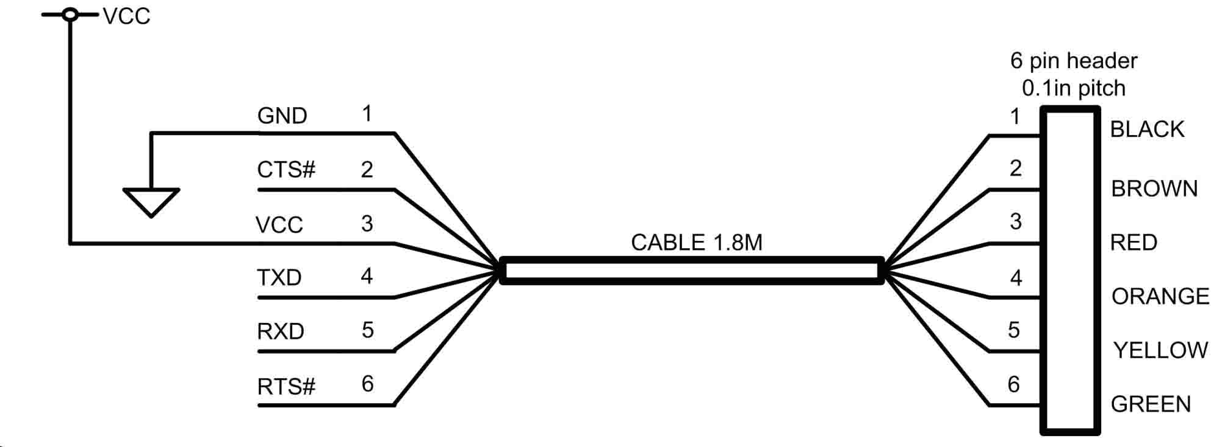
Wired Hardware Communication

Slide 5
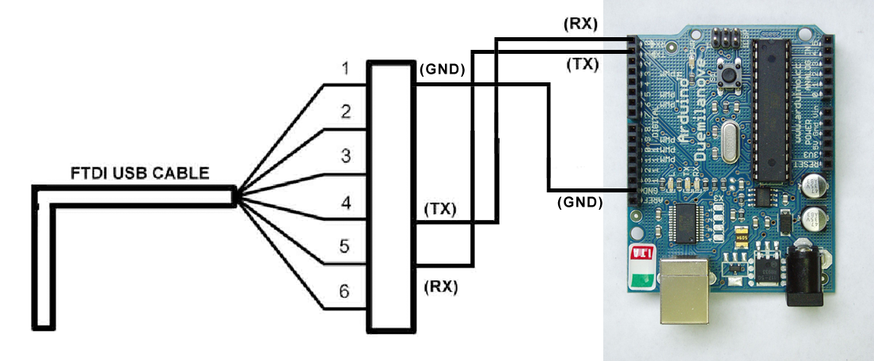
FTDI to Python

Slide 6
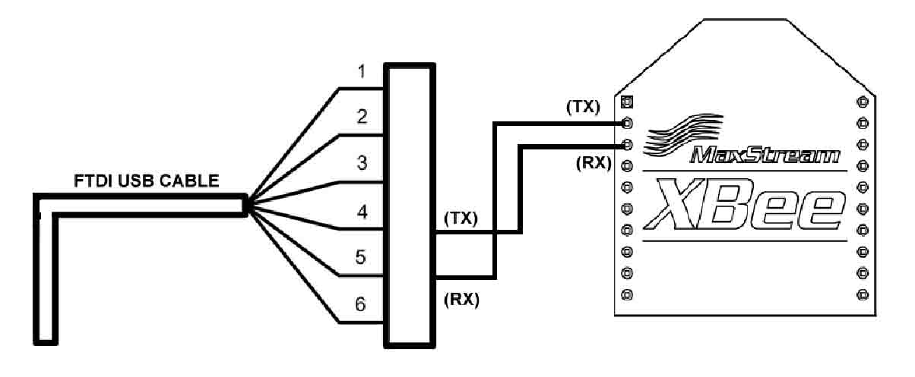
Wireless Hardware Communication

Slide 7
Programming the Arduino
You need to tell the Arduino how to interpret what it receives on the FTDI cable by Python.
A few simple Serial Commands for the Arduino More can be found here: http://arduino.cc/en/reference/serial
Serial port is set at 9600
…
//SETUP PINS and UART
void setup()
{
//Begin Serial Communication
Serial.begin(9600);
…
Serial.println("INITIALIZING................");
Serial.print("\n");
Serial.print("\r");
Serial.println("BOARD WAS RESET");

Slide 8
Finally Python
On Linux/Mac machines, this will be a bit easier as most of the time you’ll just talk to the FTDI by opening a file: /dev/ttyUSB0
Windows users might have a bit more trouble as the port isn’t a file and gets enumerated via Com 1, Com 3, etc.
Make sure to set the baud correctly otherwise you’ll just see garbage printed out (if you’re lucky).
import serial, time
#Different for Linux, Mac, Win
port= '/dev/ttyUSB0‘
baud= 9600 #Remember this from Arduino
times = 1 #The time we take to timeout (1 second)
device = serial.Serial(port, baud, timeout = times)
while 1 :
input = raw_input(">> ")
device.write(input + '\r\n')
…

Slide 9
Other Ways
There are various ways of communicating with the device over serial since you’re technically just writing out to a file.
In the previous example we used the serial library and opened: /dev/ttyUSB0
Now try opening /dev/ttyUSB0 as a file and write something to it.
import serial
#Different for Linux, Mac, Win
port= '/dev/ttyUSB0‘
baud= 9600 #Remember this from Arduino
times = 1 #The time we take to timeout (1 second)
device = open(port, “r+”)
while 1 :
input = “your input here”
device.write(input)
…

Slide 10
Oddities
Sometimes you will:
See garbage when reading the line. (Try wiggling the TX/RX cables while reading the “/dev/ttyUSB0” file) (Baud Setting, cables are loose, or you’re listening to dubstep next to the board)
Words will get chopped off. (The hardware/file buffers aren’t full or got flushed early.)
It will be very slow. (9600 baud man. 9600 bits per second) (8 bits = 1 byte. An ASCII character is about 8 bits)
It just wont work. (Solar Flares, Cables popped out, you don’t have administrative rights to open the file, ???)

Slide 11
Where to go from here
With this basic information you can now buy an FTDI cable and connect it to random devices that have UART/Serial pins. This means you can now read data from hardware or sensors and write it out to a file, parse it, or manipulate it.
There are many protocols that you can also manipulate in a similar way requiring other hardware similar to an FTDI cable which can be read by python CAN BUS (Controller Area Network) -- Hack your car’s sensors. I²C (Inter-Integrated Circuit) -- Read other sensors Devices in /dev/* -- Write py-scripts to annoy co-workers or just mess up your computer horribly

