Slide 1
Detecting Communities in Social Network
Dr. V.S. Felix Enigo, DCSE, SSNCE

Slide 2
Introduction
Importance of Detecting communities in social networks:
Used for collaborative filtering in recommendation –members have similar tastes and preferences
Understand the structures of given social networks – functions and properties of network
Visualize large-scale social networks - information sharing and diffusions, growth

Slide 3
Definition of Community
Community - subnetwork with denser intra-community edges than inter-community edges
Definitions of community can be classified as:
Local definitions
Global definitions
Based on vertex similarity

Slide 4
Local Definitions
Focused on vertices of subnetwork under investigation and its immediate neighborhood
Self referring ones – subnetwork
Clique - a maximal subnetworks where each vertex is adjacent to all the others
n-clique - a maximal subnetwork such that the distance of each pair of vertices is not larger than n
k-plex – a maximal subnetwork such that each vertex is adjacent to all the others except at most k of them

Slide 5
Contd...
Comparative ones - compares mutual connections of vertices of subnetwork with connections with external neighbors
LS set - a subnetwork where each vertex has more neighbors inside than outside of the subnetwork
Weak community - the total degrees of vertices inside community > number of edges lying between the community and the rest of network

Slide 6
Global Definitions
It characterizes a subnetwork with respect to the network as a whole
It starts from a null model (Newman and Girvan)
Null model – a network that matches original network in some topological features, but no community structure
To design a null model - introduce randomness in the distribution of edges among vertices of original network
Link properties of subnetworks to the original network, If wide difference wrt subnetwork, then it is a community
Null model is a way to evaluate goodness of partition of network into community (Modularity)

Slide 7
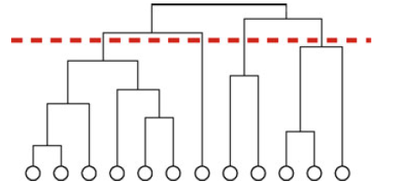
Definitions Based on Vertex Similarity
Based on assumptions that communities are groups of vertices which are similar to each other
Similarity between each pair of vertices done quantitatively
In Hierarchical clustering - layers of communities composed of vertices similar to each other
Ex. dendrogram, highly similar vertices found in lower part
Subtrees got by cutting dendrogram with horizontal line
correspond to communities
Communities of different granularity got by changing position of horizontal line

Slide 8

Evaluating Communities
Many ways to partition network into communities
A quality function needed to evaluate goodness of a partition
Modularity is the quality function proposed by Newman and Girivan:
n_{m} is the number of communities
l_{s} is the total number of edges joining vertices of community s
d_{s} is the sum of the degrees of the vertices of s
upper term in each summand represents fraction of edges of network inside community
lower term represents the expected fraction of edges in random network with same degree for each vertex (null model)
i.e. comparison between real and expected edges

Slide 9
Contd...
Newman and Girivan formula implies:
Subnetwork is a community, if no.edges inside > expected number in modularity’s null model (if true more tightly connected )
Large +ve Q indicates good partitions
Modularity of whole network, taken as single community, is zero
Modularity is always smaller than one, but can be –ve
Modularity optimization is a popular method for community detection
Modularity optimization fails for communities smaller than scale (depends on size of network and resolution limit – degree of interconnectedness of community )

Slide 10
Methods for Community Detection
Naive methods - graph partitioning, hierarchical clustering, and k-means clustering (no. of clusters or their size given in advance)
Methods for detecting communities:
Divisive algorithms
Modularity optimization
Spectral algorithms

Slide 11
Divisive Algorithms
To identify communities in a network - detect the edges that connect vertices of different communities and remove them
Girvan and Newman proposed community detection algorithm based on edge betweenness centrality
Edge betweenness centrality is defined as the number of the shortest paths that go through an edge in a network
Steps in the algorithm
(1) Computation of the centrality of all edges,
(2) Removal of edge with largest centrality
(3) Recalculation of centralities on the running network
(4) Iteration of the cycle from step (2).

Slide 12
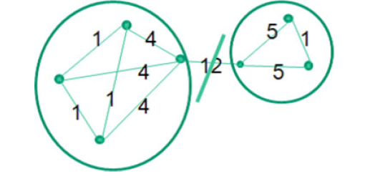
Contd...
Intercommunity edges has larger edge betweenness value, as it serves as shortest path for many communities
Ex. Edge 12 in the below figure

Slide 13
Modularity Optimization
Numerous way partition a network can be done, so need best modularity optimization Q
As NP hard problem, approximations algorithms that produce result in reasonable time is used
Most popular modularity optimization is CNM algorithm
Others greedy algorithms and simulated annealing

Slide 14
Spectral Algorithms
Spectral algorithms cuts given network into pieces so that the number of edges to be cut will be minimized
Basic algorithm is spectral graph bipartitioning
Laplacian matrix L of given network nxn symmetric matrix is used
Laplacian matrix is defined as L=D-A
where A is the adjacency matrix
D is the diagonal degree matrix
All eigenvalues of L are real and non-negative
L has a full set of n real and orthogonal eigenvectors
To minimize the above cut, vertices are partitioned based on the signs of the eigenvector that corresponds to the second smallest eigenvalue of L
Community detection based on repetative bipartitioning is relatively fast.

Slide 15
Other Algorithms & Tools
Random walk, and the ones searching for overlapping cliques
Tools for large scale networks:
CNM algorithm of community detection based on modularity optimization
Works for few million vertices
Tools for Interactive Analysis:
JUNG, Netminer, Pajek, igraph, SONIVIS, Commetrix, NetworkWorkbench, visone, Cfinder etc.

