Slide 1
Trust Models in Grid Computing
Dept of CSE
SSN College of Engineering

Slide 2
Trust and Reputation
Trust is the firm belief in the competence of an entity to behave as expected such that this firm belief is a dynamic value associated with the entity and it is also subject to the entity’s behavior and applies only within a specific context at a given time.
The Reputation of an entity is an expectation of its behavior based on its identity and other entities’ observations or information about the entity’s past behavior within a specific context at a given time.

Slide 3
Trust Classification
Trust can be classified into different categories according to different standards.
* According to attributes: identity trust and behavior trust
* According to obtaining way: direct trust and recommended trust
* According to role: code trust, third party trust and execution trust, etc.
* According to based theory: subjective trust and objective trust.

Slide 4
Trust Categories
Identity trust and Behavior trust.
Identity trust is concerned with verifying the authenticity of an entity and determining the authorizations that the entity is entitled to and is based on cryptographic techniques such as encryption and digital signatures.
Behavior trust deals with a wider notion of an entity’s “trustworthiness” and focuses more on the behavior of that entity.
For example, a digitally signed certificate does not indicate whether the issuer is an industrial spy and a piece of digitally signed code does not show whether the code will perform some malicious actions or not.

Slide 5
Trust Models
PKI Based Trust Model
Network Topology Based Trust Model
Basic Behavior Based Trust Model
Domain Based Trust Model
Subjective Trust Model
Dynamic Trust Model

Slide 6
PKI Based Trust Model
This trust model depends on a few leader nodes to secure the whole system.
The leaders’ validity certifications are signed by CA.
GSI Security Infrastructure of Globus the most famous Grid toolkit is also based on PKI technology.
Drawback: PKI model may cause uneven load or a single point of failure since it rely on leader nodes too much

Slide 7
Network Topology Based Trust Model
This trust model is constructed on the basis of network topology.
Each entity’s trust is evaluated according to its location in system topology and it usually uses tree or graph traversal algorithm
Drawback: due to the extremely complexity of network environment, trust values are often inaccurate which may cause system security risks

Slide 8
Basic Behavior Based Trust Model
This model uses history trade records to compute trust.
One entity’s trust is gained by considering both former trade experiences and other nodes’ recommendation.
Trust value is relatively complete and reliable in this model
Drawback: large-scale computation.

Slide 9
Domain Based Trust Model
This trust model is mostly used in Grid computing.
It divides Grid environment into several trust domains and distinguishes two kinds of trust.
One is in-domain trust relationship and the other is inter-domain trust relationship.
low computational complexity because
in-domain trust’s computation only depends on the number of nodes in a domain and
inter-domain trust only depends on the number of domains.
Drawback: network bottleneck and a single point of failure

Slide 10
Subjective Trust Model
Subject logic based trust model divides trust into several subclass:
execution trust,
code trust,
authority trust,
direct trust and
recommendation trust
Subjective trust is a subjective decision about specific level of entity's particular characters or behaviors
Entity A trusts entity B means A believes that B will perform certain action in some specific situation
Drawback: it cannot realize the integration of identity and behavior certification.

Slide 11
Dynamic Trust Model
Dynamic trust mechanism is a new and hot topic of security research for distributed applications.
* To decide trust degree space. Always it is defined by fuzzy logics.
* To design mechanism of acquirement of trust value. There are two kinds of methods: direct or indirect.
* To design mechanism of trust value evaluation or evolution.

Slide 12
Reputation based Trust Models
Study highlighted points in the paper titled
“Resource Selection In Grid Environment Based On Trust Evaluation Using Feedback And Performance”
File Name: Lecture1_ReputationTrustModels

Slide 13
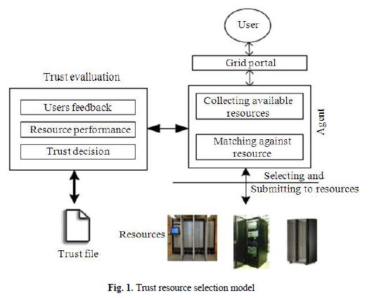
Reputation based Trust Models

Slide 14
References
Li, Wenjuan, and Lingdi Ping. "Trust model to enhance security and interoperability of cloud environment." In IEEE International Conference on Cloud Computing, pp. 69-79. Springer Berlin Heidelberg, 2009.
Mohan, Prakash, and Ravichandran Thangavel. "RESOURCE SELECTION IN GRID ENVIRONMENT BASED ON TRUST EVALUATION USING FEEDBACK AND PERFORMANCE." American Journal of Applied Sciences 10, no. 8 (2013): 924.

