Slide 1

Implementation Levels of Virtualization
SSN College of Engineering
Reference: Distributed and Cloud Computing K. Hwang, G. Fox and J. Dongarra

Slide 2
Overview
Implementation Levels of Virtualization
ISA Level
Hardware Level
OS- Level
Library Level
Application Level
VMM Design Requirements

Slide 3
Virtualization and VM
Virtualization is a technology by which multiple Virtual Machines are multiplexed in the same hardware machine each VM running their own OS.
With Virtualization, any computer platform can be installed in another host computer, even if they use processor with different ISA and distinct OS.
Purpose of VM is to enhance the following
Resource Sharing by many users
Improved Computer Performance (Resource Utilization and application Flexibility)

Slide 4
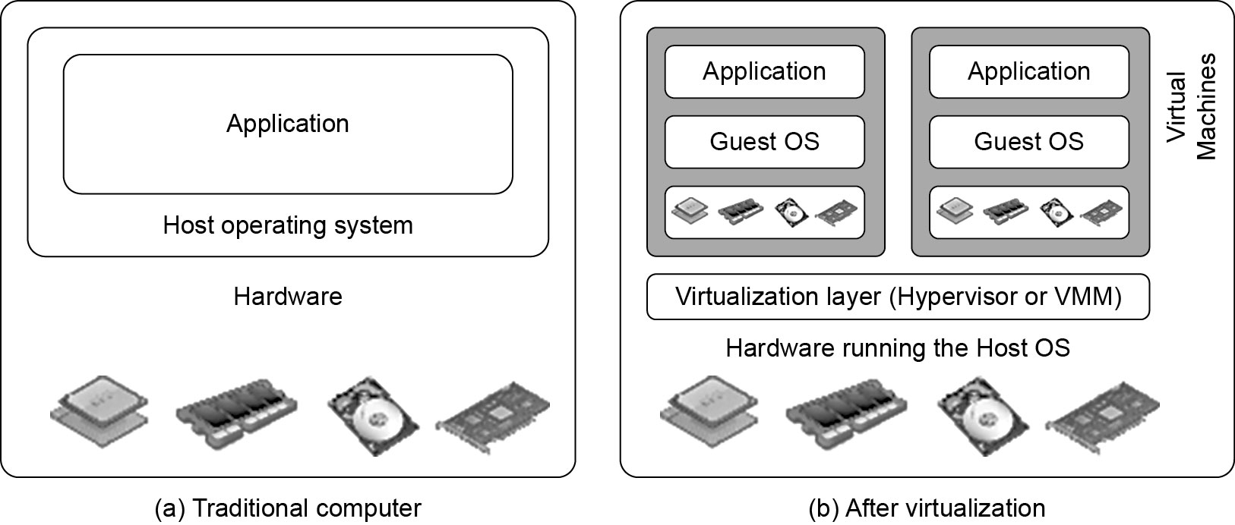
Difference between Traditional Computer and Virtual machines
(Courtesy of VMWare, 2008)

Slide 5
Virtual Machine, Guest Operating System, and VMM (Virtual Machine Monitor)
Virtual Machine
A representation of a real machine using software that provides an environment to host guest OS
Guest Operating System
An operating system running in a virtual machine.
The Virtualization layer is the middleware between the underlying hardware and virtual machines represented in the system, also known as virtual machine monitor (VMM) or hypervisor.

Slide 6
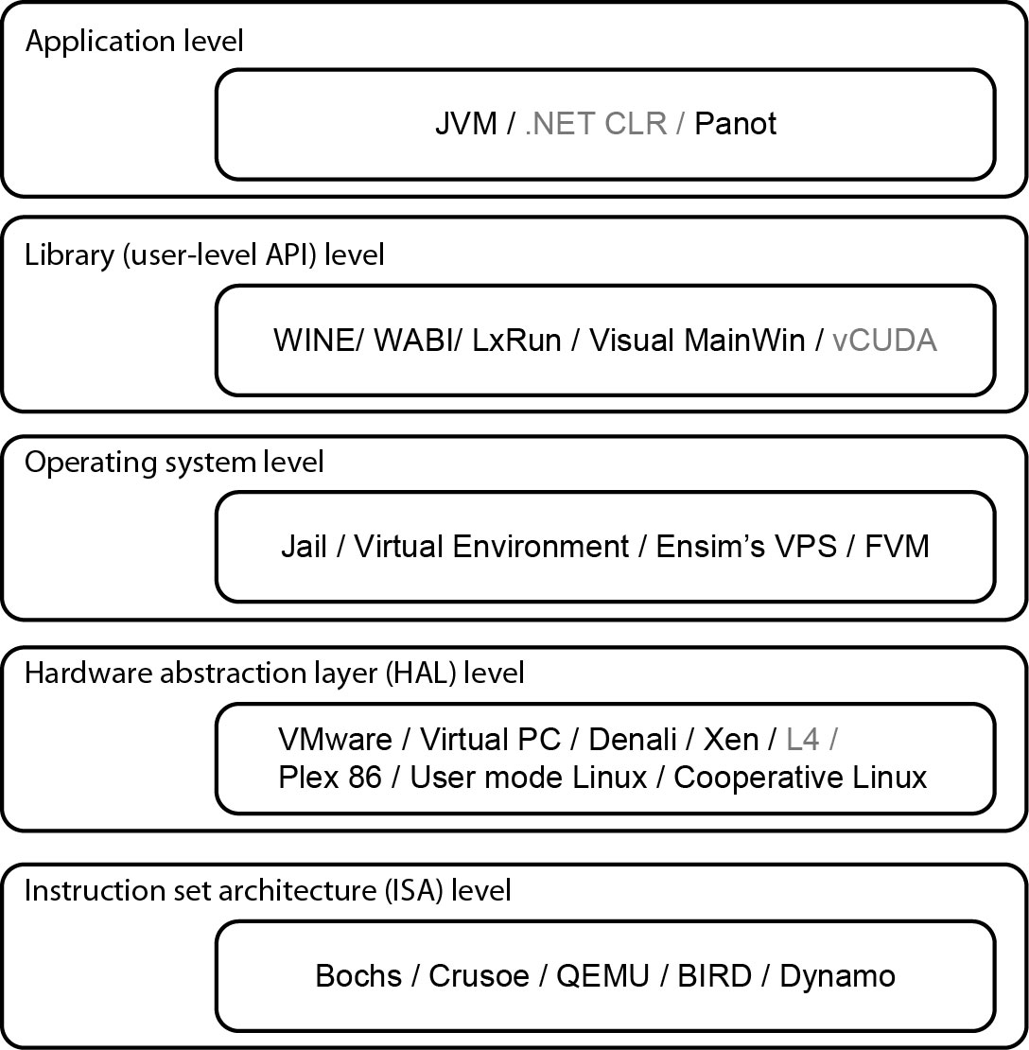
Virtualization Ranging from Hardware to Applications in Five Abstraction Levels

Slide 7
Virtualization at ISA (Instruction Set Architecture) level
Emulating a given ISA by the ISA of the host machine.
e.g, MIPS binary code can run on an x-86-based host machine with the help of ISA emulation.
Dynamic Binary Translation : Translates basic blocks of source instruction to target instruction.
Typical systems: Bochs, Crusoe, Quemu, BIRD, Dynamo
Advantage:
It can run a large amount of legacy binary codes written for various processors on any given new hardware host machines
Best application flexibility
Shortcoming & limitation:
One source instruction may require tens or hundreds of native target instructions to perform its function, which is relatively slow.
V-ISA requires adding a processor-specific software translation layer in the complier.

Slide 8
Virtualization at Hardware Abstraction level
Virtualization is performed right on top of the hardware.
It generates virtual hardware environments for VMs (CPU, Memory, I/O devices)
Manages the underlying hardware through virtualization.
Typical systems: VMware, Virtual PC, Denali, Xen
Xen hypervisor is applied to virtualize x-86 based machines to run Linux or other guest OS.
Advantage:
Has higher performance and good application isolation
Shortcoming & limitation:
Very expensive to implement (complexity)

Slide 9
Virtualization at Operating System (OS) level
It is an abstraction layer between traditional OS and user applications.
This virtualization creates isolated containers or Virtual Execution Environment or Virtual Private System ( VPS) on a single physical server and the OS-instance to utilize the hardware and software in datacenters.
Typical systems: Jail / Virtual Environment / Ensim's VPS / FVM

Slide 10
Virtualization at OS Level

Slide 11
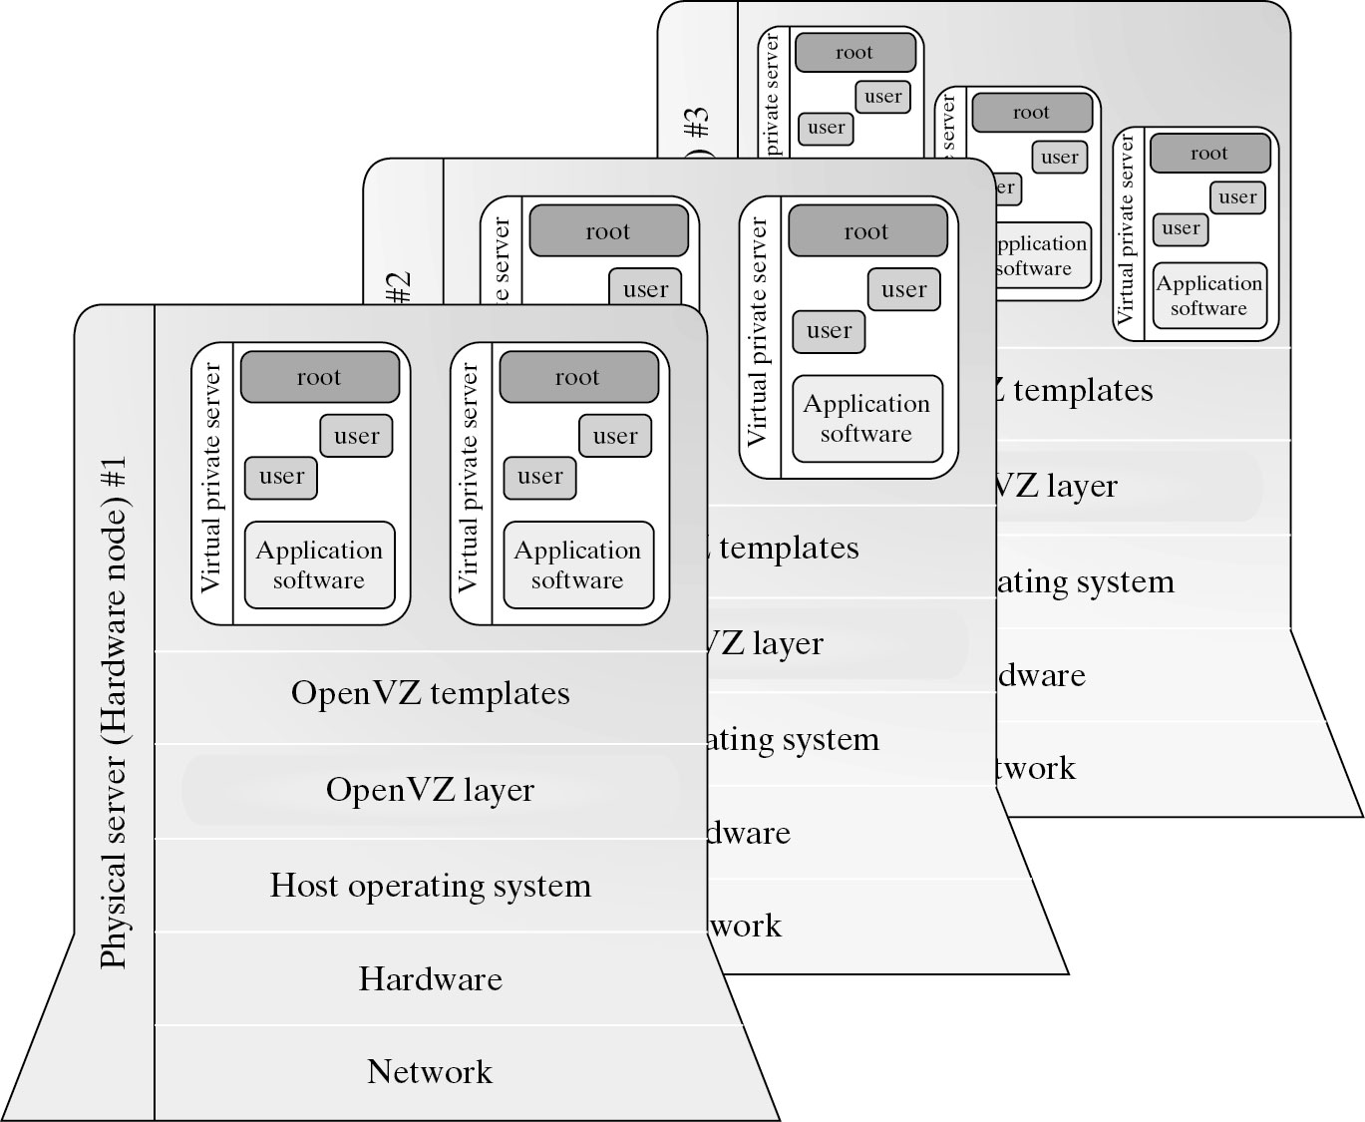
Virtualization for Linux and Windows NT Platforms

Slide 12
Virtualization for Linux and Windows NT Platforms
So far, most reported OS- Level Virtualizations are Linux based.
Virtualization for Windows-based platform is still in research stage.
Linux Kernel offers an abstraction layer, to allow software process to work with and operate on resources without knowing the hardware details.

Slide 13
Virtualization for Linux and Windows NT Platforms

Slide 14
Virtualization at OS Level
Advantages of OS Extension for Virtualization
VMs at OS level has minimum startup/shutdown costs, low resource requirement and high scalability
OS-level VM can easily synchronize with its environment
Disadvantage of OS Extension for Virtualization
All VMs in the same OS container must have the same or similar guest OS, which restrict application flexibility & isolation of different VMs on the same physical machine.

Slide 15
Library Support level
It creates execution environments for running alien programs on a platform rather than creating VM to run the entire operating system.
Also known as user-level Application Binary Interface (ABI)
It is done by API call interception and remapping.
Typical systems: Wine, WABI, LxRun , VisualMainWin and vCUDA
Advantage:
It has very low implementation effort
Shortcoming & limitation:
Poor application flexibility and isolation

Slide 16
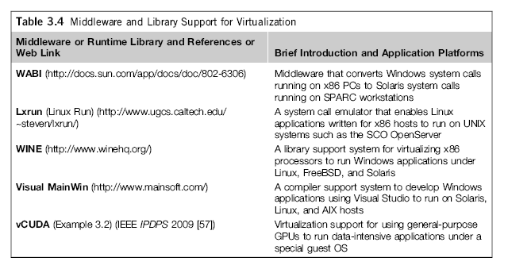
Virtualization with Middleware/Library Support

Slide 17
The vCUDA for Virtualization of GPGPU

Slide 18
The vCUDA for Virtualization of GPGPU
CUDA is programming model and library for GP- GPUs
It provides GPUs to run compute intensive applications on host OS.
It is difficult to run CUDA application on Hardware-level VMs directly.
vCUDA virtualizes CUDA library.
When CUDA applications run on guest OS and issues call to CUDA API, vCUDA intercepts and directs to CUDA API running on host OS.
vCUDA employs client server model to implement CUDA virtualization.
vGPU returns local virtual address to application and notify remote stub to allocate real device memory and execution context for APIs calls from guest OS.

Slide 19
User-Application level
It virtualizes an application as a virtual machine.
High Level Language VMs: This layer sits as an application program on top of an operating system and exports an abstraction of a VM that can run programs written and compiled to a particular abstract machine definition.
Application-level or Process-Level Virtualization
Typical systems: JVM , .NET CLI , Panot
Advantage:
Best application isolation
Shortcoming & limitation:
Low performance, low application flexibility and high implementation complexity.

Slide 20
Summary
More Xs mean higher merit

Slide 21
VMM Design Requirements
First, a VMM should provide an environment for programs which is essentially identical to the original machine.
Second, programs run in this environment should show, at worst, only minor decreases in speed.
Third, a VMM should be in complete control of the system resources
The VMM is responsible for allocating hardware resources for programs.
It is not possible for a program to access any resource not explicitly allocated to it.
It is possible under certain circumstances for a VMM to regain control of resources already allocated.
Not all processors satisfy these requirements for a VMM. A VMM is tightly related to the architectures of processors. It is difficult to implement a VMM for some types of processors, such as the x86.

Slide 22
Summary
Implementation Levels of Virtualization
ISA Level
Hardware Level
OS- Level
Library Level
Application Level
VMM Design Requirements

Slide 23
Hardware Virtualization
The concept of Hardware Virtualization is straightforward: you cheat your
OS so that you pretend to have more hardware resources that you have in
reality. So out of a single 4-cpu physical system you could carve out
12 1-cpu virtual servers and install 12 independent standard OS’es as
if you were installing these on 12 independent pieces of hardware.
Example : VMware ESX, MS Virtual Server, Xen and others

Slide 24
OS Virtualization
The concept of Operating System Virtualization is OS that cheats the Application. When you install your application, the application <think> that it is being installed in its dedicated OS but in reality it is being installed in a dedicated environment within a yet shared Operating System image. You could then install incompatible applications on the same box and be (relatively) sure that they will be living in their independent sandboxes.
Microsoft Windows Terminal Services can be considered as an example of Operating System Virtualization

Slide 25
Application Virtualization
The concept of Application Virtualization is easy. In a nutshell virtualizing an
application means re-packaging this application somehow and redistributing this same application under a different shape / format. This new “format” is usually a single big file that gets “copied” on top of an OS and that doesn’t need to be “installed”. This allows running different and potentially incompatible applications on the same Operating System without each application stepping over each other due to DLL conflicts or registry incompatibilities.

Slide 26
Summary
Hardware Virtualization: 1 hardware -> n OS images -> n Applications
Operating System virtualization 1 hardware -> 1 OS image -> n Applications
Application Virtualization 1 hardware -> 1 OS image -> n Applications
Hardware Virtualization (a standard OS gets installed on a fictitious piece of hardware)
Operating System virtualization (a standard application gets installed on a fictitious OS)
Application Virtualization (an application is packaged/shielded to run on a standard OS)

