Slide 1
IAM Architecture
SSN College of Engineering

Slide 2
Identity & Access Management
Security in any system involves primarily ensuring that the right entity gets access to only the authorized data in the authorized format at an authorized time and from an authorized location.
Identities, trust, authentication and access controls have obtained additional significance in the cloud world.
Identity and access management (IAM) is of prime importance in this regard.
Identity and Access Management (IAM) is used to manage access to resources by assuring that the identity of an entity is verified, then granting the correct level of access based on the protected resource.

Slide 3
Identity & Access Management
Identity and access management is a critical function for every organization, and a fundamental expectation of SaaS customers
The principle of least privilege states
“Only the minimum access necessary to perform an operation should be granted, and that access should be granted only for the minimum amount of time necessary”.
The advent of cloud services and services on demand is changing the identity management landscape.
Most of the current identity management solutions are focused on the enterprise and typically are architected to work in a very controlled in static environment

Slide 4
Identity & Access Management
Main Functions of IAM
Identity Provisioning
Authentication
Authorization
Policy Management

Slide 5
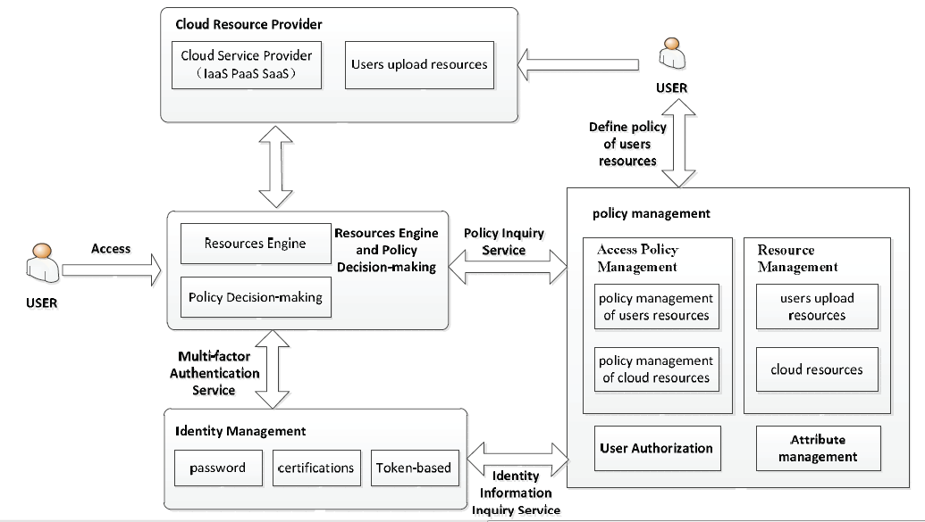
Identity & Access Management Architecture
Architecture involves four parts
Cloud Resource Provider
Identity Management
Policy Management
Resources Engine and Access Decision-making.

Slide 6
Identity & Access Management Architecture
Cloud Resource Provider (CRP) : The resource provider is responsible for providing access to resources based on user’s asserted identity and privilege.
Cloud resources : involve software, operating systems or even programming environment and network infrastructure.
User upload resources are mainly user-generated resources and upload their own resources to the cloud, which provide the data access to the users.

Slide 7
Identity & Access Management Architecture
2. Identity Management (IDM) : IDM is responsible for managing users and their identities, issuing credentials, vouching for the user's identity and identity assertion.
It provides two external services:
• Multi-factor Authentication Service: is the interface provided by IDM to validates the asserted identity information.
The authentication services evaluate credentials such as user name and password, secure ID token pass phrases, X.509 certifications, and so on, directly provided by the user.
Identity Information Inquiry Service: is the interface
provided by IDM to check the identity information for user authorization.

Slide 8
Identity & Access Management Architecture
3. Policy Management (PM): Policy management enforces access rules that associate users with resources.
Policy management supports 5 functions:
1. Attribute Management
2. User authorization
3. Resource management
4. Access policy management : Access Policy Management defines access rules of cloud resources and users own resources.
5. Policy Inquiry Service : Policy Inquiry Service is available to query the user privileges and according to resource access policies, decide whether to allow users to access

Slide 9
Identity & Access Management Architecture
4. Resources Engine and Policy Decision-making(REPD) :
Resources Engine (RE): Resources Engine implements scheduling of resources within cloud. This component is responsible for finding resources that meets the requirements of the user among the list of resource.
• Policy Decision-making (PD): Policy Decision-making determines whether to allow users to access appropriate resources by assuring security. It takes the help of IDM and Policy Management component.

Slide 10
References
Yang, Yan, Xingyuan Chen, Guangxia Wang, and Lifeng Cao. "An Identity and Access Management Architecture in Cloud." In Computational Intelligence and Design (ISCID), 2014 Seventh International Symposium on, vol. 2, pp. 200-203. IEEE, 2014.

