Slide 1

Virtual Clusters and Resource Management : Migration of Memory, Files and Network Resources & Dynamic Deployment of Clusters
SSN College of Engineering
Reference: Distributed and Cloud Computing K. Hwang, G. Fox and J. Dongarra

Slide 2
Design Issues of Virtual Cluster
Live Migration Of VMs
Memory, File system and Network Migration
Dynamic Deployment of Virtual Clusters

Slide 3
Outline
Memory Migration
File System Migration
Network Migration
Live Migrations of VMs between 2 Xen enabled Hosts.
Dynamic Deployment of Virtual Clusters

Slide 4
Memory Migration
Memory Migration is in the range of hundreds of megabytes to few gigabytes.
In Internet Suspend-Resume (ISR) technique memory states are likely to overlap in suspended and resumed instances of VM.
ISR exploits Temporal Locality
Temporal Locality refers that memory states differ only by the amount of work done since VM is last suspended and before being initiating migration.
Each file in a file system must be represented as a tree of small sub-files.
The copy of tree exist in both suspended and resumed VM
This ensures that transmission only for the files which have been changed.

Slide 5
File System Migration
In VM migration, system should provide VM with consistent and location independent view of file system available on all host.
Provide each VM with its own virtual disk which the file system is mapped.
Now transport the contents of Virtual disk along with other VM states.
If the disk capacity is very high, maintain global file system across all machines where VM can be located.
Instead of having a distributed file system, every VM will have access only to its local file system.
Copy the virtual disk contents to VM’s local file system for resumed VM.
Spatial Locality: Transmit only difference between two file systems at suspending and resuming locations

Slide 6
Network Migration
Migrating VM should maintain all open connections without relying on forwarding or redirection mechanisms.
To locate and communicate with VM, each VM is assigned with Virtual IP address, distinct from IP address of host.
VMM maintains mapping of Virtual IP with Virtual MAC address.
If source and destination machines of VM migration are in a single LAN, migrating host advertise that IP is moved to new location, which reconfigure all peers to send files to new location.

Slide 7
Copy Strategies in Live Migration
Live migration means moving VM from one physical machine to another, while keeping OS environment and applications unbroken.
Pre-copy: VM could be migrated without suspending VM and keep applications running during migration.
First transfer copies all the pages and copies only modified memory pages on subsequent iterations until writeable working set becomes small..
Drawback: This consumes large amount of network bandwidth to transfer dirty pages in each round.
When the network bandwidth is limited, total migration time increases to 10 minutes.
Solution: We can set maximum number of iterations.

Slide 8
Copy Strategies in Live Migration
A Checkpointing/recovery and trace/replay approach is proposed to enable fast VM migration. This reduces downtime and total migration time.
Post-Copy: All memory pages are transferred only once during the whole migration process.
Advantage: Total migration time is reduced.
Drawback: Downtime is higher because latency of fetching pages from source node before VM is resumed on target.
Solution: Memory compression and decompression algorithms can be applied to reduce memory overhead.

Slide 9
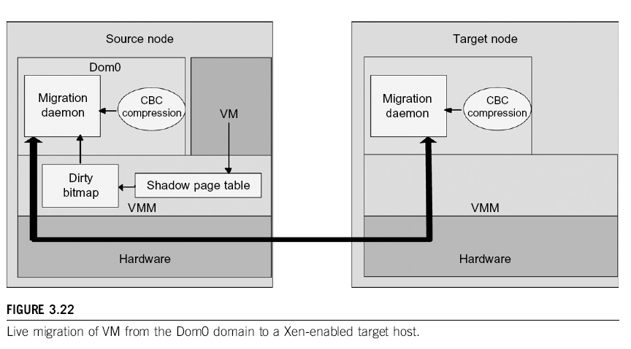
Live Migration of VM in Xen environment

Slide 10
Dynamic Deployment of Virtual Clusters

Slide 11
Virtual Cluster Projects

Slide 12
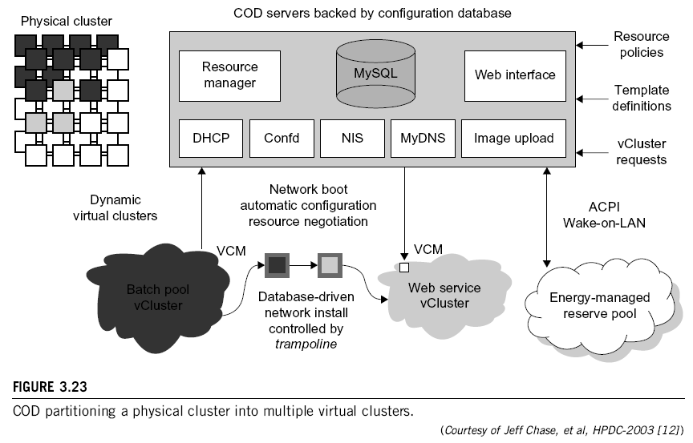
COD Project @ DUKE Univ

Slide 13
Cluster-on-Demand (COD Project) at Duke University
The COD (Cluster-on-Demand) project is a virtual cluster management system for dynamic allocation of servers from a computing pool to multiple virtual clusters.
The vClusters run a batch schedule from Sun's GridEngine on a web server cluster.
The COD system can respond to load changes in restructuring the virtual clusters dynamically.
The Duke researchers used the Sun GridEngine scheduler to demonstrate that dynamic virtual clusters are an enabling abstraction for advanced resource management in computing utilities such as grids.

Slide 14
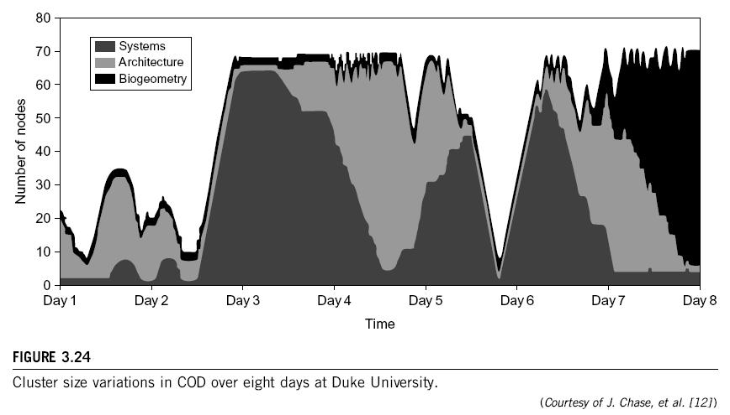
Cluster-on-Demand (COD Project) at Duke University

Slide 15
VIOLIN Project at Purdue University

Slide 16
VIOLIN Project at Purdue University
The Purdue VIOLIN Project applies live VM migration to reconfigure a virtual cluster environment.
Its purpose is to achieve better resource utilization in executing multiple cluster jobs on multiple cluster domains
A virtual execution environment is able to relocate itself across the infrastructure.
The adaptation is transparent to both users of virtual environments and administrations of infrastructures.

Slide 17
Summary
Memory Migration
File System Migration
Network Migration
Live Migrations of VMs between 2 Xen enabled Hosts.
Dynamic Deployment of Virtual Clusters

Slide 18
Thank You
Kingsoft Office

