Slide 1

Virtualization for Data Center Automation
SSN College of Engineering
Reference: Distributed and Cloud Computing K. Hwang, G. Fox and J. Dongarra

Slide 2
Virtualization for Datacenter Automation to serve millions of clients, simultaneously
Server Consolidation in Virtualized Datacenter
Virtual Storage Provisioning and De-provisioning
Cloud Operating Systems for Virtual Datacenters
Trust Management in virtualized Datacenters

Slide 3
Data Center Virtualization
Data-center automation means that huge volumes of hardware, software, and database resources in these data centers can be allocated dynamically to millions of Internet users simultaneously, with guaranteed QoS and cost-effectiveness
Latest virtualization development highlights high availability (HA), backup services, workload balancing, and further increases in client bases.

Slide 4
Virtualization for Datacenter Automation to serve millions of clients, simultaneously
Server Consolidation in Virtualized Datacenter
Virtual Storage Provisioning and De-provisioning
Cloud Operating Systems for Virtual Datacenters
Trust Management in virtualized Datacenters

Slide 5
Server Consolidation in Data Centers
In data centers, a large number of heterogeneous workloads can run on servers at various times.
Chatty workloads may burst at some point and return to a silent state at some other point.
A web video service is an example of this, whereby a lot of people use it at night and few people use it during the day.
Non-Interactive workloads do not require people's efforts to make progress after they are submitted.
High-performance computing is a typical example of this.

Slide 6
Server Consolidation in Data Centers
The workload is statically allocated enough resources so that peak demand is satisfied.
Therefore, it is common that most servers in data centers are underutilized
Among several server consolidation techniques such as centralized and physical consolidation, virtualization-based server consolidation is the most powerful.

Slide 7
Server Consolidation in Data Centers
Data centers need to optimize their resource management.
Use of VMs increases resource management complexity. Server Consolidation is a solution.
Properties of Sever Consolidation
Consolidation enhances hardware utilization. Consolidation also facilitates backup services and disaster recovery.
This approach enables more agile provisioning and deployment of resources. In a virtual environment, the images of the guest OSes and their applications are readily cloned and reused.

Slide 8
Server Consolidation in Data Centers
Properties of Sever Consolidation
The total cost of ownership is reduced
This approach improves availability and business continuity. The crash of a guest OS has no effect on the host OS or any other guest OS.
It becomes easier to transfer a VM from one server to another, because virtual servers are unaware of the underlying hardware.

Slide 9
Server Consolidation in Data Centers
In virtualized data centers, an efficient, on-demand, fine-grained scheduler is one of the key factors to improve resource utilization
Two methods Autonomic Resource Allocation.
1. Automatically adjusting resource overhead based on varying workloads in hosted services.
2. Two-level resource management system to handle the complexity involved.
A local controller at the VM level and a global controller at the server level are designed.
They implement autonomic resource allocation via the interaction of the local and global controllers

Slide 10
Virtualization for Datacenter Automation to serve millions of clients, simultaneously
Server Consolidation in Virtualized Datacenter
Virtual Storage Provisioning and De-provisioning
Cloud Operating Systems for Virtual Datacenters
Trust Management in virtualized Datacenters

Slide 11
Virtual Storage Management
Storage virtualization was largely used to describe the aggregation and repartitioning of disks for use by physical machines.
Generally, the data stored in this environment can be classified into two categories: VM images and application data.
The most important aspects of system virtualization are encapsulation and isolation.
Traditional operating systems and applications running on them can be encapsulated in VMs.
Only one operating system runs in a virtualization while many applications run in the operating system.
System virtualization allows multiple VMs to run on a physical machine and the VMs are completely isolated.

Slide 12
Virtual Storage Management
Virtualization procedure complicates storage operations.
Operations such as remapping volumes across hosts and check-pointing disks are frequently clumsy
In data centers, there are often thousands of VMs, which cause the VM images to become flooded
Lot research is going on in Storage Virtualization, to make management easy while enhancing performance and reducing the amount of storage occupied by the VM images.
Parallax is a distributed storage system customized for virtualization environments.
Content Addressable Storage (CAS) is a solution to reduce the total size of VM images.

Slide 13
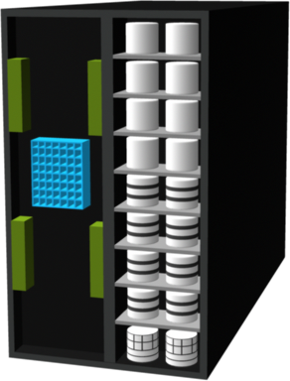

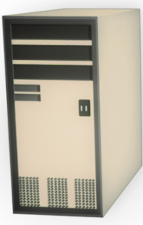
Monitoring Storage Infrastructure
Client
Cluster
Port
HBA
HBA
Port
SAN
IP
Keep Alive
Storage Arrays
Network
Accessibility
Capacity
Performance
Hosts/Servers with Applications
Security

Slide 14
Parallax Providing Virtual Disks to Client VMs from a Large Common Shared Physical Disk

Slide 15
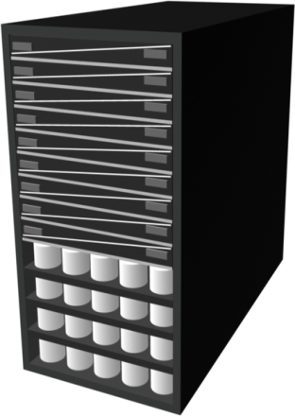
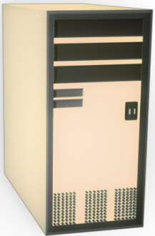
CAS – Content Addressable Storage
Storage devices (CAS Based)
Storage node
Access node
Servers (to which storage devices get connected)
Client
Storage Nodes
Access Nodes
Private LAN
IP
CAS System
API
Server

Slide 16
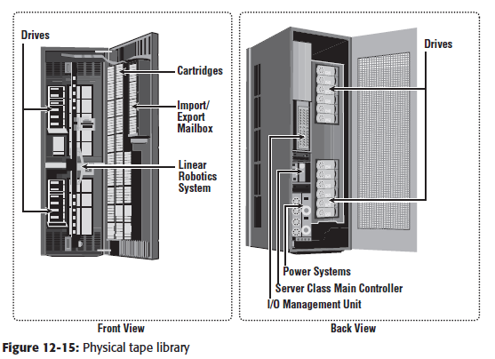
Physical Tape Library

Slide 17
Virtualization for Datacenter Automation to serve millions of clients, simultaneously
Server Consolidation in Virtualized Datacenter
Virtual Storage Provisioning and De-provisioning
Cloud Operating Systems for Virtual Datacenters
Trust Management in virtualized Datacenters

Slide 18
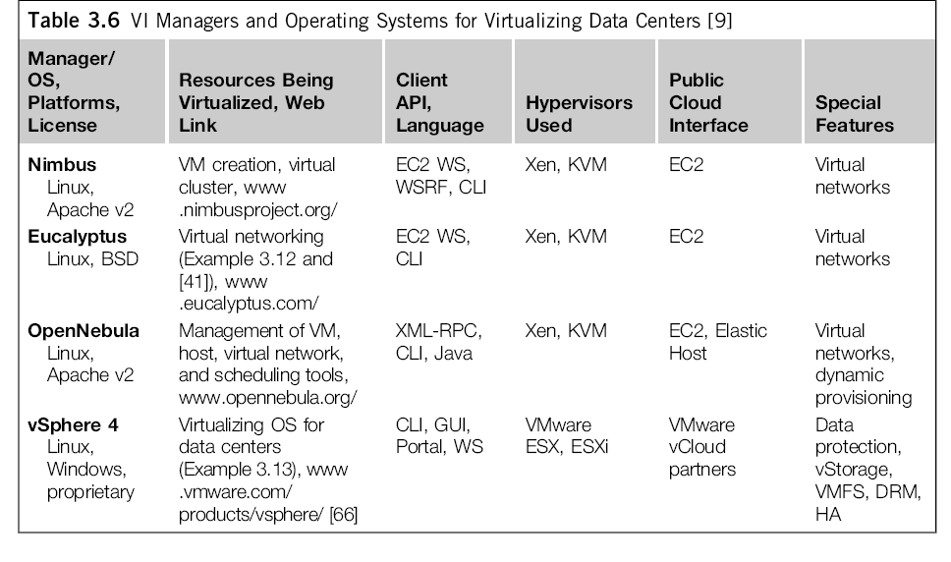
Cloud OS for Building Private Clouds

Slide 19
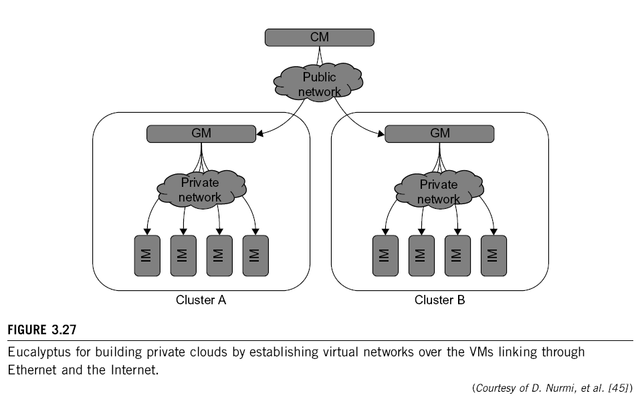
Eucalyptus : An Open-Source OS for Setting Up and Managing Private Clouds

Slide 20
VMware vSphere 4 as a Commercial Cloud OS

Slide 21
Virtualization for Datacenter Automation to serve millions of clients, simultaneously
Server Consolidation in Virtualized Datacenter
Virtual Storage Provisioning and De-provisioning
Cloud Operating Systems for Virtual Datacenters
Trust Management in virtualized Datacenters

Slide 22
Trust Management in Virtualized Data Center
VMM can provide secure isolation and a VM accesses hardware resources through the control of the VMM, so the VMM is the base of the security of a virtual system.
Normally, one VM is taken as a management VM to have some privileges such as creating, suspending, resuming, or deleting a VM.
If a hacker successfully enters the VMM or management VM, the whole system is in danger.
A subtler problem arises in protocols that rely on the "freshness" of their random number source for generating session keys
For example, the reuse of TCP initial sequence numbers can raise TCP hijacking attacks.

Slide 23
VM-Based Intrusion Detection
Intrusions are unauthorized access to a certain computer from local or network users
intrusion detection is used to recognize the unauthorized access.
An intrusion detection system (IDS) is built on operating systems, and is based on the characteristics of intrusion actions.
IDS can be classified as a host-based IDS (HIDS) or a network-based IDS (NIDS), depending on the data source.
A HIDS can be implemented on the monitored system.
A NIDS is based on the flow of network traffic which can't detect fake actions..

Slide 24
VM-Based Intrusion Detection
Implementing a VM-based IDS
IDS is an independent process in each VM or a high-privileged VM on the VMM;
IDS is integrated into the VMM and has the same privilege to access the hardware as well as the VMM
An analysis of the intrusion action is extremely important after an intrusion occurs.
Traditionally, most computer systems use logs to analyze attack actions, but it is hard to ensure the credibility and integrity of a log.
Besides IDS, honeypots and honeynets are also prevalent in intrusion detection
They attract and provide a fake system view to attackers in order to protect the real system. In addition, the attack action can be analyzed, and a secure IDS can be built.

Slide 25
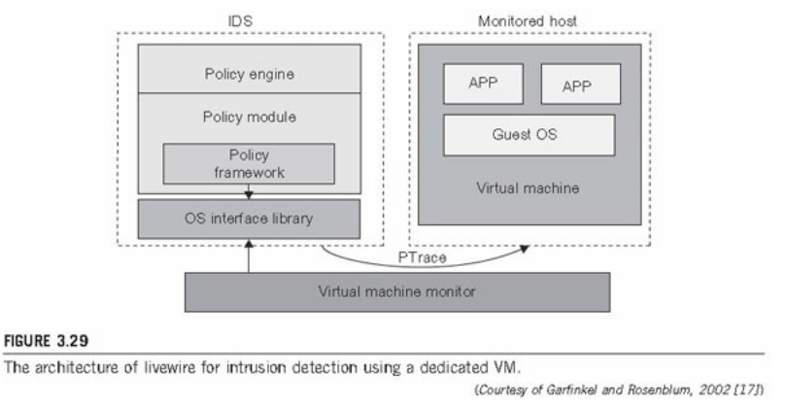
VM-Based Intrusion detection
Garfinkel and Rosenblum have proposed an IDS to run on a VMM as a high-privileged VM.

Slide 26


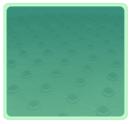



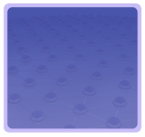

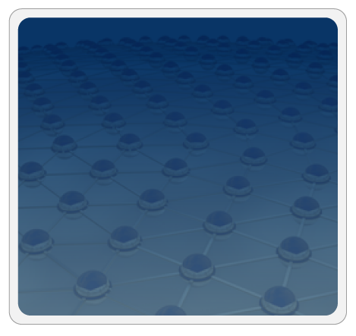



Trusted Zones for VM Insulation
Insulate infrastructure from Malware, Trojans and cybercriminals
Anti-malware
Federate identities with public clouds
Identity federation
Cybercrime intelligence
Strong authentication
APP
APP
Tenant #2
OS
OS
Control and isolate VM in the virtual infrastructure
Virtual Infrastructure
Insulate information
from other tenants
Virtual network security
Data loss prevention
APP
APP
Tenant #1
OS
OS
Virtual Infrastructure
Insulate information from cloud providers’ employees
Encryption & key mgmt
Access Mgmt
Segregate and control user access
Cloud Provider
Tokenization
Security Info. & Event Mgmt
Physical Infrastructure
GRC
Enable end to end view of security events and compliance across infrastructures
(Courtesy of L. Nick, EMC 2008)
Notes:
26

Slide 27
Summary
Server Consolidation in Virtualized Datacenter
Virtual Storage Provisioning and De-provisioning
Cloud Operating Systems for Virtual Datacenters
Trust Management in virtualized Datacenters

Slide 28
Thank You
Kingsoft Office

