Slide 1
Cloud Computing Tools
Presented By,
Sasikumar Venkatesh,
ME-CSE 2014-2016

Slide 2

Apache Hadoop 2.7

Slide 3
Outline
Hadoop - Basics
HDFS
  Goals
  Architecture
MapReduce
  Basics
  Word Count Example
Setting up of Hadoop
  Single Node (Pseudo Distributed Mode)

Slide 4
Hadoop - Why ?
Need to process huge datasets on large clusters of computers
Very expensive to build reliability into each application
Nodes fail every day
  Failure is expected, rather than exceptional
  The number of nodes in a cluster is not constant
Need a common infrastructure
  Efficient, reliable, easy to use
  Open Source, Apache License

Slide 5
Who uses Hadoop?
Amazon/A9
Facebook
Google
New York Times
Veoh
Yahoo!
Netflix
…. many more

Slide 6
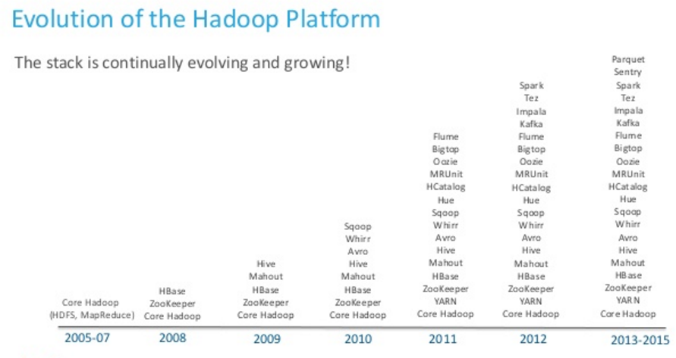
Evolution of Hadoop
Credit goes to, Cloudera

Slide 7
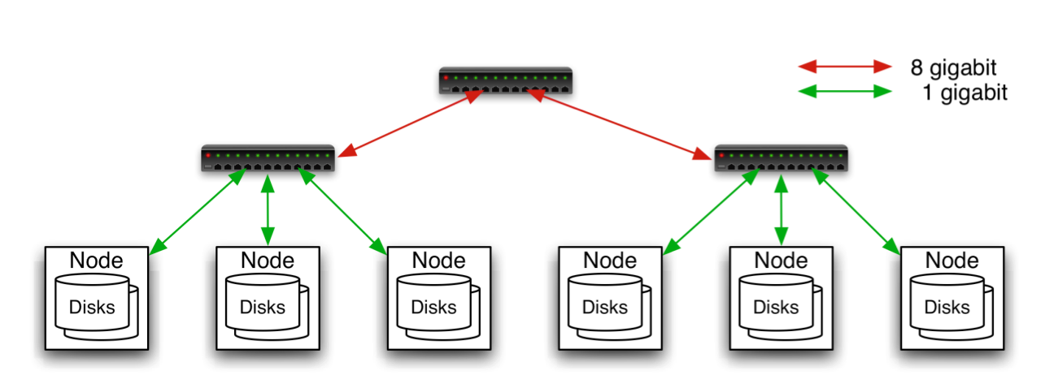
Commodity Hardware
Aggregation switch
Rack switch
Typically in 2 level architecture
  Nodes are commodity PCs
  30-40 nodes/rack
  Uplink from rack is 3-4 gigabit
  Rack-internal is 1 gigabit

Slide 8
Hadoop Distributed File System (HDFS)

Slide 9
Goals of HDFS
Very Large Distributed File System
  10K nodes, 100 million files, 10PB
Assumes Commodity Hardware
  Files are replicated to handle hardware failure
  Detect failures and recover from them
Optimized for Batch Processing
  Data locations exposed so that computations can move to where data resides
  Provides very high aggregate bandwidth

Slide 10
Distributed File System
Single Namespace for entire cluster
Data Coherency
  Write-once-read-many access model
  Client can only append to existing files
Files are broken up into blocks
  Typically 64MB block size
  Each block replicated on multiple DataNodes
Intelligent Client
  Client can find location of blocks
  Client accesses data directly from DataNode

Slide 11
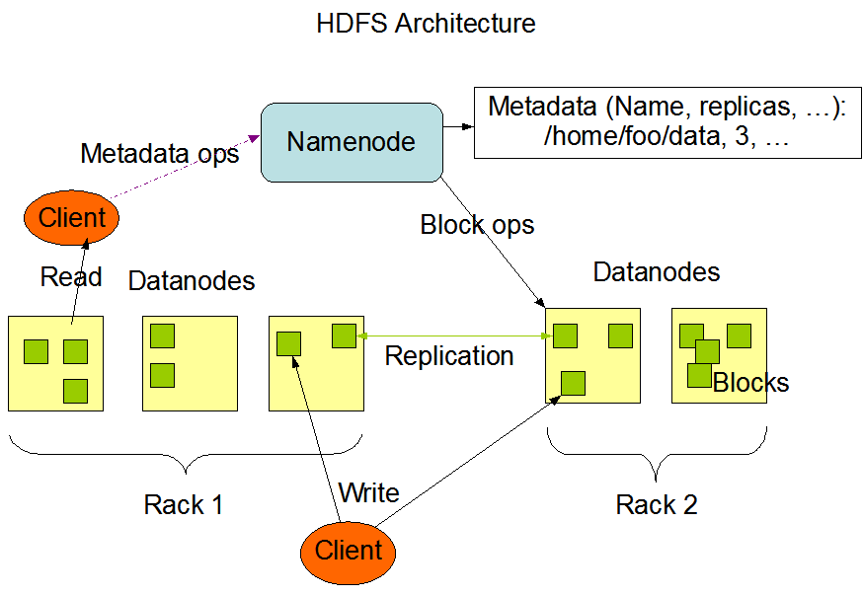
HDFS Architecture

Slide 12
Functions of a NameNode
Manages File System Namespace
  Maps a file name to a set of blocks
  Maps a block to the DataNodes where it resides
Cluster Configuration Management
Replication Engine for Blocks

Slide 13
NameNode Metadata
Metadata in Memory
  The entire metadata is in main memory
  No demand paging of metadata
Types of metadata
  List of files
  List of Blocks for each file
  List of DataNodes for each block
  File attributes, e.g. creation time, replication factor
A Transaction Log
  Records file creations, file deletions etc

Slide 14
DataNode
A Block Server
  Stores data in the local file system (e.g. ext3)
  Stores metadata of a block (e.g. CRC)
  Serves data and metadata to Clients
Block Report
  Periodically sends a report of all existing blocks to the NameNode
Facilitates Pipelining of Data
  Forwards data to other specified DataNodes

Slide 15
Heartbeats
DataNodes send hearbeat to the NameNode
  Once every 3 seconds
NameNode uses heartbeats to detect DataNode failure

Slide 16
Replication Engine
NameNode detects DataNode failures
  Chooses new DataNodes for new replicas
  Balances disk usage
  Balances communication traffic to DataNodes

Slide 17
Data Correctness
Use Checksums to validate data
  Use CRC32
File Creation
  Client computes checksum per 512 bytes
  DataNode stores the checksum
File access
  Client retrieves the data and checksum from DataNode
  If Validation fails, Client tries other replicas

Slide 18
NameNode Failure
A single point of failure
Transaction Log stored in multiple directories
  A directory on the local file system
  A directory on a remote file system (NFS/CIFS)
Need to develop a real HA solution

Slide 19
Secondary NameNode
Copies FsImage and Transaction Log from Namenode to a temporary directory
Merges FSImage and Transaction Log into a new FSImage in temporary directory
Uploads new FSImage to the NameNode
  Transaction Log on NameNode is purged

Slide 20
User Interface
Commads for HDFS User:
  hadoop dfs -mkdir /foodir
  hadoop dfs -cat /foodir/myfile.txt
  hadoop dfs -rm /foodir/myfile.txt
Commands for HDFS Administrator
  hadoop dfsadmin -report
  hadoop dfsadmin -decommision datanodename
Web Interface
  http://localhost:50070/dfshealth.jsp

Slide 21
MapReduce

Slide 22
MapReduce - What?
MapReduce is a programming model for efficient distributed computing
It works like a Unix pipeline
  cat input | grep | sort | uniq -c | cat > output
  Input | Map | Shuffle & Sort | Reduce | Output
Efficiency from
  Streaming through data, reducing seeks
  Pipelining
A good fit for a lot of applications
  Log processing
  Web index building

Slide 23
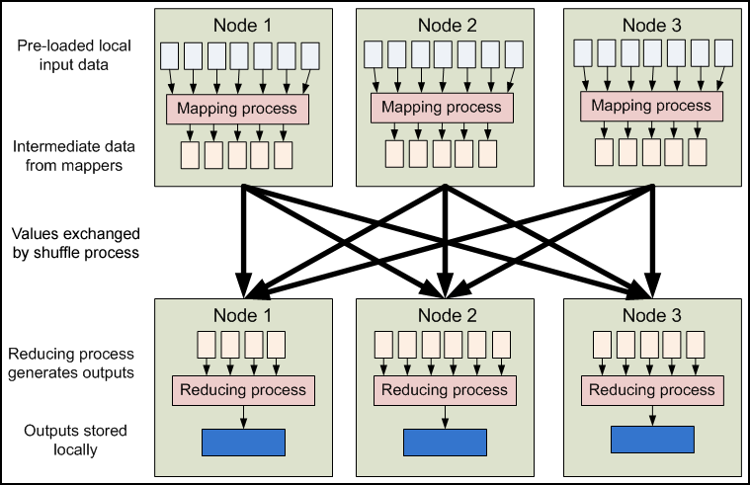
MapReduce - Dataflow

Slide 24
MapReduce - Features
Fine grained Map and Reduce tasks
  Improved load balancing
  Faster recovery from failed tasks
Automatic re-execution on failure
  In a large cluster, some nodes are always slow or flaky
  Framework re-executes failed tasks
Locality optimizations
  With large data, bandwidth to data is a problem
  Map-Reduce + HDFS is a very effective solution
  Map-Reduce queries HDFS for locations of input data
  Map tasks are scheduled close to the inputs when possible

Slide 25
Word Count Example
Mapper
  Input: value: lines of text of input
  Output: key: word, value: 1
Reducer
  Input: key: word, value: set of counts
  Output: key: word, value: sum
Launching program
  Defines this job
  Submits job to cluster

Slide 26
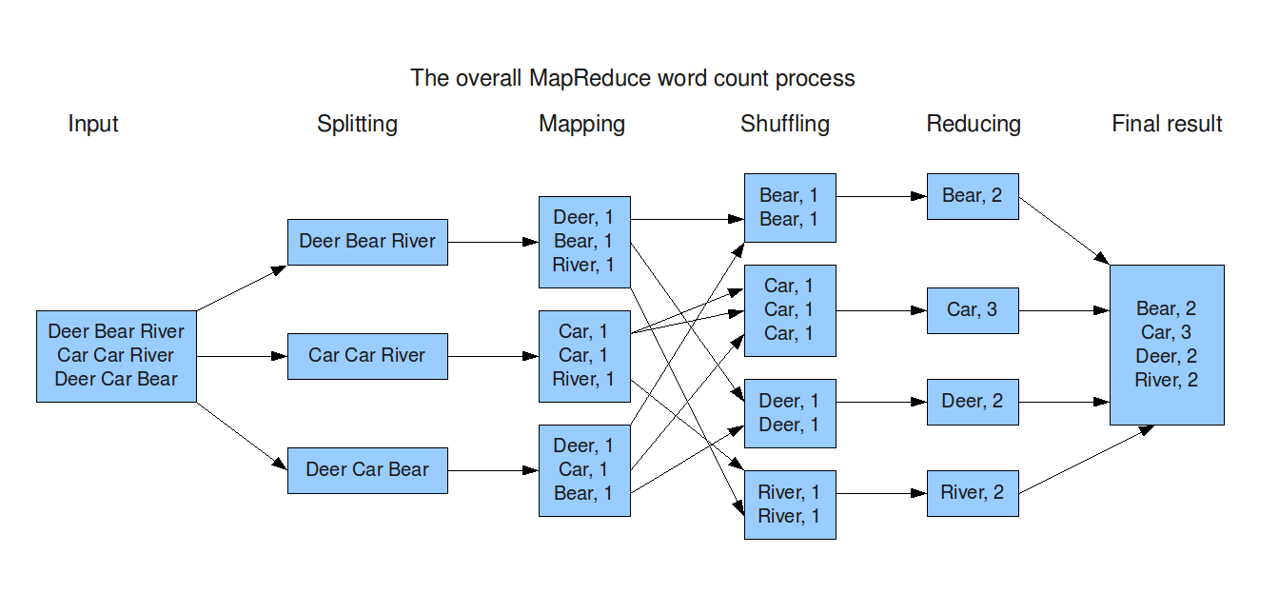
Word Count Dataflow

Slide 27
Word Count Mapper
public static class Map extends MapReduceBase implements Mapper<LongWritable,Text,Text,IntWritable> {
private static final IntWritable one = new IntWritable(1);
private Text word = new Text();
public static void map(LongWritable key, Text value, OutputCollector<Text,IntWritable> output, Reporter reporter) throws IOException {
String line = value.toString();
StringTokenizer = new StringTokenizer(line);
while(tokenizer.hasNext()) {
word.set(tokenizer.nextToken());
output.collect(word,one);
}
}
}

Slide 28
Word Count Reducer
public static class Reduce extends MapReduceBase implements Reducer<Text,IntWritable,Text,IntWritable> {
public static void map(Text key, Iterator<IntWritable> values, OutputCollector<Text,IntWritable> output, Reporter reporter) throws IOException {
int sum = 0;
while(values.hasNext()) {
sum += values.next().get();
}
output.collect(key, new IntWritable(sum));
}
}

Slide 29
Word Count Example
Jobs are controlled by configuring JobConfs
JobConfs are maps from attribute names to string values
The framework defines attributes to control how the job is executed
  conf.set(“mapred.job.name”, “MyApp”);
Applications can add arbitrary values to the JobConf
  conf.set(“my.string”, “foo”);
  conf.set(“my.integer”, 12);
JobConf is available to all tasks

Slide 30
Hadoop Installation
Single Node (Pseudo Distributed Mode)

Slide 31
Steps to Follow
Prerequisite
  Ubuntu 14.04 / 15.04 LTS 64-Bit Machines
Login as root/sudo user
Linux > sudo apt-get update
Download the JDK1.8 tar.gz file from the following URL http://www.oracle.com/technetwork/java/javase/downloads/jdk8-downloads-2133151.html
Untar the file using the following command,
Linux > tar xfz jdk-8u45-linux-x64.tar.gz
Move the java to /usr/local/java
Linux > mv jdk1.8.0_45 /usr/local/java

Slide 32
-Contd,
Set the Path and ClassPath Variables in ~/.bashrc
Linux > gedit ~/.bashrc
Add the following line in the editor, save the file and exit.
export JAVA_HOME=/usr/local/java
export PATH=$JAVA_HOME/bin:{$PATH}
export CLASSPATH=$JAVA_HOME/lib
Linux> source ~/.bashrc or . ~/.bashrc
Verify JAVA is Installed or not using this Command
Linux> java -version
make sure that you can see the JAVA version that you have installed.

Slide 33
-Contd, Installing Secure Shell
Linux> sudo apt-get install ssh
Linux> sudo apt-get install rsync
Best Practice,
  Create a new user hadoop or hduser for running hadoop
  Create and Setup SSH Certificates (Setup passphraseless ssh)
  To enable password-less login, generate a new SSH key with an empty passphrase:
  Use Hadoop User(hduser/hadoop):
Linux>ssh-keygen -t dsa -P '' -f ~/.ssh/id_dsa
Linux>cat ~/.ssh/id_dsa.pub >> ~/.ssh/authorized_keys
Verify SSH,
  Linux > ssh localhost
  Make sure that you are able to connect localhost without the password.

Slide 34
Now, You are Ready to Install Hadoop ☺
Fetcth Hadoop (Stable Version)
  Linux > wget http://apache.tradebit.com/pub/hadoop/common/current/hadoop-2.6.0.tar.gz
  Extract File,
  Linux> tar xfz hadoop-2.6.0.tar.gz
  Move the hadoop to local dir,
  Linux> mv hadoop-2.6.0 /usr/local/hadoop
Add the JAVA_HOME to hadoop-env.sh file
  Linux> gedit /usr/local/hadoop/etc/hadoop/hadoop-env.sh
  Locate java_home and set
  JAVA_HOME=/usr/local/java
  Now, save and Exit the file.

Slide 35
-Contd,
Add the following lines to ~/.bashrc
  Linux> gedit ~/.bashrc
    #HADOOP VARIABLES START
export HADOOP_INSTALL=/usr/local/hadoop
export PATH=$PATH:$HADOOP_INSTALL/bin
export PATH=$PATH:$HADOOP_INSTALL/sbin
export HADOOP_MAPRED_HOME=$HADOOP_INSTALL
export HADOOP_COMMON_HOME=$HADOOP_INSTALL
export HADOOP_HDFS_HOME=$HADOOP_INSTALL
export YARN_HOME=$HADOOP_INSTALL
export HADOOP_COMMON_LIB_NATIVE_DIR=$HADOOP_INSTALL/lib/native
export HADOOP_OPTS=“-Djava.library.path=$HADOOP_INSTALL/lib”
export HADOOP_CLASSPATH=$JAVA_HOME/lib/tools.jar
#HADOOP VARIABLES END
Now, save the file and Exit.
Linux> . ~/.bashrc

Slide 36
-Contd,
Add the following <property> tag to core-site.xml
Linux> gedit /usr/local/hadoop/etc/hadoop/core-site.xml
  <property>
  <name>fs.default.name</name>
  <value>hdfs://localhost:9000</value>
  </property>
  Now, save the file and Exit.
Add the following <property> tags to yarn-site.xml
  Linux> gedit /usr/local/hadoop/etc/hadoop/yarn-site.xml
<property>
<name>yarn.nodemanager.aux-services</name>
<value>mapreduce_shuffle</value>
</property>
<property>
<name>yarn.nodemanager.aux-services.mapreduce.shuffle.class</name>
<value>org.apache.hadoop.mapred.ShuffleHandler</value>
</property>
  Now, save the file and Exit.

Slide 37
-Contd,
Add the following <property> tag to core-site.xml
Copy the MapRed-site.xml.template file to MapRed-site.xml
Linux>cp /usr/local/hadoop/etc/hadoop/mapred-site.xml.template /usr/local/hadoop/etc/hadoop/mapred-site.xml
Linux> gedit /usr/local/hadoop/etc/hadoop/mapred-site.xml
  <property>
  <name>mapreduce.framework.name</name>
  <value>yarn</value>
  </property> Now, save the file and Exit.
Add the following <property> tags to hdfs-site.xml
Create Namenode and Datanode directories
Linux> mkdir -p /usr/local/hadoop_store/hdfs
Linux> gedit /usr/local/hadoop/etc/hadoop/hdfs-site.xml
  <property>
  <name>dfs.replication</name>
  <value>1</value>
  </property>
  <property>
  <name>dfs.namenode.name.dir</name>
  <value>file:/usr/local/hadoop_store/hdfs/namenode</value>
  </property>
  <property>
  <name>dfs.datanode.data.dir</name>
  <value>file:/usr/local/hadoop_store/hdfs/datanode</value>
  </property> Now, save the file and Exit.

Slide 38
Cheers, two more steps to go.
Replace sasz: with your hadoop users(hduser/hadoop) to be the owner of the folder
Linux> sudo chown sasz:sasz -R /usr/local/hadoop
Linux> sudo chown sasz:sasz -R /usr/local/hadoop_store
also give the folder the full permission
Linux> sudo chmod -R 777 /usr/local/hadoop
Linux> sudo chmod -R 777 /usr/local/hadoop_store
Format your HDFS, make sure you have logged in as hadoop/hduser user.
Linux> hdfs namenode -format
Start/Stop the Hadoop Cluster.
Linux> start-all.sh or stop-all.sh

Slide 39
Congratulations!!, You have successfully done installation of Hadoop
Access the User Inerfaces
ResourceManager @- http://localhost:8088/
NameNode @- http://localhost:50070/

Slide 40
Thank You!

