Slide 1
Histogram Processing
P.Mirunalini

Slide 2
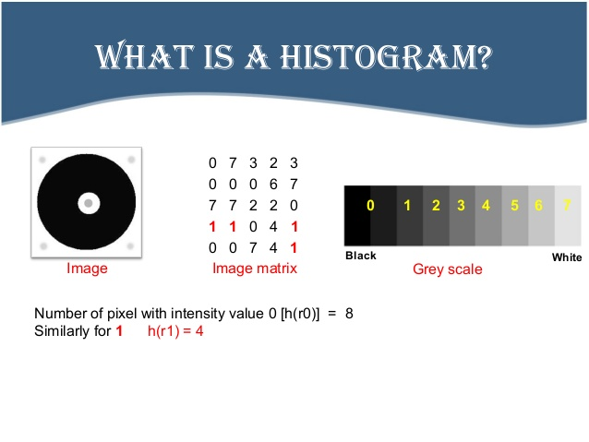

Slide 3
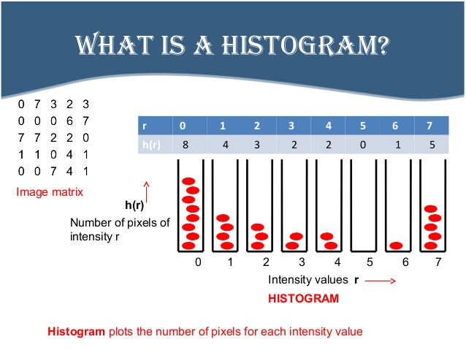
Morphological operations

Slide 4
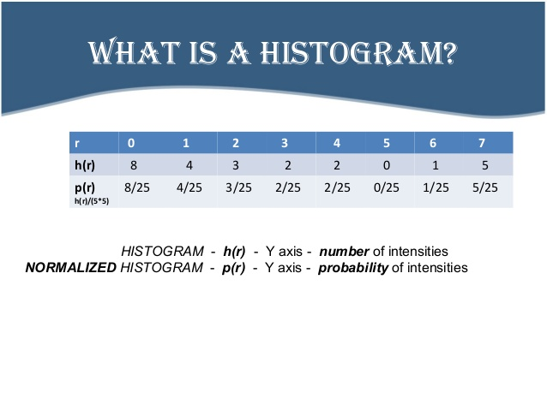

Slide 5
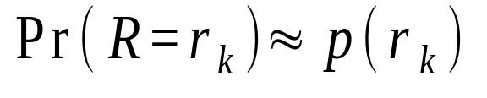
HISTOGRAM
Histogram: of a digital image with gray levels 0 to L-1 is a discrete function of h(r_{k}) = n_{k}
        r_{k}– k th gray level
        n_{k} – number of pixels having gray levels r_{k}
Normalized histogram p(r_{k}) = n_{k}/n n – total number of pixels in the image
Normalized histogram gives an estimate of probability of occurrence of each gray level.
Sum of all the components in an normalized histogram is 1.
Useful in compression, segmentation
• If we consider the gray values in the image as realizations of a random variable R, with some probability density, histogram provides an approximation to this probability density. In other words,

Slide 6
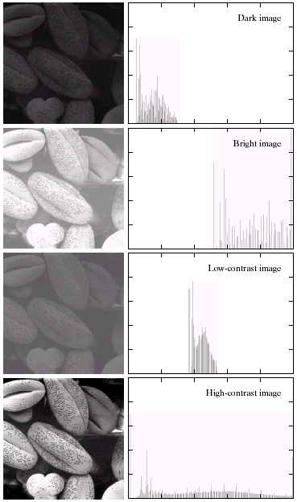
HISTOGRAM
Horizontal axis- gray level values rk
Vertical axis- h(rk) = nk or
p(rk) = nk/n
Dark image-> components of the histogram on the lowside of gray level
Bright image-> high side
Low contrast-> centered towards middle
High contrast-> board range of gray scale
Image whose pixels tends to be distrubuted uniformly will have apperance of high contrast.
Possible to develop a transformation function to achieve uniform distribution of pixels

Slide 7
HISTOGRAM Processing
To achieve the contrast enhancement two different histogram processing can be done:
Histogram Equalization
Histogram Matching

Slide 8
Histogram Equalization
The goal of histogram equalization to obtain uniform histogram for the output image
The histogram equalization is an approach to enhance a given image.
The approach is to design a transformation T(.) such that the gray values in the output is uniformly distributed in [0, 1].
Let us assume for the moment that the input image to be enhanced has continuous gray values, with r = 0 representing black and r = 1 representing white.
We need to design a gray value transformation s = T(r), based on the histogram of the input image, which will enhance the image.

Slide 9
Histogram Equalization
Assuming the pixel values are continuous functions
  p(s) ds = p(r) dr
That is probability density of the transformed variable ‘s’ is determined by the gray level distribution of the input image and by the chosen transformation function
  s = T(r)
T should satisfies the following conditions
  T(r) is single valued and monotonically increasing where r is in the range [0,1]
  T(r) also varies in the range [0,1]

Slide 10
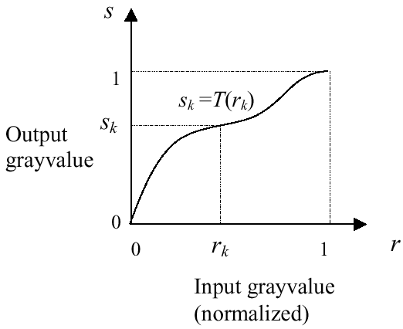
HISTOGRAM EQUALIZATION
Continuous case
The first requirement is to ensure that inverse transformation exist and monotonicity ensures the order of increasing intensities (black to white)
The second requirement is to ensure that resulting gray levels are in the same range as input levels (onto)
The inverse transformation from s back to r is denoted by r = T ⁻¹ (s)

Slide 11
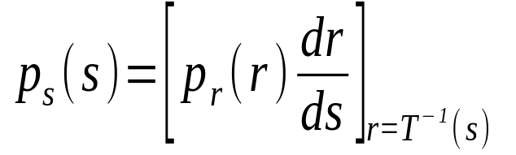
HISTOGRAM EQUALIZATION
Continuous case
The gray levels in an image can be viewed as random variables in the interval [0, 1] and their pdf calculated
If p_{r} and p_{s} are two different probability distributions on r and s (of input and transformed image) respectively,
Then the probability theory says if p_{r} (r) and T(r) is known then PDF p_{s}(s) of the transformed image at gray level s obtained using
So the pdf of s depends on pdf of r and the transformation function.

Slide 12
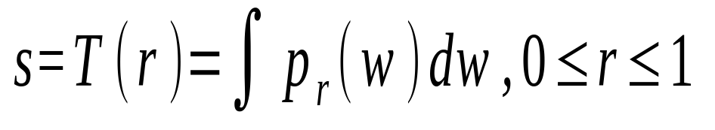
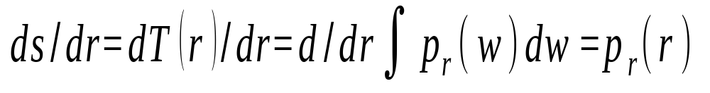
HISTOGRAM EQUALIZATION
Continuous case
W is dummy variable. This T(r) is single valued and
monotonically increasing also the integration of a pdf
is a pdf in the same range. So both constraints are statisfied.
•Consider the CDF to be the transformation

Slide 13
HISTOGRAM EQUALIZATION
Continuous case
Substiuting the value of ds/dr we get
p_{s}(s)=p_{r}(r) |dr/ds|
p_{r}(r)|1/p_{r}(r)|=1
p_{s}(s) is a pdf that is 0 outside the interval [0,1] and 1 in the interval [0,1] :- a uniform density.
• Thus, using a transformation function equal to the CDF of input gray values r, we can obtain an image with uniform gray values.
• In discrete case r takes discrete values r_{k} , k=0,1...L-1 and probability of occurrence of a gray level r_{k}in an image is approximated by: p_{r}(r_{k}) = n_{k}/n where k = 0,1...L - 1

Slide 14
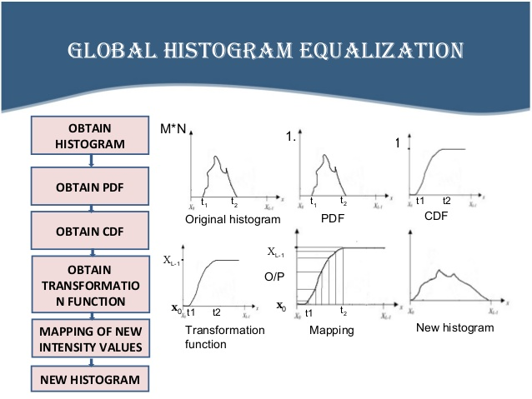

Slide 15
Histogram equalization
Steps involved:
Find the number of pixels in each gray level and total number of pixels
Find the probability mass function of all the pixels in the image
Find the cumulative distribution function
Multiply the cumulative distribution function by L-1, L being
the maximum gray level, to obtain new gray levels
Map the new gray level values to the pixels with old gray levels.

Slide 16
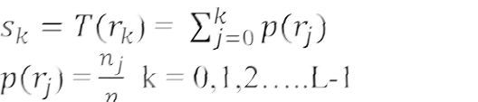
Histogram equalization
Mapping each pixel with level r_{k} in the input image into
the corresponding pixel with level s_{k} in the output image
Gray level values | Number of pixels | Probability mass function | Cumulative distribution function
0 | 790 | 0.19 | 0.19
1 | 1023 | 0.25 | 0.44
2 | 850 | 0.21 | 0.65
3 | 656 | 0.16 | 0.81
4 | 329 | 0.08 | 0.89
5 | 245 | 0.06 | 0.95
6 | 122 | 0.03 | 0.98
7 | 81 | 0.02 | 1.00
Gray level values | Number of pixels |  | Cumulative distribution function
0 | 790 | 0.19 | 0.19
1 | 1023 | 0.25 | 0.44
2 | 850 | 0.21 | 0.65
3 | 656 | 0.16 | 0.81
4 | 329 | 0.08 | 0.89
5 | 245 | 0.06 | 0.95
6 | 122 | 0.03 | 0.98
7 | 81 | 0.02 | 1.00

Slide 17
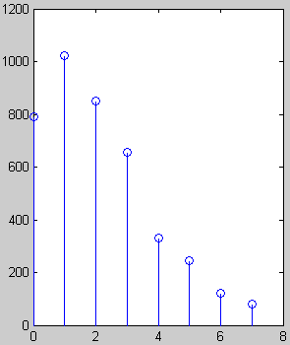
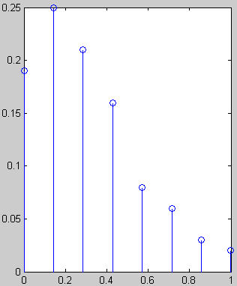
# pixels
Fraction of # pixels
Gray value
Normalized gray value

Slide 18
Histogram equalization
Gray level values | Number of pixels | Probability mass function | Cumulative distribution function | CDF * L-1
0 | 790 | 0.19 | 0.19 | 1.33 = 1
1 | 1023 | 0.25 | 0.44 | 3.08 = 3
2 | 850 | 0.21 | 0.65 | 4.55 = 5
3 | 656 | 0.16 | 0.81 | 5.67 = 6
4 | 329 | 0.08 | 0.89 | 6.23 = 6
5 | 245 | 0.06 | 0.95 | 6.65 = 7
6 | 122 | 0.03 | 0.98 | 6.86 = 7
7 | 81 | 0.02 | 1.00 | 7 = 7

Slide 19
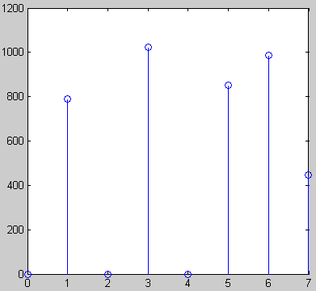
Histogram of output image
# pixels
Gray values
• Note that the histogram of output image is only approximately, and not exactly, uniform. This should not be surprising, since there is no result that claims uniformity in the discrete case.

Slide 20
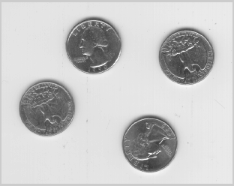
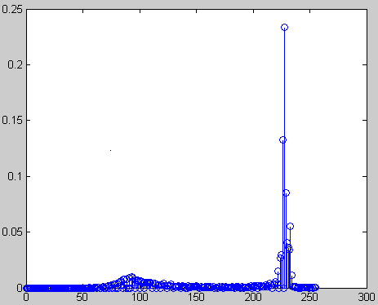
• Histogram equalization may not always produce desirable results, particularly if the given histogram is very narrow. It can produce false edges and regions. It can also increase image “graininess” and “patchiness.”

Slide 21
HISTOGRAM MATCHING
(Specification)
Histogram equalization yields an image whose pixels are
uniformly distributed among all graylevels.
Sometimes, this may not be desirable. Instead, we may want a transformation that yields an output image with a prespecified histogram. This technique is called histogram specification .

Slide 22
HISTOGRAM MATCHING
(Specification)
• Given Information
(1) Input image from which we can compute its histogram .
(2) Desired histotram.
• Goal
Derive a point operation, H(r), that maps the input image into an output image that has the user-specified histogram.
• Again, we will assume, for the moment, continuous-gray values.

Slide 23
HISTOGRAM MATCHING
(Specification)
Approach of derivation
z=H(r)
= G⁻¹(v=s=T(r))
Input image
Uniform image
Output image
s=T(r)
v=G(z)

Slide 24
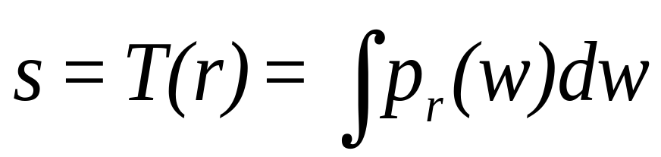
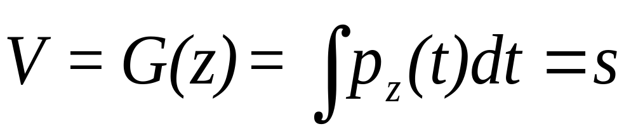
HISTOGRAM MATCHING
(Specification)
• Suppose, the input image has probability density in p(r) . We want to find a transformation z = H (r) , such that the probability density of the new image obtained by this transformation is p_{out}(z) , which is not necessarily uniform.
• First apply the transformation
(*)
This gives an image with a uniform probability density.
• If the desired output image were available, then the following
transformation would generate an image with uniform density:
(**)

Slide 25
HISTOGRAM MATCHING
(Specification)
• From the gray values ν we can obtain the gray values z by
using the inverse transformation, z = G⁻¹(s)=G⁻¹[ v=s =T(r)]
Steps:
Obtain the transformation function T(r) using (*)
Obtain the transformation function G(z) using (**)
Obtain the inverse transformation function G⁻¹
Obtain the output image by applying G⁻¹ to all pixels in the input image
The result of this procedure will be an image whose gray levels z have the specified probability density function p_{z}(z)

Slide 26
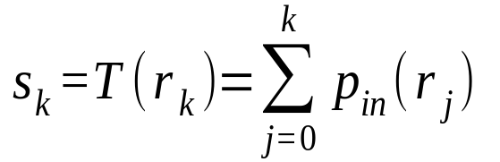

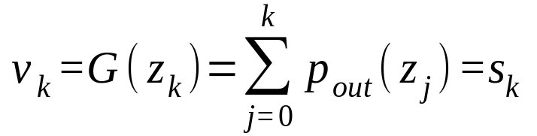
• For discrete gray levels, we have
z _{k} = G⁻¹[T(r_{k})]
• In practice, this is not usually the case (i.e., ) z_{k} → G(z_{k}) is not one-to-one) and we assign gray values to match the given histogram, as closely as possible.

Slide 27
HISTOGRAM MATCHING
(Specification)
Obtain the transformation function T(r) of input image
Obtain the transformation function G(z) of the output
Obtain the inverse transformation G⁻¹
Apply the output by applying G⁻¹ [T(r)] to all pixels in the input image
The result of the procedure will be an image whose gray levels z, have PDF p_{z}(z)

Slide 28
For discrete gray levels, we have
• If the transformation z_{k}  G(z_{k}) is one-to-one, the inverse transformation s_{k}  G⁻¹ (s_{k}) , can be easily determined, since we are dealing with a small set of discrete gray values.
• In practice, this is not usually the case (i.e., ) z_{k} → G(z_{k}) is not one-to-one) and we assign gray values to match the given histogram, as closely as possible.

Slide 29
Example
Histogram matching
Gray level values | Number of pixels | Probability mass function | Cumulative distribution function
0 | 790 | 0.19 | 0.19
1 | 1023 | 0.25 | 0.44
2 | 850 | 0.21 | 0.65
3 | 656 | 0.16 | 0.81
4 | 329 | 0.08 | 0.89
5 | 245 | 0.06 | 0.95
6 | 122 | 0.03 | 0.98
7 | 81 | 0.02 | 1.00
Gray level values | Probability mass function | Cumulative distribution function
0 | 0 | 0
1 | 0 | 0
2 | 0 | 0
3 | 0.15 | 0.15
4 | 0.2 | 0.35
5 | 0.3 | 0.65
6 | 0.2 | 0.85
7 | 0.15 | 1.0

Slide 30
Example
Histogram matching
Input gray level | Cumulative distribution function | Cumulative distribution function | Output gray level
0 | 0.19 | 0.0 | 3
1 | 0.44 | 0.0 | 4
2 | 0.65 | 0.0 | 5
3 | 0.81 | 0.15 | 6
4 | 0.89 | 0.35 | 6
5 | 0.95 | 0.65 | 7
6 | 0.98 | 0.85 | 7
7 | 1.0 | 1.0 | 7
i | 0 | 1 | 2 | 3 | 4 | 5 | 6 | 7
j | 3 | 4 | 5 | 6 | 6 | 7 | 7 | 7

