Slide 1
Module 1: Exploring Components of Generative AI Applications on AWS
Developing Generative AI Applications on AWS
Notes:
|Instructor notes
|• Course level: Advanced
|• Duration: 2 day
|Designed for 60 minutes, no lab.
|Student notes

Slide 2
Agenda
Topic A: Understanding generative AI concepts
Topic B: Identifying AWS generative AI stack components
Topic C: Designing generative AI application components
Notes:
|Student notes

Slide 3
Topic A: Understanding generative AI concepts
Notes:
|Student notes
This section provides a review of generative AI concepts that serves as a foundation for the subsequent topics in this module.

Slide 4
Generative AI is a branch of machine learning
Artificial intelligence (AI)
Machine learning (ML)
Deep learning (DL)
Generative AI
Notes:
|Instructor notes
|Do not teach the topics listed. This should be a reminder that AI is a broader field, and generative AI is a type of ML that can generate content. Refer students to the notes for additional details.
|
|Student notes
To successfully evaluate business problems and categorize them as generative AI problems, you must understand the difference between generative AI and traditional machine learning (ML).
Artificial intelligence is an umbrella term for the different strategies and techniques used to make machines more human-like. AI in action appears to simulate human intelligence—it can recognize images, write poems, and make data-based predictions. It includes everything from self-driving cars to robotic vacuum cleaners and smart assistants like Alexa. Although machine learning and deep learning fall under the AI umbrella, not all AI activities are machine learning and deep learning.
Machine learning: Machine learning is one among many other branches of artificial intelligence. It is the science of developing algorithms and statistical models to correlate data. Computer systems use machine learning algorithms to process large quantities of historical data and identify data patterns. Machine learning refers to a set of statistical techniques called machine learning models that you can use independently or to support other more complex AI techniques.
Deep learning: Deep learning takes machine learning one step further. Deep learning models use neural networks that work together to learn and process information. For example, they process individual pixels in an image to classify that image. Modern AI systems often combine multiple deep neural networks to perform complex tasks like writing poems or creating images from text prompts.
Generative AI: Generative AI is a subset of deep learning. Deep learning uses the concept of neurons and synapses similar to how our brain is wired. Generative AI is powered by large language models (LLMs) that are pre-trained on internet-scale data. These models are called foundation models (FMs). With FMs, instead of gathering labeled data for each model and training multiple models, you can adapt the same FM to perform multiple tasks.
For a description of the relationships between AI, ML, DL, and Generative AI, see What is Artificial Intelligence (AI)? at https://aws.amazon.com/what-is/artificial-intelligence.
For more information about generative AI use cases and benefits, see the following resources:
Generative AI on AWS at https://aws.amazon.com/ai/generative-ai
What is Generative AI? at https://aws.amazon.com/what-is/generative-ai

Slide 5





Generative AI uses foundation models
Foundation models (FMs)
Are pre-trained on a broad spectrum of generalized and unlabeled data
Perform a variety of tasks including understanding, transforming, and generating content
Support the following modalities:
  Text
  Images
  Code
  Audio
  Videos
Pre-training
Foundation model
(FM)
Multimodal training data
Notes:
|Student notes
Foundation models are ML models trained on a broad spectrum of generalized and unlabeled data. They perform a wide variety of general tasks, including understanding, transforming, and generating content.
FMs are the result of the latest advancements in technology that have been evolving for decades. In general, an FM uses learned patterns and relationships to predict the next item in a sequence. For example, with image generation, the model analyzes the image and creates a sharper, more clearly defined version of the image. Similarly, with text, the model predicts the next word in a string of text based on the previous words and their context. It then selects the next word using probability distribution techniques.
Generative AI works across multiple content types, or modalities, such as text, images, audio, video, structured data, and software code. For text, it produces human-like writing. For images, it creates and edits visuals. For audio, it generates speech, music, and sound effects. For video, it generates content from text prompts or starting images. For structured data, it manages database operations. For coding, it assists with writing, reviewing, debugging, and optimizing software.
Each of these content types is considered a modality of data. Some generative AI tasks are single modal, such as text summarization, whereas others are multimodal, such as image understanding, because those tasks work with more than one content type or modality.
For more information, see the following resources:
What is Generative AI? at https://aws.amazon.com/what-is/generative-ai
What are Foundation Models? at https://aws.amazon.com/what-is/foundation-models

Slide 6

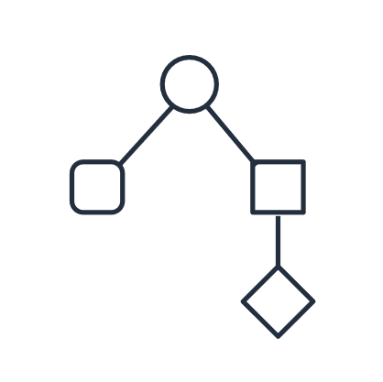

Pre-training a foundation model
Large amount of unlabeled data
Training algorithm
Foundation model
Notes:
|Student notes
You learned that FMs are created by taking large amounts of unlabeled data, training a model with that data, and then using that model for a wide range of tasks. Pre-training is the creation of an FM by training a model with terabytes of unlabeled text or multimodal data (such as images, audio, or video). This unlabeled data used for pre-training is usually obtained by crawling the internet and it contains information from publicly crawled sources and available proprietary data. Collecting unlabeled data at scale is easier to obtain compared to labeled data. The latter requires a human task force to create laborious annotations, such as explicitly adding the tag “dog” to an image that contains one.
A large model with billions of parameters can store richer, deeper context across large amounts of data compared to a smaller model trained on a smaller dataset. Pre-training models of this size require access to the following:
Sufficient quantity and quality of training data (collection and processing of relevant datasets, including removal of duplicates)
Large-scale training infrastructure
During the pre-training process, the model automatically takes context into account from unlabeled training data. The model then tracks the relationships in sequential data, such as the position and the context of the words so that it can predict the next word in a sentence.
Foundation models can be classified according to their size, the types of data on which they are trained, and the tasks of which they are capable. For example, some types of foundation models are as follows:
Small language models (SLMs)
Large language models (LLMs)
Diffusion models
Speech models

Slide 7


How a foundation model completes a sentence
A puppy is to dog as kitten is to…
Tokenization and encoding
Word embedding
Decoding
Prompt
Response
Cat
Notes:
|Instructor notes
| - https://proceedings.neurips.cc/paper_files/paper/2017/file/3f5ee243547dee91fbd053c1c4a845aa-Paper.pdf is the Attention is all you need paper that introduced the transformer architecture. Avoid diving into architecture discussions because this is not particularly relevant for this course. For students interested in more of the model architecture discussion, direct them to the information about transformer architecture included in the AWS AI resources. The link is in the student notes. The main reason for introducing this topic is to provide a basis for understanding the use of embeddings in generative AI application architectures such as Retrieval Augmented Generation.
|Student notes
How does a foundation model complete a sentence?
The specific process might differ depending on the model architecture, but the transformer architecture process illustrates the key common elements of tokenization and embedding.
The process of how a foundation model, using a transformer architecture, completes a sentence consists of the following four main steps:
Tokenization and encoding: The model breaks down the input sentence into individual tokens, which are words or subwords, and converts these tokens into numerical representations that the model can understand. As an example scenario, the sentence “A puppy is to dog as kitten is to…” might be broken up into the following tokens: “A” “puppy” “is” “to” “dog” “as” “kitten” “is” “to.” The individual tokens start the process of helping the model understand the input.
Word embedding: The model maps each token to a dense vector representation, known as a word embedding, which captures the semantic and syntactic information of the token. Words with similar meaning are located closer to each other in this vector space. Think of it as coordinates on a map. The coordinates for Cat and Feline are likely closer to each other than the coordinates for Dog and Kitten. With this information, the model can start to understand context from the input sequence.
Decoding: The transformer model processes the embedded tokens through multiple layers of self-attention and feed-forward neural networks to generate contextual representations of the input sequence. The model then uses these representations to predict the next token in the sequence. In this scenario, the decoder would be able to understand that puppy is related to dog when considering which word kitten is associated with. For example, consider the following hypothetical weights for each of the following words: cat: 9.2, bird: 5.5, bear: 4.7, human: 3.7. Cat has the highest score; therefore, the most likely output would be cat. (The numbers that appear next to the prediction answers are for illustrative purposes only.)
Outputs: The model generates the most probable next token based on the input sequence and the learned patterns from the training data. The model repeats this process until the entire sentence is completed or it meets a stop condition.
Transformer architecture
The transformer architecture is a type of neural network that is efficient, easy to scale and parallelize, and can model interdependence between input and output data.
Large transformer models can provide for the following use cases:
Natural language processing (NLP)
Machine translation
DNA sequence analysis
Protein structure analysis
The following are benefits of transformers:
Memory efficient and can be trained in parallel on GPUs: Compared to its predecessors, such as recursive neural nets, transformers are more parallelizable (sped up through processing increases). Transformers do not process words sequentially one at a time. Instead, they process the entire input all at once during the learning cycle. As a result, transformers require significantly less time to train, and one can apply more computing power to speed up training. This can lead to a model that scales well with large pieces of data.
Retain and use information about meaning and position: Transformer models also take advantage of positional information. If you are inputting a sentence, the model captures the importance of each word and the relationships between the words. Humans do this by understanding what verbs and nouns are and how adjectives relate to nouns. The model follows a similar process but encoded in mathematics.
Pay attention to multiple things at once, in different ways: Models use position encoders to prevent ambiguous meanings when a word is used in other parts of a sentence. For example, the sentences "I went to the bank to withdraw money" and "The boat anchored by the bank" have two different meanings. Although both statements include a bank, in context each bank means something different because of their position. Position encoding allows the transformer model to differentiate the semantic differences between these sentences.
For more information about transformer models and transformer architectures, see What are Transformers in Artificial Intelligence? at https://aws.amazon.com/what-is/transformers-in-artificial-intelligence.

Slide 8



Inference and context
Context is a private exchange between the application and the model. Context has the following characteristics:
Covers a request-response exchange
Does not persist. Initial information the model is using can be lost.
Has an upper limit on the number of tokens
Prompt
Response
Notes:
|Student notes
Inference is the process of invoking a foundation model with a prompt as input and getting a response as output. The model performs the tokenization and encoding, word embedding, and decoding on the input, which results in a response as output. The application or application component that invokes the foundation model is sometimes referred to as the client or the user.
One important concept is context. Context is a one-on-one session with the model.
Context has limits: it doesn't automatically persist between interactions and there is a maximum amount of information (tokens) that can be included. When you want to maintain context across interactions, you must deliberately reinclude relevant information in each new prompt. This reuse of information—whether chat history, document content, or data from retrieval systems—counts toward your token limits each time it's included, which can impact both performance and cost. Note: Caching mechanisms might offset some of those effects. The details of these considerations are beyond the scope of this module.

Slide 9
Context example
Prompt 1
Hi, what's the best place in Seattle to visit?
The Columbia Center offers breathtaking views of the city skyline […].
Response
Model uses context of conversation.
Prompt 2
Will this be fun for children?
No. There are much better places for children in Seattle.
Response
Notes:
|Student notes
The following conversation is with a generative AI model that is asked a question about Seattle.
The first input asks what is the best place in Seattle to visit, and the AI responds with the Columbia Center as its response. In the second interaction, the prompt uses the word this. The model must figure out what this refers to in the context of the current conversation.
Disclaimer: Hypothetical recommendations are included here for instructional purposes only and are not an endorsement of specific locations or events.

Slide 10
Foundation model functionality
Pre-training
Inference
Foundation models are created through training.
Foundation models are used to transform inputs (prompts) to outputs (responses).
2
Inference
1
Prompt
Application
Pre-training
Foundation
model
Broad range of
general tasks
Unlabeled data
Response
Notes:
|Student notes
A foundation model is a pre-built ML model trained on a large amount of data. The result is a model that can be adapted to a wide range of downstream tasks. The term foundation model was coined by researchers to describe ML models with the following characteristics:
Trained on a broad spectrum of generalized and unlabeled data.
Capable of performing a wide variety of general tasks such as understanding language, generating text and images, and conversing in natural language.
Foundation models have broad applicability and adaptability not only because of the massive training datasets, but also the billions or trillions of parameters that result from their training. For more information, see What are Foundation Models? at https://aws.amazon.com/what-is/foundation-models.
A unique feature of foundation models is their adaptability. These models can perform a wide range of disparate tasks with a high degree of accuracy based on input prompts. Some tasks include natural language processing, question answering, and image classification. The size and general-purpose nature of FMs make them different from traditional ML models, which typically perform specific tasks, like analyzing text for sentiment, classifying images, and forecasting trends.
You can use foundation models as base models for developing more specialized downstream applications. These models are the culmination of more than a decade of work that saw them increase in size and complexity.
The process of using a foundation model is called inference. The key components of inference using a foundation model include the foundation model itself (created previously through pre-training), the request-response process, and the inputs and outputs. The inference request provides inputs such as parameters and a prompt, which can include instructions, questions, and relevant examples or documents. The foundation model then processes this input and returns an inference response to the generative AI application. This response, sometimes called an answer, can vary depending on the task. For question-answering tasks, the response typically includes the answer. However, for other tasks like text summarization or image classification, the nature and size of the response can differ significantly. Most foundation models are versatile and can be used for a broad range of general tasks, adapting their output based on the specific requirements of each task.

Slide 11


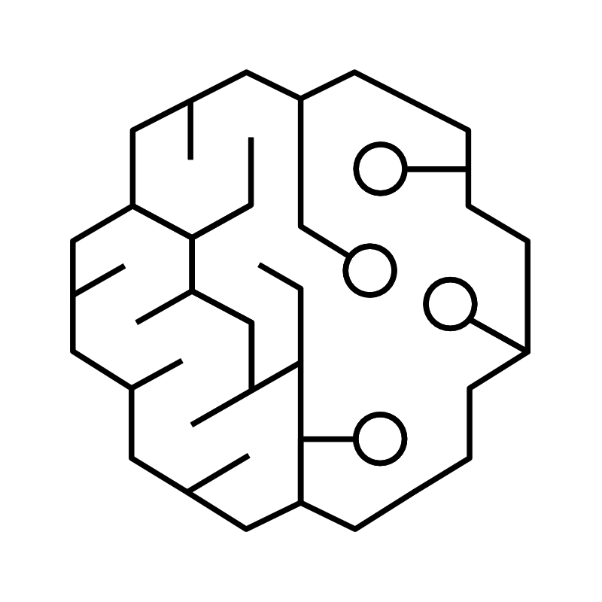





Applications of understanding models
Example types of tasks:
Text generation
Text summarization
Information extraction
AI assistant
Question answering
Code generation
Image analysis
Video analysis
Multimodal inputs (prompts)
Text outputs (responses)
Notes:
|Student notes
Some foundation models are classified as understanding models, which can perform a wide range of tasks such as the following:
Text generation: Creating coherent, contextually appropriate text for various purposes
Text summarization: Condensing long documents into concise summaries
Information extraction: Identifying and extracting specific data points from unstructured text
AI assistants: Powering conversational AI systems for customer service and interactions
Question answering: Providing accurate responses based on available information
Code generation: Automatically generating code for various programming languages and tasks based on natural language descriptions or specifications

Slide 12




Applications of creative content generation models
Example types of tasks:
Image generation
Image editing
Video generation
Video composition
Speech recognition*
Speech synthesis
Multimodal inputs (prompts)
Multimodal outputs (responses)
Notes:
|Student notes
Creative content generation models can perform a wide range of tasks such as the following:
Image generation: Creating new images based on text or images provided as inputs. Diffusion Models are a type of FM for Images/Video
Image editing: Editing images using text inputs, and adjusting color scheme and layout
Video generation and editing: Creating high-quality video based on text and images provided as input Adjusting visual style and pacing, including camera motion, rotation, and zooming
Speech recognition: * Recognizing natural language speech could be considered a task of an understanding model when the result is text, however speech recognition could be classified as a creative content generation task when the output is either speech or annotation/augmented speech. Thus, sometimes a model could be classified as an understanding model, another model could be classified as a creative content generation model, however in some cases the distinction of understanding or creative content generation may be a property of the task
Speech synthesis: Creating natural language speech

Slide 13




Generative AI can add value across the business
Customer experience
Employee productivity
Creativity and content
Business operations
Notes:
|Instructor notes
| Don’t go into detail about use cases here. The intent is to highlight that generative AI can add value in lots of different types of applications.
|Student notes
Generative AI creates business impact across four main areas: customer experience, employee productivity, creativity and content, and business operations. You can apply these capabilities for chat, virtual assistants, search, image processing, and document processing to enhance efficiency, streamline processes, reduce costs, and unlock new revenue streams.
You can apply generative AI across all lines of business, including engineering, marketing, customer service, finance, and sales. You can also apply it to many use cases, from text summarization to image generation.
The following are common areas where generative AI adds business value:
Improve customer experience: You can use generative AI as chatbots, virtual assistants, intelligent contact centers, personalization, and content moderation.
Boost employee productivity: You can boost your employees’ productivity with generative AI-powered conversational search, content creation, text summarization, and code generation. Amazon QuickSight uses the power of generative AI to generate, customize, and share reports using natural language prompts, thereby increasing business user productivity.
Increase creativity: Use generative AI to accelerate production of creative content, from art and music to text, images, animations, and video.
Improve business operations: Use generative AI to improve business operations with intelligent document processing, maintenance assistants, quality control and visual inspection, and generating synthetic training data.
For more information about generative AI use cases, see Generative AI use cases at https://aws.amazon.com/ai/generative-ai/use-cases.

Slide 14
Topic B: Identifying AWS generative AI stack components
Notes:
|Student notes
This section provides an overview of how AWS helps with generative AI projects and demonstrates how to get started with Amazon Bedrock.

Slide 15









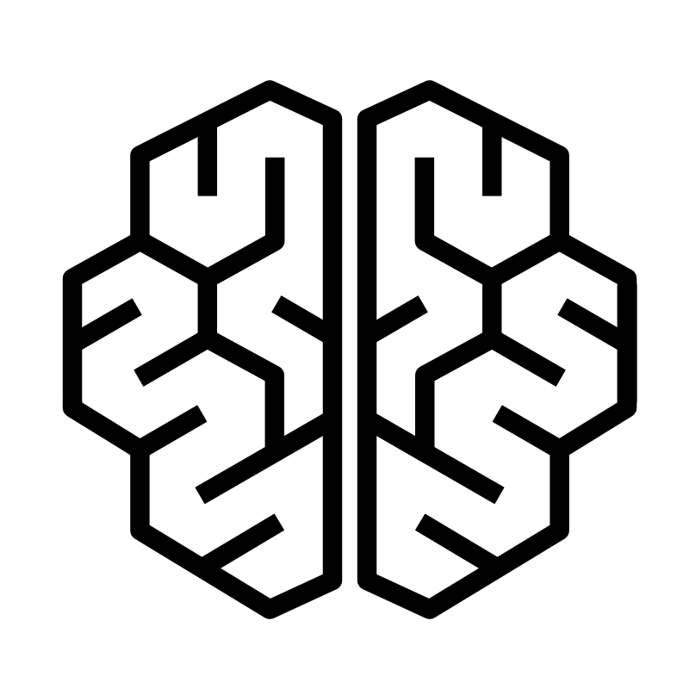

AWS AI services for common use cases
Search
Virtual voice agents
Recommendations
Fraud detection
Amazon Kendra
Amazon Lex V2
Amazon Personalize
Amazon Fraud Detector
Development
Contact centers
Multimodal processing
Text processing
Amazon CodeGuru
Amazon Q Developer
Amazon Connect
Contact Lens
Amazon Rekognition
Amazon Polly
Amazon Transcribe
Amazon Textract
Amazon Translate
Amazon Comprehend
Notes:
|Instructor notes
|Highlight other AWS AI services that are purpose-built. Do not attempt to describe each of these services. Highlight one or two as examples and direct the students to the webpage to learn more. The point is to consider each use case and decide if generative AI is the right fit and if there is a tool that would provide what you need with lesser cost and complexity.
|
|Student notes
Amazon offers a comprehensive suite of AI services designed to handle different types of data, such as vision, speech, and text. Each category addresses specific use cases while maintaining integration capabilities with other AWS services. This helps you to use them as tools for building AI based applications.
These pre-built solutions help you enhance customer experiences, improve operational efficiency, and create new AI-powered applications without the need to build custom ML models from scratch. By using these services, you can quickly implement AI capabilities tailored to specific business use cases, accelerating innovation and digital transformation efforts.
For more information, see AI Services at https://aws.amazon.com/ai/services.

Slide 16





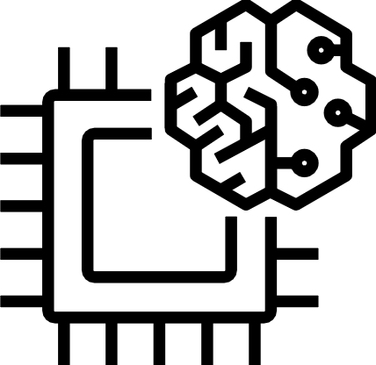

Generative AI services and components on AWS
APPLICATIONS TO BOOST PRODUCTIVITY
Amazon Q Business
Insights and automation
Amazon Q Developer
Software development lifecycle
Kiro
Agentic IDE
MODELS AND TOOLS TO BUILD GENERATIVE AI Applications
Amazon Bedrock
Amazon models | Partner models | Customization
Guardrails | Agents | Knowledge Bases | Studio
Amazon Bedrock AgentCore
Deployment and operation of AI agents at scale
INFRASTRUCTURE TO BUILD AND TRAIN AI MODELS
Amazon SageMaker AI
Managed infrastructure | Amazon SageMaker JumpStart | Amazon SageMaker Unified Studio
AWS Trainium
AWS Inferentia
GPUs
High performance compute
Notes:
|Instructor notes
|Use this slide to touch on services that the course does not focus on without going deep. Do not cover details of any of the services while on this slide. For Amazon SageMaker AI, be sure to mention its uses for full lifecycle ML in addition to SageMaker Jumpstart for foundation models and the Unified Studio which brings together the functionality and tools from existing AWS Analytics and AI/ML services including Amazon Bedrock. Encourage students to use the links provided to go deeper on any of these topics but avoid starting to teach any of the services here.
|Note: As of this writing in August 2025, Kiro is still in preview.
|
|Student notes
Use services across the generative AI stack to meet different generative AI needs and use cases.
Generative AI applications to boost productivity
The top layer includes Amazon Q and Kiro. Amazon Q is a generative AI assistant that includes the following services:
Amazon Q Business helps roles including business intelligence analysts, contact center employees, and supply chain analysts to get insights into their data and accelerate their tasks using generative AI.
Amazon Q Developer is a generative AI assistant that helps software developers, and anyone building with AWS, to ask questions and generate code.
Kiro is an agentic IDE that helps you deliver from concept to production through a streamlined developer experience for working with AI agents. The strength of Kiro comes from getting prototypes into production systems with features such as specs and hooks. Kiro specs are artifacts that prove useful anytime you need to think through a feature in-depth, refactor work that needs upfront planning, or when you want to understand the behavior of systems. Kiro hooks act like an experienced developer catching things you miss or completing boilerplate tasks in the background as you work.
Models and tools to build generative AI applications
The middle layer provides foundation models as a service through Amazon Bedrock. Amazon Bedrock provides access to LLMs and other FMs. This service is the focus of this course. This layer also includes Amazon Bedrock AgentCore. Bedrock AgentCore provides a set of enterprise-grade services that help developers quickly and securely deploy and operate AI agents at scale with any framework and model.
Infrastructure to build and train AI models
This layer includes Amazon SageMaker AI, an ML service designed to streamline the entire ML lifecycle. Amazon SageMaker JumpStart is an ML hub for evaluating, comparing, and selecting pre-trained FMs. Amazon SageMaker AI also includes Amazon SageMaker Unified Studio, a single data and AI development environment that brings together the functionality and tools from existing AWS analytics and AI/ML services, including Amazon Bedrock. For a complete list of SageMaker AI features and services, see the SageMaker AI documentation at https://docs.aws.amazon.com/sagemaker/latest/dg/whatis.html.
The infrastructure layer also includes compute with AWS Trainium, AWS Inferentia, and graphics processing units (GPUs), which provide specialized hardware and instances optimized for ML workloads.
To learn more about these generative AI components, see Welcome to a New Era of Building in the Cloud with Generative AI on AWS at https://aws.amazon.com/blogs/machine-learning/welcome-to-a-new-era-of-building-in-the-cloud-with-generative-ai-on-aws.

Slide 17


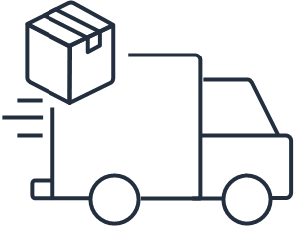
Key benefits of Amazon Bedrock
Efficiently build
with API-based access to hundreds of FMs
Securely build
generative AI
applications
Deliver customized experiences using your organization’s data
Notes:
|Instructor notes
|Consider demonstrating Amazon Bedrock Model Access and Model Catalog or ask the group what providers they are using or interested in and show them in the catalog or the playground.
|Student notes
Amazon Bedrock makes hundreds of foundation models available through an API. Amazon Bedrock offers a variety of foundation models from Amazon and leading AI companies like AI21 Labs, Anthropic, and Stability AI. This allows you to choose the best model for your specific use case. With Amazon Bedrock, you can efficiently build with FMs, securely build generative AI applications, and deliver customized experiences using your organization’s data. For information on the latest list of supported providers and model versions, see the Amazon Bedrock User Guide at https://docs.aws.amazon.com/bedrock/latest/userguide/models-regions.html.
The following are some key reasons to consider using Amazon Bedrock:
Easy integration: With a single API, you can integrate these AI models into your applications without having to manage the underlying infrastructure.
Customization: Amazon Bedrock helps you to fine-tune models with your own data, creating custom models tailored to your specific needs.
Privacy and security: Your data and customizations remain private and secure within your AWS account. Amazon Bedrock also supports AWS security, identity, and compliance features.
Cost-effective: Pay only for what you use, without upfront costs or commitments.
Scalability: Amazon Bedrock can automatically scale to meet your application's demands.
Continuous updates: Access the latest model versions and capabilities as they become available.
Integration with AWS services: Integrate with other AWS services for a comprehensive AI/ML workflow.
Reduced complexity: Amazon Bedrock eliminates the need to build and manage your own infrastructure for running large language models.
Experimentation: You can experiment with different models to find the best fit for your use case.
Compliance: It helps you meet regulatory requirements with built-in governance and control features.

Slide 18


Build with comprehensive data protection and privacy
Secure your generative AI applications
Access support for governance and auditability
Notes:
|Student notes
There are many benefits of using the secure and comprehensive AI/ML services available from AWS. AWS offers a broad portfolio of secure AI/ML services, all built on the secure AWS Global Infrastructure. This provides a solid foundation for building and deploying generative AI applications with confidence.
Secure your generative AI applications: Implement robust security measures such as model watermarking, content filtering, and monitoring to mitigate risks associated with generative AI models. This helps prevent misuse and maintain trust.
Access support for governance and auditability: Use AWS services for AI governance, including model tracking, explainability, and bias detection. This provides responsible AI development and deployment while meeting compliance requirements.

Slide 19

Demonstration: Amazon Bedrock
Setting up Amazon Bedrock access and using playgrounds
In this demonstration, your instructor will show you the following things:
Amazon Bedrock model catalog
Amazon Bedrock model access
Amazon Bedrock playgrounds
Notes:
|Instructor notes
|Use the console to show the students the following items – keep the demo limited to 10 minutes.
|Show the chat playgrounds – show how to compare models.
|Compare Amazon Titan Text G1 Express with Anthropic Claude 3 Sonnet.
|Ask the models to recommend the top 5 pizza restaurants in Seattle.
|Ask which pizza place is closest to downtown.
|Give it a format to follow – ask to list the top 5 pizza places, give a rank number, restaurant stars, the number of positive reviews, and a brief description.
|Go to the text playground – use Nova Lite.
|Ask the question what AWS services can be used for compute – provide an output indicator to list in a bullet list format.
|Go to image playground – use Amazon Titan Image Generator G1.
|Ask it to create a skyline of New York at night – generate one image.
|Explain prompt strength, the seed.
|Student notes
This demonstration shows how to set up access to Amazon Bedrock and use its playgrounds feature.

Slide 20
Topic C: Designing generative AI application components
Notes:
|Student notes
This section explains the core and optional components of a generative AI application, so you can design applications that incorporate these components to use the art of the possible with generative AI.

Slide 21
Planning a generative AI project
Step 1: Define the scope
Step 2: Select data and model
Step 3: Adapt the model
Step 4: Use the model
Understand customer needs
Consider organization capabilities
Identify and curate enterprise data
Select a pre-trained model
Apply prompt engineering
Use augmentation
Customize a model
Employ agents
Consider responsible AI concerns
Track performance and changes
Notes:
|Instructor notes
|Consider asking the attendees for example customer needs and capabilities in their organization and use that as an activity of not more than 5 minutes of workshopping their ideas. Alternatively, present this slide in the context of the use cases identified earlier in this topic.
|Student notes
There are four key steps involved in planning a generative AI project. By following these steps, you can effectively plan and operate a generative AI project, making sure that it aligns with your goals, uses the right data and model architecture, and produces high-quality, reliable outputs. The steps are as follows:
Define the scope. This step helps to ensure that the AI project is focused, relevant, and achievable. Understand customer needs and consider organization capabilities. Assess the long-term and short-term impacts that each solution provides. What are the trade-offs of having faster development cycles for your developers? What about implementation time of the solutions?
Select a model. The choice between using a pre-trained model as is or fine-tuning a model for customization is primarily a trade-off between ease of use and flexibility. By using a pre-trained model as is, you have a quick solution for integrating generative AI capabilities. It is suitable for general tasks. It is a good choice when the need for customization is minimal, and speed is important. For more customized output, it offers the flexibility to tailor the model to your specific needs. It is suitable for specialized tasks. You can use it to choose from a wider range of open source models. The downsides include greater computational resources, expertise, and time required.
Adapt the model. There are two ways you can customize the type of output you are getting from your models. How you choose to customize your output will largely be impacted by your previous decision of model selection. If you choose the simple solution to use the pre-trained model with a large dataset, you will most likely be using prompt engineering. A particularly useful prompt engineering technique for incorporating enterprise data is RAG. Your application can also use conversational history, possibly including persistent storage of such history on an organizational, team, or per-user basis. If you decide to customize a model, you will start the process of continued pre-training, fine-tuning, or distillation of either an FM or an open source model on your use-case specific data. These types of solutions could incur large costs if the models are large and need a policy for maintaining data quality. Another adaptation technique is to use agents, tools, and other resources.
Use the model. Now it's time to ask yourself the following questions when using your new solution. Have you managed all the responsible AI concerns? Do you have a plan for feedback from users? How are you going to track performance of your FM over time? How are you tracking changes to the pre-trained model so you can retrain your fine-tuned model?

Slide 22


FM is at the core of generative AI applications
Core application components
Application frontend
Application logic
FM interface
Foundation model
Notes:
|Student notes
In this section, you learn about the basic application components as shown on this slide, additional components, and the additional governance and security features available to generative AI components.
An FM is the core of building a generative AI application. The core components include a frontend web application or mobile app, application logic that uses an FM interface, and the FM itself. FMs are developed and hosted in an ML environment, including model training.
To use an FM, you need an interface that provides access to it. The interface is generally an API that is managed, or it can be self-hosted using an open source or proprietary model. Self-hosting often involves procuring access to an ML environment that is supported by purpose-built accelerated computing instances to host the model. Using the API call, you can pass prompts to the FM and receive inference responses back. Such FM interfaces also allow passing inference parameters to the FM, such as a temperature or seed.
You can use Amazon Bedrock as the FM interface. As a fully managed service, Amazon Bedrock offers a choice of high-performing foundation models through a single API, along with a broad set of capabilities you need to build generative AI applications with security, privacy, and responsible AI.
Governance and security are integrated into all components.

Slide 23






Integrating enterprise data and complex workflows
Core application components
Optional application components
Enterprise datasets
Application frontend
Embedding models
Vector stores
Application logic
FM interface
Memory
Foundation model
Agents
Governance and security integrated in all components
Notes:
|Instructor notes
|Keep it light. This is like a table of contents for what the course will cover. Don’t go into depth on each of the elements. The notes go a bit deeper to provide reference for the students and to work in conjunction with the previous planning slide to help them think about the types of tradeoffs required in choosing project components and planning the project. The talk track is “Here are the pieces we’re going to spend the next two days talking about in this course: Enterprise datasets that allow you to use the value in your data, embeddings models and vector stores that facilitate more relevant outputs, and memory and agents for more complex workflows. And as with any cloud-based application, there must be a security and governance layer integrated across all components.”
|Student notes
Beyond the core components of a generative AI application, you could optionally add additional components to integrate enterprise datasets into your applications. Three additional components of a generative AI application are as follows:
Enterprise datasets: Enterprises accumulate huge volumes of internal data that the foundation model has never encountered. Ingesting and using enterprise data sources provides the foundation model with domain-specific knowledge to generate tailored, highly relevant outputs that align with the needs of the enterprise. To power customized enterprise applications, the FMs need relevant data from enterprise datasets. In addition to pre-training, enterprise data can also be used for domain adaptation or fine-tuning.
Text or image embeddings: You can supply enterprise data to the FMs as context along with the prompt, which will help the model to return more accurate outputs. How do you figure out the context to pass? For that, you need a way to search the enterprise datasets using the prompt text that is passed. This is where vector embeddings help. Embedding is the process by which text, images, and audio are given numerical representation in a vector space. Embedding is usually performed by a machine learning model. Enterprise datasets, such as documents, images, and audio, are passed to ML models as tokens and are vectorized. These vectors in an n-dimensional space, along with the metadata about them, are stored in purpose-built vector databases for faster retrieval.
Vector stores (databases): The core function of vector databases is to compactly store billions of high-dimensional vectors representing words and entities. Vector databases provide ultra-fast similarity search across these billions of vectors in real time. The most common algorithms used to perform the similarity search are k-nearest neighbors (k-NN) or cosine similarity. After enterprise data is vectorized, you can search the given prompt in a vector database. You can supply the relevant chunks of information as context to improve the output of the generative AI model. This can reduce hallucinations, a phenomenon in which an LLM confidently generates plausible sounding but false information. Vector databases and context are used in RAG.
If your application needs to support complex workflows around the generative AI components, you could also include optional components such as the following:
Memory components: To cache the natural language requests generative AI applications accept as inputs, having a persistent semantic caching layer will improve speed and reduce cost for generative AI workloads. Without a memory component, an LLM chat application would treat each input as an isolated query, losing the benefits of context and continuity that make conversations feel natural and productive. The memory component bridges the gap between the model's vast knowledge and the specific context of each unique conversation. A prompt history store is another essential component in a generative AI application, particularly applications used for conversational AI, such as chatbots. A prompt history store helps with contextually aware conversations that are both relevant and coherent. Many foundation models have a limited context window, which means you can only pass so much data as input to them. Storing state information in a multiple-turn conversation becomes difficult, which is why a prompt history store is needed. It can persist the state and make it possible to have long-term memory of the conversation. By storing the history of prompts and responses, you can look up prompts from a previous conversation and avoid repetitive requests to the FM. For requests, this helps your audit and compliance teams adhere to company policy and regulations. You can also debug prompt requests and responses to diagnose errors and warnings from your applications.
Agents: Agents use the power of LLMs to prompt and respond using natural language. Agents break down tasks, then orchestrate and complete tasks by dynamically invoking APIs.
Governance and security are of paramount importance when building generative AI applications. They are vital to every step and component of a generative AI application. Governance and security must be in place to make sure that you mitigate risks, maintain oversight, ensure accountability, and earn trust with your customers.
Consider the following points when building generative AI applications:
Manage and audit who can access each part of the generative AI application, such the FMs, API methods, and so on.
Monitor, log, and report on access to the underlying FM either directly or through customized approaches.
Log requests to and responses from the FM to stay compliant with regulations and to ensure explainability of your actions.
Periodically audit FMs with test data and simulate prompt injection attacks to ensure that there are no unintended consequences.
Document the complete process of the various facets of the application and keep them up to date.

Slide 24
Basic generative AI application architecture
User
Application
frontend
Amazon Bedrock
Foundation
model
Notes:
|Student notes
A simple application architecture could consist of an application frontend that invokes Amazon Bedrock APIs directly. As depicted, a user sends a request to the application front end. The application frontend invokes Amazon Bedrock using the API. Amazon Bedrock interacts with the foundation model to provide the prompt and capture the response, then return the results to the application frontend.
The application frontend that invokes Amazon Bedrock APIs could be implemented and deployed in a variety of ways, including (but not limited to) the following:
Mobile application
Web browser-based application
Amazon Elastic Compute Cloud (Amazon EC2) application component
AWS Fargate container application component
AWS Lambda function application component
On-premises devices or computers

Slide 25



Example serverless application architecture
User
Application
frontend
Amazon API Gateway
AWS Lambda
Amazon Bedrock
Amazon Simple Storage Service
(Amazon S3)
Foundation
model
Notes:
|Student notes
Alternatively, you could implement application components that invoke Amazon Bedrock APIs directly and design in additional architecture that frontends those. The depicted architecture includes a user interacting with the application frontend. The application frontend is connected to Amazon S3 and is also connected to Amazon API Gateway. Amazon API Gateway is connected to AWS Lambda. AWS Lambda is connected to Amazon Bedrock and Amazon Bedrock is connected to the foundation model. Arrows flow both ways from all components.
For this example, consider a serverless function hosted in Lambda that invokes a foundation model through an Amazon Bedrock API. You could deploy an Amazon API Gateway configured to use such Lambda functions as backends. Furthermore, you could have the application frontend hosted in mobile or web applications, potentially using an Amazon CloudFront distribution. The origin of the CloudFront distribution could be an Amazon Simple Storage Service (Amazon S3) bucket with static web content and the JavaScript files for the web application frontend. This is a common serverless application architecture that many AWS customers use. You can use more elaborate application architectures to meet your needs in which a foundation model (or models) accessed through Amazon Bedrock are only one component (or a few components) of your architecture.

Slide 26


Conversational interfaces
4
User
Application
frontend
Amazon API Gateway
AWS Lambda
Amazon Bedrock
What is a good place for pizza in this city?
The user is in Seattle.
Try Serios Pie
1
2
3
Memory
(Conversation context)
Foundation
model
Amazon S3
Notes:
|Student notes
You can use conversational interfaces, such as chatbots and virtual assistants, to enhance the user experience for customers. Chatbots use NLP and ML algorithms to understand and respond to user queries. You can use chatbots in a variety of applications, such as customer service, sales, and ecommerce, to provide quick and efficient responses to users. You can access chatbots through various channels, such as websites, social media platforms, and messaging apps.
This architecture includes the following steps:
The user queries the chatbot using the application frontend. For example, “What is a good place for pizza in this city?” The frontend passes the request to Amazon API Gateway which sends it to an AWS Lambda function.
The Lambda function consults the chat history (if there is any) from long-term memory. This can include information such as the user’s location or a prior conversation. The memory provides “The user is in Seattle.” The application component that queried that chat history (Lambda, in this example) passes this context along with the query to Amazon Bedrock so that the FM considers that context along with the question.
The model then generates the response, “Try Serious Pie.”
The model passes the response back to the user. In this example architecture, the model returns the response to Amazon Bedrock, which relays it back to the Lambda function, which relays the response back through API Gateway to the application frontend that presents the response to the user.
Distinguishing chat history as a separate application component from the foundation model is critical to designing effective application architectures when you need to include these types of memory or conversational behaviors.
Disclaimer: Hypothetical recommendations are included here for instructional purposes only and are not an endorsement of specific locations or events.

Slide 27
Knowledge check

Slide 28
Question 1
What is the main step after tokenization and encoding when a foundation model (FM) is processing text?
Choice
Response
A
Categorization
B
Embedding
C
Decoupling
D
Correlation
Notes:
|Instructor notes
| The intent of this question is to see if the students remember the key elements of tokenization and embedding as illustrated using a transformer architecture process. Embedding is particularly important for memory and RAG components.
| If the input is a sentence, the tokens are words. Embedding then transforms the token sequence into a mathematical vector sequence. The vectors carry semantic and syntax information, represented as numbers, and their attributes are learned during the training process.
|
|Student notes

Slide 29
Question 1 answer
What is the main step after tokenization and encoding when a foundation model (FM) is processing text?
Choice
Response
A
Categorization
B
Correct
Embedding
C
Decoupling
D
Correlation
Notes:
|Student notes
A. Incorrect. Categorization is a classification task common in multiclass classification with machine learning.
B. Correct. Embedding transforms the token sequence into a mathematical vector sequence. The vectors carry semantic and syntax information, represented as numbers, and their attributes are learned during the training process.
C. Incorrect. Decoupling is the technique of reducing the dependencies between application components, which can help to enable horizontal scaling.
D. Incorrect. Correlation is the strength between parameters during machine learning model training.

Slide 30
Question 2
In which layer of the AWS generative AI stack is Amazon Bedrock categorized?
Choice
Response
A
Applications to boost productivity
B
Models and tools to build generative AI applications
C
Infrastructure to build and train AI models
D
High-performance compute
Notes:
|Instructor notes
|
|Student notes

Slide 31
Question 2 answer
In which layer of the AWS generative AI stack is Amazon Bedrock categorized?
Choice
Response
A
Applications to boost productivity
B
Correct
Models and tools to build generative AI applications
C
Infrastructure to build and train AI models
D
High-performance compute
Notes:
|Student notes
A. Incorrect. Examples of applications that boost productivity are Amazon Q products, such as Amazon Q Developer.
B. Correct. Amazon Bedrock is a fully managed service that offers a choice of high-performing foundation models (FMs) from leading AI companies through a single API, along with a broad set of capabilities that you need to build generative AI applications with security, privacy, and responsible AI. Using Amazon Bedrock, you can experiment with and evaluate top FMs for your use case, privately customize them with your data using techniques such as fine-tuning and Retrieval Augmented Generation (RAG), and build agents that execute tasks using your enterprise systems and data sources.
C. Incorrect. An example of a service that is categorized in the layer of infrastructure to build and train AI models is Amazon SageMaker AI.
D. Incorrect. High-performance compute is a part of the layer of infrastructure to build and train AI models.

Slide 32
Question 3
Which optional application component could be used to make sure that the foundation model (FM) being used can appropriately handle pronouns such as this, that, and it in a conversational application?
Choice
Response
A
Enterprise datasets
B
Vector stores
C
Memory
D
Agents

Slide 33
Question 3 answer
Which optional application component could be used to make sure that the foundation model (FM) being used can appropriately handle pronouns such as this, that, and it in a conversational application?
Choice
Response
A
Enterprise datasets
B
Vector stores
C
Correct
Memory
D
Agents
Notes:
|Student notes
A. Incorrect. Enterprise datasets can be used to customize models using continued pre-training, fine-tuning, or distillation. They can also be used to hydrate vector stores to be used as knowledge bases for Retrieval Augmented Generation (RAG).
B. Incorrect. Vector stores are used in Retrieval Augmented Generation (RAG) techniques and would not have the proper context to retrieve conversational history.
C. Correct. Memory components can be used to make sure that applications can send prior conversational responses back to the foundation model in the prompts of subsequent interchanges.
D. Incorrect. Agents can be used to offload work from your core application components.

Slide 34

Module summary
You should now be able to do the following:
  Explain the core concepts and principles of generative AI.
  Identify the core components of an AWS generative AI technology stack.
  Design basic generative AI application architectures.
Notes:
|Instructor notes
|
|Student notes

Slide 35
Questions?
Notes:
|Instructor notes
|
|Student notes

