Slide 1
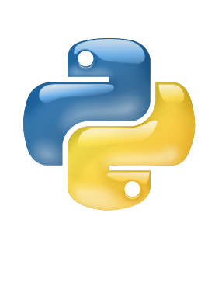
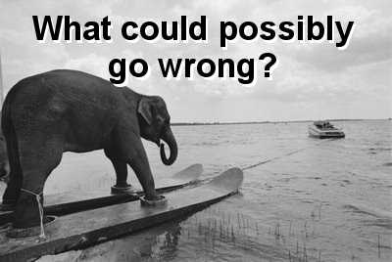

Postgresql and Python
… plus sqlalchemy, alembic, flask, py-test, and friends

Slide 2
What is PostgreSqL?
Open Source Database
Uses unique MVCC Architecture (Multi-Version Concurrency Control)
Great SQL compliance, but didn’t start with SQL
https://www.postgresql.org/about/

Slide 3
What is Postgresql?
Maximum DB Size: Unlimited
Maximum Table Size: 32 TB
Maximum Row Size: 1.6 TB
Maximum Field Size: 1 GB
Maximum Rows Per Table: Unlimited
Maximum Columns Per Table: 250-1600 depending on types
Maximum Indexes Per Table: Unlimited

Slide 4
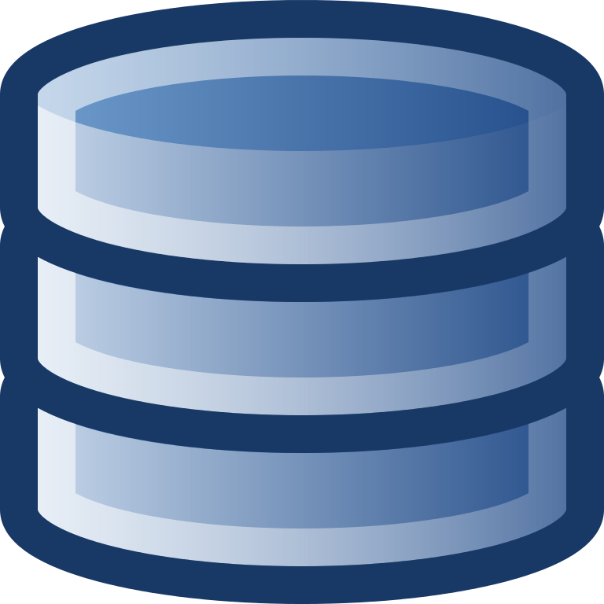
Database

Slide 5

Database

Slide 6

Database

Slide 7

It’s in the Computer Database

Slide 8

DATABASE ACTIONS (CRUD)
CREATE
READ
UPDATE
DELETE

Slide 9
Types of Databases
“SQL” a.k.a Relational Database
NoSQL (Not only SQL - No SQL!)
key-value stores
document stores

Slide 10
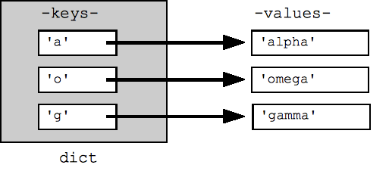
Key-Value Store

Slide 11
Key-Value Store
{
"id": 54,
"company": "Arts Management Systems Ltd.",
"date_entered": "2004-08-14T07:53:34-04:00",
"date_updated": "2010-01-18T09:41:17-05:00",
"deceased": false,
"first_name": "David",
"height": 193.00,
"initial": “M J",
"last_name": "McKeone",
"nick_name": "Dave",
"title": "Presenter Extraordinaire",
"weight": 95.00,
"gender": "Male",
"salutation": "Mr."
}
54 =

Slide 12
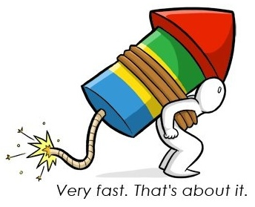
Key-Value Store
Great for caching
https://dogpilecache.readthedocs.io/en/latest/
http://docs.sqlalchemy.org/en/latest/_modules/examples/dogpile_caching/caching_query.html

Slide 13
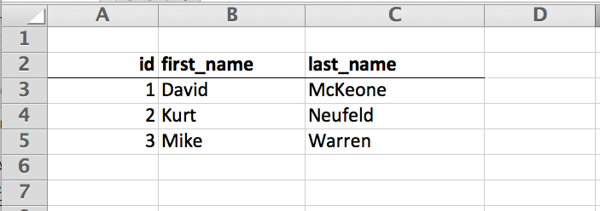
Relational Databases
Table

Slide 14
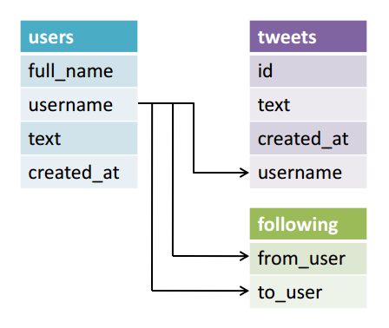
Relational Databases
Relationships

Slide 15
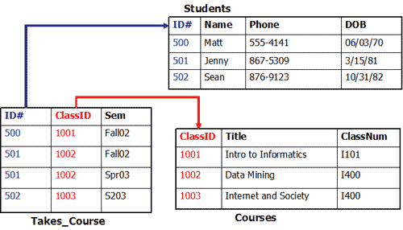
Relational Databases
Relationships - Primary/Foreign Keys

Slide 16
DATABASE ACTIONS (CRUD)
CREATE > INSERT
READ > SELECT
UPDATE > UPDATE
DELETE > DELETE

Slide 17
SQL READ
SELECT *
FROM users
WHERE first_name = ‘Kurt’

Slide 18
CREATE
INSERT INTO users (first_name, last_name)
VALUES (‘David’, ‘McKeone’)

Slide 19
UPDATE
UPDATE users
SET data = {‘awesome’: true}
WHERE first_name = ‘Mike’

Slide 20
DELETE
DELETE FROM users
WHERE first_name = ‘Mike’

Slide 21
Document Database
Table ~= Document
Documents aren’t rows/columns (they are trees)
Relationship enforcement is up to you (good luck!)

Slide 22
How do you track Relationships in NoSQL?
All the answers for how to store many-to-many associations in the "NoSQL way" reduce to the same thing: storing data redundantly.
In NoSQL, you don't design your database based on the relationships between data entities. You design your database based on the queries you will run against it. Use the same criteria you would use to denormalize a relational database: if it's more important for data to have cohesion (think of values in a comma-separated list instead of a normalized table), then do it that way.
But this inevitably optimizes for one type of query (e.g. comments by any user for a given article) at the expense of other types of queries (comments for any article by a given user). If your application has the need for both types of queries to be equally optimized, you should not denormalize. And likewise, you should not use a NoSQL solution if you need to use the data in a relational way.
There is a risk with denormalization and redundancy that redundant sets of data will get out of sync with one another. This is called an anomaly. When you use a normalized relational database, the RDBMS can prevent anomalies. In a denormalized database or in NoSQL, it becomes your responsibility to write application code to prevent anomalies.
One might think that it'd be great for a NoSQL database to do the hard work of preventing anomalies for you. There is a paradigm that can do this -- the relational paradigm.
http://stackoverflow.com/a/4210561/589362

Slide 23
Postgresql - Relational
Good for the vast majority of your data
Will help you with data correctness when you don’t know you need help (but ya, that can be frustrating)
Fast enough that for most applications a single server (maybe with replication) will be good for a long, long time.
Distributed: https://www.citusdata.com/

Slide 24
So, what could possibly go wrong?

Slide 25

Nothing! Turns out, Elephants can move fast!!

Slide 26

It’ll be fine…
… just play with the elephant.

