Slide 1
Hogwarts Example

Slide 2
Translating ER to Relational Model
Main ideas:
Each entity set maps to a new table
Each attribute maps to a new table column
Each relationship set maps to either new table columns or to a new table

Slide 3
Representing Strong Entity Sets
Entity set E with attributes a₁,…a_{n} translates to table E with attributes a₁,…,a_{n}
Entity of type E => row in table E
Primary key of entity set = primary key of table
What about ISA relationships?
Two options
Person ( ID , Name , Pet , Wand )
Student ( ID, yearEnteredSchool )
Teacher ( ID, yearJoined )
Student (ID , Name , Pet , Wand , yearEnteredSchool )
Teacher (ID , Name , Pet , Wand , yearJoined )

Slide 4
Representing Strong Entity Sets (Cont.)
Student ( ID , Name , Pet , Wand , yearEnteredSchool )
Teacher ( ID , Name , Pet , Wand , yearJoined )
Subject ( Name )
House ( Name )

Slide 5
Representing Weak Entity Sets
Weak entity set E translates to table E
Columns of table E should include
Attributes of the weak entity set
Attributes of the identifying relationship set
Primary key attributes of entity set for dominating entities
Primary key of weak entity set = primary key of table
Deed ( ID , Points , Description , Date/Time )

Slide 6
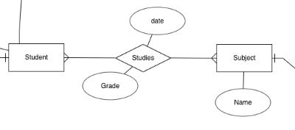
Representing Relationship Sets
N:N Relationship
Create a new relation that contains the ID from both entities
Student ( ID, Name, Pet, Wand, dateEntered)
Subject ( Name )
Studies ( ID, Name, Grade , Date )

Slide 7
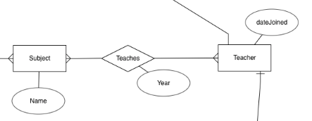
Representing Relationship Sets
N:N Relationship
Create a new relation that contains the ID from both entities
Teacher( ID, Name, Pet, Wand, dateJoined)
Subject ( Name )
TeachingAssignment ( ID, Name, Year )

Slide 8
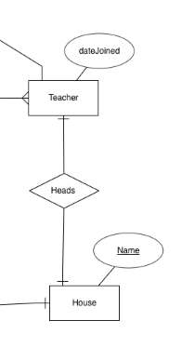
Representing Relationship Sets
1:1 Relationship
To keep it simple and even for better performances at data retrieval, I would personally recommend using attributes to represent such relationship.
Teacher( TID, Name, Pet, Wand, dateJoined)
House ( Name , TID )
Or
Teacher( TID, Name, Pet, Wand, dateJoined, HouseName)
House ( Name)

Slide 9
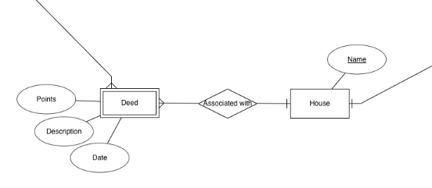
Representing Relationship Sets
1:N Relationship
This is the tricky one !
On the Many side, add a foreign-key from the other relation
Deed ( ID , Points , Description , Date/Time , HouseName)
House ( Name )

