Slide 1
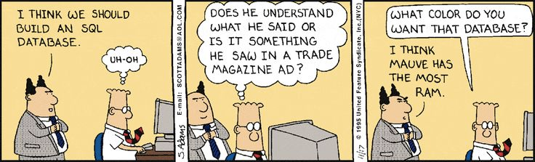
Relational & NoSQL DB

Slide 2
Outline
Why databases?
What is a database anyway?
History of databases
Important DMBS features
NoSQL DB
mongoDB
SQL details

Slide 3
Why Databases?
In the early days, database applications were built on top of file systems.
Drawbacks of using file systems to store data:
Data redundancy and inconsistency
Multiple file formations, duplication of information in different files
Difficulty in accessing data
Need to write a new program to carry out each new task
Data Isolation – multiple files and formats
Integrity problems
Enforcing integrity constraints
Adding / changing existing constraints

Slide 4
Why Databases?
Drawbacks of using file systems (cont.)
Atomicity of updates
Failures may leave database in an inconsistent state with partial updates carried out
Concurrent access by multiple users
Concurrent accessed needed for performance
Uncontrolled concurrent accesses can lead to inconsistencies
i.e. Two people reading a balance and updating it at the same time
Security problems

Slide 5
Students
Name, Year, Major, Enrollment
Mary Jane, 2017 , CS , [CS135 – Web Dev, CS133 - DB, CS181-Big Data]
John Smith , 2018 , Math , [Math105 – Linear Alg, CS135- Web Dev]
Erin Key , 2017 , Econ , [CS181 – Big Data, CS133- DB]
…
What we add/remove courses, or update course information such as name? … we would need to update in all relevant places!!
What if we want to answer the query “How many students are registered for CS 133? ... The programmer has to write specific code to form the query!
What if we want to enforce constraint that each student is registered for at least 1 course? ... Its hard to enforce as students add/drop, and courses are canceled and added continuously.
Database systems offer solutions to all the above problems

Slide 6
What is a database?
Database: a collection of data, typically describing the activities of one or more related organizations.
Database Management System (DBMS): is a software system designed to store, manage, and facilitate access to databases
Reliable storage and recovery of 100s of GB
Querying/Updating interface and API for applications and Web pages
Support for many concurrent users

Slide 7
Timeline of Databases
1960s – hierarchical databases which provided support for concurrency, recover, and fast access.
1970-1972 - Edgar Codd who was working at IBM proposed the ‘relational database model’. Provided support for more reliability, less redundancy, more flexibility, etc.
1970s – two major RDBMS prototypes were proposed: Ingres and System R
Mid 1970s – A DB model called Entity –Relationship(ER) was proposed
1980s – Structured Query Language (SQL) became standard querying language.
Late 1980s - 1990s – Parallel and distributed databases
2000s & Now – NoSQL databases

Slide 8

Relational DBMS to the rescue
[There should be] a clear boundary between the logical and physical aspects of database management.
https://en.wikipedia.org/wiki/Edgar_F._Codd
Edgar F. Codd
Turing award, 1981

Slide 9
Architecture of Databases
View Level
View 1
View 2
…
View n
View Level defines how users or applications interact with the database and how they perceive the data.
Different user views or external schemas are defined, tailored to the specific needs and requirements of individual users or application modules.
Logical Level defines the logical schema, which describes the relationships, entities, attributes, and constraints of the data, regardless of the physical implementation.
Logical Level
Physical Level
Physical Level refers to how data is physically stored, organized, and accessed on the underlying storage devices, such as hard drives or solid-state drives.

Slide 10
Relational DBMS to the rescue
Relational data model: data is stored in relations
Example: Banking Info
A declarative query language
Specify what answer a query should return, but not how the query is executed
Ex. SQL – structured query language
Query : What is Mary’s balance?
Account | Branch | Name | Balance
4500 | Pomona | Mary | 18,300
6831 | Claremont | John | 15,000
9834 | Pasadena | Erin | 11,000
SELECT balance
FROM Banking
WHERE name = “Mary” ;

Slide 11
Key Concepts: Relational Model
Database : collection of relations
Schema (meta data)
Specification of how data is to be structured logically
Contains attribute types
Defined at set-up
Relation: list of attributes
Rows: an instance in the relation with various attributes/columns
Students
sid | name | login | gpa
456 | mary | marys | 3.7
123 | john | johns | 3.5

Slide 12
Structured Query Language (SQL)
SQL was proposed in 1970s by D. Chamberlin and R. Boyce
Data definition language (DDL)
Define the schema (create, change, delete relations)
Specify constraints, user permissions
Ex. CREATE TABLE Students (sid string, name string, …. );
Data modification language (DML)
Find data that matches criteria
Add, remove, update data
The DBMS is responsible for efficient evaluation
Ex. SELECT * FROM Students were name = “Mary”;

Slide 13
ACID Properties
Atomicity – system should ensure that updates of a partially executed transaction are not reflected in the database.
Consistency – system should ensure that any changes to values in an instance are consistent with changes to other values in the same instance.
Isolation – system should ensure that transactions that occur in parallel will have same effect if they were run sequentially.
Durability – system should ensure updates of committed transactions is critical.

Slide 14
ACID (Cont.) - System Failures
Banking example … balance transfer
Decrement account X by $100
Increment account Y by $100
What if power goes out after first instruction?
If first instruction is executed but not the second, then operations are not atomic.
DBMS must keep a log of updates, and upon system failure the DBMS will replay the log checking the status of the records to recover database to a consistent state.

Slide 15
ACID (Cont.) - Parallel Transactions
Transaction 1 – Deposit to account X
Transaction 2 – Add interest to account X
This is an example of lost update…
There are many other scenarios that cause issues when we don’t consider the order of transactions running in parallel.
Transaction 1
Transaction 2
Lookup balance of account X
Lookup balance of account X
Deposit 2 times the balance of account x
Add 3% to balance of account X

Slide 16
Designing a DB using E-R Model
The E-R (entity-relationship) data model views the real world as a set of basic objects (entities) and relationships among these objects.
It is intended primarily for the DB design process by allowing the specification of an enterprise scheme. This represents the overall logical structure of the DB.

Slide 17
Entities and Entity Sets
An entity is an object that exists and is distinguishable from other objects. For instance, Michelle Lee with S.S.N. 890-12-3456 is an entity, as she can be uniquely identified as one particular person in the universe.
An entity may be concrete (a person or a book, for example) or abstract (like a holiday or a disease or a concept).
An entity set is a set of entities of the same type (e.g., all persons having an account at a bank).
Entity sets need not be disjoint. For example, the entity set Student (all students in a university) and the entity set professor (all professors in a university) may have members in common. (i.e a computer science professor might take a class in anthropology).

Slide 18
We can express the overall logical structure of a database graphically with an E-R diagram.
Its components are:
rectangles representing entity sets.
ellipses representing attributes.
diamonds representing relationship sets.
lines linking attributes to entity sets and entity sets to relationship sets.
The “since” attribute in this example is called a descriptive attribute, since it describes the mapping from A to B
S.S.N
Street
since
name
P.I.D
name
City
Students
advised
by
Professor

Slide 19
SQL

Slide 20
Structured Query Language (SQL)
SQL was proposed in 1970s by D. Chamberlin and R. Boyce
Data definition language (DDL)
Define the schema (create, change, delete relations)
Specify constraints, user permissions
Ex. CREATE TABLE Students (sid string, name string, …. );
Data modification language (DML)
Find data that matches criteria
Add, remove, update data
The DBMS is responsible for efficient evaluation
Ex. SELECT * FROM Students were name = “Mary”;

Slide 21
SQL: Creating Relations
Create Students relation:
Create Enrolled relation:
CREATE TABLE Students (
sid CHAR(20),
name CHAR(20),
login CHAR(20),
SSN CHAR(12),
gpa FLOAT
);
CREATE TABLE Enrolled (
sid CHAR(20),
cid CHAR(20),
grade FLOAT
);
Insert a single tuple
Delete tuples that satisfy condition
INSERT INTO Students (sid, name, login, SSN, gpa) VALUES (21, “Mary”, “marys”, “000-00-0000”, 3.4);
DELETE FROM Students S
WHERE S.name = “Mary”;

Slide 22
Integrity Constraints
Students
Enrollment
SID | Name | Login | SSN | GPA
45 | Mary | maryS | 000-000-000 | 3.4
67 | John | johnT | 000-000-000 | 3.5
78 | Erin | erinK | 000-000-000 | 3.7
SID | CID | Grade
45 | Mary | 100
67 | John | 99
78 | Erin | 89
Primary Key
Foreign Key
The Primary Key is a field that uniquely identifies a tuple (a super key is a set of fields)
A Foreign Key is a key in one relation refers to a primary key of another relation.

Slide 23
SQL: Creating Relations
Create Students relation:
Create Enrolled relation:
CREATE TABLE Students (
sid CHAR(20),
name CHAR(20),
login CHAR(20),
SSN CHAR(12),
gpa FLOAT
PRIMARY KEY(sid),
UNIQUE (SSN)
);
CREATE TABLE Enrolled (
sid CHAR(20),
cid CHAR(20),
grade FLOAT,
PRIMARY KEY (sid,cid),
FOREIGN KEY (sid)
);

Slide 24
Basic SQL Query
Remove duplicate tuples
Selecting fields of interest
SELECT [DISTINCT] target-list
FROM relation-list
WHERE qualification
ORDER BY fields(s) DESC
LIMIT num_rows
Set of relations
Discard tuples that fail condition
Order tuples in result
Limit number of tuples in the result
What actually happens when you write a SQL query?? Well, the query is optimized before execution… but we still should try to write efficient queries.

Slide 25
Example
sname
rating
bid
sid
day
sid
age
reserves
Sailors
Reserves
Is reserved
Boats
bid
bname
color

Slide 26
Visualizing Query Evaluation
SELECT sname
FROM Sailors, Reserves
WHERE Sailors.sid = Reserves.sid AND bid=103
Sailors
Boats
Reserves
Sid | name | rating | age
22 | Dustin | 7 | 45
31 | Lubber | 8 | 55.5
95 | Bob | 3 | 63.5
bid | bname | color
101 | SinkRise | blue
102 | SinkRise | red
103 | Clipper | green
104 | Marine | red
sid | bid | day
22 | 101 | 10/10/96
95 | 103 | 11/12/96
Is this bid=103?
Join condition: are these the same sid?

Slide 27
Example Relation Instances
Sailors
Boats
Reserves
Sailors
Boats
Reserves
Sid v | name | rating | age
22 | Dustin | 7 | 45
31 | Lubber | 8 | 55.5
95 | Bob | 3 | 63.5
Sid v | name | rating | age
22 | Dustin | 7 | 45
31 | Lubber | 8 | 55.5
95 | Bob | 3 | 63.5
bid |  | color
101 | SinkRise | blue
102 |  | red
 | Clipper | green
104 | Marine | red
sid | bid | day
22 | 101 | 10/10/96
95 | 103 | 11/12/96
bid | bname | color
101 | SinkRise | blue
102 | SinkRise | red
103 | Clipper | green
104 | Marine | red
sid | bid | day
22 | 101 | 10/10/96
95 | 103 | 11/12/96

Slide 28
Range Variables
We can associate “range variables” with the relations in the FROM clause
Saves writing, makes queries easier to understand
Like an alias
Needed when ambiguity could arise
For example, if the same relation used multiple times in the same FROM clause (called self-join)
SELECT sname
FROM Sailors S, Reserves R
WHERE S.sid = R.sid;
QUERY: Find all the Sailors who have reserved at least 1 boat

Slide 29
Range Variables
Example where range variables are required (self-join example)
SELECT S1.sname, S1.age, S2.name, S2.age
FROM Sailors S1, Sailors S2
WHERE S1.age = S2.age AND S1.rating = S2.rating;
Since we are doing a self-join, we need to use the “Range Variables”

Slide 30
NULL Values
Field values in a tuple are sometimes missing
Unknown (e.g. a rating or grade has not been assigned)
Inapplicable (e.g. no spouse’s name)
SQL provides a special value null for such situations.
The presence of null complicates things
Is “rating > 8” true or false when rating is null?
It is not possible to test for NULL values with comparison operators, such as =, <, or <>.
Proper way: check if a value is not null using IS NULL
SELECT LastName, FirstName, Address
FROM Persons WHERE Address IS NULL
Lastname | FirstName | Address
Smith | Dustin
Hansen | Lubber
Patterson | Bob

Slide 31
Null Values – 3 Valued Logic
We need a 3-valued logic:
Values : True, False, and Unknown
AND | T | F | NULL
T | T | F | Unknown
F | F | F | F
NULL | Unknown | F | Unknown
OR | T | F | NULL
T | T | T | T
F | T | F | Unknown
NULL | T | Unknown | Unknown

Slide 32
Expressions
Can use arithmetic expressions in SELECT clause (plus other calculations we’ll discuss later)
Use AS to provide column names
Can also have expressions in WHERE clause:
SELECT S.sname, S.rating %2 AS evenOddRating
FROM Sailors S
WHERE S.age >= 18;
SELECT S1.sname as name1, S2.sname as name2
FROM Sailors S1, Sailors S2
WHERE 2*S1.rating > S2.rating;

Slide 33
QUERY: Find sids of sailors who have reserved a red or green boat
SELECT DISTINCT R.sid
FROM Boats B, Reserves R
WHERE R.bid = B.bid AND
B.color=‘red’ AND B.color=‘green’;
Is this correct???

Slide 34
QUERY: Find sids of sailors who have reserved a red or green boat
SELECT DISTINCT R.sid
FROM Boats B, Reserves R
WHERE R.bid = B.bid AND
(B.color=‘red’ OR B.color=‘green’);
UNION: allows to compute the union of two union-compatible sets of tuples
SELECT DISTINCT R.sid
FROM Boats B, Reserves R
WHERE R.bid = B.bid AND B.color=‘red’
UNION
SELECT DISTINCT R.sid
FROM Boats B, Reserves R
WHERE R.bid = B.bid AND B.color=‘green’;

Slide 35
QUERY: Find sids of sailors who have reserved a red and a green boat.
INTERSECT:
Can be used to compute the intersection of any two union-compatible sets of tuples
SELECT R.sid
FROM Boats B, Reserves R
WHERE R.bid = B.bid AND B.color=‘red’
INTERSECT
SELECT R.sid
FROM Boats B, Reserves R
WHERE R.bid = B.bid AND B.color=‘green’;
INTERSECT will find the overlapping tuples between the first and second queries.

Slide 36
Nested Queries
Can use SQL queries to aid the evaluation of another SQL query
WHERE clause can itself contain an SQL query~
Actually, so can FROM and HAVING clauses.
SELECT S.sid
FROM Sailors S
WHERE S.rating > (SELECT AVG(rating)
FROM Sailors);
To understand semantics of nested queries, think of a nested loops evaluation: For each Sailors tuple, check the qualification by computing the subquery.

Slide 37
Nested Queries
Subqueries can also be relations with many tuples
QUERY: Find Sailors who have not reserved boat #103
SELECT S.sname
FROM Sailors S
WHERE S.sid NOT IN ( SELECT R.sid
FROM Reserves R
WHERE R.bid = 103
);

Slide 38
Nested Queries with Correlation
QUERY: Find names of sailors who’ve reserved boat #103
EXISTS is another set comparison operator, like IN.
SELECT S.sname
FROM Sailors S
WHERE EXISTS ( SELECT *
FROM Reserves R
WHERE R.bid = 103 AND S.sid=R.sid
);

Slide 39
More on Set-Comparison Operators
We’ve already seen IN, EXISTS and UNIQUE.
Can also use NOT IN, NOT EXISTS and NOT UNIQUE.
Also available: op ANY, op ALL, op IN
QUERY: Find sailors whose rating is greater than that of some sailor called Horatio
SELECT *
FROM Sailors S
WHERE S.rating > ANY (
SELECT S2.rating FROM Sailors S2
WHERE S2.sname=‘Horatio’)

Slide 40
Rewriting INTERSECT Queries Using IN
QUERY: Find sid’s of sailors who’ve reserved both a red and a green boat
Similarly, EXCEPT queries can be re-written using NOT IN.
But why???
INTERSECT is not supported by all databases
SELECT S.sid
FROM Sailors S, Boats B, Reserves R
WHERE S.sid=R.sid AND R.bid=B.bid AND B.color=‘red’
AND S.sid IN (
SELECT S2.sid
FROM Sailors S2, Boats B2, Reserves R2 WHERE S2.sid=R2.sid AND R2.bid=B2.bid AND B2.color=‘green’)

Slide 41
Aggregate Operators
SELECT COUNT (*)
FROM Sailors S
COUNT (*)
COUNT ( [DISTINCT] A)
SUM ( [DISTINCT] A)
AVG ( [DISTINCT] A)
MAX (A)
MIN (A)
SELECT AVG (S.age)
FROM Sailors S
WHERE S.rating=10
SELECT S.sname
FROM Sailors S
WHERE S.rating = ( SELECT MAX(S2.rating)
FROM Sailors S2)
SELECT AVG ( DISTINCT S.age)
FROM Sailors S
WHERE S.rating=10
SELECT COUNT (DISTINCT S.rating)
FROM Sailors S
WHERE S.sname=‘Bob’

Slide 42
QUERY: Find name and age of the oldest sailor.
Does the above query work???
SELECT S.sname, MAX (S.age)
FROM Sailors S
SELECT S.sname, S.age
FROM Sailors S
WHERE S.age = (
SELECT MAX (S2.age)
FROM Sailors S2 )

Slide 43
GROUP BY and HAVING
SELECT [DISTINCT] target-list
FROM relation-list
WHERE qualification
GROUP BY grouping-list
HAVING group-qualification
The target-list contains
(i) attribute names
(ii) terms with aggregate operations (e.g., MIN (S.age)).
The attribute list (i) must be a subset of grouping-list.
Intuitively, each answer tuple corresponds to a group, and these attributes must have a single value per group. (A group is a set of tuples that have the same value for all attributes in grouping-list.)

Slide 44
Evaluations of GROUP BY
The cross-product of relation-list is computed, tuples that fail qualification are discarded, `unnecessary’ fields are deleted, and the remaining tuples are partitioned into groups by the value of attributes in grouping-list.
The group-qualification is then applied to eliminate some groups.
Expressions in group-qualification must have a single value per group! In effect, an attribute in group-qualification that is not an argument of an aggregate op also appears in grouping-list. (SQL does not exploit primary key semantics here!)
One answer tuple is generated per qualifying group.

Slide 45
QUERY: Find the age of the youngest sailor with age 18, for each rating with at least 2 such sailors
Sailors
SELECT S.rating, MIN (S.age)
FROM Sailors S
WHERE S.age >= 18
GROUP BY S.rating
HAVING COUNT (*) > 1
sid | name | rating | age
22 | Dustin | 7 | 45
31 | Lubber | 8 | 55.5
64 | Rusty | 3 | 18
45 | Chris | 5 | 20
37 | Brian | 4 | 17
95 | Bob | 3 | 63.5
rating | age
7 | 45
8 | 55.5
3 | 18
5 | 20
4 | 17
3 | 63.5
rating | age
7 | 45
8 | 55.5
3 | 18
5 | 20
3 | 63.5
Only S.rating and S.age are mentioned in the SELECT, GROUP BY or HAVING clauses; other attributes `unnecessary’.
2nd column of result is unnamed. (Use AS to name it.)
rating | age
3 | 18
3 | 63.5
rating
3 | 18

Slide 46
NoSQL

Slide 47
NoSQL databases
Stands for “Not Only SQL”
Basic idea
Operates without a schema
Allows users to add fields without having to define any changes in structure first
Useful when dealing with non-uniform data and custom fields
Handle data access with size and performance that demands a cluster
Simpler “horizontal” scaling of data across clusters of machines
Improves the productivity of application development by using a more convenient data integration style .

Slide 48
Emergence of NoSQL
Hadoop summit 2009 San Francisco
Johan Oskarsso coined the term “NoSQL”
Simpler “horizontal” scaling of data across clusters of machines
NoSQL databases
Google BigTable
Amazon Dynamo
MarkLogic
MogoDB
Apache Cassandra
Apache Hbase
Redis

Slide 49

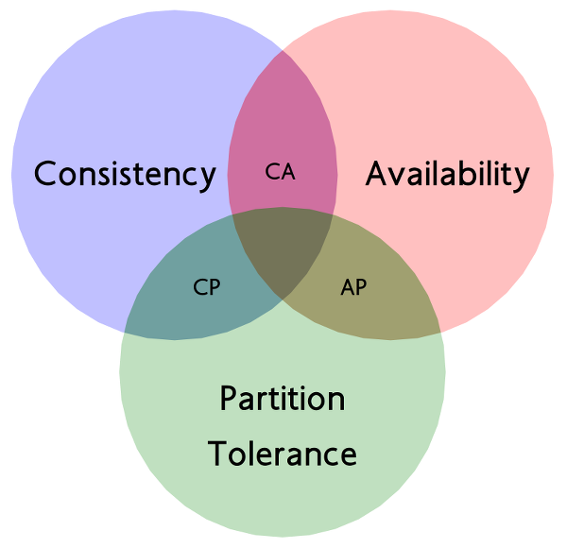
CAP Theorem
CAP theorem (also called Brewer’s theorem)
States that its impossible for a distributed computer system to simultaneously provide all three guarantees:
Consistency ( all nodes see the same data at the same time)
Availability (a guarantee that every request receives a response about whether it succeeded or failed)
Partition tolerance (the system continues to operate despite network failures.
Pick two out of three

Slide 50
CAP Theorem
The CAP theorem is nicely explained here : https://www.youtube.com/watch?v=Jw1iFr4v58M
Its usually said that you are really giving up A vs C!
Availability is achieved by replicating the data across different machines.
Consistency is achieved by updating several nodes before allowing further reads .
As updates are propagated between nodes, it will then cause a temporary decision between A and C:
On systems that allow reads before updating all the nodes, we will get high Availability
On systems that lock all the nodes before allowing reads, we will get Consistency
And since this decision is temporary, it exists only for the duration of the delay, some say that we are really contrasting Latency (another word for Availability) against Consistency.

Slide 51
CAP Theorem: Proof
A simple proof using two nodes:
A
B

Slide 52
CAP Theorem: Proof
A simple proof using two nodes:
Not Consistent!
A
B
Respond to client

Slide 53

CAP Theorem: Proof
A simple proof using two nodes:
Not Available!
A
B
Wait to be updated

Slide 54
CAP Theorem: Proof
A simple proof using two nodes:
Not Partition Tolerant!
A
B
A gets updated from B

Slide 55
Why this is important?
The future of databases is distributed (Big Data Trend, etc.)
CAP theorem describes the trade-offs involved in distributed systems
A proper understanding of CAP theorem is essential to making decisions about the future of distributed database design
Misunderstanding can lead to erroneous or inappropriate design choices

Slide 56
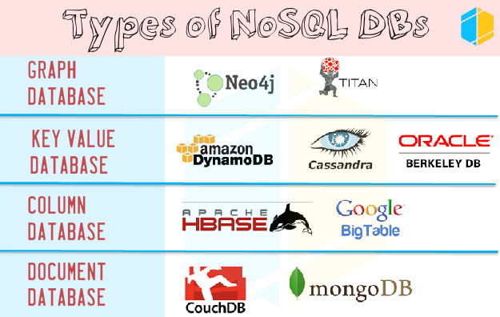


Slide 57




Key-Value Stores
Uses a hash table/map.
The Key/value model is the simplest and easiest to implement.
But it is inefficient when you are only interested in querying or updating part of a value.

Slide 58



Column Family Stores
These were created to store and process very large amounts of data distributed over many machines.
There are still keys but they point to multiple columns. The columns are arranged by column family.

Slide 59


Document Databases
The model is basically versioned documents that are collections of other key-value collections.
The semi-structured documents are stored in formats like JSON.
Document databases support querying more efficiently.

Slide 60



Graph Databases
Instead of tables of rows and columns and the rigid structure of SQL, a flexible graph model is used which, again, can scale across multiple machines.
Do not provide a high-level declarative query language like SQL to avoid overtime in processing.

Slide 61
MongoDB
A document-oriented database NoSQL database
Founded by 10gen in 2007
No DDL ( Data Definition Language )
Hashed-based - schema-less language
Keys - strings
Values – BSON (Binary JSON)
MongoDB written in C++ ( for efficency )
Support APIs in most languages
JavaScript, Python, Ruby, Perl, Java, C++

Slide 62
MongoDB
Non-adherence to the widely used relational database – highly optimized for retrieve and append operations
No transactions
No joins
Supports secondary indexes
Build-in horizontal scaling via automated range-based partitioning of data (sharding).
Master-slave replication with automated failover
Atomic writes and fully-consistent reads
So, it supports CP (Consistency and Partition -Tolerance in CAP theorem)

Slide 63
The Basics
A MongoDB instance may have zero or more databases
A database may have zero or more collections.
Can be thought of as the relation (table) in DBMS, but with many differences.
A collection may have zero or more documents.
Docs in the same collection don’t even need to have the same fields
Docs are the records in RDBMS
Docs can embed other documents
Documents are addressed in the database via a unique key
A document may have one or more fields.
MongoDB Indexes is much like their RDBMS counterparts.

Slide 64
The Basics
MongoDB instance may have zero or more ‘databases’
A database may have zero or more ‘collections’
A collection may have zero or more ‘documents’
A document may have one or more ‘fields’
An index can be build on ‘fields’ much like RDBMS
0 or more ‘databases’
0 or more ‘collections’
0 or more ‘documents’
0 or more ‘fields’

Slide 65
MongoDB | RDBMS
Database | Database
Collection | Table, View
Document (BSON) | Row
Field | Column
Collection is not strict about what data it stores….its
schema-less
MongoDB | RDBMS
Index | Index
Embedded Document | Join
Schema-less | Schema-Oriented
Shard | Partition
Reference | Foreign Key

Slide 66
Design Choices for MongoDB
Scale horizontally over commodity hardware
Lots of relatively inexpensive servers
Keep the functionality that works well in RDMS
Ad hoc queries
Indexes / Secondary indexes
MongoDB supports indexes on any field or sub-field contained in documents
MongoDB defines indexes on a per-collection level (table)
All MongoDB indexes use a B-tree data structure.
Pass-over what does not distribute well in RDMS
Long running multi-row transactions
Joins between tables

Slide 67
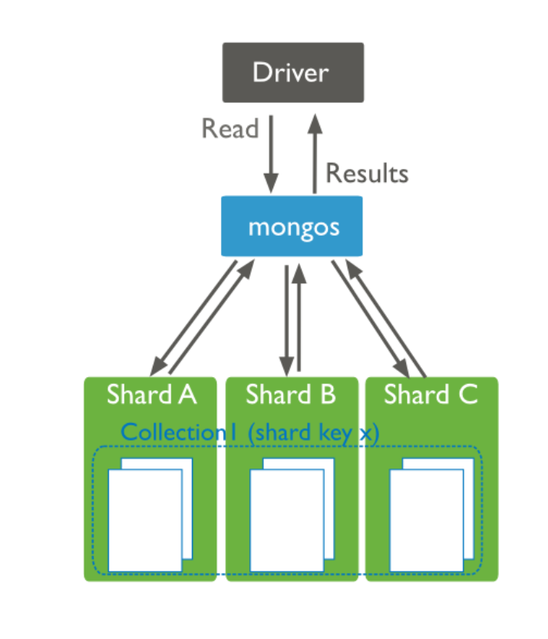
Auto-sharding for linear scalability
MongoDB provides horizontal scale-out for databases on low cost, commodity hardware
Uses a technique called sharding, which is transparent to applications.
Sharding distributes data across multiple physical partitions called shards.
Sharding allows MongoDB deployments to address the hardware limitations of a single server, such as bottlenecks in RAM or disk I/O.
MongoDB automatically balances the data in the cluster as the data grows or the size of the cluster increases or decreases.

Slide 68
Auto-sharding for linear scalability
Unlike NoSQL databases, you have multiple sharding policies available that enable you to distribute your data across a cluster according to query patterns or data locality.
Range-based Sharding
Documents are partitioned across shards according to the shard key value
This approach is well suited for applications that need to optimize range based queries.
Hash-based Sharding.
Documents are distributed according to an MD5 hash of the shard key value.
This approach guarantees a uniform distribution of writes across shards, but is less optimal for range-based queries.
Location-based Sharding.
Documents are partitioned according to a user-specified configuration that associates shard key ranges with specific shards and hardware.
Users can continuously refine the physical location of documents for application requirements such as locating data in specific data centers .

Slide 69
BSON format
Binary-encoded serialization of JSON-like documents
Zero or more key/value pairs are stored as a single entity
Each entry consists of a field name, a data type, and a value
Large elements in a BSON document are prefixed with a length field to facilitate scanning

Slide 70
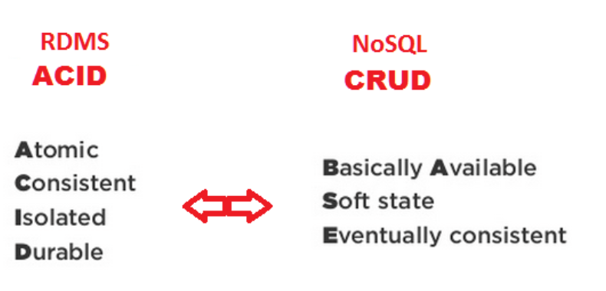
Limitations of MongoDB
No referential integrity / No ACID guarantees
Clients may see writes before they are committed
If a query updates multiple documents, might read some updates and not others
BASE
Instead, offers high availability and eventual consistency
High degree of de-normalization means updating something in many places instead of one
Lack of predefined schema is a double-edged sword
You must have a model in your app
Objects within a collection can be completely inconsistent in their fields
But allows for easy schema change
C - Create
R - Read
U - Update
D - Delete

