Slide 1
ZiqueDB
Instructions for use

Slide 2
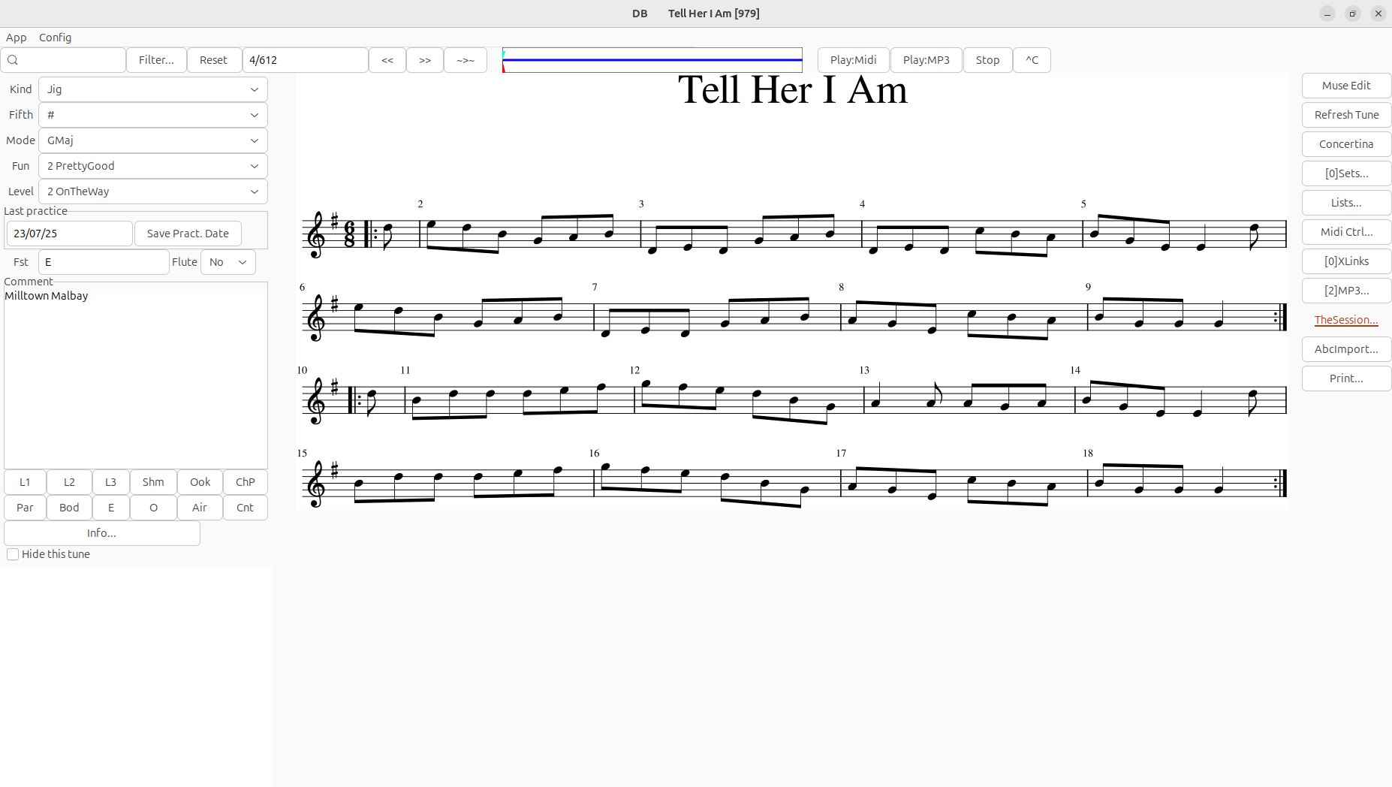
Main Screen
Menu bar
Title bar
Search panel
Quick play panel
Right
panel
Left
panel
Score View

Slide 3
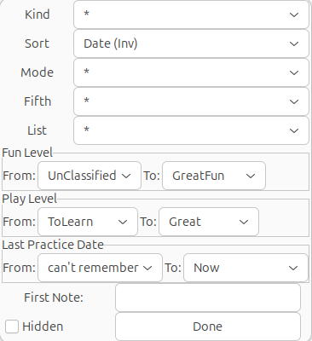
Search panel
Enter keywords
Rank of tune/
Count of found tunes
Previous tune
Next tune
Advance search criteria:
Clear advanced search
Start searching
Include hidden tunes in search

Slide 4
Quick play panel
MIDI play the tune
Stop MIDI/MP3
Copy tune title to clipboard
MP3 Progress bar
Play MP3 (if configured)

Slide 5
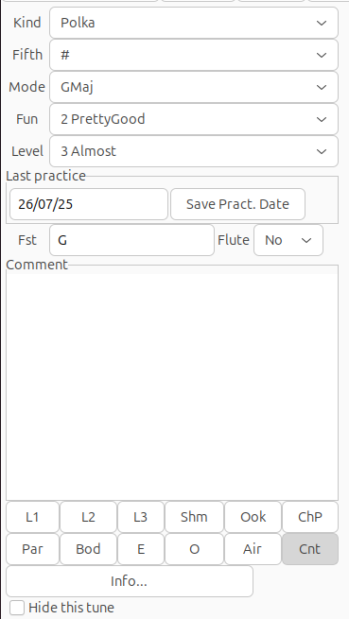
Left panel (Tune information)
Set the kind of tune
Set the fifth (if it differs from the score)
Set the mode of the tune
Rate how you like it
Rate how you play it
Click here to set the last time you practice the tune
Free comment area
Shortcuts to add/remove the tune from lists
Hide the tune => exclude it from search for any reason (ie: duplacate)

Slide 6
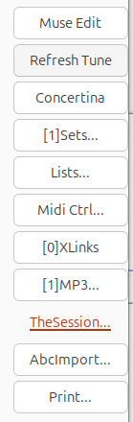
Right panel
Launch MuseScore to edit the tune
Refresh the display after the tune has be edited
Concertina tab editing (to be described...)
Arrange tune sets
Create lists of tunes
MIDI Control Panel
Bookmark links related to the tune (ie: videos)
Associate tune to MP3 files and play MP3
Shortcuts to “thesession.org”
Import a new tune in ABC format

Slide 7
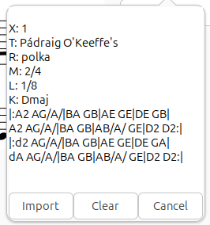
Import a new tune in ABC format
ABC Paste area
Typical use:
From “thesession.org” (or other), search a tune and copy it in ABC format
Paste it in “Abc Paste area”
Click on “Import” will open the tune in MuseScore4
In MuseScore4, when OK with the tune, save it in the the appropriate folder depending on the kind of Tune.
In ZiqueDB, import the tune :
Menu: App→Scan MuseScore Repositories”

Slide 8
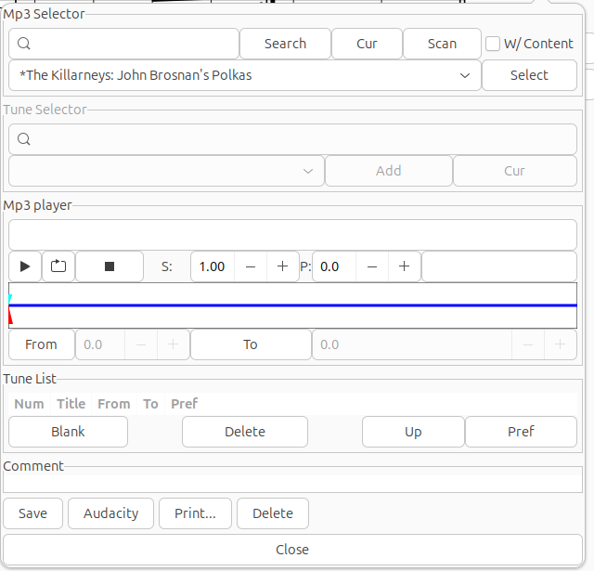
Associate tune to MP3 files and play MP3 (1 :Select MP3)
Enter key words
Use current tune title as key words
Scan local repositories for new MP3
MP3 selection dropbox
Load selected MP3 file

Slide 9
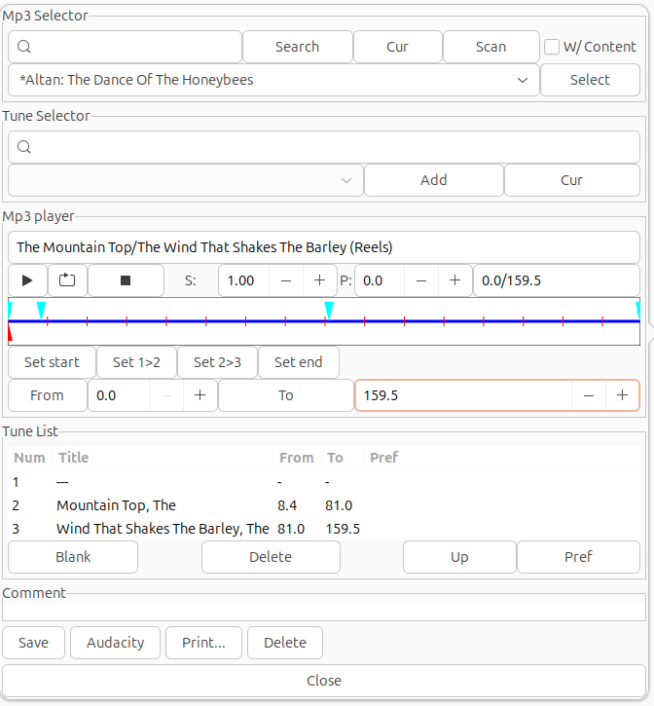
Associate tune to MP3 files and play MP3 (2 :Select Tunes)
Enter key words for tune selection
Select tune
Add selected tune
Shortcut to add current tune
List of tunes associated to MP3 file
Save it when OK

Slide 10
Associate tune to MP3 files and play MP3 (2 :Select Tunes)
Enter key words for tune selection
Select tune
Add selected tune
Shortcut to add current tune
List of tunes associated to MP3 file
Remove Tune
Move tune (change order)
Mark this MP3 as prefered for this tune
Save the changes

Slide 11
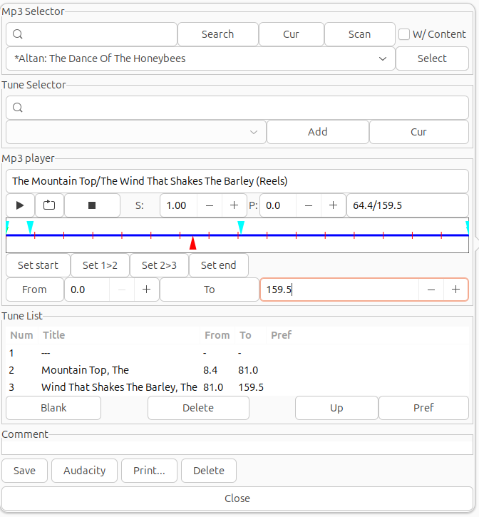
Associate tune to MP3 files and play MP3 (3 :Set tune boundaries in MP3)
Click on progress bar to play the MP3
Set tune boundaries while playing:
When you hear the transition from one tune to another click on the button that set this transition
For example, “Set 2-3” must be clicked when your hear the change from the second tune to the third of the set
If adjustment is needed, click again on the progress bar before the boundary to set again the transition
Free comment area (ie: which key is used)
Save it when OK

Slide 12
Associate tune to MP3 files and play MP3 (4 : Play the tune)
Play once all the MP3
Loop play the MP3
Speed adjustment
Pitch adjustment
Double click on a tune to repeat it again and again

Slide 13
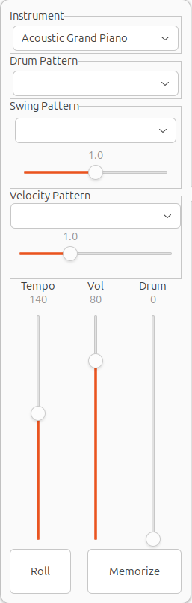
Midi Control
Instrument Selection
Add drum sequence (to be described)
Swing to be described
Stress pattern to be described
Change Tempo (Number of crotchets per minute (requires improvement))

